Slide 1
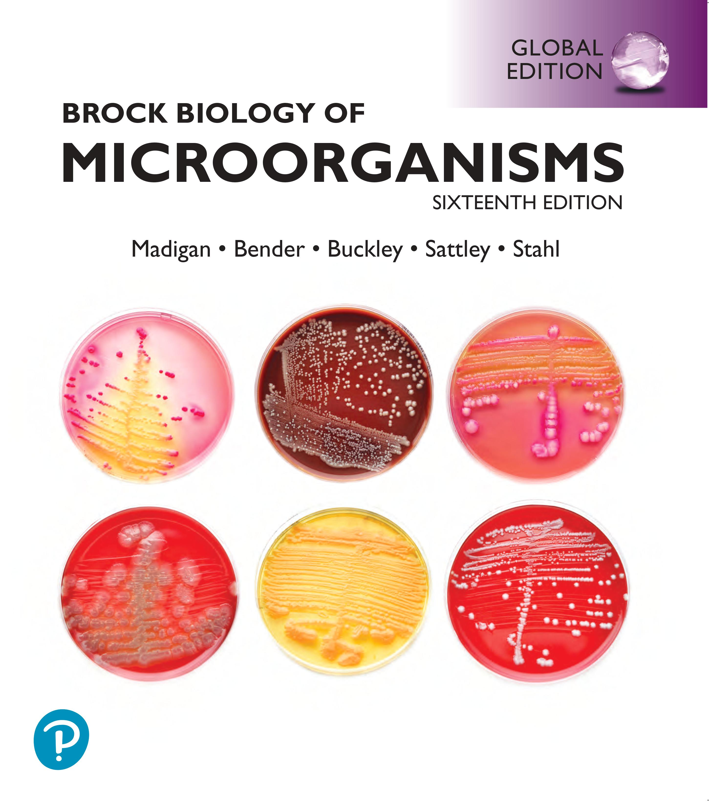
Brock Biology of Microorganisms
Sixteenth Edition, Global Edition
Chapter 3
Microbial Metabolism
Copyright © 2022 Pearson Education Ltd. All Rights Reserved.
Notes:
If this PowerPoint presentation contains mathematical equations, you may need to check that your computer has the following installed:
1) MathType Plugin
2) Math Player (free versions available)
3) NVDA Reader (free versions available)

Slide 2
One. Fundamentals of Metabolism
3.1 Defining the Requirements for Life
3.2 Electron Transfer Reactions
3.3 Calculating Changes in Free Energy
3.4 Cellular Energy Conservation
3.5 Catalysis and Enzymes

Slide 3
3.1 Defining the Requirements for Life (1 of 9)
Metabolism: All biochemical reactions needed for life
Includes catabolism (to obtain energy) and anabolism (to make cellular material) (Figure 3.1)
Relies on electron donors directing electrons to electron acceptors
Energy is neither created nor destroyed
Cells conserve energy by conversion into a form that can do work
Generate adenosine triphosphate (A T P) to store energy and fuel processes

Slide 5
Figure 3.1 Metabolic Coupling with Respect to Energy Conservation and Electron Flow
Notes:
(a) Catabolism employs exergonic reactions to drive the synthesis of A T P. Anabolism employs endergonic reactions, which consume A T P, to drive the biosynthesis of cellular material. Some energy would be lost as heat and cannot be conserved in the formation of A T P (not shown). (b) Cells require reducing power, in the form of a reduced electron donor, as a source of electrons (e⁻) needed to carry out anabolic and catabolic reactions. Inputs to metabolism are labeled in {green} and outputs of metabolism are labeled in {yellow}.
Part a. During catabolism, reactants yield products, synthesizing ATP. During anabolism, precursors yield cellular materials, consuming ATP and synthesizing ADP + P sub i. Part b. Both anabolism and Catabolism require a reduced electron donor which yields an oxidized electron donor during the process.

Slide 6
3.1 Defining the Requirements for Life (2 of 9)
All cells have certain fundamental metabolic requirements
Water
Carbon and other nutrients
Free energy: energy available to do work
Reducing power: source of electrons

Slide 7
3.1 Defining the Requirements for Life (3 of 9)
Free Energy
Some reactions release energy, others require energy
The change in free energy during a reaction is referred to as Δ G⁰′ (“change in” and standard conditions: p H 7, 25°Celsius, 1 atmosphere, all reactants and products = 1 M).
Measured in kilo Joule/mole (heat energy)
Exergonic: Reactions with −Δ G⁰′ release free energy.
Endergonic: Reactions with +Δ G⁰′ require energy.

Slide 8
3.1 Defining the Requirements for Life (4 of 9)
Free Energy
Catabolic pathways: exergonic cellular processes that generate free energy
Free energy produced is conserved by synthesizing energy-rich molecules, e.g., A T P
A T P formation requires Δ G⁰′ = −31.8 kilo Joule/mole
Aerobic respiration of 1 mole glucose could produce 91 moles A T P under standard conditions, though 38 moles actually produced; some energy lost as heat

Slide 9
3.1 Defining the Requirements for Life (5 of 9)
Free Energy
Anabolic pathways: endergonic cellular processes in which cellular synthesis requires energy
Energy comes from hydrolysis of A T P
Catabolic and anabolic reactions are fundamentally linked

Slide 10
3.1 Defining the Requirements for Life (6 of 9)
Reducing Power
Reducing power: ability to donate electrons during electron transfer reactions (redox reactions)
Redox reactions include two half reactions.
Electron donor: transfers electrons (oxidized)
Electron acceptor: adds electrons (reduced)
e.g., Aerobic respiration of glucose (Figure 3.2)
Electron donor: glucose, electron acceptor: O₂

Slide 11
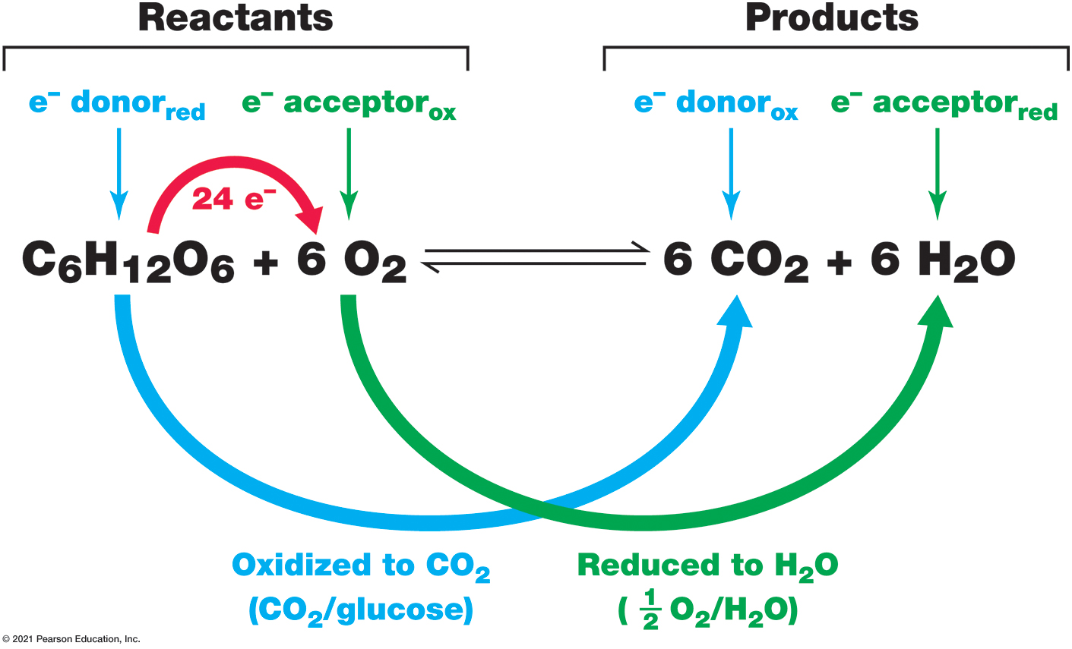
Figure 3.2 Example of an Oxidation–Reduction Reaction
Notes:
The oxidation of glucose to C O2 is coupled with the reduction of O2 to H 2 O in aerobic chemoorganotrophic organisms. This redox reaction is composed of two half reactions: C O2/glucose and ½ O2/H2O (see Figure 3.4). The overall reaction is balanced, which means that equal amounts of each element (C, H, O) are present in reactants and products. The complete oxidation of one glucose to 6 C O2 donates 24 electrons, which are accepted by 6 O2.

Slide 12
3.1 Defining the Requirements for Life (7 of 9)
Reducing Power
Also required by anabolic reactions
Biosynthesis requires free energy (A T P) and reducing power (electron carriers)

Slide 13
3.1 Defining the Requirements for Life (8 of 9)
Metabolic Classes of Microorganisms (Figure 3.3)
Phototrophs obtain energy from light
Do not require chemicals as a source of energy
Oxygenic (O₂ produced) and anoxygenic (no O₂ produced) photosynthesis
Chemotrophs obtain energy from chemical reactions
Aerobic reactions require O₂ as electron acceptor
Anaerobic reactions use anything other than O₂ as electron acceptor
Respiration or fermentation
Energy source can be organic (containing carbon with some exceptions) or inorganic

Slide 14
3.1 Defining the Requirements for Life (9 of 9)
Metabolic Classes of Microorganisms (Figure 3.3)
Chemoorganotrophs obtain energy and reducing power from organics
Chemolithotrophs obtain energy and reducing power from inorganics
Heterotrophs obtain carbon from organics
Autotrophs obtain carbon from C O₂
Also called primary producers: synthesize organic matter from inorganic carbon

Slide 15
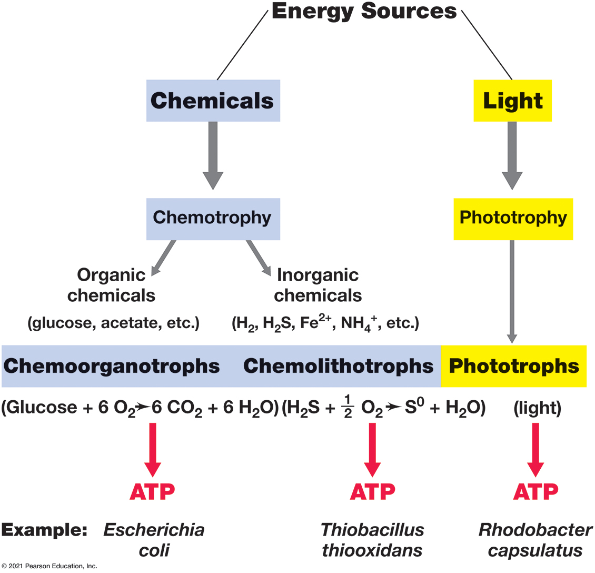
Figure 3.3 Classification of Metabolic Types Based on Energy Sources
Notes:
Microorganisms can obtain energy from organic chemicals, inorganic chemicals, or light. Most organisms employ only one type of metabolism, but some microbes can use different energy sources depending on environmental conditions.
A tree of conserving energy is topped by energy sources which splits into chemicals and light. Chemicals leads down to chemotrophy which splits into organic chemicals like glucose, acetate, etcetera and inorganic chemicals like H 2, H 2 S, F e 2 positive, N H 4 positive, etcetera. Organic chemicals leads to chemoorganotrophs which use the equation glucose + 6 O 2 yielding 6 C O 2 + 6 H 2 O to form A T P. An example of this is Escheria coli. Going back to inorganic chemicals the next step is chemolithotrophs which use the equation H 2 S + one half O 2 yields S + H 2 O to form A T P. An example of this is Thiobacillus thiooxidans. Going back to light which steps down to phototrophy. Phototrophy leads to phototrophs which use light to form A T P. An example of this is Rhosobacter capsulatus.

Slide 16
3.2 Electron Transfer Reactions (1 of 5)
Catabolism depends on electron flow from electron donor to electron acceptor
Reduction potential (Figure 3.4): affinity of substance for electrons
Redox Reactions and Reduction Potentials
Electrons cannot exist in solution
Must be transferred directly in redox reactions
Redox reactions occur in pairs (half reactions or redox couple)
Oxidized form on left, reduced form on right (e.g., N O₃⁻/N O₂⁻)

Slide 17
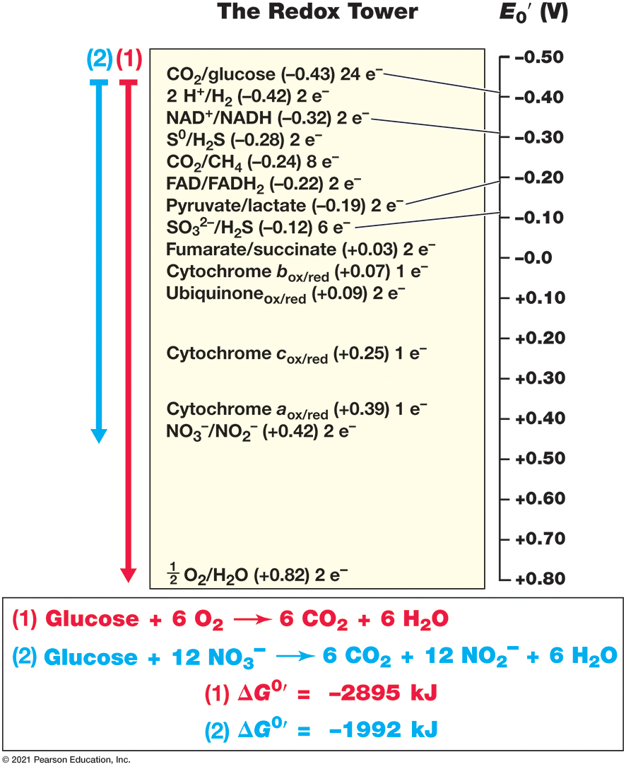
Figure 3.4 The Redox Tower
Notes:
Redox couples are arranged from the strongest electron donors at the top to the strongest electron acceptors at the bottom. The greater the difference in reduction potential between electron donor and electron acceptor, the greater the free energy released. Note the differences in free-energy yield when glucose reacts with either O2 (1) or nitrate (2).
The elements and energy levels in the tower are represented by the following table.
A table has 29 rows and 2 columns. The columns have the following headings from left to right. Redox elements, energy level. The row entries are as follows. Row 1. Redox elements, S O 4 negative 2 or H S O 3 negative which has 2 electrons. energy level, negative 0.52. Row 2. Redox elements, C O 2 or glucose which has 24 electrons. energy level, negative 0.43. Row 3. Redox elements, 2 H positive or H 2 which has 2 electrons. energy level, negative 0.42. Row 4. Redox elements, Ferredoxin sub ox Ferredoxin sub red . energy level, negative 0.4. Row 5. Redox elements, C O 2 or methanol which has 6 electrons. energy level, negative 0.38. Row 6. Redox elements, N A D positive or N A D H which has 2 electrons. energy level, negative 0.32. Row 7. Redox elements, C O 2 or acetate which has 8 electrons. energy level, negative 0.28. Row 8. Redox elements, S super 0 or H 2 S which has 2 electrons. energy level, negative 0.28. Row 9. Redox elements, C O 2 or C H 4 which has 8 electrons. energy level, negative 0.24. Row 10. Redox elements, F A D or F A D H which has 2 electrons. energy level, negative 0.22. Row 11. Redox elements, Pyruvate or lactate which has 2 electrons. energy level, negative 0.19. Row 12. Redox elements, S O 3 negative 2 or H 2 S which has 6 electrons. energy level, negative 0.12. Row 13. Redox elements, Adenosine phosphosulfate or A M P + H S O 3 negative which has 2 electrons. energy level, negative 0.06. Row 14. Redox elements, Fumarate or succinate which has 2 electrons. energy level, positive 0.03. Row 15. Redox elements, Cytochrome b sub ox and red which has 1 electrons. energy level, positive 0.035. Row 16. Redox elements, Ubiquinone sub ox and red which has 2 electrons. energy level, positive 0.11. Row 17. Redox elements, D M S O or D M S which has 2 electrons. energy level, positive 0.16. Row 18. Redox elements, F e positive 3 or F e positive 2 which has 1 electrons, which has p H 7. energy level, positive 0.2. Row 19. Redox elements, Cytochrome c sub ox or red which has 1 electrons. energy level, positive 0.25. Row 20. Redox elements, Chlorobenzoatelectrons or benzoate which has 2 electrons. energy level, positive 0.3. Row 21. Redox elements, N O 2 negative or N O which has 2 electrons. energy level, positive 0.36. Row 22. Redox elements, Cytochrome a sub ox or red which has 1 electrons. energy level, positive 0.39. Row 23. Redox elements, N O 3 negative or N O 2 negative which has 2 electrons. energy level, positive 0.42. Row 24. Redox elements, S e O 4 negative 2 or S e O 3 negative 2 which has 2 electrons. energy level, positive 0.48. Row 25. Redox elements, N O 3 negative or one half N 2 which has 5 electrons. energy level, positive 0.74. Row 26. Redox elements, F e positive 3 or F e positive 2 which has 1 electrons, which has p H 2. energy level, positive 0.76. Row 27. Redox elements, M n positive 4 or M n positive 2 which has 2 electrons. energy level, positive 0.8. Row 28. Redox elements, one half O 2 or H 2 O which has 2 electrons. energy level, positive 0.82. Row 29. Redox elements, C l O 3 negative or C l negative which has 4 electrons. energy level, positive 1.03.
An arrow indicates the substrates H 2 + fumarate on the table which yields succinate delta g super prime = negative 86 kilojoules. An arrow indicates the substrates H 2 + N O 3 negative on the table which yields N O 2 negative H 2 O delta g super prime = negative 163 kilojoules. An arrow indicates the substrates H 2 + one half O 2 on the table which yields H 2 O delta g super prime = negative 237 kilojoules.

Slide 18
3.2 Electron Transfer Reactions (2 of 5)
Redox Reactions and Reduction Potentials
First half reaction produces electrons consumed by second half reaction
Oxidized reactant (electron donor) donates electrons, reduced reactant (electron acceptor) accepts electrons
Many redox couples in nature (Figure 3.4 and Table 3.1)
Reduction potential (E₀′): tendency to donate electrons
expressed as volts (V) compared with reference (typically H₂)
Reduced substance of a redox couple has strong tendency to donate when couple has negative reduction potential (e.g., glucose in C O₂/glucose, −0.43 Volt)
Oxidized substance will accept electrons when redox couple has positive reduction potential (e.g., O₂ in ½ O₂/H₂ O, +0.82 Volt)

Slide 19
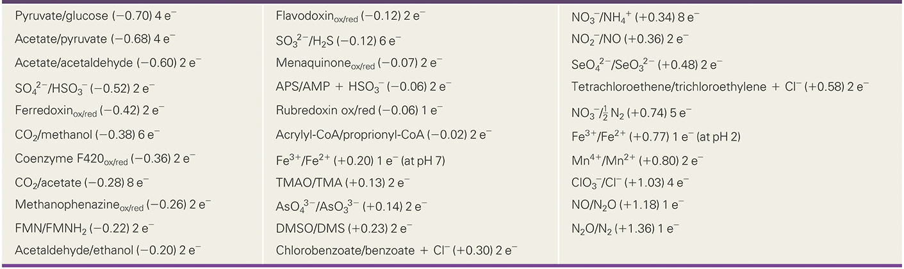
Table 3.1 Reduction Potentials, E₀′ (Volts), of Some Redox Half Reactions Commonly Encountered in Microbiology ª
ªEntries are read as: oxidized form/reduced form (E₀′ in volts) and number of e⁻ transferred per half reaction. Values are organized from lowest (most electronegative) to highest (most electropositive) reduction potential.
Notes:
The lists oxidized/reduced form, (volts), and number of electrons transferred per half reaction as follows.
Pyruvate/glucose, (negative 0.70), 4 electrons
Acetate/pyruvate (negative 0.68) 4 electrons
Acetate/acetaldehyde (negative0.60) 2 electrons
S O 4 2 minus/HSO3 negative (negative 0.52) 2 electrons
Ferredoxinox/red (negative 0.42) 2 electrons
C O 2/methanol (negative 0.38) 6 electrons
Coenzyme F 420 ox/red (negative 0.36) 2 electrons
C O 2/acetate (negative 0.28) 8 electrons
Methanophenazineox/red (negative 0.26) 2 electrons
F M N/F M N H 2 (negative 0.22) 2 electrons
Acetaldehyde/ethanol (negative 0.20) 2 electrons
Flavodoxinox/red (negative 0.12) 2 electrons
S O 3 2negative /H2S (negative 0.12) 6 electrons
Menaquinoneox/red (negative 0.07) 2 electrons
A P S/A M P + H S O 3 minus (negative 0.06) 2 electrons
Rubredoxin ox/red (negative 0.06) 1 electron
Acrylylnegative C o A/proprionylnegative C o A (negative 0.02) 2 electrons
F e 3 +/F e 2 + (+0.20) 1 electron (at pH 7)
T M A O/T M A (+0.13) 2 electrons
As O 4 3 minus /AsO3 3negative (+0.14) 2 electrons
D M S O/D M S (+0.23) 2 electrons
Chlorobenzoate/benzoate + Cl negative (+0.30) 2 electrons
N O 3 negative /N H 4 + (+0.34) 8 electrons
N O 2 negative /N O (+0.36) 2 electrons
S e O 4 2 minus /S e O 3 2 minus (+0.48) 2 electrons
Tetrachloroethene/trichloroethylene + Cl minus (+0.58) 2 electrons
N O 3 minus/ 1 2 N2 (+0.74) 5 electrons
F e 3 +/ F e 2 + (+0.77) 1 electron (at pH 2)
M n 4 +/M n 2 + (+0.80) 2 electrons
C l O 3 negative /C l minus (+1.03) 4 electrons
N O/N 2 O (+1.18) 1 electron
N 2 O/N 2 (+1.36) 1 electron

Slide 20
3.2 Electron Transfer Reactions (3 of 5)
Redox Reactions and Reduction Potentials
Half reactions written as reductions
When two half reactions are combined, the donor half reaction is an oxidation; orientation is written in reverse overall
Reduction potentials can be used to determine whether any given substance will serve as donor or acceptor
The greater the difference in reduction potentials of two half reactions, the more energy will be available

Slide 21
3.2 Electron Transfer Reactions (4 of 5)
Electron Carriers and N A D⁺/N A D H Cycling
Typically, electron movement proceeds through consecutive reactions
Soluble electron carriers such as nicotinamide adenine dinucleotide (N A D⁺/N A D H) needed to carry electrons (Figure 3.5)
N A D⁺/N A D H redox couple = −0.32 Volt; N A D H good electron donor, N A D⁺ weak electron acceptor
Reduction requires 2 e⁻ and 1 H⁺
Reduction of N A D⁺ results in N A D H + H⁺

Slide 22
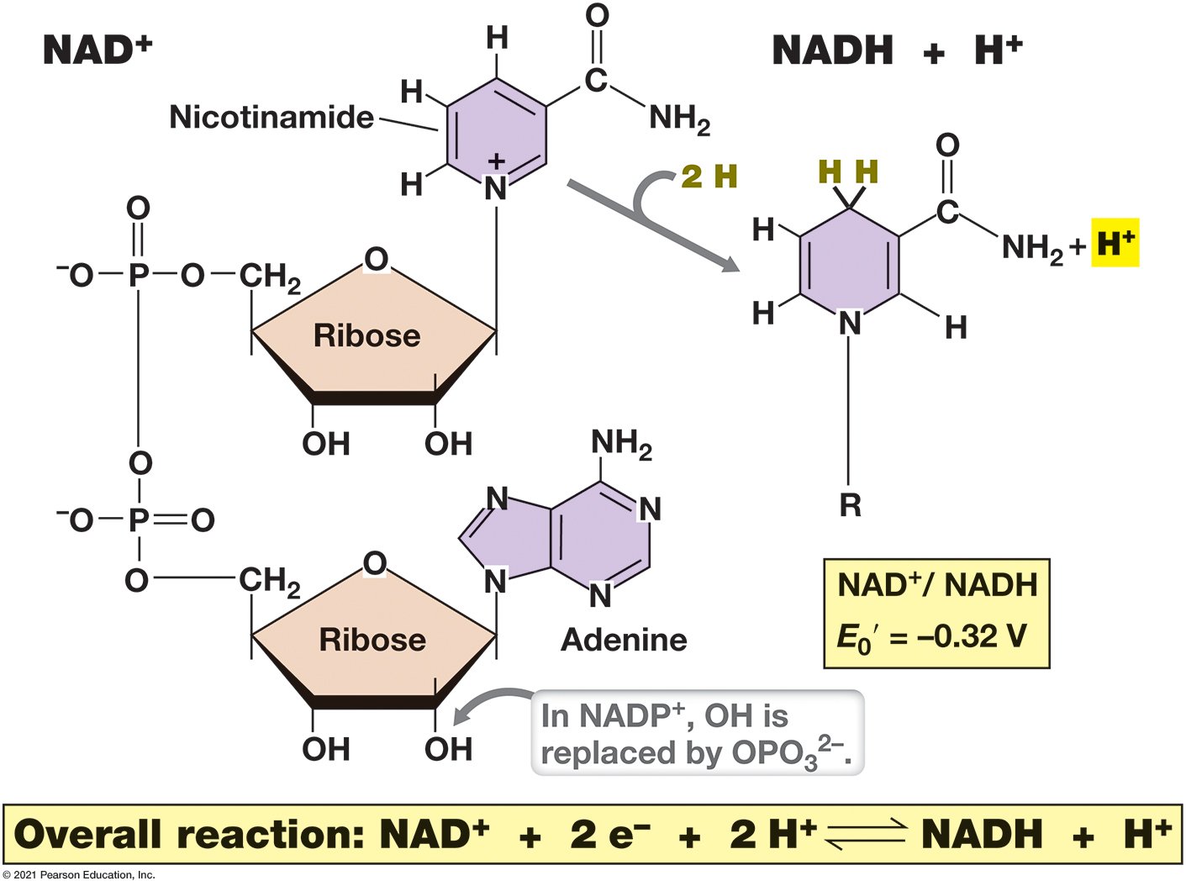
Figure 3.5 The Redox Coenzymes Nicotinamide Adenine Dinucleotide (N A D⁺) and N A D P⁺
Notes:
N A D+ undergoes oxidation–reduction as shown and is freely diffusible. “R” is the adenine dinucleotide portion of N A D+; H is hydrogen (consisting of H+ + e−).
N A D positive is made up of an A D P molecule where the second phosphate is attached to a ribose sugar molecule which is attached to nicotinamide. The Nicotinamide is made up a hexagonal ring with three double bonds and a nitrogen in it and a tail made of C attached to N H 2, the C is also double bonded to an O. When 2 H positive and 2 e negative attach to N A D positive that leads to the reduced form N A D H with an additional H attaching to the ring.

Slide 23
3.2 Electron Transfer Reactions (5 of 5)
Electron Carriers and N A D⁺/N A D H Cycling
N A D⁺/N A D H are coenzymes
Allow many different electron donors and acceptors to interact (Figure 3.6)
Many other molecules are electron shuttles, e.g., nicotinamide adenine dinucleotide phosphate (N A D P⁺/N A D P H) in anabolic biosynthetic reactions

Slide 24
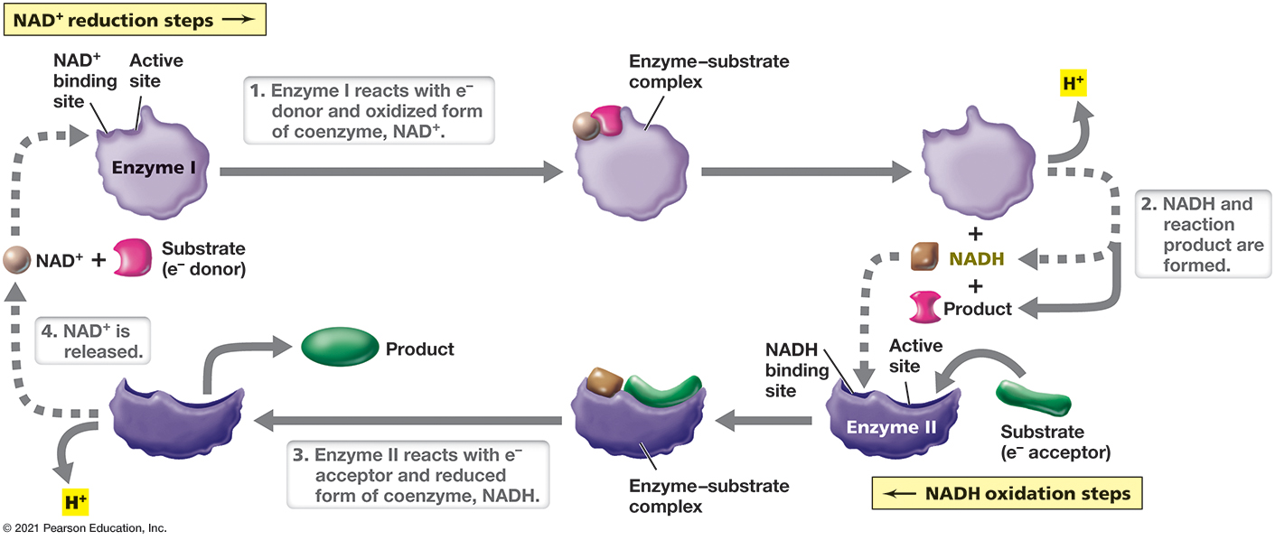
Figure 3.6 N A D⁺/N A D H Cycling
Notes:
A schematic example of redox reactions in which two different enzymes are linked by their requirement for either N A D+ or N A D H. One enzyme reduces N A D+ in its reaction while the other enzyme oxidizes N A D H in its reaction.
Enzyme 1 has an N A D positive binding side and an active site. Enzyme 1 reacts with an electron donor and oxidized form of coenzyme, N A D positive. The circle of N A D positive is changed into a square to demonstrate the change into N A D H. N A D H and the product are released from enzyme 1. Enzyme 2 has a N A D H binding site and an active site. Enzyme 2 reacts with electron acceptor and reduced form of coenzyme, N A D H. Once the reaction takes place in the enzyme substrate complex the product and N A D positive are released.

Slide 25
3.3 Calculating Changes in Free Energy (1 of 4)
The Redox Tower and Its Relationship to Δ G⁰′
The redox tower represents the range of possible reduction potentials with the most negative potential at top, most positive potential at bottom (Figure 3.4)
The further the electrons “drop,” the greater the amount of energy released (Δ E₀′ = change in reduction potential) (Table 3.2)
Δ G⁰ = −n F Δ E₀ʹ
n = # electrons transferred, F Faraday constant

Slide 26
Table 3.2 Example of Free-Energy-Change Calculations Using Electrochemical Potentials or G_{f}⁰ Values
ªThe reaction is balanced and is an 8-electron oxidation (n = 8 in equation 2). G _{f}⁰ values were taken from Table 3.3.
^{b}F is the Faraday constant (96.5 kilo joule/Volts) and Δ E₀′ is calculated from the E₀′ values in Figure 3.4 and Table 3.1.
Notes:
For the reaction in which acetate is oxidized completely to C O 2. C H 3 C O O negative + H positive + 2 O 2 yields 2 C O 2 + 2 H 2 O. Calculation from G sub f values. delta G super 0 prime = G sub f, products, minus G sub f, reactants. = G sub f, 2 C O 2 + 2 H 2 O, minus G sub f, C H 3 C O O negative, + H positive, + 2 O 2. = negative 852 kilojoules over reaction. Calculation from the Nernst equation. delta G super 0 prime = negative n F delta E sub 0 prime = negative 8, times 96.5, times 1.1 = negative 849 kilojoules over reaction.

Slide 27
3.3 Calculating Changes in Free Energy (2 of 4)
Calculating Δ G⁰′ from the Free Energy of Formation
Can calculate Δ G⁰′ if free energy of formation (G _{f}⁰; energy released or required during formation of a given molecule from its elements) of reactants and products known (Table 3.3)

Slide 28
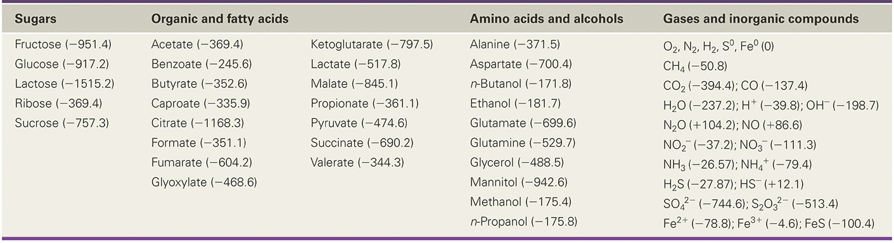
Table 3.3 Free Energy of Formation (G_{f}⁰, kilo Joule/Mole) for Some Common Substancesª
ªValues for free energy of formation taken from Speight, J. 2005. Lange’s Handbook of Chemistry, 16th edition, and Thauer, R.K., K. Jungermann, and H. Decker. 1977. Energy conservation in anaerobic chemotrophic bacteria. Bacteriol. Rev. 41: 100–180.
Notes:
Free energy of formation, G sub f super 0, kilojoules over moles, for some common substances as follows. Sugars. Fructose, negative 951.4, Glucose, negative 917.2, Lactose, negative 1515.2, Ribose, negative 369.4, Sucrose, negative 757.3. Organic and fatty acids. Acetate, negative 369.4, Benzoate, negative 245.6, Butyrate, negative 352.6, Caproate, negative 335.9, Citrate, negative 1168.3, Formate, negative 351.1, Fumarate, negative 604.2, Glyoxylate, negative 468.6, Ketoglutarate, negative 797.5, Lactate, negative 517.8, Malate, negative 845.1, Propionate, negative 361.1, Pyruvate, negative 474.6, Succinate, negative 690.2, Valerate, negative 344.3. Amino acids and alcohols. Alanine, negative 371.5, Aspartate, negative 700.4, n Butanol, negative 171.8, Ethanol, negative 181.7, Glutamate, negative 699.6, Glutamine, negative 529.7, Glycerol, negative 488.5, Mannitol, negative 942.6, Methanol, negative 175.4, n Propanol, negative 175.8. Gases and inorganic compounds. O 2, N 2, H 2, S super 0, F e super 0. 0, C H 4, negative 50.8, C O 2, negative 394.4. C O, negative 137.4, H 2 O, negative 237.2. H positive, negative 39.8. O H minus, negative 198.7, N 2 O, plus 104.2. N O, plus 86.6, N O 2 , negative 37.2. N O 3 negative, negative 111.3, N H 3, negative 26.57. N H 4 plus, negative 79.4, H 2 S, negative 27.87. H S negative, plus 12.1, S O 4 negative 2, negative 744.6. S 2 O 3 negative 2, negative 513.4, F e positive 2 , negative 78.8. F e positive 3 , negative 4.6. F e S, negative 100.4.

Slide 29
3.3 Calculating Changes in Free Energy (3 of 4)
Calculating Δ G⁰′ from the Free Energy of Formation
For the reaction
Δ G⁰′ tells whether reaction is exergonic or endergonic

Slide 30
3.3 Calculating Changes in Free Energy (4 of 4)
Calculating Free-Energy Change in Natural Condtions
Δ G⁰′ is not always a good estimate of actual free energy changes (Figure 3.7)
Actual concentrations of products and reactants are almost never at molar concentrations
Δ G⁰′ may misrepresent actual available energy in cells
More relevant Δ G: free energy under actual conditions
R and T are physical constants and K _{e q} is the equilibrium constant for the reaction
Key: Only exergonic reactions yield energy that can be conserved by the cell.

Slide 31
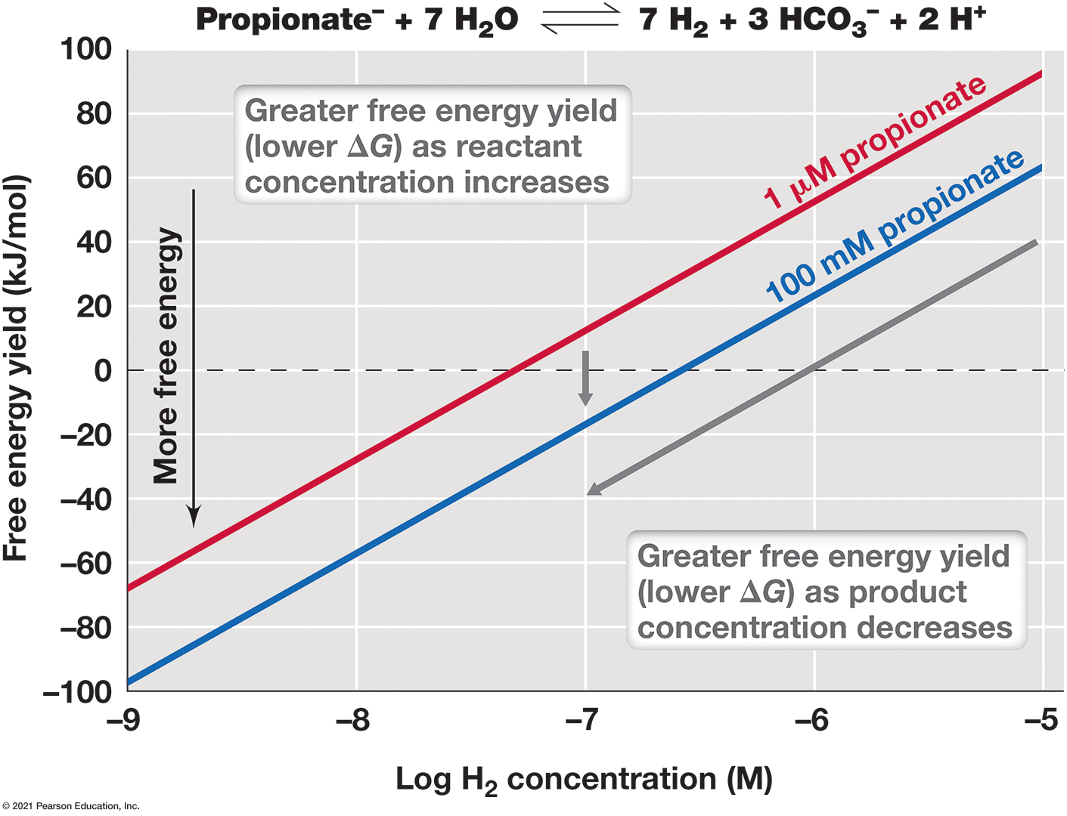
Figure 3.7 Calculating Free Energy Under Natural Conditions (Δ G)
Notes:
The example is the oxidation of propionate to H2 and C O 2 (as shown at the top of the figure, with C O 2 written as H C O 3 − [bicarbonate] because this is the form in which it naturally occurs in solution at neutral p H). This reaction is endergonic under standard conditions (Δ G⁰′ = +304 k J/mol) but can be exergonic under natural conditions in an environment where the H2 produced in the reaction is quickly consumed by other microbes. The Δ G was calculated at different concentrations of reactants (propionate) and products (H2).
A plot representing 1 micrometer propionate rises diagonally from (negative 9, negative 65) to (negative 5, 90). A plot for 100 nanometers propionate rises diagonally from (negative 9, negative 100) to (negative 5, 60). The graph shows that there is a greater free energy yield, lower change in G, as reactant concentration increases. There is greater free energy yield as product concentration decreases. All values estimated.

Slide 32
3.4 Cellular Energy Conservation (1 of 3)
Adenosine Triphosphate (A T P)
Most important energy-rich phosphate compound (Figure 3.8)
Two high energy phosphate bonds

Slide 33
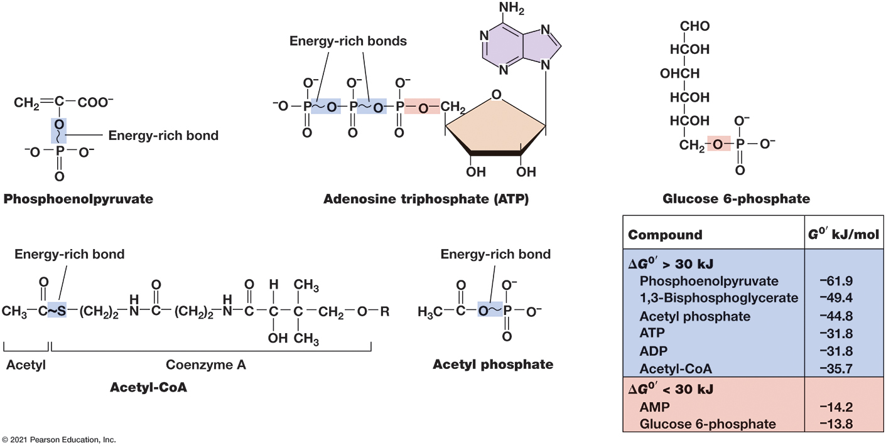
Figure 3.8 Energy-Rich Bonds in Compounds That Conserve Energy in Microbial Metabolism
Notes:
The range in free energy of hydrolysis values for the phosphate or sulfur bonds highlighted in the compounds is listed in the table. The “R” group of acetyl-C o A is a 3′-phospho A D P group.
A table of the energy in important microbial metabolism molecules.
A table has 8 rows and 3 columns. The columns have the following headings from left to right. Compound, G super 0 prime kilojoules per mole, energy above or below 30 kilo joules, . The row entries are as follows. Row 1. Compound, Phosphoenolpyruvate. G super 0 prime kilojoules per mole, negative 51.6. energy above or below 30 kilo joules, above. Row 2. Compound, 1, 3 Bisphosphoglycerate. G super 0 prime kilojoules per mole, negative 52.0. energy above or below 30 kilo joules, above. Row 3. Compound, Acetyl phosphate. G super 0 prime kilojoules per mole, negative 44.8. energy above or below 30 kilo joules, above. Row 4. Compound, A T P. G super 0 prime kilojoules per mole, negative 31.8. energy above or below 30 kilo joules, above. Row 5. Compound, A D P. G super 0 prime kilojoules per mole, negative 31.8. energy above or below 30 kilo joules, above. Row 6. Compound, Acetyl Co A. G super 0 prime kilojoules per mole, negative 35.7. energy above or below 30 kilo joules, above. Row 7. Compound, A M P. G super 0 prime kilojoules per mole, negative 14.2. energy above or below 30 kilo joules, below. Row 8. Compound, Glucose 6 phosphate. G super 0 prime kilojoules per mole, negative 13.8. energy above or below 30 kilo joules, below.
Phosphoenolpyruvate has an energy rich anhydride bond. Adenosine triphosphate otherwise known as A T P has two energy rich anhydride bonds and an ester bond. Acetyl Co A has an energy rich thioester bond. Acetyl phosphate has an energy rich anhydride bond. Glucose 6 phosphate has an energy rich ester bond.

Slide 34
3.4 Cellular Energy Conservation (2 of 3)
Energy-Rich Compounds
Several others have energy-rich phosphate or sulfur bonds
Not all phosphate bonds are energy-rich
Cells need compounds where Δ G⁰′’< −31.8 kilo Joule/mole to synthesize A T P
Coenzyme A derivatives have energy-rich thioester bonds

Slide 35
3.4 Cellular Energy Conservation (3 of 3)
Mechanisms of Energy Conservation
A T P generated through 1 of 3 mechanisms
Substrate-level phosphorylation: energy-rich substrate bond hydrolyzed directly to drive A T P formation (e.g., hydrolysis of phosphoenolpyruvate)
Oxidative phosphorylation: Movement of electrons generates proton motive force (electrochemical gradient) used to synthesize A T P
Photophosphorylation: light used to form proton motive force

Slide 36
3.5 Catalysis and Enzymes (1 of 4)
Free energy calculations do not provide information on reaction rates.
Activation energy: minimum energy required for chemical reaction to begin (Figure 3.9)
A catalyst (facilitates reaction without being consumed) is usually required to overcome activation energy barrier.

Slide 37
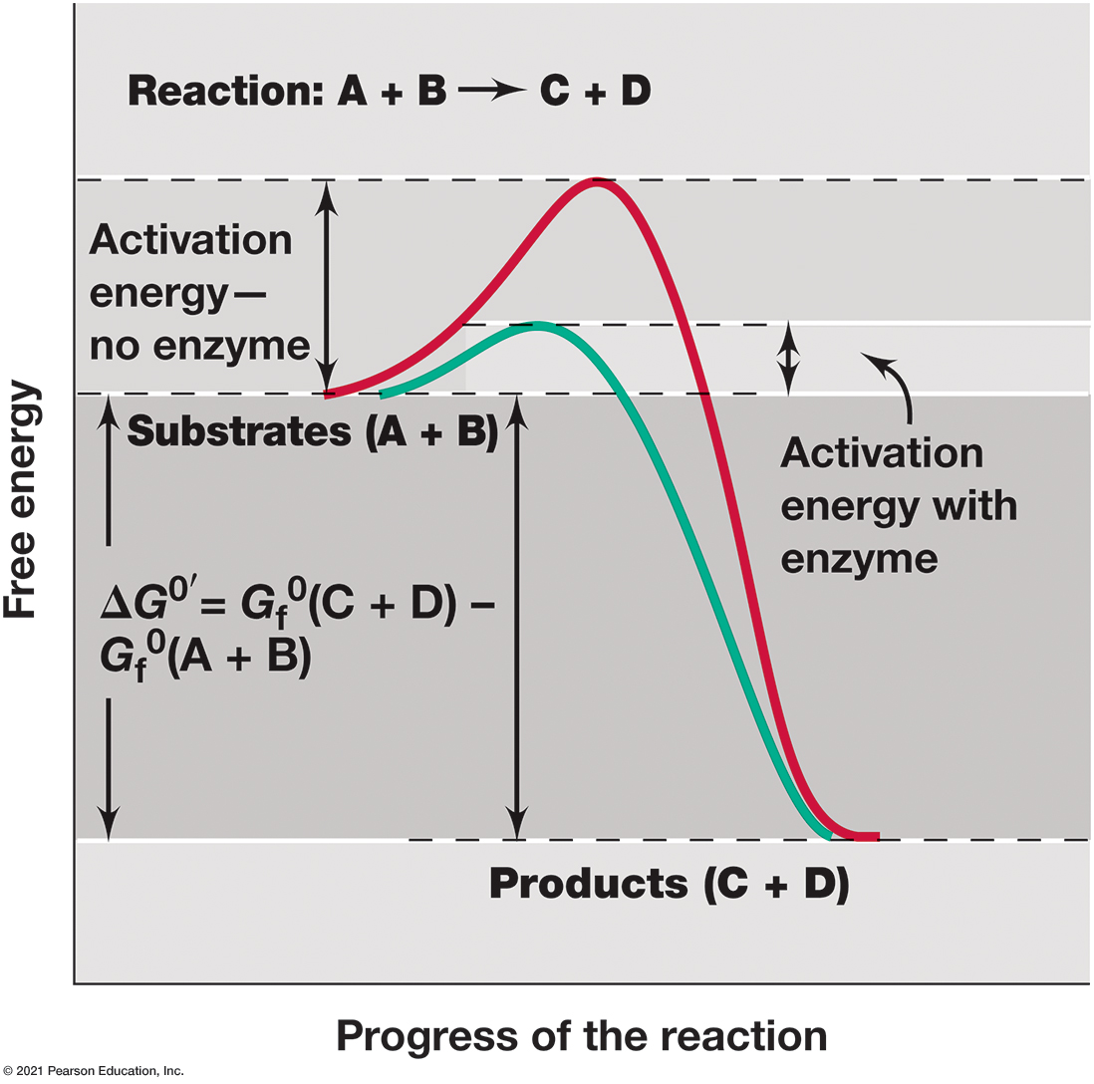
Figure 3.9 Activation Energy and Catalysis
Notes:
Even chemical reactions that release energy may not proceed spontaneously if not activated. Once the reactants are activated, the reaction proceeds spontaneously. Catalysts such as enzymes lower the required activation energy.
The graph begins at the energy level of substrates A and B and increases until the reaction takes place and then drops down to the energy level of Products C and D. The difference between the products and substrate energy is noted with delta G super 0 prime = G sub f super 0 left parenthesis C + D right parenthesis minus G sub f super 0 left parenthesis A + B right parenthesis. With no enzyme the increase over the substrate energy level is large with an enzyme it is small.

Slide 38
3.5 Catalysis and Enzymes (2 of 4)
Enzymes
Catalysts lower activation energy, increasing reaction rate
Enzymes: major cellular catalysts
typically proteins (some R N A s)
highly specific as a result of structure
in reaction, enzyme combines with reactant (substrate), forming enzyme-substrate complex, releasing product and enzyme (Figure 3.10)
active site: region of enzyme that binds substrate

Slide 39
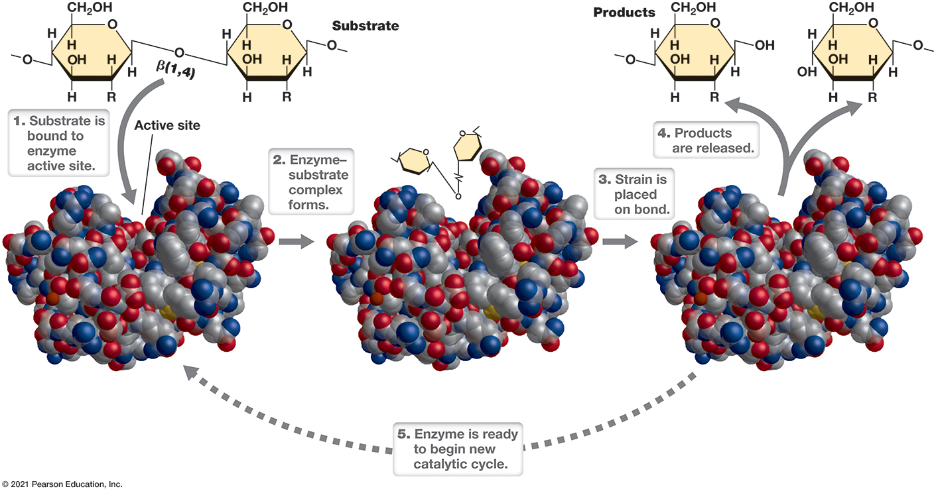
Figure 3.10 The Catalytic Cycle of an Enzyme
Notes:
The enzyme depicted here, lysozyme, catalyzes the cleavage of the β-1,4-glycosidic bond in the polysaccharide backbone of peptidoglycan (◀ Section 2.3). Following substrate binding in the enzyme’s active site, strain is placed on the bond, and this favors breakage. Space-filling model of lysozyme courtesy of Richard Feldmann.
A substrate is bound to enzyme active site like a key into a lock. An enzyme substrate complex is formed. A strain is placed on bond. The products are released. The enzyme is ready to bend in a new catalytic cycle.

Slide 40
3.5 Catalysis and Enzymes (3 of 4)
Enzymes
Many contain small nonprotein, nonsubstrate molecules that participate in catalysis.
Prosthetic groups
tightly bound, usually covalently and permanently (e.g., heme in cytochromes)
Coenzymes
Loosely, transiently bound
Most are derivatives of vitamins. (Table 3.1)

Slide 41
3.5 Catalysis and Enzymes (4 of 4)
Enzyme Catalysis
Binding and proper positioning of substrate needed for catalysis
Enzyme-substrate complex aligns reactive groups and strains specific bonds, reducing activation energy
To catalyze endergonic reactions, coupling used between endergonic and exergonic reactions
Overall reaction has negative or zero free-energy change
All enzymes theoretically reversible, but highly exergonic or endergonic reaction catalysis usually goes in one direction
Another enzyme needed for reverse reaction

Slide 42
Two. Catabolism: Chemoorganotrophs
3.6 Glycolysis, the Citric Acid Cycle, and the Glyoxylate Cycle
3.7 Principles of Fermentation
3.8 Principles of Respiration: Electron Carriers
3.9 Principles of Respiration: Generating a Proton Motive Force

Slide 43
3.6 Glycolysis, the Citric Acid Cycle, and the Glyoxylate Cycle (1 of 8)
Glycolysis (Embden–Meyerhof–Parnas pathway)
Nearly universal pathway for glucose catabolism that oxidizes glucose to pyruvate
Can participate in multiple forms of catabolism (fermentation, aerobic respiration, anaerobic respiration)

Slide 44
3.6 Glycolysis, the Citric Acid Cycle, and the Glyoxylate Cycle (2 of 8)
Glycolysis
Two stages
Stage
“preparatory,” form key intermediate
Stage
redox, energy conserved, 2 pyruvate
formed (Figure 3.11)

Slide 45
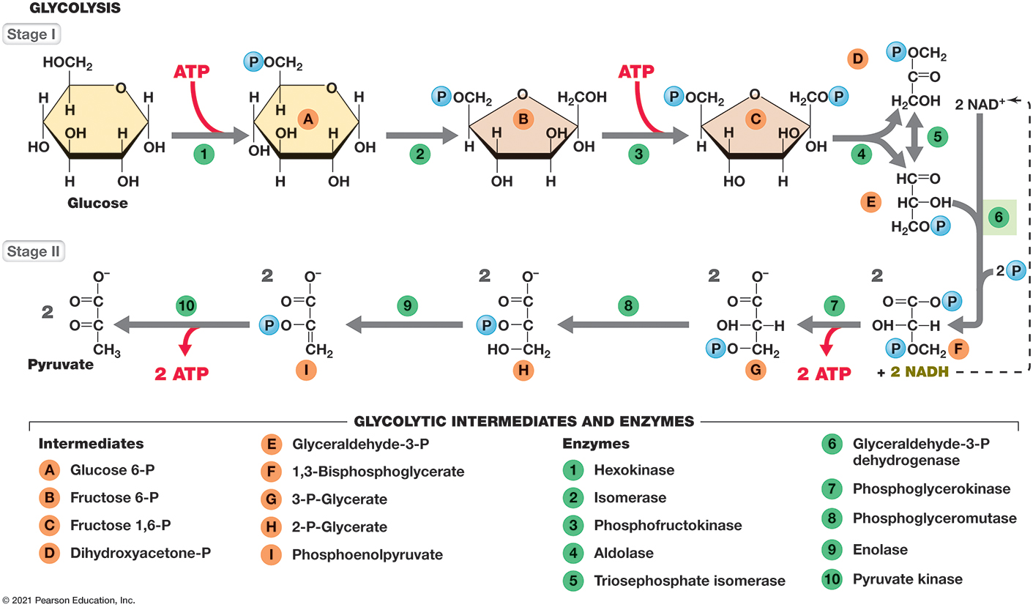
Figure 3.11 Embden–Meyerhof–Parnas Pathway (Glycolysis)
Notes:
The sequence of reactions in the catabolism of glucose to pyruvate. Glycolysis results in the formation of 2 each of pyruvate, A T P, and N A D H per glucose molecule.
A stepwise path of glycolysis going through stage 1, stage 2, and stage 3. A list of glycolytic intermediates and enzymes. The intermediates are as follows, Glucose 6 P, Fructose 6 P, Fructose 1, 6 P, Dihydroxyacetone P, Glyceraldehyde 3 P, 1, 3 Bisphosphoglycerate, 3 P Glycerate, 2 P Glycerate, Phosphoenolpyruvate. The enzymes are as follows, Hexokinase, Isomerase, Phosphofructokinase, Aldolase, Triosephosphate isomerase, Glyceraldehyde 3 P dehydrogenase, Phosphoglycerokinase, Phosphoglyceromutase, Enolase, Pyruvate kinase, Lactate dehydrogenase, Pyruvate decarboxylase, Alcohol dehydrogenase. An energetics table is below the steps.
A table has 2 rows and 4 columns. The columns have the following headings from left to right. Organism, Fermentation, Energy conserved, Efficiency. The row entries are as follows. Row 1. Organism, Yeast. Fermentation, Glucose yields 2 ethanol + 2 C O 2. Energy conserved, negative 239. Efficiency, 0.27. Row 2. Organism, Lactic acid bacteria. Fermentation, Glucose yields 2 lactate. Energy conserved, negative 196. Efficiency, 0.33.

Slide 46
3.6 Glycolysis, the Citric Acid Cycle, and the Glyoxylate Cycle (3 of 8)
Glycolysis
Glucose phosphorylated to glucose-6-phosphate
Glucose-6-phosphate isomerized to fructose-6-phosphate
Phosphorylation produces fructose-1,6-bisphosphate
Aldolase splits fructose-1,6-bisphosphate into glyceraldehyde-3-phosphate and dihydroxyacetone phosphate
Dihydroxyacetone phosphate isomerized to second glyceraldehyde-3-phosphate

Slide 47
3.6 Glycolysis, the Citric Acid Cycle, and the Glyoxylate Cycle (4 of 8)
Glycolysis
Glyceraldehyde-3-phosphate oxidized to 1,3-bisphosphoglycerate (2x), reducing N A D⁺ to N A D H
A T P synthesized by substrate-level phosphorylation when 1,3-bisphosphoglycerate converted to 3-phosphoglycerate (2x)
Later, phosphoenolpyruvate converted to pyruvate (x2)
Glycolysis uses 2 A T P in
and produces 4 in
net is 2 A T P, 2 N A D H, 2 pyruvate per glucose
Redox balance requires pyruvate reduction or respiration

Slide 48
3.6 Glycolysis, the Citric Acid Cycle, and the Glyoxylate Cycle (5 of 8)
The Citric Acid Cycle (C A C)
Pathway by which pyruvate is oxidized to C O₂ (Figure 3.12)
Pyruvate from glycolysis is decarboxylated, producing C O₂, N A D H, energy rich acetyl-c o A (which enters C A C)
Acetyl-C o A + intermediate oxaloacetate forms citric acid.
2 C O₂, 3 N A D H, 1 F A D H₂, 1 A T P formed per oxidized pyruvate
oxaloacetate regenerated
Redox balance achieved through respiration

Slide 49
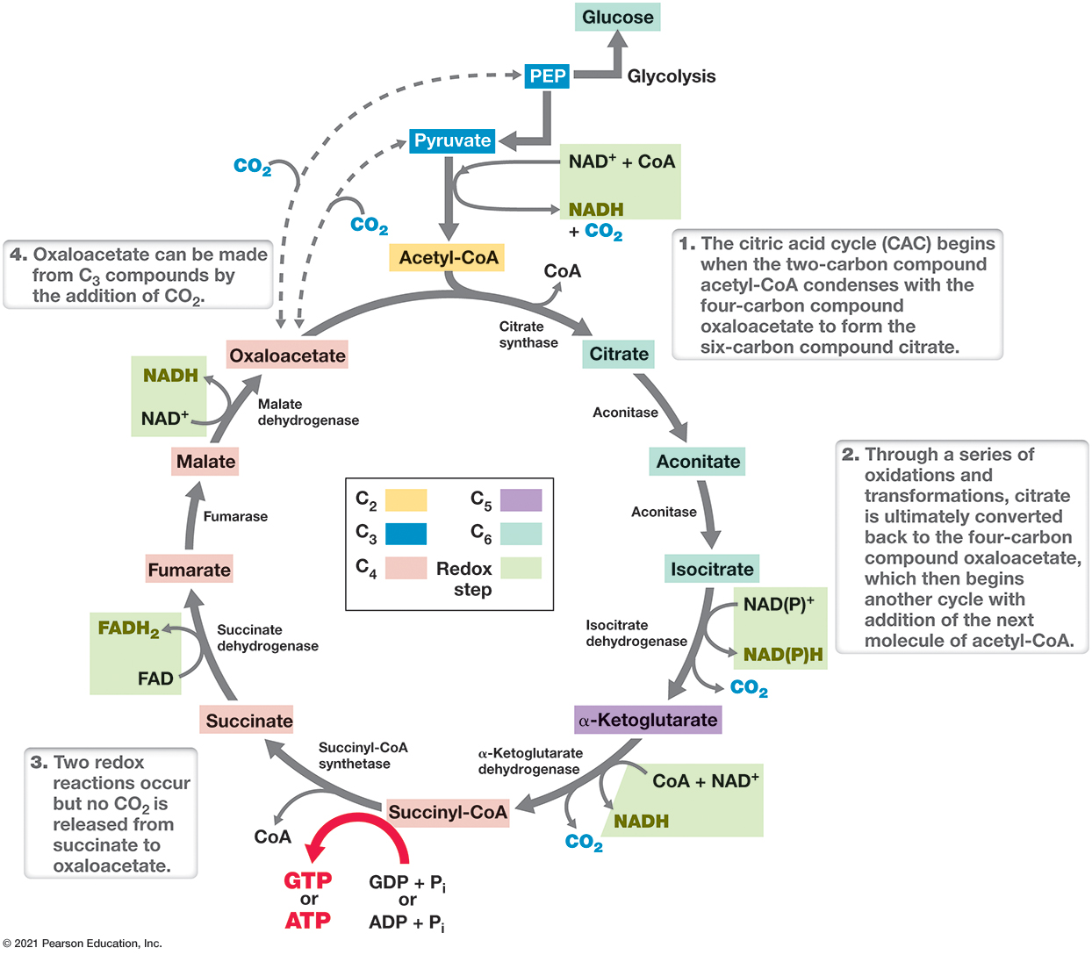
Figure 3.12 The Citric Acid Cycle
Notes:
The citric acid cycle begins when the two-carbon compound acetyl-C o A (derived from pyruvate) condenses with the four-carbon compound oxaloacetate to form the six-carbon compound citrate. Through a series of oxidations and transformations, citrate is converted to two C O2 and the acetyl acceptor molecule, oxaloacetate. For every pyruvate that enters the cycle, 3 C O2, 1 A T P, 4 N A D H, and 1 F A D H2 are produced.
The citric acid cycle or C A C begins when the two carbon compound acetyl Co A condenses with the four carbon compound oxaloacetate to form the six carbon compound citrate. Through a series of oxidations and transformations, citrate is ultimately converted back to the four carbon compound oxaloacetate, which then begins another cycle with addition of the next molecule of acetyl Co A. Two redox reactions occur but no C O 2 is released from succinate to oxaloacetate. Oxaloacetate can be made from C 3 compounds by the addition of C O 2. The energetics table is below.
A table has 7 rows and 2 columns. The columns have the following headings from left to right. step, equations and products. The row entries are as follows. Row 1. step, Glycolosis. equations and products, glucose + 2 N A D positive yields 2 pyruvate which goes on to C A C + A T P + 2 N A D H goes on to Complex 1. Row 2. step, substrate level phosphorylation in glycolosis. equations and products, 2 A D P + P sub i yields 2 A T P. Row 3. step, oxidative phosphorylation in glycolosis. equations and products, 2 N A D H yields 6 A T P. Row 4. step, C A C. equations and products, 2 Pyruvate + 8 N A D positive + 2 G D P + 2 F A D yields 6 C O 2 + 8 N A D H which goes to complex 1 + 2 F A D H 2 which goes to complex 2 + 2 G T P which is similar to A T P. Row 5. step, Substrate level phosphorylation in C A C. equations and products, 2 G D P + p sub i yields 2 G T P which is similar to A T P. Row 6. step, oxidative phosphorylation in C A C. equations and products, 8 N A D H yields 24 A T P and 2 F A D H 2 yields 4 A T P. Row 7. step, Total of glycolosis and C A C. equations and products, Glucose yields 6 C O 2 + 6 H 2 O yields 38 A T P.

Slide 50
3.6 Glycolysis, the Citric Acid Cycle, and the Glyoxylate Cycle (6 of 8)
Biosynthesis and the Citric Acid Cycle
α-Ketoglutarate and oxaloacetate: precursors of several amino acids; O A A also converted if necessary to phosphoenolpyruvate, a precursor of glucose
succinyl-C o A: required for synthesis of cytochromes, chlorophyll, and related molecules
acetate: necessary for fatty acid biosynthesis
Like glycolysis, C A C oxidizes organics and biosynthesizes key intermediates

Slide 51
3.6 Glycolysis, the Citric Acid Cycle, and the Glyoxylate Cycle (7 of 8)
Other Pathways for Chemoorganotrophy
Glycolysis and the C A C can oxidize several C₄-C₆ compounds (e.g., glucose, citrate, malate, fumarate, succinate)
Unrelated catabolic pathways can be linked for oxidation (e.g., isomerization)

Slide 52
3.6 Glycolysis, the Citric Acid Cycle, and the Glyoxylate Cycle (8 of 8)
Other Pathways for Chemoorganotrophy
Some C₂ (e.g., acetate) compounds catabolized through glyoxylate cycle (Figure 3.13)
Includes several C A C enzymes + isocitrate lyase and malate synthase
C₃ compounds are carboxylated by pyruvate carboxylase or phosphoenolpyruvate carboxylase; glyoxylate cycle unnecessary

Slide 53
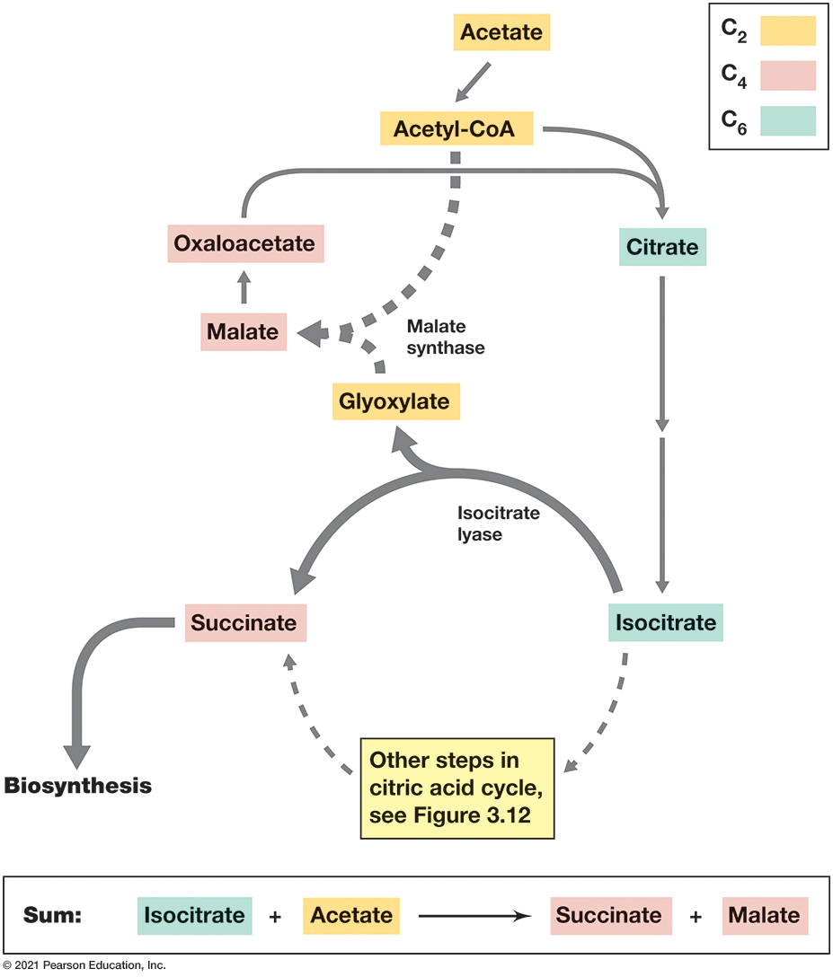
Figure 3.13 The Glyoxylate Cycle
Notes:
These reactions occur in conjunction with the citric acid cycle when cells grow on two-carbon electron donors, such as acetate.The glyoxylate cycle regenerates oxaloacetate (from malate) to maintain an acetyl acceptor for the citric acid cycle.
A small key on the side of the diagram says that molecules with 2 carbons is yellow, molecules with 4 carbons are pink and molecules with 6 carbon molecules are green. Molecules with 2 carbons include, acetate, acetyl Co A, and Glyoxylate. Molecules with 4 carbons include, oxaloacetate, malate, succinate. Molecules with 6 carbons include, citrate and isocitrate. The sum equation on the bottom reads, isocitrate + acetate yields succinate + malate.

Slide 54
3.7 Principles of Fermentation (1 of 4)
Fermentation of glucose involves substrate-level phosphorylation and redox balance via pyruvate reduction + excretion as waste (Figure 3.14)
Many fermentation products are useful for humans (e.g., beer and wine, yogurt, cheese, effect of microbiome on health)

Slide 55
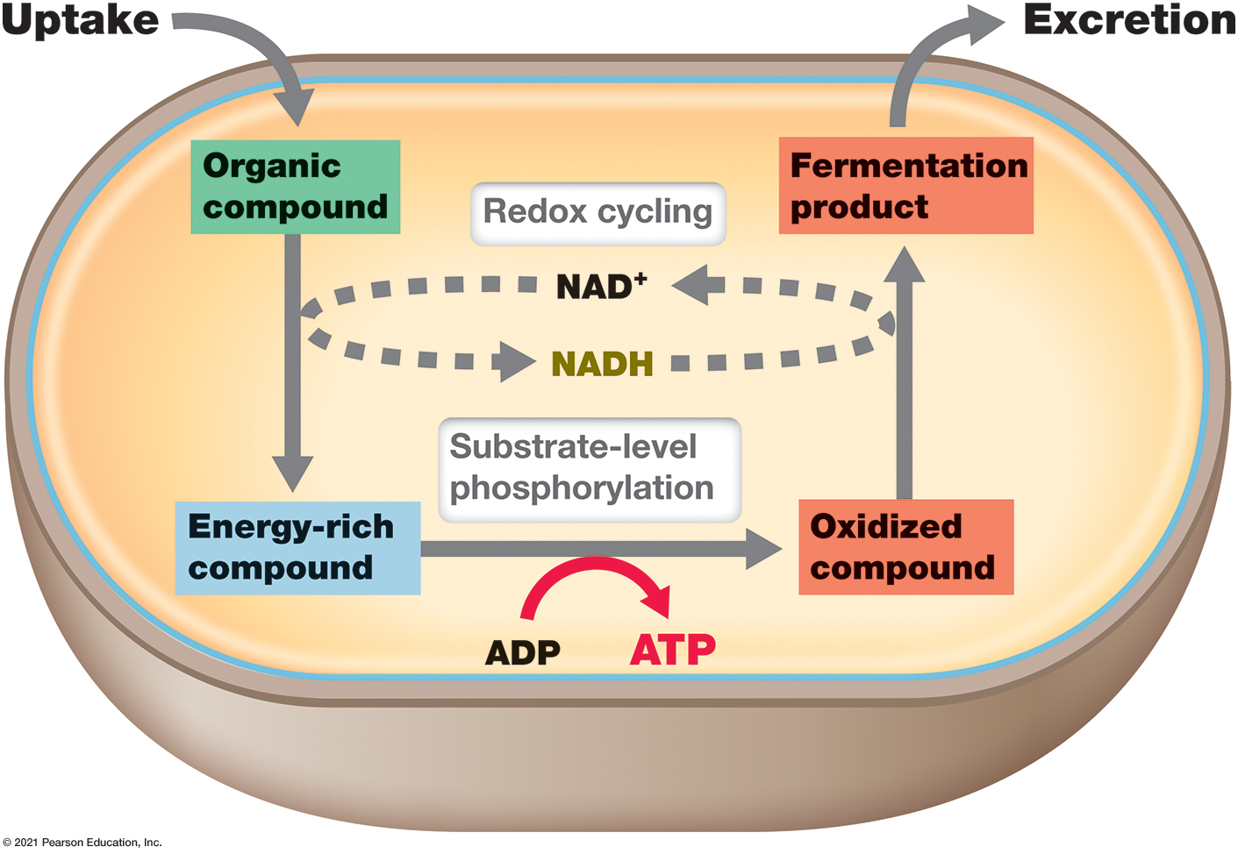
Figure 3.14 The Essentials of Fermentation
Notes:
An organic compound is oxidized, and the electrons are ultimately recycled back to one of the oxidized organic products because an external electron acceptor is lacking. The fermentation product so formed is excreted from the cell and A T P is produced by substrate-level phosphorylation. Most of the fermentable substrate is used for energy generation and only a relatively small amount is used for biosynthesis.
Uptake, an organic compound, enters the cells. It yields an energy-rich compound. Substrate-level phosphoration occurs and ADP is synthesized from ATP, yielding an oxidized compound. The oxidized compound yields the fermentation product which is excreted from the cell. Redox recycling of N A D plus and N A D H occurs between the processes.

Slide 56
3.7 Principles of Fermentation (2 of 4)
Energy Conservation and Redox Balance in Fermentation
All fermentations must do two things:
Conserve energy
Redox balance
Need to produce compounds containing high-energy bonds for A T P synthesis
Must oxidize N A D H back to N A D⁺
Donate electrons back to an electron acceptor derived from original organic donor

Slide 57
3.7 Principles of Fermentation (3 of 4)
Energy Conservation and Redox Balance in Fermentation
e.g., Yeast ferments glucose to 2 ethanol + 2 C O₂
A T P from glycolysis
N A D⁺ regenerated by donating electrons from N A D H to pyruvate (electron acceptor), producing ethanol and C O₂
e.g., Lactic acid bacteria ferment glucose to 2 lactic acid
Different enzymes reduce pyruvate to lactic acid
Important in fermenting food and human health

Slide 58
3.7 Principles of Fermentation (4 of 4)
Fermentative Diversity
Tremendous diversity: sugars, amino acids, fatty acids, purines, pyrimidines, aromatics
Acetate, other volatile fatty acids are products
Allow additional A T P synthesis from substrate-level phosphorylation
Involves coenzyme-A derivatives (e.g., Clostridium butyricum)
Redox balance can be improved by producing H₂ (low reduction potential)
Associated with ferredoxin and hydrogenase

Slide 59
3.8 Principles of Respiration: Electron Carriers (1 of 6)
Respiration: electrons transferred from reduced electron donors to external electron acceptors (e.g., O₂)
N A D H and F A D H₂ produced in glycolysis and citric acid cycle must be reoxidized for redox balance
In respiration, reoxidation occurs during electron transport
Occurs in cytoplasmic membrane
Forms electrochemical gradient (usually protons) that conserves energy through A T P synthesis

Slide 60
3.8 Principles of Respiration: Electron Carriers (2 of 6)
N A D H Dehydrogenases and Flavoproteins
Electron transport occurs in membranes
Many oxidation–reduction enzymes (e.g., N A D H dehydrogenases, flavoproteins, iron–sulfur proteins, cytochromes)
Also quinones: nonprotein electron carriers
Arranged with increasingly more positive reduction potential
N A D H dehydrogenase 1st, cytochromes last

Slide 61
3.8 Principles of Respiration: Electron Carriers (3 of 6)
N A D H Dehydrogenases and Flavoproteins
N A D H dehydrogenases: active site binds N A D H, accept two electrons and two protons that are transferred to flavoproteins, regenerating N A D⁺
Flavoproteins: contain deriviative of riboflavin (Figure 3.15) as prosthetic group (e.g., F M N, F A D) that accepts two electrons and two protons but only donate electrons

Slide 62
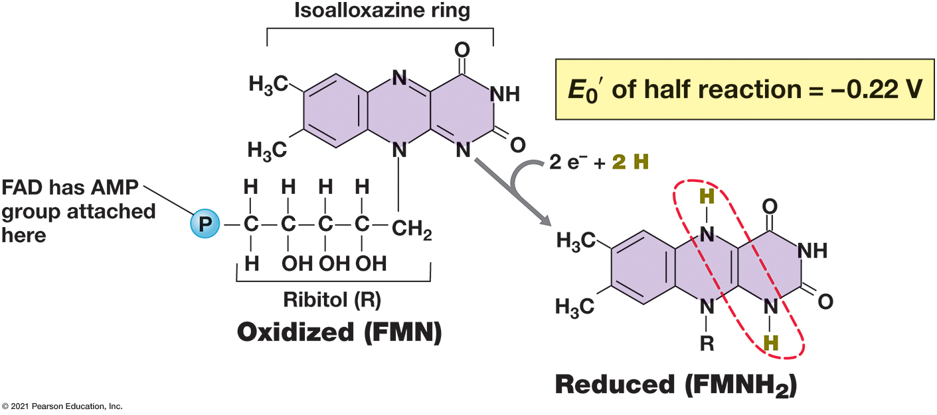
Figure 3.15 Flavin Mononucleotide (F M N), a Hydrogen Atom Carrier
Notes:
The site of oxidation–reduction (dashed red circle) is the same in F M N and the related coenzyme flavin adenine dinucleotide (F A D, not shown). F A D contains an adenosine monophosphate (A M P) group bonded through the phosphate group on F M N.
F M N + 2 electrons + 2 H yields a reduced F M N H 2. The F M N H 2 is the same as F M N except that two of the nitrogen double bonds in the rings have unbonded to take hydrogens. E sub 0 prime of half reaction = negative 0.22 volts.

Slide 63
3.8 Principles of Respiration: Electron Carriers (4 of 6)
Cytochromes, Other Iron Proteins, and Quinones
Cytochromes: proteins that contain heme prosthetic groups (Figure 3.16)
Oxidized/reduced by 1 electron via the iron atom (F e²⁺ or F e³⁺)
Several classes, differ widely in reduction potentials, designated by letters based on heme
sometimes form complexes (e.g., cytochrome b c₁)

Slide 64
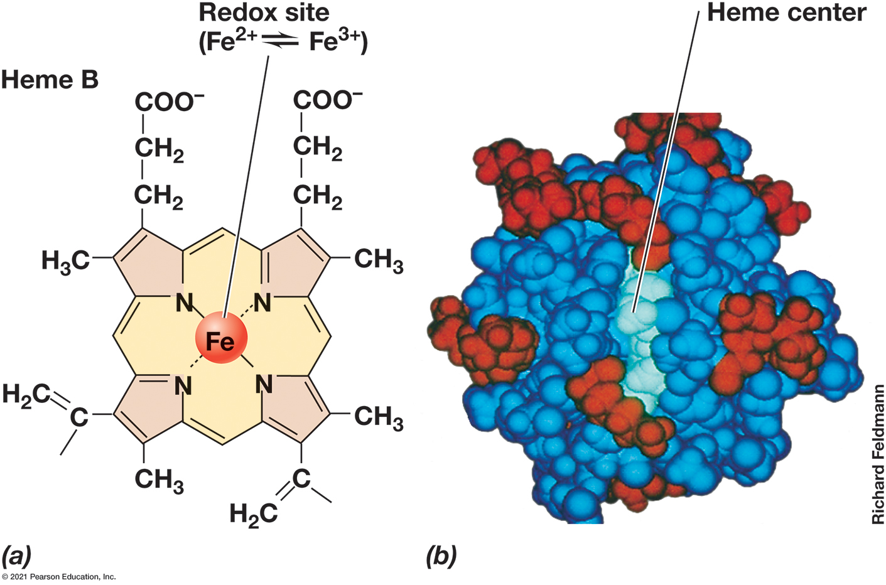
Figure 3.16 Cytochrome and Its Structure
Notes:
(a) Structure of heme, the iron-containing portion of cytochromes. Hemes are tetrapyrroles, composed of four pyrrole rings. Cytochromes carry electrons only, and the redox site is the iron atom, which can alternate between the F e2+ and F e3+ oxidation states. (b) Space-filling model of cytochrome c; heme (light blue) is covalently linked via disulfide bridges to cysteine residues in the protein (dark blue).

Slide 65
3.8 Principles of Respiration: Electron Carriers (5 of 6)
Cytochromes, Other Iron Proteins, and Quinones
Nonheme iron proteins
contain clusters of iron and sulfur (F e₂S₂ and F e₄S₄; Figure 3.17)
e.g., ferredoxin: low reduction potential, important in H₂ production
Reduction potentials vary.
only carry electrons

Slide 66
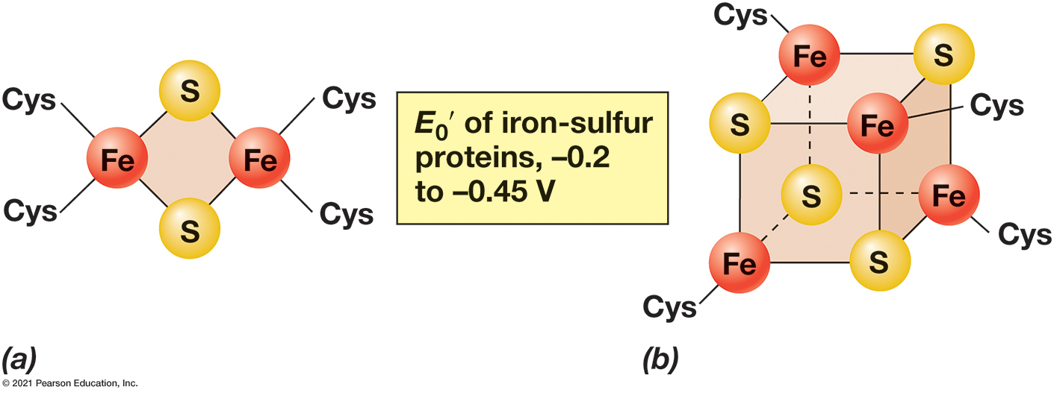
Figure 3.17 Arrangement of the Iron–Sulfur Centers of Nonheme Iron–Sulfur Proteins
Notes:
F e2S2 center. (b) F e4S4 center. The cysteines (Cys) link the protein to its F e/S cluster.
One arrangement is a 4 member ring with S on two opposite corners and F e on two opposite corners. The other arrangement is a cube with alternate corners or the upper back left, upper forward right, lower back right, and lower forward left. The other corners are S atoms.

Slide 67
3.8 Principles of Respiration: Electron Carriers (6 of 6)
Cytochromes, Other Iron Proteins, and Quinones
Quinones: small hydrophobic nonprotein redox molecules (Figure 3.18)
can move within membrane
Accept two electrons and two protons but transfer electrons only
typically link iron–sulfur proteins and cytochromes
ubiquinone (coenzyme Q) and menaquinone most common

Slide 68
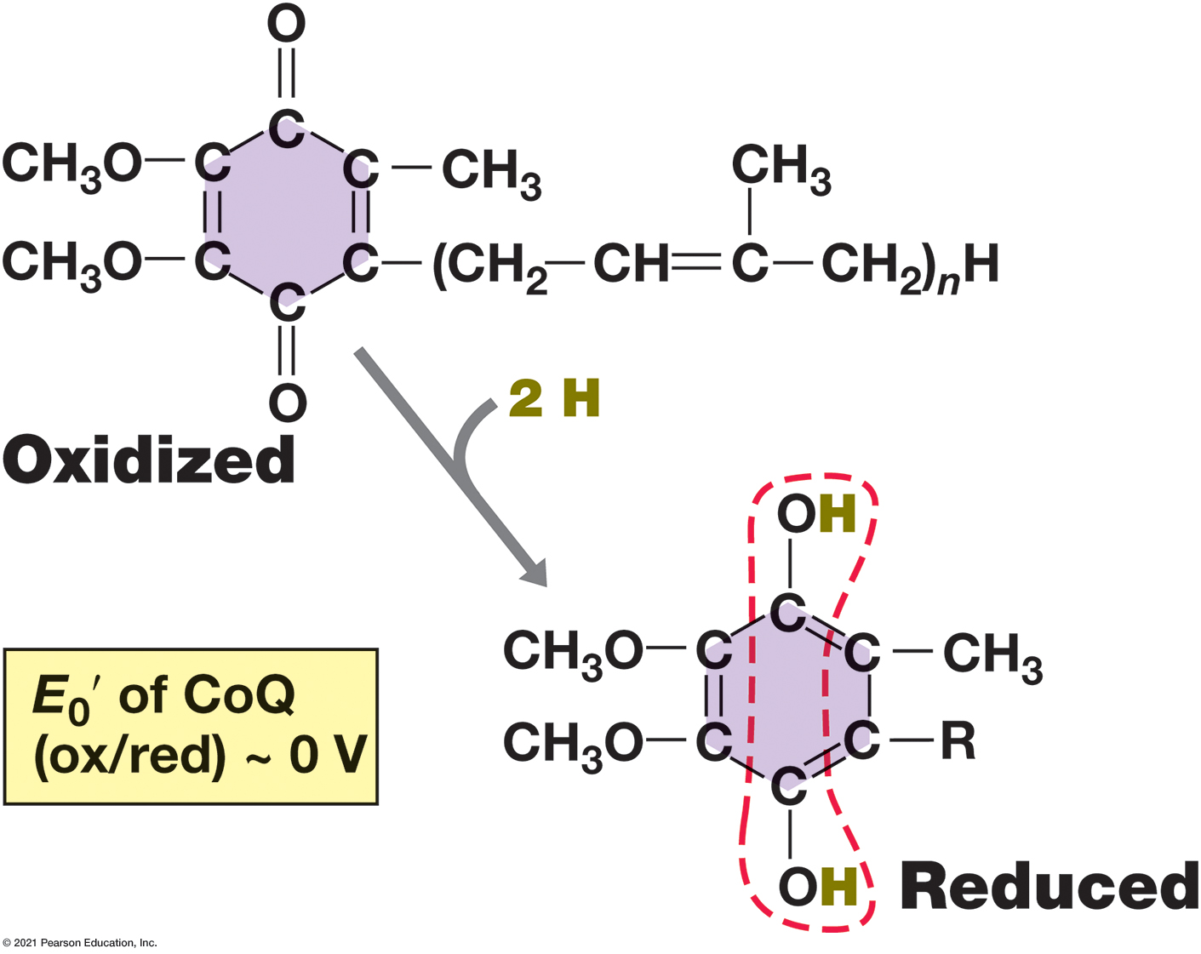
Figure 3.18 Structure of Oxidized and Reduced Forms of Ubiquinone (Coenzyme Q, or C o Q)
Notes:
The five-carbon unit in the side chain (an isoprenoid) occurs in multiples, typically 6–10. Oxidized ubiquinone requires 2 e− and 2 H+ to become fully reduced (dashed red outline).
The e sub 0 prime of Co Q is about 0 volts. The oxidized from has double bonds attaching the oxygens to the carbon ring while the reduced form has single bonded O H groups instead.

Slide 69
3.9 Principles of Respiration: Generating a Proton Motive Force (1 of 11)
Electron Transport
Organized in cytoplasmic membrane (Figure 3.19)
Composition varies
Multiple chains can sometimes function
Starts when electron donor adds electrons
In chemoorganotrophs, from N A D H or F A D H₂
In chemolithotrophs, many different inorganics
Electron carriers embedded in order of increasingly positive reduction potentials
Passed until they reduce a terminal electron acceptor (e.g., O₂)

Slide 70
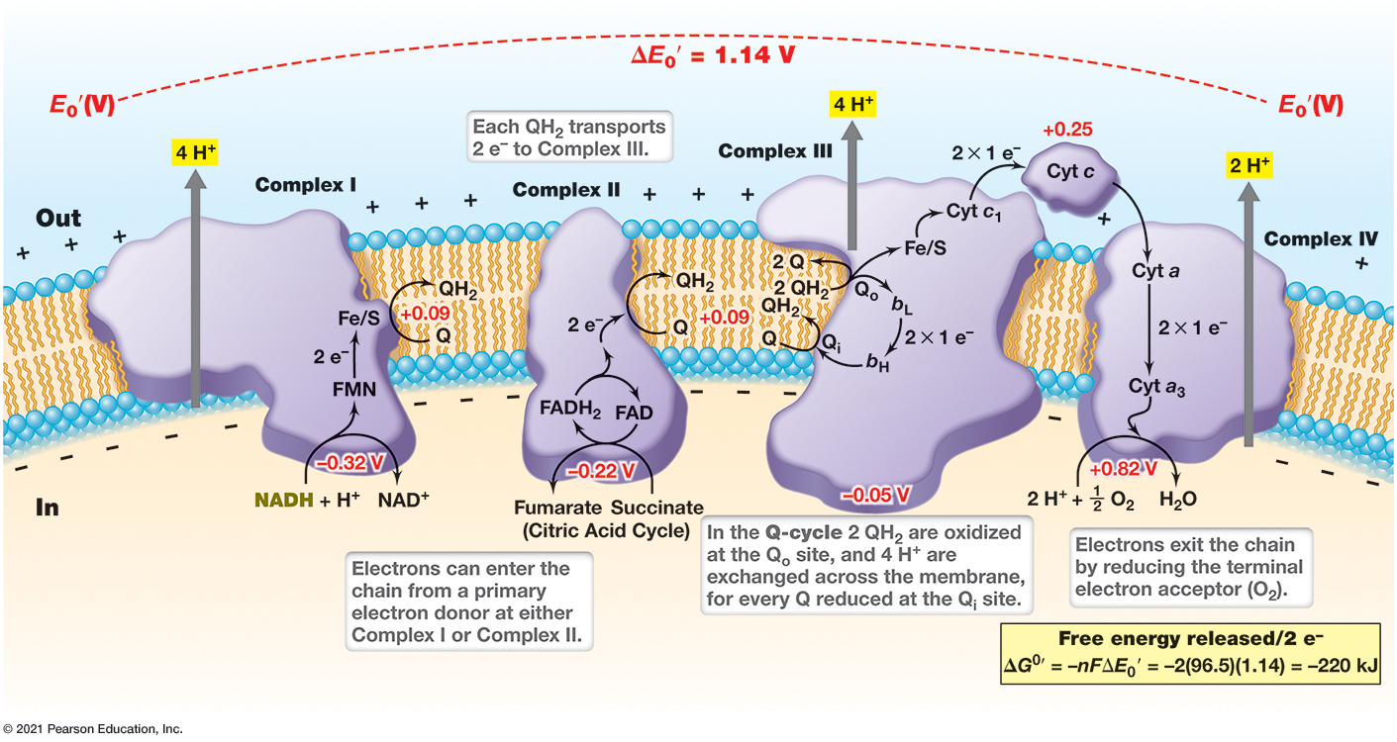
Figure 3.19 Generation of the Proton Motive Force During Aerobic Respiration
Notes:
The orientation of electron carriers in the cytoplasmic membrane of the bacterium Paracoccus denitrificans. The + and − charges at the inner and outer membrane surfaces represent H+ and O H−, respectively. F M N, flavin mononucleotide; F A D, flavin adenine dinucleotide; Q, quinone; F e/S, iron–sulfur protein; cyt a, b, c, cytochromes (b L and b H, low- and high-potential b-type cytochromes, respectively). The Q-cycle occurs at Complex III (cytochrome b c1). During the Q-cycle, two molecules of Q H2 are oxidized and a total of 4 H+ exchanged across the membrane for every 2 e− that pass through the complex. Complex II, the succinate dehydrogenase complex, bypasses Complex I and feeds electrons directly into the quinone pool at a more positive E0′ than N A D H (see the redox tower in Figure 3.4).
As electrons enter the chain from a primary electron donor the E sub 0 prime is negative 0.22. When F M N H 2 reduces an F e and S protein protons are extruded the E sub 0 prime is negative 0.0. During the Q cycle reactions the E sub 0 prime is positive 0.1. cytochrome c has E sub 0 prime is positive 0.26. Electrons exit the chain by reducing the terminal electron acceptor which is O 2 the E sub 0 prime is positive 0.39. The E sub 0 prime total change is 1.14 volts.

Slide 71
3.9 Principles of Respiration: Generating a Proton Motive Force (2 of 11)
Electron Transport
Electron movements are exergonic, providing free energy to pump protons to outer surface of membrane
Generates proton motive force
H⁺ (charged and polar) cannot diffuse across membrane
Separation of H⁺ and O H⁻ creates p H difference and electrochemical potential across membrane
e.g., Paracoccus denitrificans (Figure 3.19)

Slide 72
3.9 Principles of Respiration: Generating a Proton Motive Force (3 of 11)
Generation of the Proton Motive Force: Complexes
Complex
(N A D H: quinone oxidoreductase, N A D H
dehydrogenase)
Begins electron transport
Composed of many proteins that function as a unit
N A D H oxidized to N A D⁺, quinone reduced and
diffuses to Complex
four H⁺ released

Slide 73
3.9 Principles of Respiration: Generating a Proton Motive Force (4 of 11)
Generation of the Proton Motive Force: Complexes
Complex
(succinate dehydrogenase complex)
Alternative entry point
2 e⁻ from F A D H₂ and 2 H⁺ from cytoplasm transferred to ubiquinone (Q) to make ubiquinol
Less energy conserved due to lack of H⁺ translocation

Slide 74
3.9 Principles of Respiration: Generating a Proton Motive Force (5 of 11)
Complexes
b c1 and c- and a-Type Cytochromes
Complex
(cytochrome b c₁ complex)
transfers e⁻ from Q H₂ ubiquinol (reduced quinone) to cytochrome c
pumps 2 H⁺ from Q H₂ outside of cytoplasmic membrane
Q cycle (electron bifurcation) sends electrons to cytochrome c and subunit b _{L}; 4 H⁺ transferred across membrane
Cytochrome c shuttles e⁻ to Complex

Slide 75
3.9 Principles of Respiration: Generating a Proton Motive Force (6 of 11)
Complexes
b c1 and c- and a-Type Cytochromes
Complex
(cytochromes a and a₃ )
terminal oxidase; reduces O₂ to H₂O
Needs 4 e⁻ and 4 H⁺ from cytoplasm
pumps 1 H⁺ per electron

Slide 76
3.9 Principles of Respiration: Generating a Proton Motive Force (7 of 11)
Complexes
b c1 and c- and a-Type Cytochromes
For every 2 e⁻ from N A D H to O₂, 10 H⁺ transferred outside membrane (4 at Complex 1, 4 at Complex
2 at Complex
2 consumed in cytoplasm (H₂O)
For every 2 e⁻ from F A D H₂ to O₂, 6 H⁺ transferred
outside membrane (4 at Complex
2 consumed in cytoplasm (H₂O)

Slide 77
3.9 Principles of Respiration: Generating a Proton Motive Force (8 of 11)
A T P Synthase (A T Pase)
Uses energy from proton motive force (p m f) to form A T P (Figure 3.20)
p m f generates torque; mechanical energy catalyzes A D P + P_{i} to A T P
oxidative phosphorylation from respiratory electrons
photophosphorylation from light energy

Slide 78
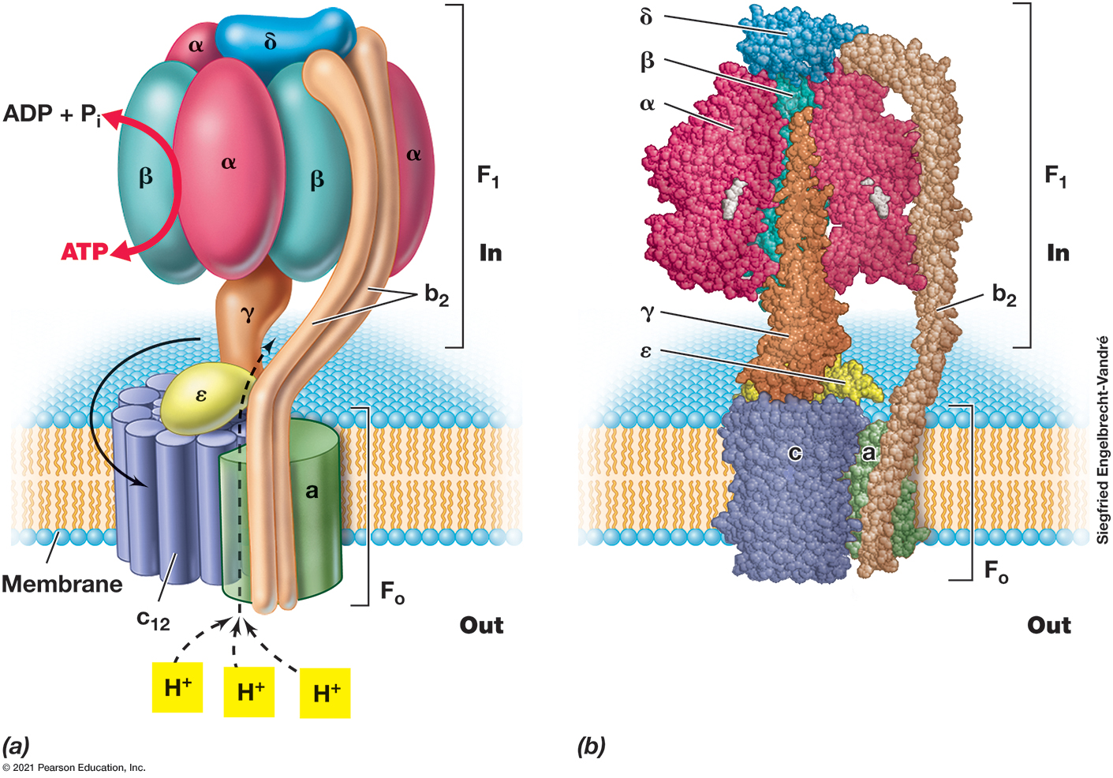
Figure 3.20 Structure and Function of the Reversible A T P Synthase (A T Pase) in Escherichia Coli op
Notes:
(a) Schematic.F1, the stator, consists of five different polypeptides forming an α3β3γεδ complex. F1 is the catalytic complex responsible for the interconversion of A D P + Pi and A T P. Fo, the rotor, is integrated in the membrane and consists of three polypeptides in an ab2c12 complex. As protons enter, the dissipation of the proton motive force drives A T P synthesis (3–5 H+/A T P). (b) Space-filling model. The color-coding corresponds to the art in part a. Since proton translocation from outside the cell to inside the cell leads to A T P synthesis by A T Pase, it follows that proton translocation from inside to outside in the electron transport chain (Figure 3.19) represents work done on the system and a source of potential energy. This energy can be used to drive a number of energy-requiring processes in the cell, including in particular motility and some forms of nutrient transport. Nearly all cells of all domains contain A T Pases. Also, some bacterial and archaeal A T Pases are linked to a sodium (N a+) rather than a proton (H+) gradient.
Part a. The outer part of the A T P ase is F sub 1, the inter membrane part is F sub 0. The F sub 1 section transfers A D P and a phosphate into A T P. The F sub 0 section pumps the H positive ions. Part b. The basic shape is demonstrated in a space filling model as well with the rotor in the cell membrane and the bulbous upper section attached by the gamma like an inner trunk and an outer line piece which is b sub 2.

Slide 79
3.9 Principles of Respiration: Generating a Proton Motive Force (9 of 11)
A T P Synthase (A T Pase)
Two components
F₁: multiprotein complex extending into cytoplasm that catalyzes A T P synthesis
F_{o}: membrane-integrated proton-translocating multiprotein complex
found in nearly all organisms, highly conserved
reversible reaction

Slide 80
3.9 Principles of Respiration: Generating a Proton Motive Force (10 of 11)
A T P synthase (A T Pase)
For every full rotation of F₀ c ring, 3 A T P formed by F₁
In E. coli, approximately 3.3 H⁺ required per A T P
Number of c subunits varies between organisms, so # of H⁺ needed also varies
Oxidative phosphorylation conserves much more energy because substrate is completely oxidized (Figure 3.21)
e.g., 38 A T P in aerobic respiration, 2 A T P in lactic acid fermentation

Slide 81
3.9 Principles of Respiration: Generating a Proton Motive Force (11 of 11)
A T P synthase (A T Pase)
A T Pases are reversible
A T P hydrolysis can reverse A T Pase activity and transport protons out of cytoplasm, generating instead of dissipating p m f
A T Pases in strict fermenters generate p m f for motility and transport by hydrolyzing A T P from substrate-level phosphorylation

Slide 82
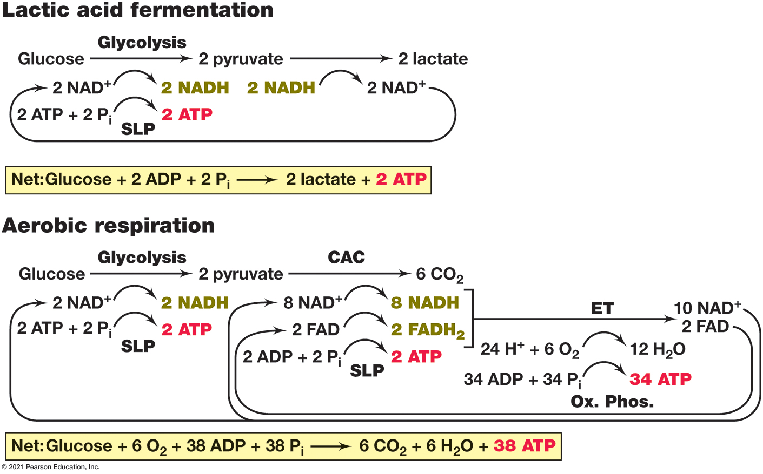
Figure 3.21 Energetics in Fermentation and Aerobic Respiration
Notes:
Fermentation and respiration both oxidize NADH and allow for the regeneration of N A D+. However, respiration conserves far more energy than fermentation as a result of oxidative phosphorylation. Note that reduction of 6 O2 with 24 e− produces 12 H2O while only 6 H2O are produced in the net reaction. The difference between the gross and net production of water occurs because H2O is in equilibrium with H+ and O H− and only the net production of water is written in the balanced reaction. S L P, substrate-level phosphorylation; Ox. Phos., oxidative phosphorylation; C A C, citric acid cycle; E T, electron transport.
The energetics are as follows.
Lactic acid fermentation. Glucose, through glycolosis, yields 2 pyruvate, which yields 2 lactate. 2 N A D plus yields 2 N A D H, which yields 2 N A D plus. During S L P from glucose to 2 pyruvate, 2 A T P + 2 P sub i yields 2 A T P. Net, Glucose + 2 A D P + 2 P sub i yields 2 lactate + 2 A T P.
Aerobic respiration. Glucose, through glycolosis, yields 2 pyruvate, which, through C A C, yields 6 C O 2. 2 N A D plus yields 2 N A D H. 8 N A D plus then yields 8 N A D H, which after E T yields 10 N A D plus. 2 F A D then yields 2 F A D H 2, which after E T yields 2 F A D. During S L P from glucose to 2 pyruvate, 2 A D P + 2 P sub i yields 2 A T P. During E T, 24 H plus + 6 O 2 yields 12 H 2 0. During oxidative phosphorylation, 34 A D P + 34 P sub i yields 34 A T P.

Slide 83
Three. Catabolism: Electron Transport and Metabolic Diversity
3.10 Anaerobic Respiration and Metabolic Modularity
3.11 Chemolithotrophy and Phototrophy

Slide 84
3.10 Anaerobic Respiration and Metabolic Modularity (1 of 7)
Respiration can occur under both oxic (O₂) and anoxic (no O₂) conditions
Aerobic respiration requires O₂ as terminal electron acceptor
Anaerobic respiration uses other terminal electron acceptors (Figure 3.22)
Originally no O₂ in atmosphere
Anaerobic microbes dominated much of history of life
Still occurs widely today

Slide 85
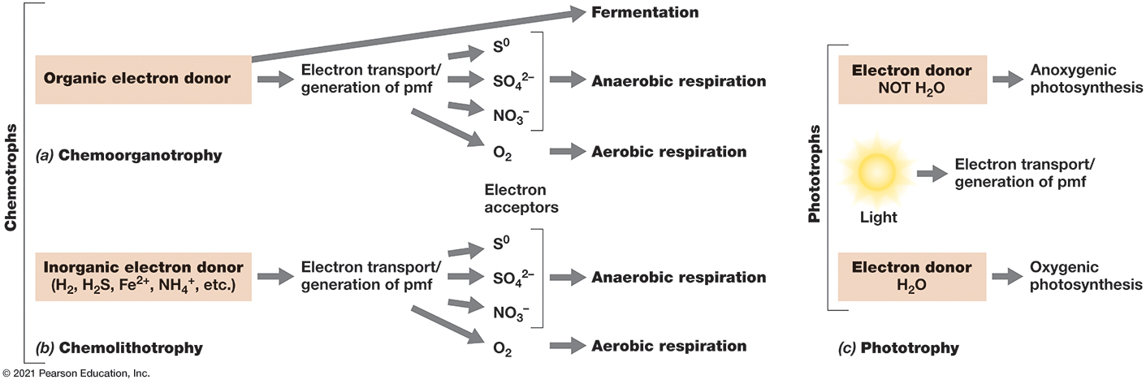
Figure 3.22 Metabolic Diversity and Its Relationship to Oxygen
Notes:
(a) Chemoorganotrophs can be fermentative or engage in aerobic or anaerobic respiration, whereas (b) chemolithotrophs are typically respiratory. (c) Phototrophs are oxygenic if they generate O2 by oxidizing H2O and anoxygenic if they do not. P m f, proton motive force.
Parts a and b. In chemoorganotrophy an electron donor which is an organic compound which can either go into fermentation or electron transport or generation of p m f to electron acceptors including S, N O 3 negative, S O 4 negative 2, or organic electron acceptors. It could also go to O 2 in aerobic respiration. In chemolithotrophy an electron donor which can be H 2, H 2 S, F e positive 2, or N H 4 positive which can go into electron transport or generation of p m f to electron acceptors including S, N O 3 negative, or S O 4 negative 2. It could also go to O 2 in aerobic respiration. Part c. There are three processes described. The first is photoheterotrophy where an organic compound turns into cell material. The second is unlabeled where light powers an electron transport into generation of p m f. The third is photoautotrophy where an C O 2 as well as electrons from H 2 O and H 2 S turns into cell material.

Slide 86
3.10 Anaerobic Respiration and Metabolic Modularity (2 of 7)
Fermentation and anaerobic respiration both occur in anaerobes
Respiration requires an external electron acceptor, generates A T P by oxidative phosphorylation
Fermentation does not require an external electron acceptor, generates A T P by substrate-level phosphorylation

Slide 87
3.10 Anaerobic Respiration and Metabolic Modularity (3 of 7)
Respiration in Escherichia coli
E. coli is a versatile chemoorganotroph with electron transport similar but not identical to Paracoccus denitrificans
Grows by aerobic respiration (O₂), fermentation (no external electron acceptors), anaerobic respiration (with nitrate)

Slide 88
3.10 Anaerobic Respiration and Metabolic Modularity (4 of 7)
Respiration in Escherichia coli
Can optimize under multiple conditions
With organic carbon source, grows fastest by aerobic respiration
Grows faster with nitrate respiration than fermentation
Can insert many different proteins into electron transport chain

Slide 89
3.10 Anaerobic Respiration and Metabolic Modularity (5 of 7)
Respiration in Escherichia coli
Basic organization (Figure 3.23)
complex
quinones, terminal reductase
Can swap components
alternative quinones
alternative dehydrogenases/terminal reductases (5+ sets each)

Slide 90
Figure 3.23 Respiration and Nitrate-Based Anaerobic Respiration in Escherichia Coli
Notes:
Electron transport processes in the membrane of E. coli when (a) O2 or (b) N O3 − is used as terminal electron acceptor. Note the difference in the number of protons translocated with the different terminal electron acceptors and compare these to the difference in the energetics of these reactions when glucose is the electron donor (see Figure 3.4). Q, ubiquinone.
The parts are as follows.
Part a. Aerobic respiration. During complex 1, when F M N H 2 reduces an F e and S protein, 4 H + protons are translocated. Complex 2 consists of citric acid cycle reactions, after which 2 H + are translocated. The result is cytochrome b o 3, where 2 H + are released.
Part b. Nitrate reduction. During complex 1, when F M N H 2 reduces an F e and S protein, 4 H + protons are translocated. Complex 2 consists of citric acid cycle reactions, with no H + translocated. The result is nitrate reductatse, where 2 H + are released.

Slide 91
3.10 Anaerobic Respiration and Metabolic Modularity (6 of 7)
Respiration in Escherichia coli
No complex
Conserves less energy than P.denitrificans
Exchanges only 8 H⁺ instead of 10 for every 2 electrons
If no O₂ and nitrate present, E. coli uses nitrate reductase as terminal reductase
N O₃⁻/N O₂⁻ couple is less electropositive
Provides less energy
Only 6 H⁺ exchanged for every 2 electrons

Slide 92
3.10 Anaerobic Respiration and Metabolic Modularity (7 of 7)
Respiration in Escherichia coli
For any electron donor, aerobic organisms always conserve more energy and will outcompete anaerobic organisms
O₂ consumed very quickly
Anoxic habitats and anaerobic microbes widespread

Slide 93
3.11 Chemolithotrophy and Phototrophy (1 of 6)
Chemolithotrophy
Uses inorganic chemicals as electron donors
e.g., hydrogen sulfide (H₂S), hydrogen gas (H₂), ferrous iron (F e²⁺), ammonium (N H₄⁺)
Begins with oxidation of inorganic electron donor, electrons enter electron transport chain
e.g., Ralstonia eutropha: aerobic chemolithotroph with H₂ as electron donor (2 H⁺/H₂, −0.42 Volt) (Figure 3.24)

Slide 94
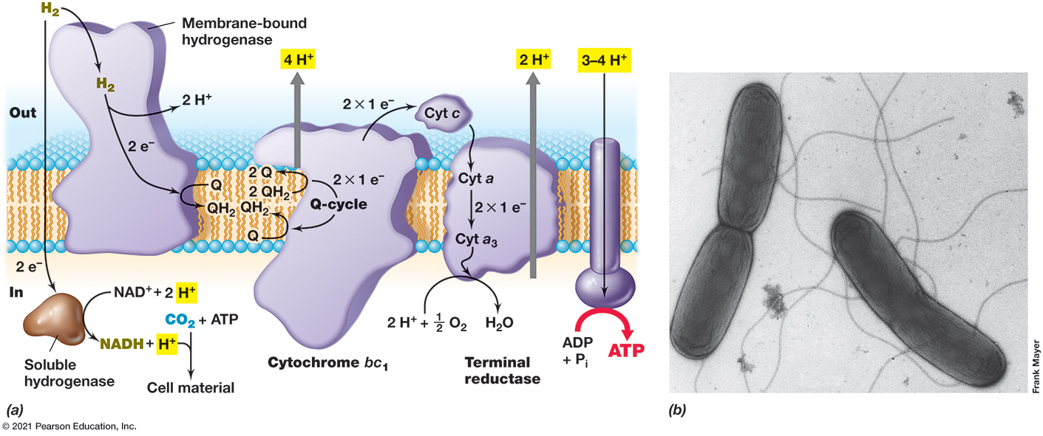
Figure 3.24 Energy Conservation in Ralstonia Eutropha, an Autotrophic Chemolithotroph That Oxidizes H₂
Notes:
(a) In R. eutropha, two hydrogenases are present; the membrane-bound hydrogenase participates in electron transport, whereas the soluble hydrogenase makes N A D H for the Calvin cycle (see Section 3.12). Cyt, cytochrome; Q, quinone. For details of the Q-cycle, see Figure 3.19. (b) Transmission electron micrograph of negatively stained cells of R. eutropha. A cell is about 0.6 μ m in diameter and contains several flagella.

Slide 95
3.11 Chemolithotrophy and Phototrophy (2 of 6)
Chemolithotrophy
Both chemoorganotrophs and chemolithotrophs depend on oxidative phosphorylation
Can be aerobic or anerobic
Major difference is source of cellular carbon
Chemoorganotrophs are heterotrophs, using organics as carbon sources
Chemolithotrophs typically use C O₂ as carbon source (autotrophs)
Use reverse electron transport to form reducing power

Slide 96
3.11 Chemolithotrophy and Phototrophy (3 of 6)
Phototrophy
Uses light to generate proton motive force
A T P synthase makes A T P by photophosphorylation (Figure 3.25a)
oxygenic (e.g., cyanobacteria, algae, plants), forming O₂ as waste product, or anoxygenic (many Bacteria)
anoxygenic phototrophs evolved first, more metabolic diversity

Slide 97
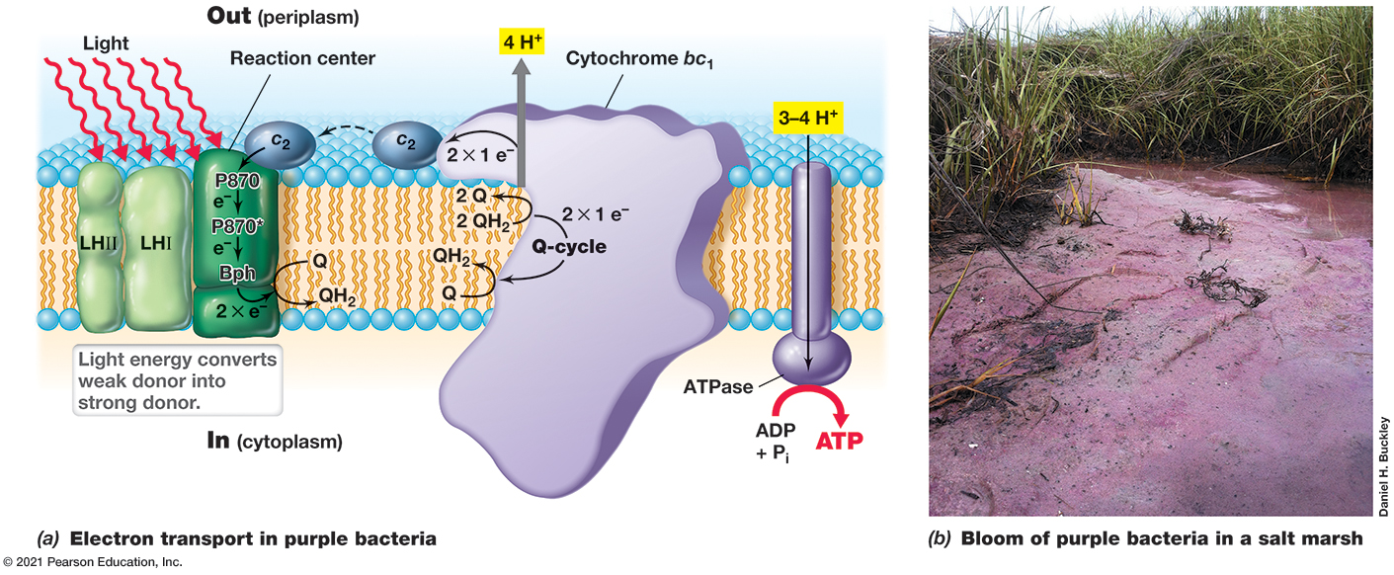
Figure 3.25 Electron Flow in Anoxygenic Photosynthesis in a Purple Bacterium
Notes:
(a) Energy conservation in purple bacteria results from cyclic photophosphorylation.The photosynthetic reaction center uses light energy to energize electrons for use in electron transport and the generation of proton motive force. Four protons are translocated for every two electrons that pass from the reaction center to cytochrome b c1. P870 is a form of bacteriochlorophyll a in the ground state and is a fairly electropositive electron donor. P870* is formed after light excitation of P870 and is a strongly electronegative electron donor. L H, light-harvesting bacteriochlorophyll complexes; B p h, bacteriopheophytin; Q, quinone; c2, cytochrome c2. For details of the Q-cycle, see Figure 3.19. (b) A bloom of purple bacteria that formed in the Sippewissett Salt Marsh, Cape Cod, Massachusetts, U S A. High rates of O2 consumption, and its low solubility in water, can cause anoxic conditions in a water film less than 100 μ m thick, and this allows anoxygenic phototrophs to grow on the sediment surface.

Slide 98
3.11 Chemolithotrophy and Phototrophy (4 of 6)
Phototrophy
Purple bacteria are anoxygenic prototrophs common in anoxic aquatic environments
produce photosynthetic reaction center that converts light into chemical energy
reaction centers contain photopigments (e.g., chlorophylls, bacteriochlorophylls)
photopigments absorb light, transfer energy to photosynthetic reaction center, forms proton motive force that A T P synthase uses to make A T P

Slide 99
3.11 Chemolithotrophy and Phototrophy (5 of 6)
Phototrophy
Major difference between respiratory and photosynthetic electron transport in purple bacteria is electrons are returned (cyclic photophosphorylation)

Slide 100
3.11 Chemolithotrophy and Phototrophy (6 of 6)
Generation of Reducing Power
Reducing power (N A D H) necessary to produce cellular material
Can come from variety of electron donors (e.g., H₂S)
Use reverse electron transport (pushing electrons from quinone pool backward to reduce N A D⁺ to N A D H)

Slide 101
https://www.sigmaaldrich.com/deepweb/assets/sigmaaldrich/marketing/global/documents/261/398/metabolic-pathways-poster.pdf?srsltid=AfmBOor1oHeRVfZGHWGscZu1O0MFUxN_FSxfdReBGpaLho8uhdK6laEi
https://biochemical-pathways.com/#/map/1

Slide 102
Four. Biosynthesis
3.12 Autotrophy and Nitrogen Fixation
3.13 Sugars and Polysaccharides
3.14 Amino Acids and Nucleotides
3.15 Fatty Acids and Lipids

Slide 103
3.12 Autotrophy and Nitrogen Fixation (1 of 6)
Anabolism: Biosynthesis of cellular macromolecules
Cells require carbon and nitrogen to perform biosynthesis
Atmospheric sources (C O₂ and N₂) must be chemically reduced for assimilation (C O₂ fixation and N₂ fixation)
Requires A T P and reducing power

Slide 104
3.12 Autotrophy and Nitrogen Fixation (2 of 6)
The Calvin Cycle (Figure 3.26)
Used by many autotrophs, including all oxygenic phototrophs
Found in purple bacteria, cyanobacteria, algae, green plants, most chemolithotrophic Bacteria, few Archaea
Requires C O₂, a C O₂ acceptor, N A D P H, A T P, ribulose bisphophate carboxylase (RubisCO), and phosphoribulokinase
First step catalyzed by RubisCO, forming two molecules of 3-phosphoglyceric acid (P G A) from ribulose bisphophate and C O₂
P G A then phosphorylated and reduced to glyceraldehyde-3-phosphate
glucose formed by reversal of glycolysis

Slide 105
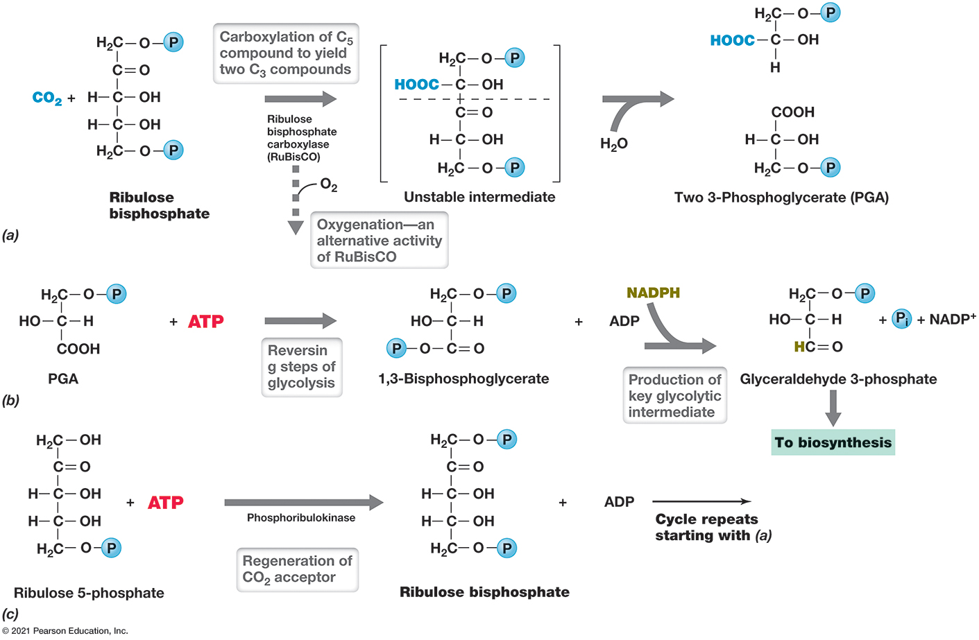
Figure 3.26 Key Reactions of the Calvin Cycle
Notes:
(a) Reaction of the enzyme ribulose bisphosphate carboxylase. (b) Steps in the conversion of 3-phosphoglycerate (P G A) to glyceraldehyde 3-phosphate. Note that both A T P and N A D P H are required. (c) Conversion of ribulose 5-phosphate to the C O2 acceptor molecule ribulose 1,5-bisphosphate by the enzyme phosphoribulokinase.
The reactions are as follows.
Part a. C O 2 + ribulose bisphosphate yields ribulose bisphosphate carboxylase. After carboxylation, this C 5 compound yields two C 3 compounds. First, it yields an unstable intermediate. With the introduction of H 2 O, the intermediate yields two 3 phosphoglycerate, P G A. Note, Oxygenation––an alternative activity of R u B I s C O, rather than carboxylation.
Part b. While reversing the steps of glycosis, P G A + A T P yields 1, 3 Bisphosphoglycerate. 1, 3 Bisphosphoglycerate + A T P, with the introduction of N A D P H yields Glyceraldehyde 3-phosphate, which leads to biosynthesis.
Part c. In regeneration of C O 2 acceptor, Ribulose 5-phosphate + A T P, in the presence of Phosphoribulokinase, yields ribulose bisphosphate. Ribulose bisphosphate + A D P starts the cycle over.

Slide 106
3.12 Autotrophy and Nitrogen Fixation (3 of 6)
The Calvin Cycle
Easiest to consider cycle as six molecules of C O₂ required to make one hexose (C₆H₁₂O₆)
6 ribulose bisphosphate and 6 C O₂ required (Figure 3.27)
Results in 6 molecules of ribulose 5-phosphate (30 carbons) + one hexose (6 carbons) for biosynthesis
Phosphoribulokinase phosphorylates each ribulose 5-phosphate to regenerate ribulose bisphosphate
12 N A D P H and 18 A T P required to synthesize one glucose
Many alternative pathways for C O₂ fixation

Slide 107
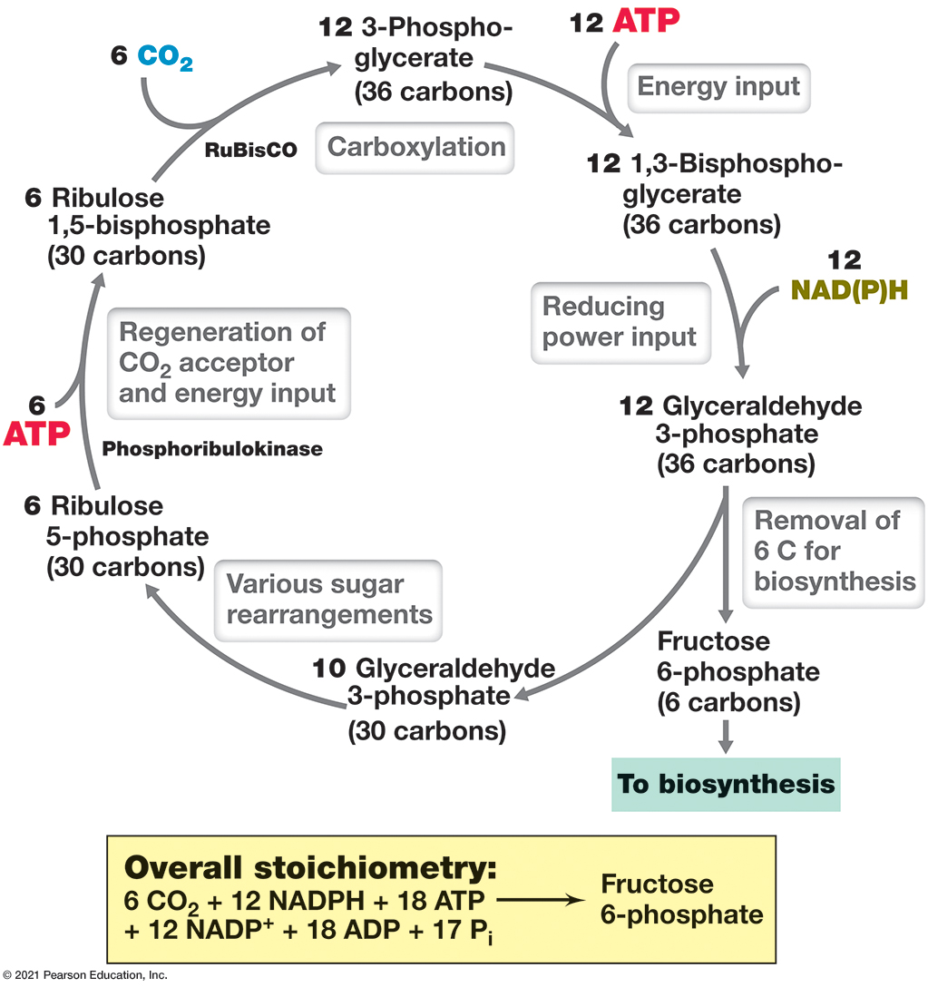
Figure 3.27 The Calvin Cycle
Notes:
Shown is the production of one hexose molecule from six C O2. For each six molecules of C O2 incorporated, one fructose 6-phosphate is produced that can be drawn off for biosynthesis. In phototrophs, the energy to produce A T P comes from light; in chemolithotrophs, the energy to produce A T P comes from the oxidation of inorganic electron donors. In oxygenic phototrophs, electrons for N A D(P)H come from water; in anoxygenic phototrophs, the electrons come from reduced substances such as H2S. In chemolithotrophs, N A D(P)H is formed from inorganic electron donors.
The cycle is as follows.
Carboxylation. 6 Ribulose 1, 5 bisphosphate (30 carbons). RuBisCO + 6 C O 2 yields 12 1, 3 Phosphoglycerate (30 carbons).
Energy input. 12 1,3 Phosphoglycerate + A T P yields 1,3-Bisphospho- glycerate (36 carbons).
Reducing power input. 12 1,3 Phosphoglycerate + 12 N A D, P, H yields 12 Glyceraldehyde 3-phosphate (36 carbons).
Removal of 6 C for biosynthesis yields Fructose 6-phosphate (6 carbons), which exits the cycle.
Various sugar rearrangements. 10 Glyceraldehyde 3-phosphate (30 carbons) then yields 6 ribulose 5-phosphate (30 carbons).
Regeneration of C O 2 acceptor and energy input. Phosphoribulokinase. 6 ribulose 5-phosphate + 6 A T P yields 6 Ribulose 1, 5 bisphosphate.
Overall stoichiometry. 6 C O 2 + 12 N A D P H + 16 A T P + 12 N A D P plus + 18 A D P + 17 P sub i yields Fructose 6 phosphate.

Slide 108
3.12 Autotrophy and Nitrogen Fixation (4 of 6)
Nitrogen Fixation
Nitrogen needed for proteins, nucleic acids, other organics
Most microbes obtain this nitrogen from “fixed” nitrogen (ammonia, N H₃, or nitrate, N O₃⁻)
Many prokaryotes can conduct nitrogen fixation: form ammonia (N H₃) from gaseous dinitrogen (N₂). (Figure 3.28)

Slide 109
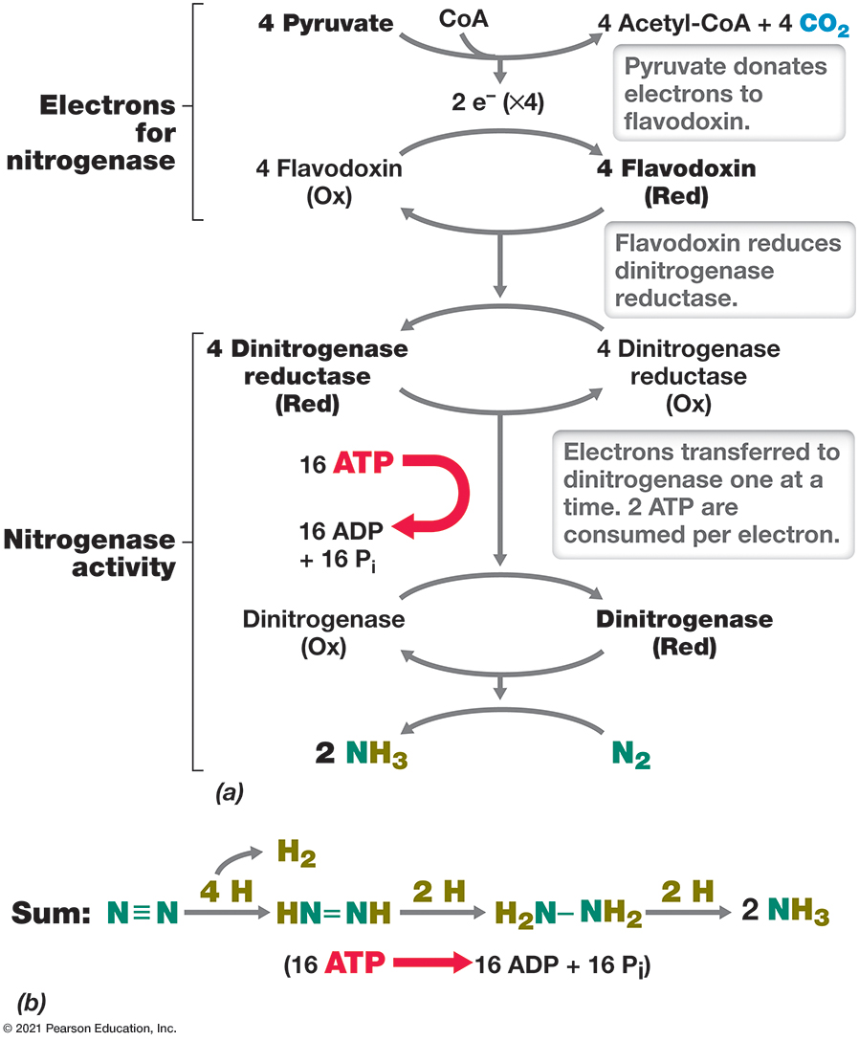
Figure 3.28 Biological Nitrogen Fixation by Nitrogenase
Notes:
The nitrogenase complex is composed of dinitrogenase and dinitrogenase reductase. Electrons from reduced flavodoxin (or ferredoxin) are used to reduce dinitrogenase reductase, and this enzyme in turn reduces dinitrogenase at the expense of A T P. Dinitrogenase ultimately donates electrons to N2 at the active site of the enzyme, resulting in the formation of 2 N H3. H is hydrogen (which consists of H+ + e−).
Part a. The process is as follows. Electrons for nitrogenase are obtained. Pyruvate donates electrons to flavodoxin. Flavodoxin reduces dinitrogenase reductase. Nitrogenase activity commences. Electrons transferred to dinitrogenase one at a time. 2 ATP are consumed per electron. Part b. Sum. N, triple bond, N, in the presence of 4 H, after 2 H is translocated, yields H N, double bond, N H, in the presence of 2 H yields H 2 N, single bond, N H 2, in the presence of 2 H yields 2 N H 3. 16 A T P yields 16 A D P + 16 P sub i.

Slide 110
3.12 Autotrophy and Nitrogen Fixation (5 of 6)
Nitrogen Fixation
Catalyzed by nitrogenase enzyme complex
Consists of dinitrogenase and dinitrogenase reductase
Iron-molybdenum cofactor (FeMo-co) of dinitrogenase is where N₂ reduction occurs
Triple bond stability makes activation and reduction very energy demanding
6 electrons needed; 8 actually consumed because H₂ must be produced
16 A T P required to lower protein’s reduction potential, enabling dinitrogenase reductase to reduce dinitrogenase

Slide 111
3.12 Autotrophy and Nitrogen Fixation (6 of 6)
Nitrogen Fixation
Catalyzed by nitrogenase enzyme complex
inhibited by oxygen
in obligate aerobes, nitrogenase is protected from oxygen by combination of removal by respiration, production of oxygen-retarding slime layers, localization of nitrogenase in differentiated heterocyst (Figure 3.29)

Slide 112
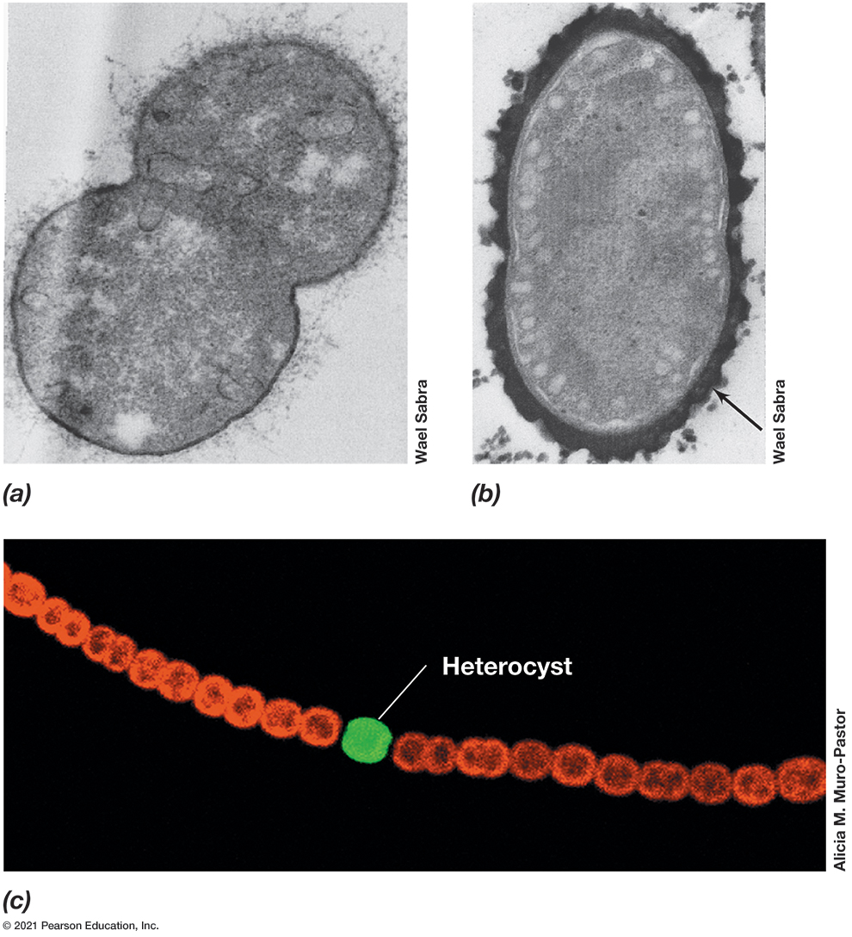
Figure 3.29 Two Ways of Protecting Nitrogenase from O₂
Notes:
Induction of slime formation by O2 is demonstrated by comparing transmission electron micrographs of (a) nitrogen-fixing Azotobacter vinelandii cells grown with 2.5% O2 and showing very little slime with (b) nitrogen-fixing A. vinelandii cells grown in air (21% O2) and showing an extensive, darkly staining slime layer (arrow). The slime retards diffusion of O2 into the cell, thus preventing nitrogenase inactivation by O2. A single cell of A. vinelandii is about 2 μm in diameter. (c) Fluorescence photomicrograph of cells of the filamentous cyanobacterium Anabaena showing a single heterocyst (green). The heterocyst is a thick-walled differentiated cell that does not produce O2 but instead specializes in nitrogen fixation and protects nitrogenase from O2 inactivation.

Slide 113
3.13 Sugars and Polysaccharides (1 of 3)
Polysaccharide Biosyntheses and Gluconeogenesis
Polysaccharides synthesized from activated glucose (Figure 3.30a)
uridine diphosphoglucose (U D P G)
precursor of glucose derivatives for biosynthesis of structural polysaccharides (e.g., N-acetylglucosamine, N-acetylmuramic acid, lipopolysaccharide)
adenosine diphosphoglucose (A D P G)
add activated glucose to polymer fragment
Gluconeogenesis: synthesis of glucose from phosphoenolpyruvate (Figure 3.30b)

Slide 114
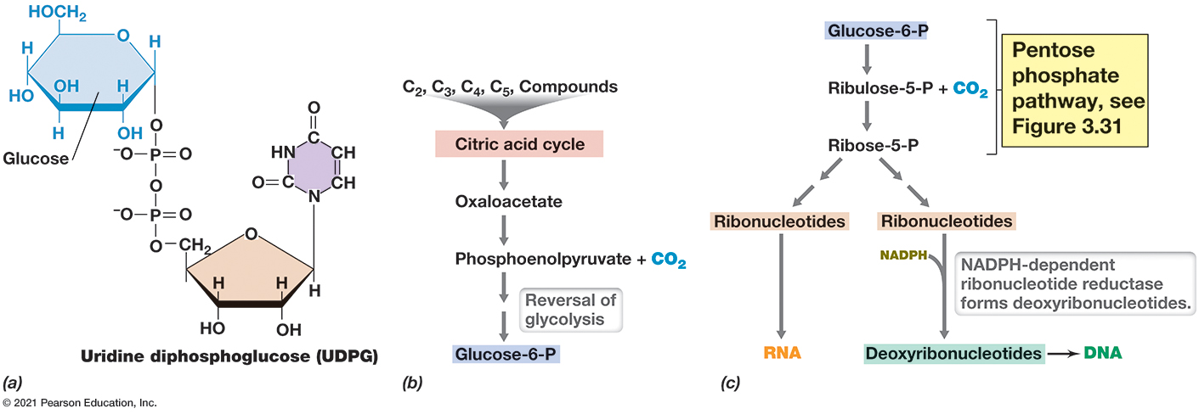
Figure 3.30 Sugar Metabolism
Notes:
(a) Polysaccharides are synthesized from activated forms of hexoses such as U D P G. (b) Gluconeogenesis. When glucose is needed, it can be biosynthesized from other carbon compounds by reversing the steps in glycolysis. (c) Pentoses for nucleic acid synthesis are formed by decarboxylation of hexoses such as glucose 6-phosphate. Note how the precursors of D N A are produced from the precursors of R N A by the enzyme ribonucleotide reductase.
The structure of uridine diphosphosphoglucose. C 2, C 3, C 4, and C 5 compounds go through the citric acid cycle, then oxaloacetate, then phosphoenolpyruvate + C O 2. The reversal of glycolysis creates glucose 6 P. Glucose 6 P passes through the pentose phosphate pathway past steps ribulose 5 P + C O 2 and Ribose 5 P. The ribose then splits down two paths. One goes to ribonucleotides to R N A. The other goes to ribonucleotides and adds N A D P H to go through N A D P H dependent ribonucleotide reductase forms deoxyribonucleotides to create deoxyribonucleotides or D N A.

Slide 115
3.13 Sugars and Polysaccharides (2 of 3)
Pentose Metabolism and the Pentose Phosphate Pathway
Pentoses (C₅ sugars)
formed by the removal of one carbon atom from a hexose (Figure 3.30c)
required for the synthesis of nucleic acids (e.g., ribonucleotide reductase converts ribo- to deoxyribonucleotides)

Slide 116
3.13 Sugars and Polysaccharides (3 of 3)
Pentose Metabolism and the Pentose Phosphate Pathway
Major pathway for pentose production is the pentose phosphate pathway (Figure 3.31)
glucose oxidized to C O₂, N A D P H, ribulose-5-phosphate (which leads to several derivatives)
pentoses can be catabolized through this pathway
produces several 4-7 carbon-sugars
generates N A D P H for deoxyribonucleotide and fatty acid biosynthesis

Slide 117
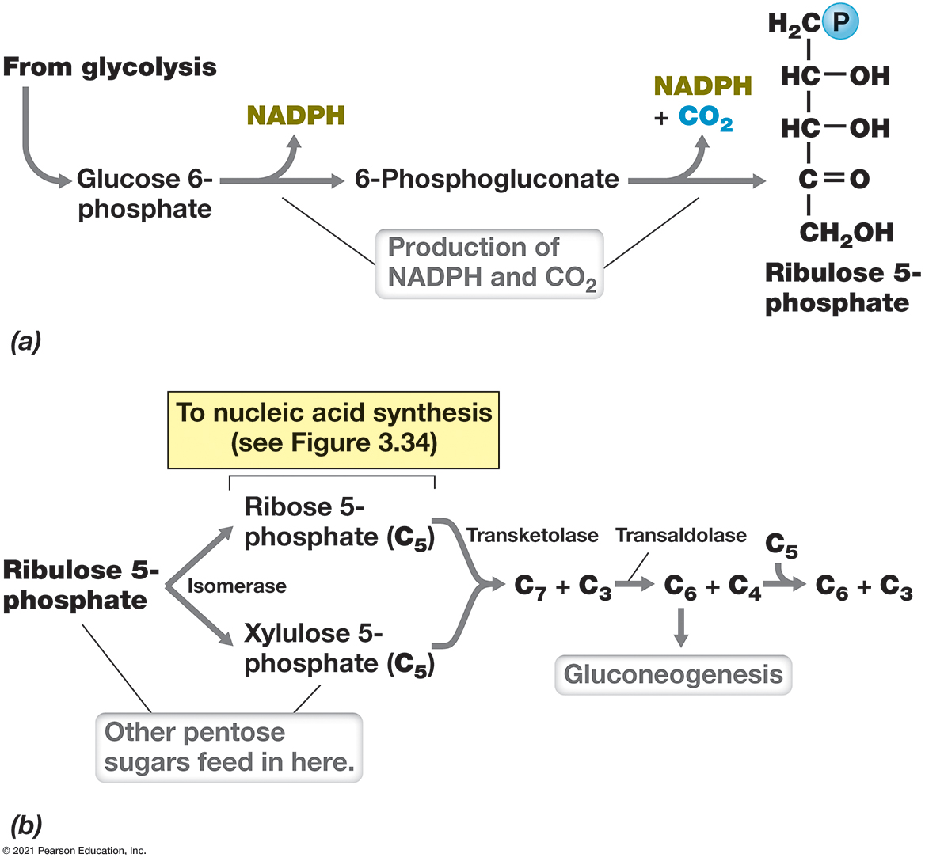
Figure 3.31 Pentose Phosphate Pathway
Notes:
This pathway generates pentoses from other sugars for biosynthesis and also functions to catabolize pentose sugars. (a) Production of the key intermediate, ribulose 5-phosphate. (b) Other reactions in the pentose phosphate pathway.
The primary production on the pentose phosphate pathway goes from glycolysis with a glucose 5 phosphate which then releases N A D P H to 6 phosphogluconate with then releases N A D P H and C O 2 to create Ribulose 5 phosphate. Other reactions in this pathway include isomerase on ribulose 5 phosphate to ribose 5 phosphate to xylulose 5 phosphate, transketolase which take the last two products to create C 7 + C 3 which pass through transaldolase to C 6 + C 4 where C 6 goes on to gluconeogensis and to C 4 is added C 5 to C 6 + C 3.

Slide 118
3.14 Amino Acids and Nucleotides (1 of 3)
Amino acid and nucleotide biosynthesis typically use long, multistep pathways.
Monomers of Proteins: Amino Acids
If amino acids are not obtained from environment, synthesized from glucose or other carbon sources
Grouped into structural families based on shared biosynthetic steps
Carbon skeletons come from intermediates of glycolysis or citric acid cycle (Figure 3.32)

Slide 119
Figure 3.32 Amino Acid Families
Notes:
Glycolysis (a) and the citric acid cycle (b) provide the carbon skeletons for most amino acids. Synthesis of the various amino acids in a family may require many steps starting with the parent amino acid (shown in bold as the name of the family).
A table of the cycles and precursors is as follows.
A table has 15 rows and 3 columns. The columns have the following headings from left to right. Part of cycle, Precursors, Amino acid created by the precursor, . The row entries are as follows. Row 1. Part of cycle, Glycolysis. Precursors, Pyruvate. Amino acid created by the precursor, Valine. Row 2. Part of cycle, Glycolysis. Precursors, Pyruvate. Amino acid created by the precursor, Leucine. Row 3. Part of cycle, Glycolysis. Precursors, 3 Phosphoglycerate. Amino acid created by the precursor, Glycine. Row 4. Part of cycle, Glycolysis. Precursors, 3 Phosphoglycerate. Amino acid created by the precursor, Cysteine. Row 5. Part of cycle, Glycolysis. Precursors, Chlorismate, made from phosphoenolpyruvate. Amino acid created by the precursor, Phenylalanine. Row 6. Part of cycle, Glycolysis. Precursors, Chlorismate, made from phosphoenolpyruvate. Amino acid created by the precursor, Tyrosine. Row 7. Part of cycle, Glycolysis. Precursors, Chlorismate, made from phosphoenolpyruvate. Amino acid created by the precursor, Tryptophan. Row 8. Part of cycle, Citric Acid Cycle. Precursors, alpha ketoglutarate. Amino acid created by the precursor, Proline. Row 9. Part of cycle, Citric Acid Cycle. Precursors, alpha ketoglutarate. Amino acid created by the precursor, Glutamine. Row 10. Part of cycle, Citric Acid Cycle. Precursors, alpha ketoglutarate. Amino acid created by the precursor, Arginine. Row 11. Part of cycle, Citric Acid Cycle. Precursors, Oxaloacetate. Amino acid created by the precursor, Asparagine. Row 12. Part of cycle, Citric Acid Cycle. Precursors, Oxaloacetate. Amino acid created by the precursor, Lysine. Row 13. Part of cycle, Citric Acid Cycle. Precursors, Oxaloacetate. Amino acid created by the precursor, Methionine. Row 14. Part of cycle, Citric Acid Cycle. Precursors, Oxaloacetate. Amino acid created by the precursor, Threonine. Row 15. Part of cycle, Citric Acid Cycle. Precursors, Oxaloacetate. Amino acid created by the precursor, Isoleucine.

Slide 120
3.14 Amino Acids and Nucleotides (2 of 3)
Monomers of Proteins: Amino Acids
Amino group (−N H₂) typically from inorganic nitrogen source (e.g., ammonia, N H₃)
Ammonia is incorporated by glutamine dehydrogenase or glutamine synthetase in biosynthesis of glutamate or glutamine (Figure 3.33)
Amino group from glutamate or glutamine can be transferred by transaminase/aminotransferase shuttles

Slide 121
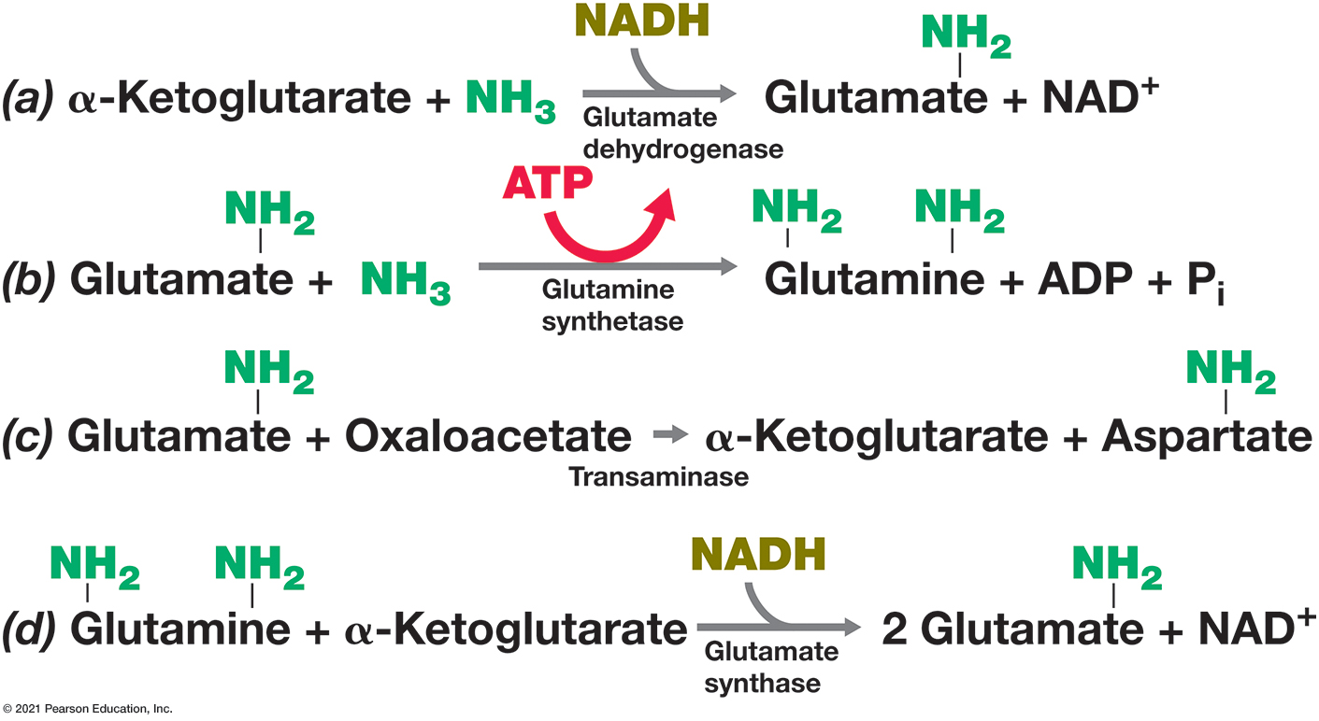
Figure 3.33 Ammonia Incorporation in Bacteria
Notes:
Ammonia (N H3) and the amino groups of all amino acids are shown in green. Two major pathways for N H3 assimilation in bacteria are those catalyzed by the enzymes (a) glutamate dehydrogenase and (b) glutamine synthetase. (c) Transaminase reactions transfer an amino group from an amino acid to an organic acid. (d) The enzyme glutamate synthase forms two glutamates from one glutamine and one α-ketoglutarate.
Alpha ketoglutarate + N H 3 are combined by Glutamate dehydrogenase with N A D H to create glutamate with N H 2 branched + N A D positive. Glutamate with N H 2 branched + N H 3 combined by glutamine synthetase with A T P to Glutamine with N H 2 and N H 2 branched + A D P + P sub i. Glutamate with N H 2 branched + Oxaloacetate combined by transaminase to make alpha ketoglutarate + Aspartate N H 2 branched. Glutamine with N H 2 and N H 2 branched + alpha ketoglutarate is combined by glutamate synthase with N A D H to make 2 Glutamate N H 2 branched + N A D positive.

Slide 122
3.14 Amino Acids and Nucleotides (3 of 3)
Monomers of Nucleic Acids: Nucleotides
Purine and pyrimidine biosynthesis is complex (Figure 3.34)
Constructed from multiple carbon and nitrogen sources
Purines: Inosinic acid skeleton is precursor to adenine and guanine
Pyrimidines: Uridylate skeleton is precursor to thymine, cytosine, and uracil

Slide 123
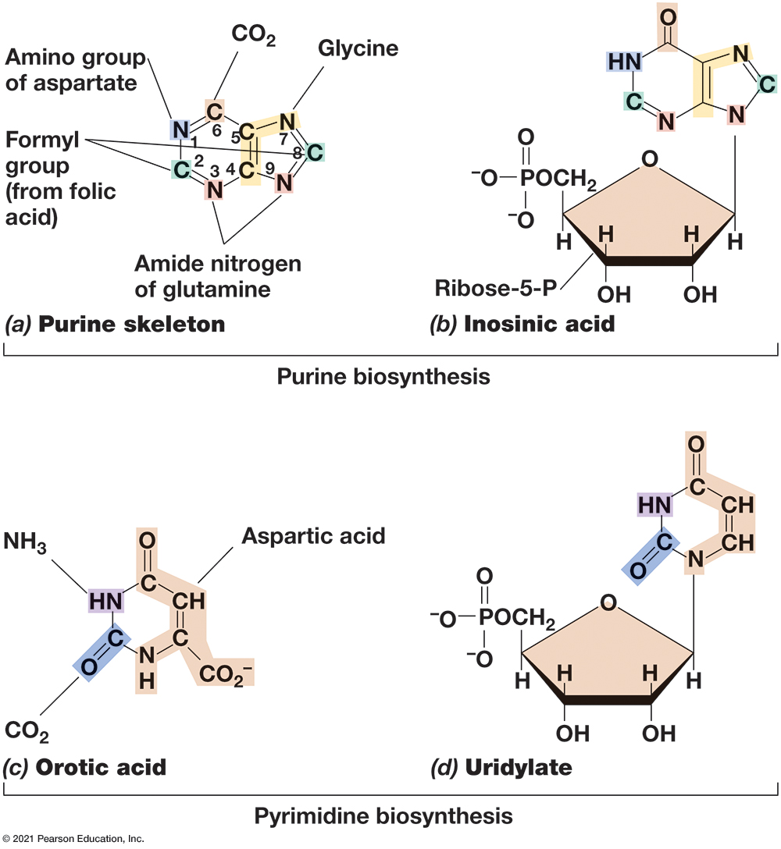
Figure 3.34 Biosynthesis of Purines and Pyrimidines
Notes:
(a) Components of the purine skeleton, labeled with their sources. (b) Inosinic acid, the precursor of all purine nucleotides. (c) Components of the pyrimidine skeleton, orotic acid, labeled with their sources. (d) Uridylate, the precursor of all pyrimidine nucleotides. Uridylate is formed from orotate following a decarboxylation and the addition of ribose 5-phosphate.
Part a. Purine skeleton. In the purine group, nitrogen 1 comes from the amino group of aspartate, carbons 2 and 6 come from a formyl group in folic acid, nitrogen 7 is from glycine, carbon 6 is from C O 2, nitrogens 3 and 9 come from an amide nitrogen of glutamine. Part b. The whole precursor is inosinic acid. Part c. Ortic acid. In the pyridimidine group the N H on the upper left is from N H 3, the C H on the upper right is from aspartic acid, the C double bond O is from C O 2. Part d. The whole precursor is uridylate.

Slide 124
3.15 Fatty Acids and Lipids (1 of 4)
Fatty Acids: Backbone of Microbial Lipids
Archaea do not contain fatty acids; have hydrophobic isoprenoids instead
Fatty Acid Biosynthesis
Biosynthesized two carbons at a time (Figure 3.35)
Acyl carrier protein (A C P) holds the growing fatty acid during synthesis and releases it after final length
each C₂ acetyl actually originates from C₃ malonate; C O₂ released

Slide 125
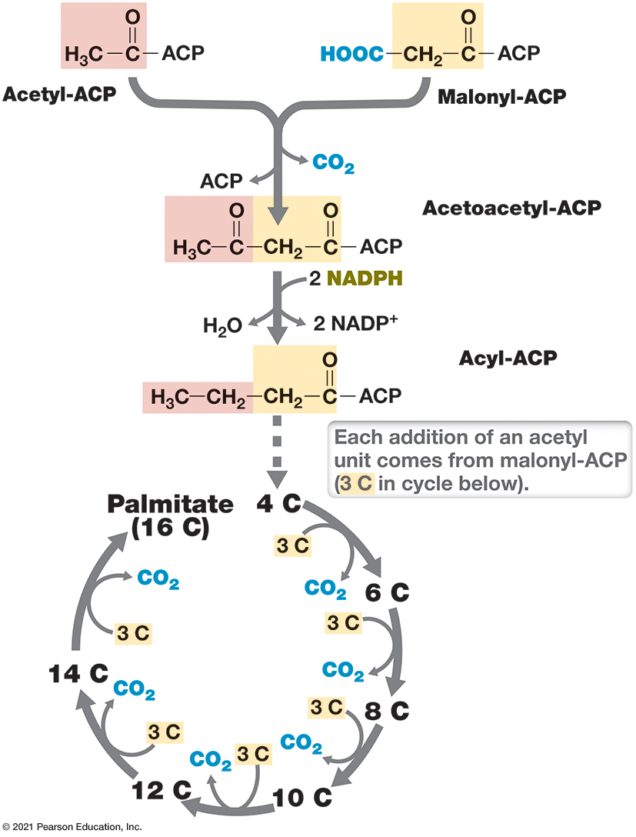
Figure 3.35 The Biosynthesis of the C₁₆ Fatty Acid Palmitate
Notes:
The condensation of acetyl-A C P (which is formed from acetyl-C o A) and malonyl-A C P forms acetoacetyl-A C P. A C P (acyl carrier protein) is a small protein used to add carbon subunits to a growing fatty acid chain. Each successive addition of an acetyl unit comes from malonyl-A C P.
Acetyl A C P and malonyl A C P combine to create acetoacetyl Co A + A C P + C O 2. Acetoacetyl combines with 2 N A D P H to create Acyl A C P and H 2 O and 2 N A D P positive. The Acyl A C P has an arrow down to a loop where every step brings in a Malonyl A C P and gives off a C O 2 while adding 2 more carbons to the chain until Palmitate with 16 carbons is created.

Slide 126
3.15 Fatty Acids and Lipids (2 of 4)
Fatty Acid Biosynthesis
Can be unsaturated, branched, or contain odd numbers of carbon atoms
Varies between species and at different temperatures
lower temps: shorter, more unsaturated
higher temps: longer, more saturated
Bacteria most commonly have C₁₂-C₂₀ lipids

Slide 127
3.15 Fatty Acids and Lipids (3 of 4)
Lipid Biosynthesis
In Bacteria and Eukarya, assembly of lipids first involves addition of fatty acids to glycerol.
Simple triglycerides have glycerol esterified to 3 fatty acids
In complex lipids, one carbon is modified with a polar group (e.g., phosphate, ethanolamine, sugar)

Slide 128
3.15 Fatty Acids and Lipids (4 of 4)
Lipid Biosynthesis
In Archaea, lipids are made from isoprene, but glycerol contains a polar group (like Bacteria and Eukarya)
Polar groups necessary for canonical membrane architecture (hydrophobic interior, hydrophilic surfaces)

