Slide 1
Brock Biology of Microorganisms
Sixteenth Edition, Global Edition
Chapter 4
Microbial Growth and Its Control
Copyright © 2022 Pearson Education Ltd. All Rights Reserved.
Notes:
If this PowerPoint presentation contains mathematical equations, you may need to check that your computer has the following installed:
1) MathType Plugin
2) Math Player (free versions available)
3) NVDA Reader (free versions available)

Slide 2
One. Culturing Microbes and Measuring Their Growth
4.1 Feeding the Microbe: Cell Nutrition
4.2 Growth Media and Laboratory Culture
4.3 Microscopic Counts of Microbial Cell Numbers
4.4 Viable Counting of Microbial Cell Numbers
4.5 Turbidimetric Measures of Microbial Cell Numbers

Slide 3
4.1 Feeding the Microbe: Cell Nutrition (1 of 8)
Nutrients
Supply of elements required by cells for growth
Macronutrients
Nutrients required in large amounts
Micronutrients
Nutrients required in minute amounts
Trace metals and growth factors

Slide 4
4.1 Feeding the Microbe: Cell Nutrition (2 of 8)
Chemical Makeup of a Cell
Handful of elements dominate living systems
C, O, N, H, P, S are ~96% of dry weight of bacterial cell (Figure 4.1) and required by all life
K, N a, C a, M g, C l, F e ~3.7% of dry weight
62 total elements can be metabolized
Macromolecules (proteins, lipids, polysaccharides, lipopolysaccharides, nucleic acids) ~96% of dry weight
Mostly proteins and R N A, not D N A

Slide 5
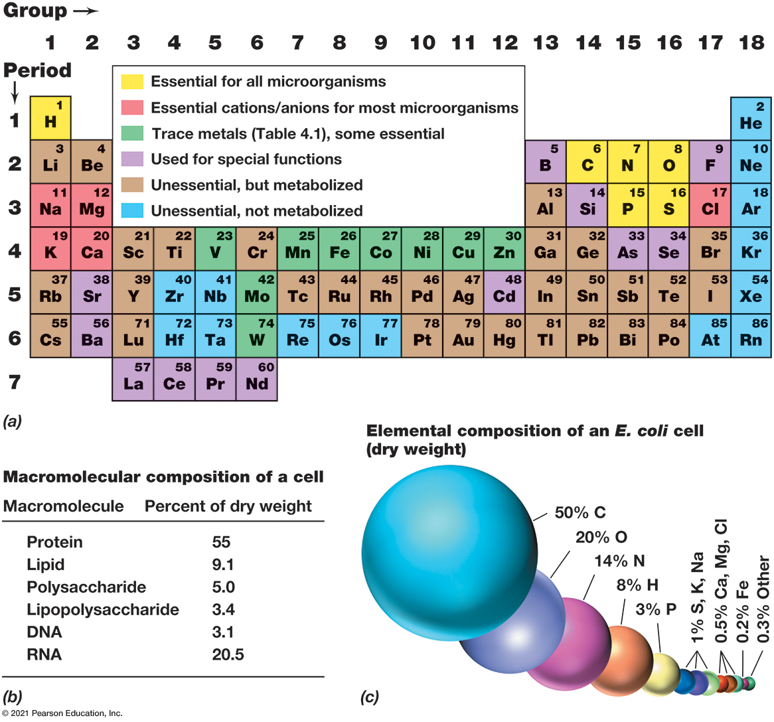
Figure 4.1 Elemental and Macromolecular Composition of a Bacterial Cell
Notes:
(a) A microbial periodic table of the elements. With the exception of those shown in row 7, other elements in row 7 and elements in rows beyond row 7 are not known to be metabolized. (b) Relative abundance of macromolecules in a bacterial cell. Data from Escherichia coli and Salmonella typhimurium: Cellular and Molecular Biology. A S M, Washington, D C (1996). (c) Distribution of the elements in an average E. coli cell (dry weight). “Other” includes in order of abundance: S e, B, C u, M n, Z n, F, S i, A s, C s, S r, B a, V, C o, W, and N i.
Part a. There is a key over a periodic table that indicates that essential for all microorganisms elements are highlighted in yellow, essential cations or anions for most microorganisms are in microorganisms elements are highlighted in pink, trace metal elements are highlighted in green, used for special functions elements are highlighted in purple, unessential but metabolized elements are highlighted in brown, and unessential not metabolized elements are highlighted in blue. Essential for all elements are mentioned in the text. Essential cations or anions include N a, M g, K, C a, and C l. Trace metals include V, M n, F e, C o, N i, C u, Z n, C u, Z n, M o, and W. Elements used for special functions include, B, F, S i, A s, C d, S r, B a, L a, C e, P r, and N d. Unessential and not metabolized elements include, H e, N e, A r, K r, X e, R n, Z r, N b, H f, T a, R e, O s, I r, and A t. All the rest are unessential but metabolized. Part b. A small table shows the macromolecular composition of the cell as follows.
A table has 6 rows and 2 columns. The columns have the following headings from left to right. Macromolecule, Percent of dry weight. The row entries are as follows. Row 1. Macromolecule, Protein. Percent of dry weight, 55. Row 2. Macromolecule, Lipid. Percent of dry weight, 9.1. Row 3. Macromolecule, Polysaccharide. Percent of dry weight, 5. Row 4. Macromolecule, Lipopolysaccharide. Percent of dry weight, 3.4. Row 5. Macromolecule, D N A. Percent of dry weight, 3.1. Row 6. Macromolecule, R N A. Percent of dry weight, 20.5.
Part c. A diagram shows the elemental composition of an E coli cell, dry weight.
50% C.
20% O.
14% N/
8% H.
3% P.
1% S, K, N a.
0.5% C a, M g, C l.
0.2% F e.
0.3% other.

Slide 6
4.1 Feeding the Microbe: Cell Nutrition (3 of 8)
Carbon, Nitrogen, and Other Macronutrients
Heterotrophs (require organic carbon (C)) obtain C from breakdown of organic polymers or uptake of monomers (amino acids, fatty acids, organic acids, sugars, nitrogen bases, other organics)
Autotrophs synthesize organics from carbon dioxide (C O₂)

Slide 7
4.1 Feeding the Microbe: Cell Nutrition (4 of 8)
Carbon, Nitrogen, and Other Macronutrients
Nitrogen (N): mostly proteins, ammonia (N H₃), nitrate (N O₃⁻), or nitrogen gas (N₂).
Nearly all microbes can use N H_{3.}
many use nitrate (N O₃⁻)
some use organics (e.g., amino acids) or N₂ (nitrogen-fixing)
Oxygen (O) and hydrogen (H): from water

Slide 8
4.1 Feeding the Microbe: Cell Nutrition (5 of 8)
Carbon, Nitrogen, and Other Macronutrients
Phosphorus (P)
nucleic acids and phospholipids
usually inorganic phosphate (P O₄³⁻)
Sulfur (S)
sulfur-containing amino acids (cysteine and methionine)
vitamins (e.g., thiamine, biotin, lipoic acid)
microbes assimilate sulfate (S O₄⁻²), sulfide (H₂S), or organics

Slide 9
4.1 Feeding the Microbe: Cell Nutrition (6 of 8)
Carbon, Nitrogen, and Other Macronutrients
Potassium (K)
required by several enzymes
Magnesium (M g)
stabilizes ribosomes, membranes, and nucleic acids
also required by many enzymes
Calcium (C a) and sodium (N a)
required by some microbes (e.g., marine microbes)

Slide 10
4.1 Feeding the Microbe: Cell Nutrition (7 of 8)
Micronutrients: Trace Metals and Growth Factors
Many enzymes require metal ion or small organic as a cofactor for catalysis
Iron (F e)
cellular respiration, related oxidation-reduction reactions
Trace metals (Table 3.1): required in small amounts

Slide 11
Table 4.1 Micronutrients Needed by Microorganisms ª (1 of 2)
Trace elements
Element | Function
Boron (B) | Autoinducer for quorum sensing in bacteria; also found in some polyketide antibiotics
Cobalt (C o) | Vitamin B₁₂; transcarboxylase (only in propionic acid bacteria)
Copper (C u) | In respiration, cytochrome c oxidase; in photosynthesis, plastocyanin, some superoxide dismutases
Iron (F e)^{b} | Cytochromes; catalases; peroxidases; iron–sulfur proteins; oxygenases; all nitrogenases
Manganese (M n) | Activator of many enzymes; component of certain superoxide dismutases and of the water-splitting enzyme in oxygenic phototrophs (photosystem two)
Molybdenum (M o) | Certain flavin-containing enzymes; some nitrogenases, nitrate reductases, sulfite oxidases, D M S O–T M A O reductases; some formate dehydrogenases
Nickel (N i) | Most hydrogenases; coenzyme F₄₃₀ of methanogens; carbon monoxide dehydrogenase; urease
Selenium (S e) | Formate dehydrogenase; some hydrogenases; the amino acid selenocysteine
Tungsten (W) | Some formate dehydrogenases; oxotransferases of hyperthermophiles
Vanadium (V) | Vanadium nitrogenase; bromoperoxidase
Zinc (Z n) | Carbonic anhydrase; nucleic acid polymerases; many D N A-binding proteins

Slide 12
Table 4.1 Micronutrients Needed by Microorganisms ª (2 of 2)
Growth factors
Growth factor | Function
P A B A (p-aminobenzoic acid) | Precursor of folic acid
Folic acid | One-carbon metabolism; methyl transfers
Biotin | Fatty acid biosynthesis; some C O₂ fixation reactions
B₁₂ (Cobalamin) | One-carbon metabolism; synthesis of deoxyribose
B₁ (Thiamine) | Decarboxylation reactions
B₆ (Pyridoxine) | Amino acid/keto acid transformations
Nicotinic acid (Niacin) | Precursor of N A D⁺
Riboflavin | Precursor of F M N, F A D
Pantothenic acid | Precursor of coenzyme A
Lipoic acid | Decarboxylation of pyruvate and α-ketoglutarate
Vitamin K | Electron transport
Coenzymes M and B | Methanogenesis ^{c}
F₄₂₀ and F₄₃₀ | Methanogenesis ^{c}
ª Not all trace elements or growth factors are needed by all organisms, and many growth factors are biosynthesized and not required from the environment.
^{b} Iron is typically needed in larger amounts than the other trace metals shown.
^{c} The production of methane (C H4) by methanogens (Archaea).

Slide 13
4.1 Feeding the Microbe: Cell Nutrition (8 of 8)
Micronutrients: Trace Metals and Growth Factors
Growth factors: organic micronutrients
vitamins (Table 4.1)
Most function as coenzymes.
Most frequently required growth factors
others: amino acids, purines, pyrimidines, other organics

Slide 14
4.2 Growth Media and Laboratory Culture (1 of 5)
Culture media (Table 4.2)
Nutrient solutions used to grow microbes in the laboratory
Typically sterilized in an autoclave

Slide 15
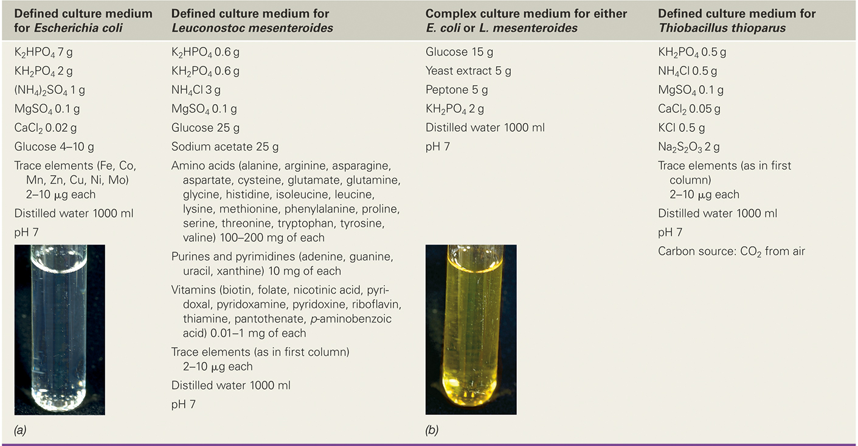
Table 4.2 Examples of Culture Media for Microorganisms with Simple and Demanding Nutritional Requirements ª
ª The photos are tubes of (a) the defined medium for Escherichia coli, and (b) the complex medium described. Note how the complex medium is colored from the various organic extracts and digests that it contains. Photo credits: Cheryl L. Broadie and John Vercillo, Southern Illinois University at Carbondale.
Notes:
The defined culture medium for Escherichia coli is as follows.
K 2 H P O 4, 7 grams
K H 2 P O 4, 2 grams
N H 4, 2 S O 4, 1 grams
M g S O 4, 0.1 grams
C a. C l 2, 0.02 grams
Glucose, 4 to10 grams
Trace elements, F e, C o, M n, Z n, C u, N i, M o, 2 to 10 micrograms each
Distilled water, 1000 milliliters, p H 7
The defined culture medium for Leuconostoc mesenteroides is as follows.
K 2 H P O 4, 0.6 grams
K H 2 P O 4, 0.6 grams
N H 4 C l, 3 grams
M g S O 4, 0.1 grams
Glucose, 25 grams
Sodium acetate, 25 grams
Amino acids, alanine, arginine, asparagine, aspartate, cysteine, glutamate, glutamine, glycine, histidine, isoleucine, leucine, lysine, methionine, phenylalanine, proline, serine, threonine, tryptophan, tyrosine, valine, 100 to 200 micrograms of each
Purines and pyrimidines, adenine, guanine, uracil, xanthine, 10 milligrams of each
Vitamins, biotin, folate, nicotinic acid, pyridoxal, pyridoxamine, pyridoxine, riboflavin, thiamine, pantothenate, p aminobenzoic acid, 0.01 to 1 milligrams of each
Trace elements, as in first column, 2 to 10 micrograms each
Distilled water, 1000 milliliters, p H 7
The Complex culture medium for either E. coli or L. mesenteroides is as follows.
Glucose, 15 grams
Yeast extract, 5 grams
Peptone, 5 grams
K H 2 P O 4, 2 grams
Distilled water, 1000 milliliters, p H 7
The Defined culture medium for Thiobacillus thioparus is as follows.
K H 2 P O 4, 0.5 grams
N H 4 C l, 0.5 grams
M g S O 4, 0.1 grams
C a. C l 2, 0.05 grams
K C l, 0.5 grams
N a. 2 S 2 O 3, 2 grams
Trace elements, as in first column, 2 to 10 micrograms each
Distilled water, 1000 milliliters, p H 7
Carbon source, C O 2 from air

Slide 16
4.2 Growth Media and Laboratory Culture (2 of 5)
Classes of Culture Media
Defined media: exact chemical composition known
Complex media: composed of digests of microbial, animal, or plant products (e.g., yeast and meat extracts)
Selective medium
contains compounds that selectively inhibit growth of some microbes but not others
Differential medium
contains an indicator, usually a dye, that detects particular metabolic reactions during growth

Slide 17
4.2 Growth Media and Laboratory Culture (3 of 5)
Nutritional Requirements and Biosynthetic Capacity
Different microorganisms may have vastly different nutritional requirements
Necessary to understand physiology & nutritional requirements and supply with nutrients in proper form and amount

Slide 18
4.2 Growth Media and Laboratory Culture (4 of 5)
Laboratory Culture
Either liquid or solid (Figure 4.2)
Solid media are prepared by addition of the gelling agent agar to liquid media.
When grown on solid media, cells form isolated masses (colonies).
Colony morphology (visible characteristics)
Sometimes used to identify microorganisms
Routinely used to determine if a culture is pure (one microbe), contaminated, or mixed

Slide 19
4.2 Growth Media and Laboratory Culture (5 of 5)
Laboratory Culture
Aseptic technique (transfer without contamination) (Figure 4.3)
Airborne contaminants everywhere
Pure cultures containing a single microbe usually require streak plate technique with inoculating loop

Slide 20
4.3 Microscopic Counts of Microbial Cell Numbers (1 of 2)
Total Cell Count
Microscopic cell count: observing and enumerating cells present
Dried on slides or on liquid samples
Counting chambers with squares etched on a slide used for liquid samples (Figure 4.4)
Several limitations

Slide 21
Figure 4.4 Direct Microscopic Counting Procedure Using the Petroff–Hausser Counting Chamber
Notes:
A phase-contrast microscope is typically used to count the cells to avoid the necessity for staining.
The sample is added to a coverslip that rests on a series of ridges that support it. Care must be taken not to allow overflow. Space between coverslip and slide is 0.02 millimeters. the whole grid has 25 large squares, a total area of 1 square millimeter and a total volume of 0.02 cubic millimeters. Microscopic observation, all cells are counted in a large square, made of 16 small squares, there are 12 cells in the example. In practice, several large squares are counted and the numbers are averaged. To calculate the number per milliliter of sample, the equation is 12 cells times 25 large squares, times 50, times 10 cubed.

Slide 22
4.3 Microscopic Counts of Microbial Cell Numbers (2 of 2)
Microscopic cell counts in microbial ecology
Often used on natural samples
Use stains to visualize and provide phylogenetic or metabolic properties
e.g., D A P I binds D N A.
Other fluorescent stains differentiate live and dead cells.
Phylogenetic stains can determine proportions of Bacteria and Archaea in a sample.

Slide 23
4.4 Viable Counting of Microbial Cell Numbers (1 of 4)
Viable (alive/living) counts: measurement of living, reproducing population
Two main ways to perform viable (plate) counts (Figure 4.5):
spread-plate method
pour-plate method
Count colonies on plates with 30–300 colonies
Reporting in colony-forming units instead of number of viable cells accounts for clumps.

Slide 24
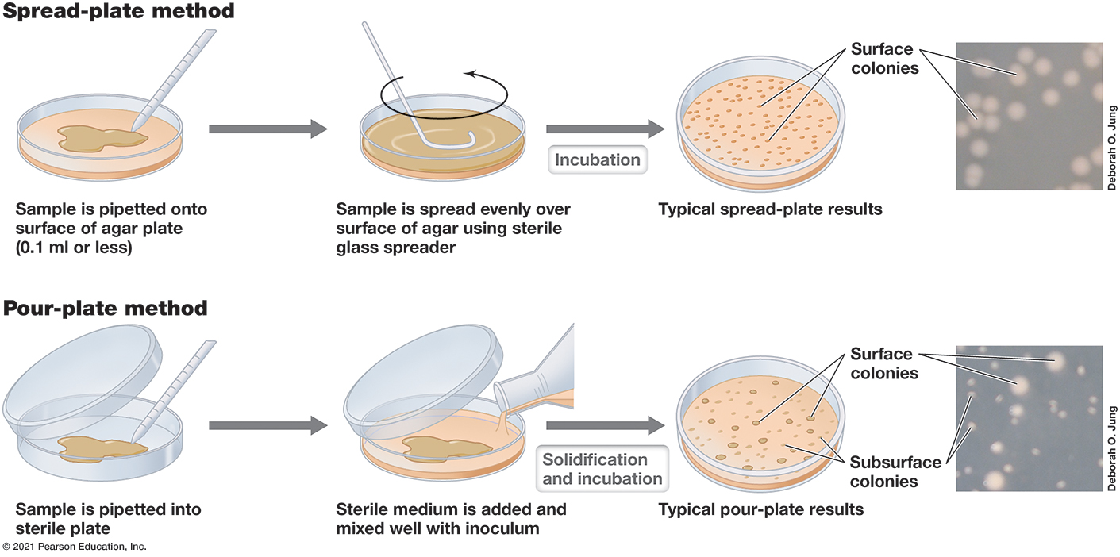
Figure 4.5 Two Methods for the Viable Count
Notes:
Only surface colonies form in the spread plate technique. By contrast, in the pour-plate method, colonies form within the agar as well as on the agar surface. On the far right are photos of colonies of Escherichia coli formed from cells plated by the spread-plate method (top) or the pour-plate method (bottom).
In the spread plate method, the sample is pipetted onto the surface of an agar plate, the sample is spread evenly over the surface with a sterile glass spreader, and the plate is incubated to get an even distribution of small colonies. In the pour plate method, the sample is pipetted onto a sterile plate, a sterile medium is added mixed well with the inoculum, and solidification and incubation produce a plate with a distribution of colonies with varying size.

Slide 25
4.4 Viable Counting of Microbial Cell Numbers (2 of 4)
Diluting a Sample
Samples often contain thousands, millions, billions of viable cells
Ten-fold dilutions commonly used (Figure 4.6)
Serial (successive) dilutions needed for dense cultures

Slide 26
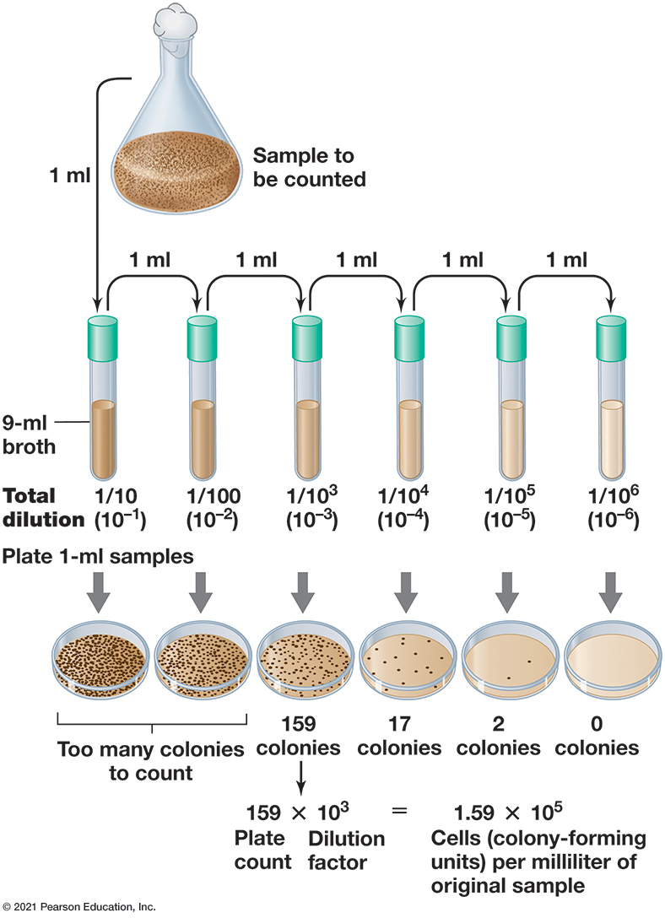
Figure 4.6 Procedure for Viable Counting Using Serial Dilutions of the Sample and the Pour-Plate Method
Notes:
The sterile liquid used for making dilutions can simply be water, but a solution of mineral salts or actual growth medium may yield a higher recovery. The dilution factor is the reciprocal of the dilution.
1 milliliter of a sample is added to a tube with 9 milliliters of broth to get a dilution of 10 to the negative first power. 1 milliliter of that is added to another tube with 9 milliliters of broth to get a dilution of 10 to the negative second power. This is repeated 4 more times to get samples with dilutions of 10 to the negative third power, 10 to the negative fourth power, 10 to the negative fifth power, and 10 to the negative sixth power. 1 milliliter of each is incubated on an agar plate, the results are as follows.
Dilution 10 to the negative 1, too many colonies to count.
Dilution 10 to the negative 2, too many colonies to count.
Dilution 10 to the negative 3, 159 colonies.
Dilution 10 to the negative 4, 17 colonies.
Dilution 10 to the negative 5, 2 colonies.
Dilution 10 to the negative 6, 0 colonies.
Dilution 10 to the negative 3 is used to calculate the number of cells per milliliter of the original sample. the plate count of 159 is multiplied by the dilution factor, 10 to the third, to get a result of 1.59 times 10 to the fifth cells per milliliter.

Slide 27
4.4 Viable Counting of Microbial Cell Numbers (3 of 4)
Applications of the Plate Count
quick and easy
used in food, dairy, medical, and aquatic microbiology
high sensitivity
can target particular species in mixed samples (e.g., Staphylococcus)
common in wastewater and other water analyses

Slide 28
4.4 Viable Counting of Microbial Cell Numbers (4 of 4)
“The great plate count anomaly”: Direct microscopic counts of natural samples reveal far more organisms than those recoverable on plates.
Why is this?
Different organisms may have vastly different requirements for growth.
May underestimate actual by one to several orders of magnitude

Slide 29
4.5 Turbidimetric Measures of Microbial Cell Numbers (1 of 3)
Cell suspensions are turbid (cloudy) because cells scatter light.
More cells, more light scattered, more turbid suspension
Turbidity measurements are rapid, widely used for estimates

Slide 30
4.5 Turbidimetric Measures of Microbial Cell Numbers (2 of 3)
Optical Density and Its Relationship to Cell Numbers
Measured with a spectrophotometer (Figure 4.7)
Unit is optical density (O D) at specified wavelength (e.g., O D₅₄₀ for measurements at 540 n m [green light]).
For unicellular organisms, O D is proportional to cell number within limits.
To relate a direct cell count to a turbidity value, a standard curve must first be established.

Slide 31
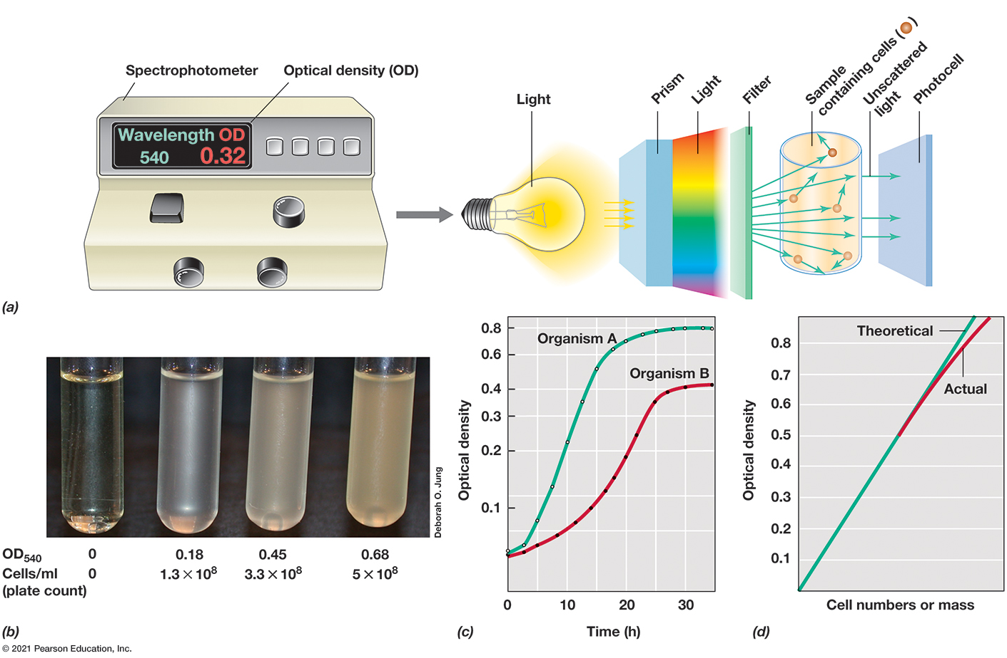
Figure 4.7 Turbidity Measurements of Microbial Growth
Notes:
(a) Measurements of turbidity are made in a spectrophotometer. The photocell measures incident light unscattered by cells in suspension and gives readings in optical density units. (b) Liquid cultures of Escherichia coli; the tube on the far left is sterile medium. The increasing (left to right) optical density (O D 540) of each culture is shown below the tube, as is the actual cell number measured in a viable count. (c) Typical growth curve data for two organisms growing at different growth rates. For practice, calculate the generation time of the two cultures using the formula n = 3.3 (log N t - log N 0) where N t and N 0 are two different O D readings with a time interval t between the two (see Section 4.7). Which organism is growing faster, A or B? (d) Relationship between cell number or dry weight and turbidity readings. Note that the direct relationship between these values breaks down at high turbidities.
Part A. Light is shined into a prism to create incident light, which is passed through a filter before is shines on a sample containing cells. A photocell measures the unscattered light and a spectrophotometer records optical density. Part B. The optical density of 2 organisms, A and B, is recorded over time. Both organisms’ optical density rises quickly then plateaus, with organism A maintaining a higher optical density overall. Organism A plateaus at a density of about 0.8 after 25 hours, and organism B plateaus at a density of about 0.4 after 27 hours. Part C. Optical density is plotted against cell numbers or dry weight mass. The theoretical value increases at a constant rate, but the actual curve starts to fall off slightly after 0.7 optical density. Part D. 4 samples of Escherichia coli with increasing optical density from left to right. The optical density is 0, 0.18, 0.45, and 0.68. The cells per milliliter are 0, 1.3 times 10 to the eighth power, 3.3 times 10 to the eighth power, and 5 times 10 to the eighth power. Higher optical density results in a more cloudy appearance in the test tube.

Slide 32
4.5 Turbidimetric Measures of Microbial Cell Numbers (3 of 3)
Other Issues with Turbidimetric Growth Estimates
quick and easy to perform
typically do not require destruction or significant disturbance of sample
Same sample can be checked repeatedly.
sometimes problematic (e.g., microbes that form clumps or biofilms in liquid medium)

Slide 33
Two Dynamics of Microbial Growth
4.6 Binary Fission and the Microbial Growth Cycle
4.7 Quantitative Aspects of Microbial Growth
4.8 Continuous Culture
4.9 Biofilm Growth
4.10 Alternatives to Binary Fission

Slide 34
4.6 Binary Fission and the Microbial Growth Cycle (1 of 4)
Growth: increase in the number of cells
Binary fission: cell division following enlargement of a cell to twice original size (Figure 4.8)
Septum: partition between dividing cells, pinches off between two daughter cells (Figure 4.9)
Generation (doubling) time: time required for microbial cells to double in number
Differs for microbes and varies depending on conditions
example: Escherichia coli = 20 minutes
During cell division, each daughter cell receives a chromosome and sufficient copies of all other cell constituents to exist as an independent cell.

Slide 35
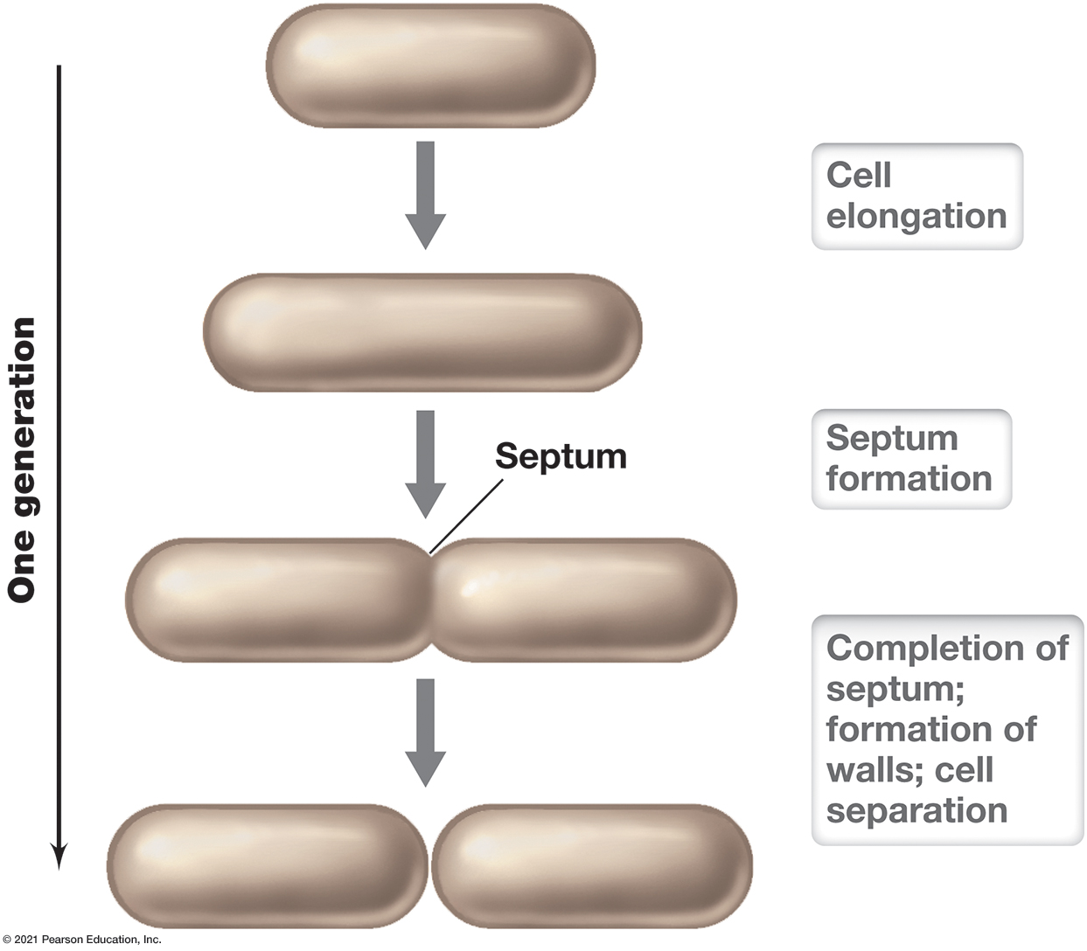
Figure 4.8 Binary Fission in a Rod-Shaped Bacterium
Notes:
Cell numbers (and all components of the cells) double every generation.

Slide 36
Binary Fission

Slide 37
4.6 Binary Fission and the Microbial Growth Cycle (2 of 4)
The Microbial Growth Cycle
Batch culture: a closed-system microbial culture of fixed volume
Typical growth curve for population of cells grown in a closed system is characterized by four phases. (Figure 4.10)
lag phase
exponential phase
stationary phase
death phase

Slide 38
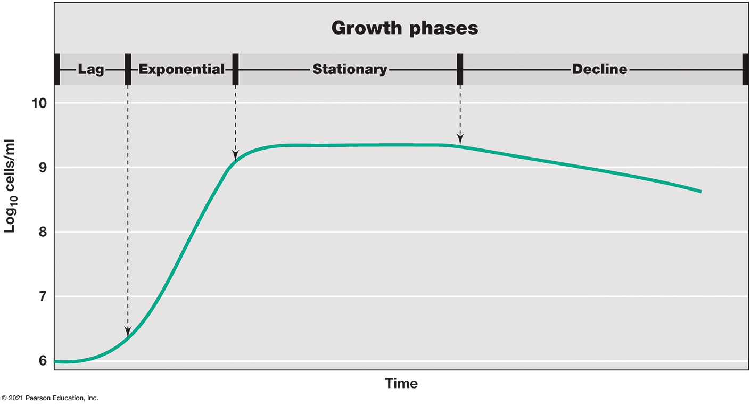
Figure 4.10 Typical Growth Curve for a Bacterial Population
Notes:
A viable count measures the cells in the culture that are capable of reproducing. Optical density (turbidity), a quantitative measure of light scattering by a liquid culture (see Figure 4.7), increases with the increase in cell number.

Slide 39
Bacterial Growth Curve

Slide 40
4.6 Binary Fission and the Microbial Growth Cycle (3 of 4)
Lag and Exponential Phases
Lag phase: interval between inoculation of a culture and beginning of growth
new conditions require altering metabolic state
time needed for biosynthesis of new enzymes and to produce required metabolites before growth can begin
Exponential phase (balanced growth): doubling at regular intervals
close to metabolically identical
rates vary greatly, influenced by media, conditions, organism itself
continues until conditions can no longer sustain growth

Slide 41
4.6 Binary Fission and the Microbial Growth Cycle (4 of 4)
Stationary and Death Phases
Growth limited by nutrient depletion or waste accumulation
Stationary phase: growth rate of population is zero
Metabolism continues at greatly reduced rate
Decline phase: total number decreases due to cell death
Cryptic growth: subpopulations adapt

Slide 42
4.7 Quantitative Aspects of Microbial Growth (1 of 3)
Plotting Growth Data
Exponential growth: cell numbers double at regular intervals (Figure 4.11)
Semilogarithmic relationship
Generation time (g) (Figure 4.12) of the exponentially growing population is:
t is the duration of exponential growth (days/hours/minutes)
n is the number of generations during the period of exponential growth

Slide 43
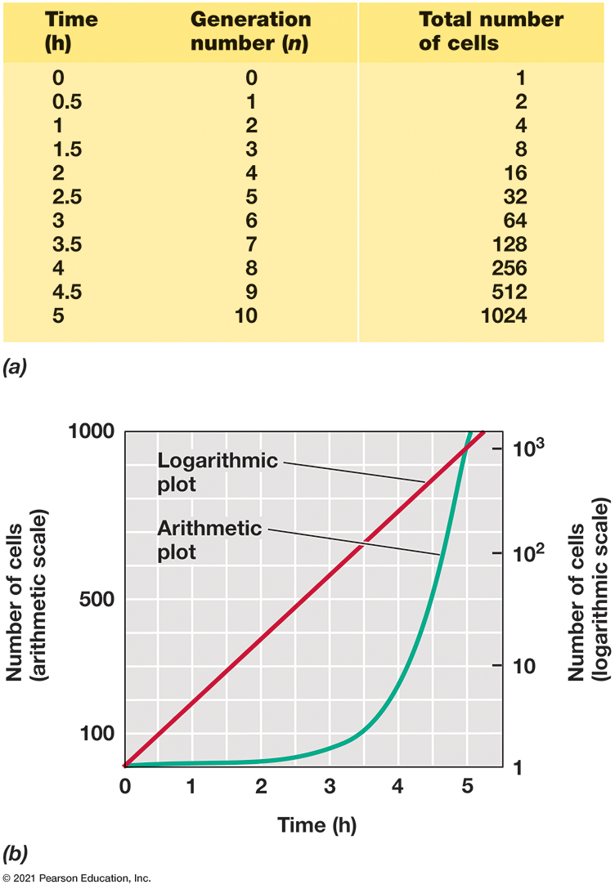
Figure 4.11 The Rate of Growth of a Microbial Culture
Notes:
(a) Data for a cell population that doubles every 30 min. (b) Data plotted on arithmetic (left ordinate) and logarithmic (right ordinate) scales.
The data for a cell population that doubles every 30 minutes is described as follows.
A table has 15 rows and 2 columns. The columns have the following headings from left to right. Time in hours, Total number of cells. The row entries are as follows. Row 1. Time in hours, 0. Total number of cells, 1. Row 2. Time in hours, 0.5. Total number of cells, 2. Row 3. Time in hours, 1. Total number of cells, 4. Row 4. Time in hours, 1.5. Total number of cells, 8. Row 5. Time in hours, 2. Total number of cells, 16. Row 6. Time in hours, 2.5. Total number of cells, 32. Row 7. Time in hours, 3. Total number of cells, 64. Row 8. Time in hours, 3.5. Total number of cells, 128. Row 9. Time in hours, 4. Total number of cells, 256, 2 to the 8. Row 10. Time in hours, 4.5. Total number of cells, 512, 2 to the 9. Row 11. Time in hours, 5. Total number of cells, 1,024, 2 to the 10. Row 12. Time in hours, 5.5. Total number of cells, 2,048, 2 to the 11. Row 13. Time in hours, 6. Total number of cells, 4,096, 2 to the 12. Row 14. Time in hours, incomplete row. Total number of cells, incomplete row. Row 15. Time in hours, 10. Total number of cells, 1,048,576, 2 to the 20.
Part B. A graph plots number of cells on an arithmetic scale versus time in hours. A logarithmic plot increases by a factor of 10 every hour and a half, A arithmetic plot starts out slowly but rises with increasing steepness, surpassing the logarithmic scale at about 5 hours.

Slide 44
4.7 Quantitative Aspects of Microbial Growth (2 of 3)
The Mathematics of Bacterial Growth
A relationship exists between the initial number of cells present in a culture and the number present after a period of exponential growth:
N_{t} is cell number at time t
N₀ is the initial cell number (time 0)
n is the number of generations during the period of exponential growth.

Slide 45
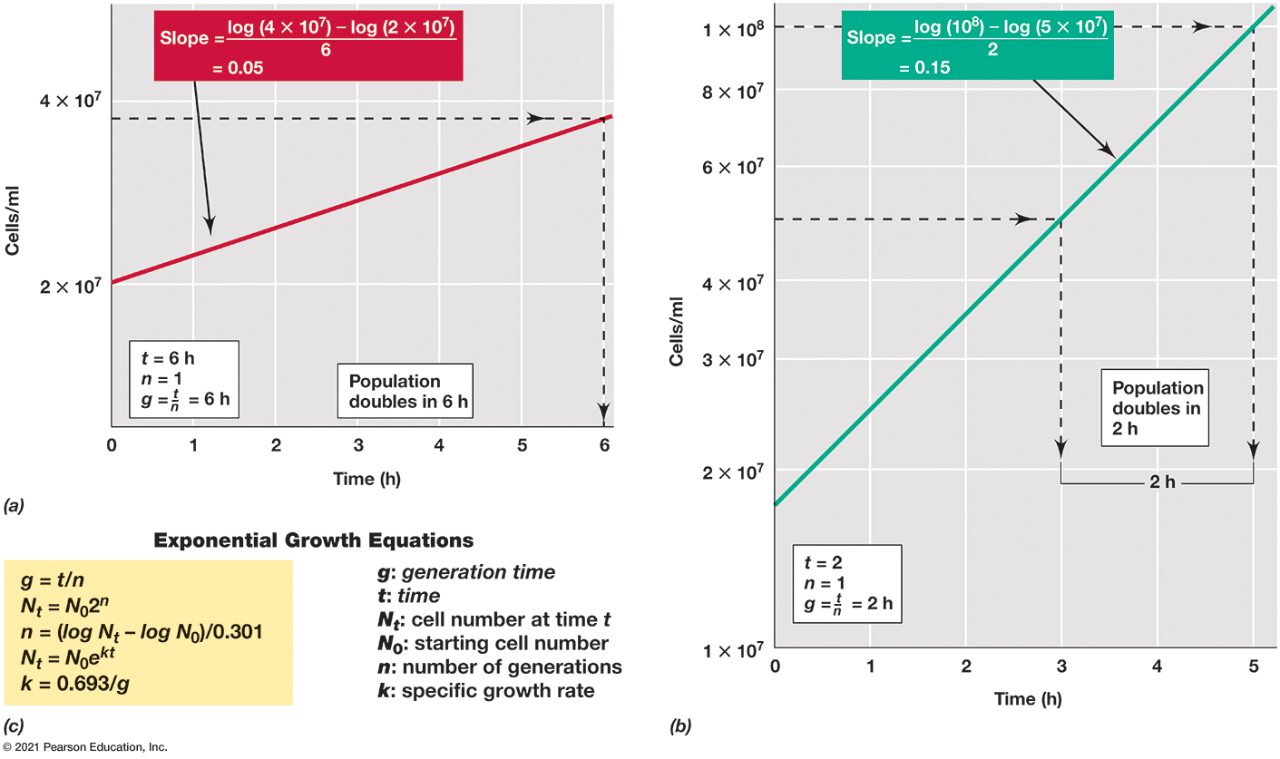
Figure 4.12 Calculating Microbial Growth Parameters
Notes:
Method of estimating the generation times (g) of exponentially growing populations with g of (a) 6 h and (b) 2 h from data plotted on semilogarithmic graphs. The slope of each line is equal to 0.301/g, and n is the number of generations in the time t. All numbers are expressed in scientific notation; that is, 10,000,000 is 1 × 10 to the 7 power, 60,000,000 is 6 × 10 to the 7 power, and so on. (c) Useful expressions for analyzing microbial growth.
Part A of two graphs calculating microbial growth parameters. A cell population that doubles every 6 hours is represented by a line with a slope equal to, log of, 4 times 10 to the seventh power, minus log of, 2 times 10 to the seventh power, all over 6. The resulting slope is 0.05. t = 6 h, n = 1, g = t over n. Part B of two graphs calculating microbial growth parameters. A cell population that doubles every 6 hours is represented by a line with a slope equal to, log of, 10 to the eighth power, minus log of, 5 times 10 to the seventh power, all over 2. The resulting slope is 0.15. t = 2, n = 1, g = t over n. Part c. A list of exponential growth equations is as follows. Note. g = generation time, t = time, N sub t = cell number at time t, N 0 = starting cell number, n = number of generations, k = specific growth rate.
g = t over n.
N sub t = N 0 2 to the n power.
n = start fraction log N t minus log N 0 over 0.301 end fraction.
N sub t = N 0 e to the k t power.
k = 0.693 over g

Slide 46
4.7 Quantitative Aspects of Microbial Growth (3 of 3)
Specific Growth Rate
Specific growth rate (k) expresses rate of growth at any instant.
Specific growth rate (k) is calculated as
Consequences of Exponential Growth
Initial increase is slow but increases, resulting in huge increase in cell numbers (e.g., lactic acid bacteria spoiling milk).

Slide 47
4.8 Continuous Culture (1 of 3)
Continuous culture: an open system
Chemostat: most common type of continuous culture device (Figure 4.13); known volume added while spent medium is removed at same rate
Steady state: cell density and substrate concentration do not change over time

Slide 48
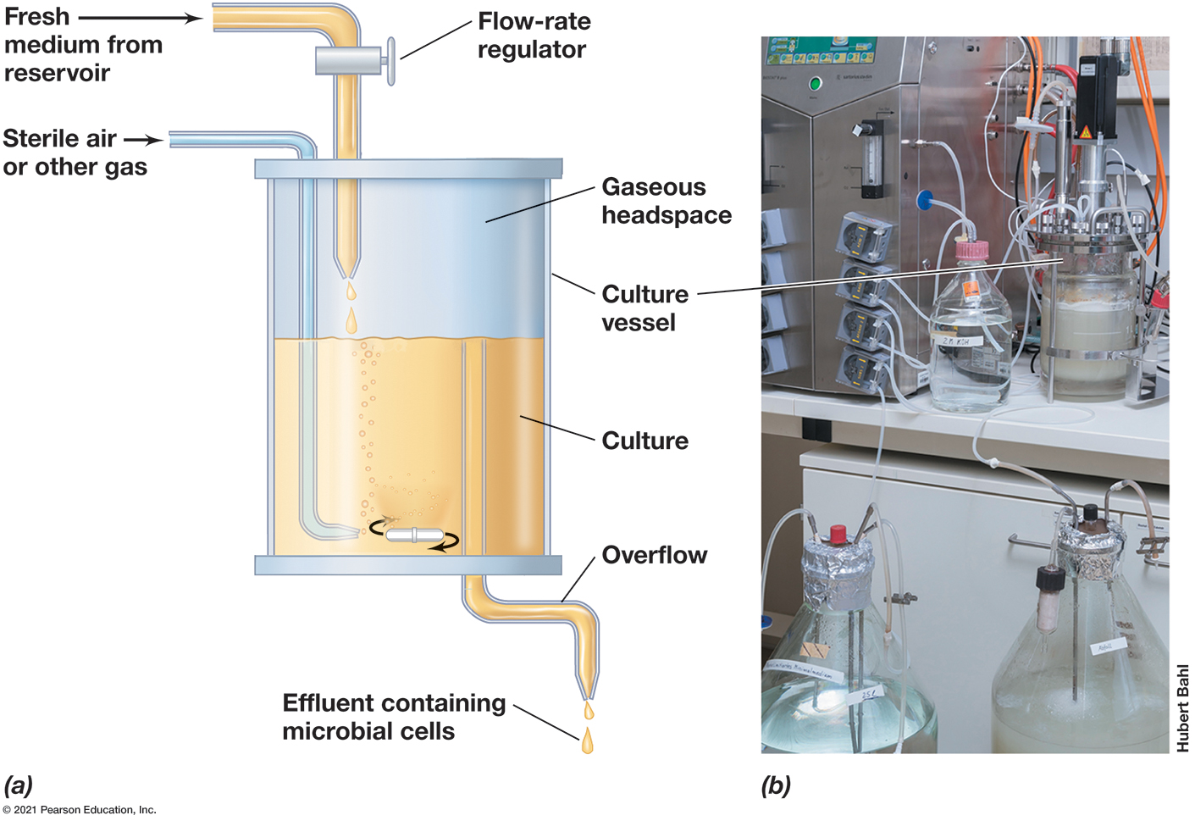
Figure 4.13 Continuous Culture Device (Chemostat)
Notes:
The population density is controlled by the concentration of a limiting nutrient in the reservoir, and the growth rate is controlled by the dilution rate; both parameters are set by the experimenter. (a) Chemostat components. (b) Photo of a chemostat setup.
Part A is an illustration of a chemostat. Fresh medium is supplied from a reservoir and must pass through a flow rate regulator before it enters the culture vessel above the culture, another tube provides sterile air or other gas to the bottom of the culture. The culture vessel contains a culture in liquid and a gaseous headspace in the culture vessel. Overflow from the culture is pushed through a channel that is aligned with the top of the culture and effluent containing microbial cells is released. Part B. A chemostat setup in a lab next to several other set ups surrounded by tubes.

Slide 49
4.8 Continuous Culture (2 of 3)
The Chemostat and the Concept of Steady State
Controls both specific growth rate (k) and yield (biomass/m l) (Figures 4.14 and 4.15)
Both growth rate and population density of culture can be controlled independently and simultaneously, depending on:
Dilution rate (D):
(F is flow rate of adding fresh
medium and removing spent medium, V is culture volume.)
Growth yield controlled by concentration of a limiting nutrient.

Slide 50
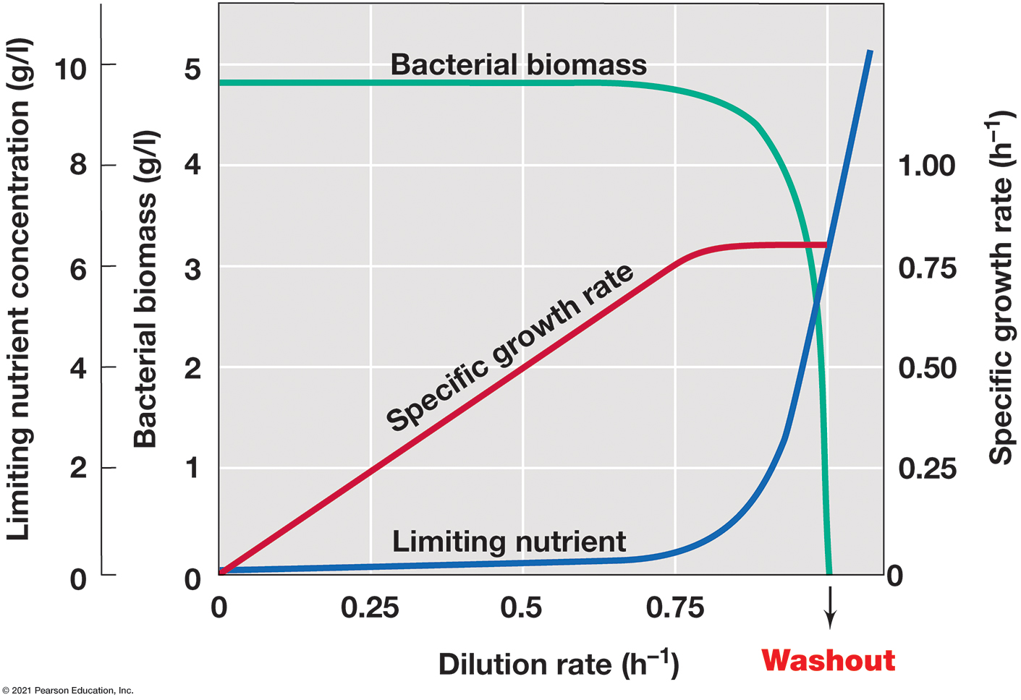
Figure 4.14 Steady-State Relationships in the Chemostat
Notes:
The dilution rate is determined from the flow rate and the volume of the culture vessel. Note that at a high dilution rate, growth cannot balance dilution, and the population washes out. Note also that although the population density (bacterial biomass) remains constant and the concentration of the growth-limiting nutrient remains near zero during steady state, the specific growth rate can vary over a wide range.
Limiting nutrient concentration, bacterial concentration, and doubling time are measured against dilution rate in the chemostat. As dilution rate increases, doubling time falls with decreasing steepness and limiting nutrient concentration rises with increasing steepness. Bacterial concentration rises with decreasing steepness from 0 to 0.25, plateaus from 0.25 to 0.75, and falls with increasing steepness back to zero from 0.75 to 1.

Slide 51
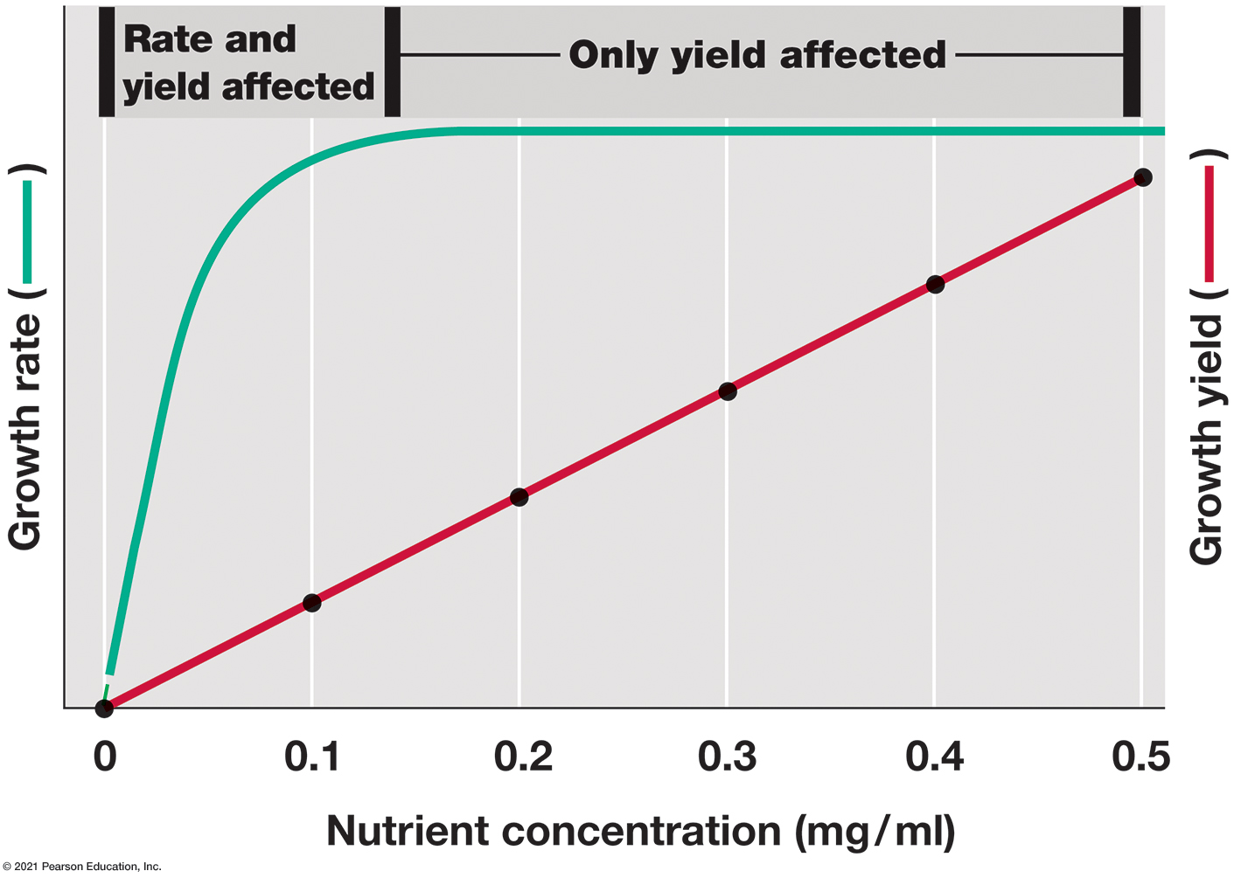
Figure 4.15 The Effect of Nutrients on Growth in a Chemostat
Notes:
Relationship between nutrient concentration, growth rate, and growth yield (bacterial biomass) in a chemostat culture. Only at low nutrient concentrations are both growth rate and growth yield affected.

Slide 52
4.8 Continuous Culture (3 of 3)
Experimental Uses of the Chemostat
can maintain exponential growth phase for weeks/months
used to study physiology, microbial ecology and evolution, enrichment and isolation of bacteria from nature

Slide 53
4.9 Biofilm Growth (1 of 3)
Planktonic growth: growth in suspension of free-floating/free-swimming cells
Sessile growth: attached to surface
can develop into biofilms
Important in medical and industrial applications
Different properties than planktonic cells

Slide 54
4.9 Biofilm Growth (2 of 3)
Biofilm: cells enmeshed polysaccharide matrix attached to surface (Figure 4.16)
Form in stages:
Planktonic cells attach (flagella, fimbriae, pili)
Colonization: growth and extracellular polysaccharide (E P S) production
Development: metabolic changes
Dispersal: colonize new sites
Can study in flow chamber

Slide 55
4.9 Biofilm Growth (3 of 3)
Biofilms and Humans
Microbial mats: multilayered sheets with different organisms in each layer (e.g., hot springs, intertidal regions) (Figure 4.17a)
Implicated in joint infections, implanted medical devices
Responsible for cavities and cause gum disease
Foul, plug, and corrode pipes
Form in fuel tanks and on ship hulls

Slide 56
4.10 Alternatives to Binary Fission (1 of 2)
Balanced growth: result of binary fission, producing nearly identical cells
Budding cell division (Figure 4.18)
Unequal cell growth forming different daughter cells.
Some budding bacteria form cytoplasmic extensions such as stalks (Caulobacter and Hyphomicrobium) and appendages (Ancalomicrobium).

Slide 57
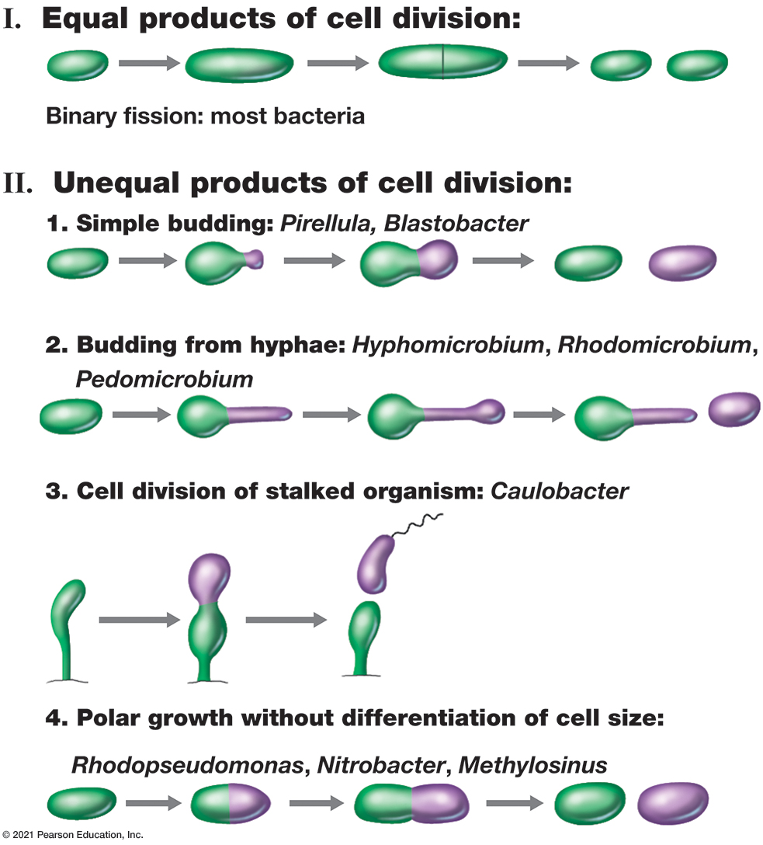
Figure 4.18 Cell Division in Different Morphological Forms of Bacteria
Notes:
The contrast is shown between cell division in conventional bacteria (cells that divide by binary fission) and in various budding and stalked bacteria.
Types of cell division in bacteria are categorized as follows. Equal products of cell division.
Binary fission, where one cell splits into two equal parts, most bacteria.
Unequal products of cell division.
Simple budding where a cell makes a smaller version of itself, Pirellula, blastobacter.
Budding from hyphae where a bud is created off a stalk, Hyphomicrobium, Rhodomicrobium, Pedomicrobium.
Cell division of stalked organism where a cell daughter that has a flagellum is made from a stalked cell, Caulobacter.
Polar growth without differentiation of cell size, Rhodopseudomonas, Nitrobacter, Methylosinus.

Slide 58
4.10 Alternatives to Binary Fission (2 of 2)
Hyphal Growth and Multiple Fission
Hyphae: long, thin filaments of actinomycetes (gram-positive filamentous bacteria, e.g., Streptomyces) (Figure 4.19)
Hyphal growth occurs only at filament tip
Cell growth is not linked directly to division (no septa)
Mycelia: weaved hyphae
Arthrospores: survival structures formed from mycelia
Multiple fission: hyphal filament forms many septa simultaneously

Slide 59
Three Environmental Effects on Growth: Temperature
4.11 Temperature Classes of Microorganisms
4.12 Microbial Life in the Cold
4.13 Microbial Life at High Temperatures

Slide 60
4.11 Temperature Classes of Microorganisms (1 of 2)
Cardinal Temperatures
Minimum, optimum, and maximum temperatures at which an organism grows (Figure 4.20)
Characteristic of any given microorganism
Differ dramatically between species
Range is typically < 40°C
At optimum, all/most cellular components are functioning at maximum rate

Slide 61
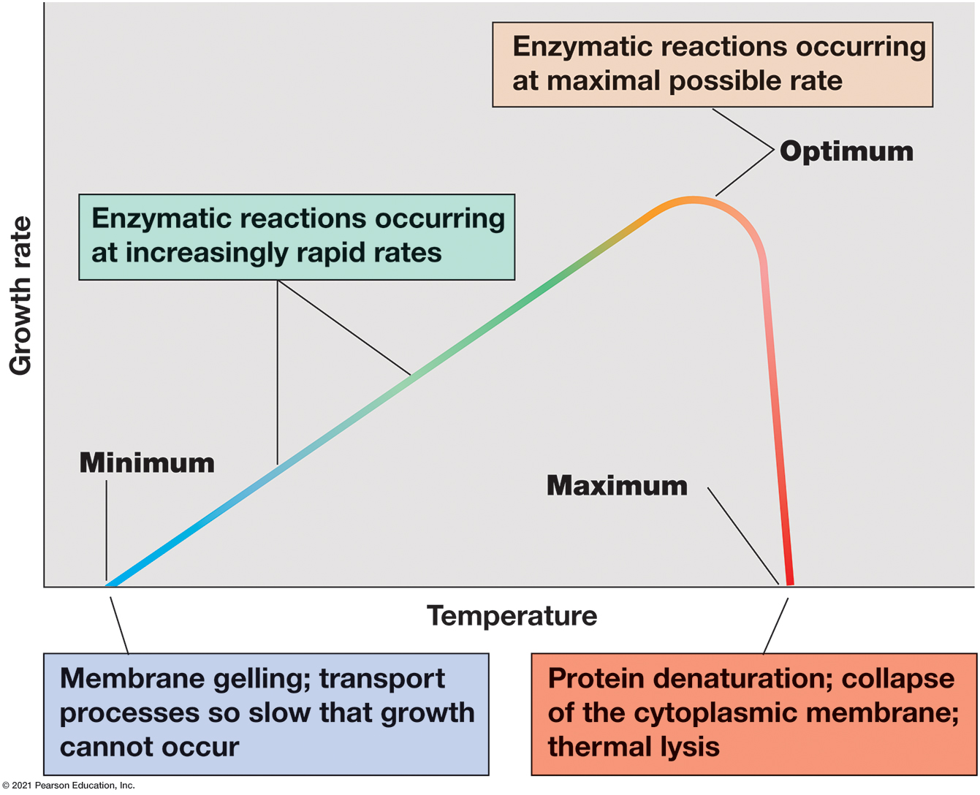
Figure 4.20 The Cardinal Temperatures: Minimum, Optimum, and Maximum
Notes:
The actual values may vary greatly for different organisms (see Figure 4.21).
A graph plots growth rate versus temperature. The lowest temperature where growth occurs is labeled minimum. At this point, membrane gelling occurs and transport processes are so slow that growth cannot occur. As temperature rises, so does the growth rate, Enzymatic reactions occur as increasingly rapid rates. Growth rate hits a peak, labeled optimum, before it starts to fall again. Enzymatic reactions occur as the maximal possible rate. Continued heating results in a rapid decline in growth rate until it once again reaches 0 at a point labeled maximum. Protein denaturation occurs, the cytoplasmic membrane collapses and causes thermal lysis.

Slide 62
4.11 Temperature Classes of Microorganisms (2 of 2)
Temperature Classes of Organisms
Four broad classes related to growth temperature optima (Figure 4.21)
psychrophile: low, found in cold environments
mesophile: midrange, most commonly studied
thermophile: high, found in hot environments
hyperthermophile: very high, found in extremely hot habitats such as hot springs and deep-sea hydrothermal vents

Slide 63
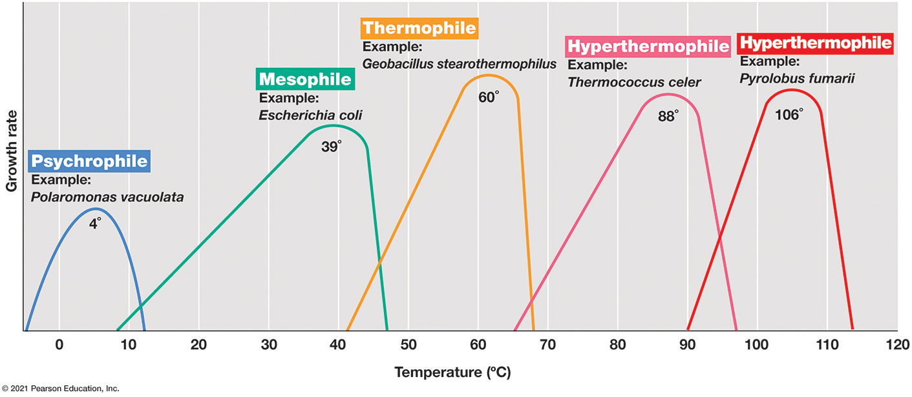
Figure 4.21 Temperature and Growth Response in Different Temperature Classes of Microorganisms
Notes:
The temperature optimum of each example organism is shown on the graph.
A graph plots growth rate versus temperature in degrees Celsius for various types of organisms. The minimum, optimum, and maximum for each is as follows.
A table has 5 rows and 5 columns. The columns have the following headings from left to right. Temperature class, Example, Minimum, Optimum, Maximum, . The row entries are as follows. Row 1. Temperature class, Psychrophile. Example, Polaromonas vacuolata. Minimum, negative 5. Optimum, 4. Maximum, 13. Row 2. Temperature class, Mesophile. Example, Escherichia coli. Minimum, 9. Optimum, 39. Maximum, 47. Row 3. Temperature class, Thermophile. Example, Geobacillus stearothermophilus. Minimum, 41. Optimum, 60. Maximum, 68. Row 4. Temperature class, Hyperthermophile. Example, Thermococcus celer. Minimum, 65. Optimum, 88. Maximum, 96. Row 5. Temperature class, Hyperthermophile. Example, Pyrolobus fumarii. Minimum, 90. Optimum, 106. Maximum, 114.

Slide 64
4.12 Microbial Life in the Cold (1 of 4)
Extremophiles
Organisms that grow under very hot or very cold conditions
Cold Environments
Much of Earth’s surface is cold
Oceans 5°Celsius
Arctic and Antarctic are permanently frozen or rarely unfrozen (Figure 4.22)
Constantly versus seasonally cold

Slide 65
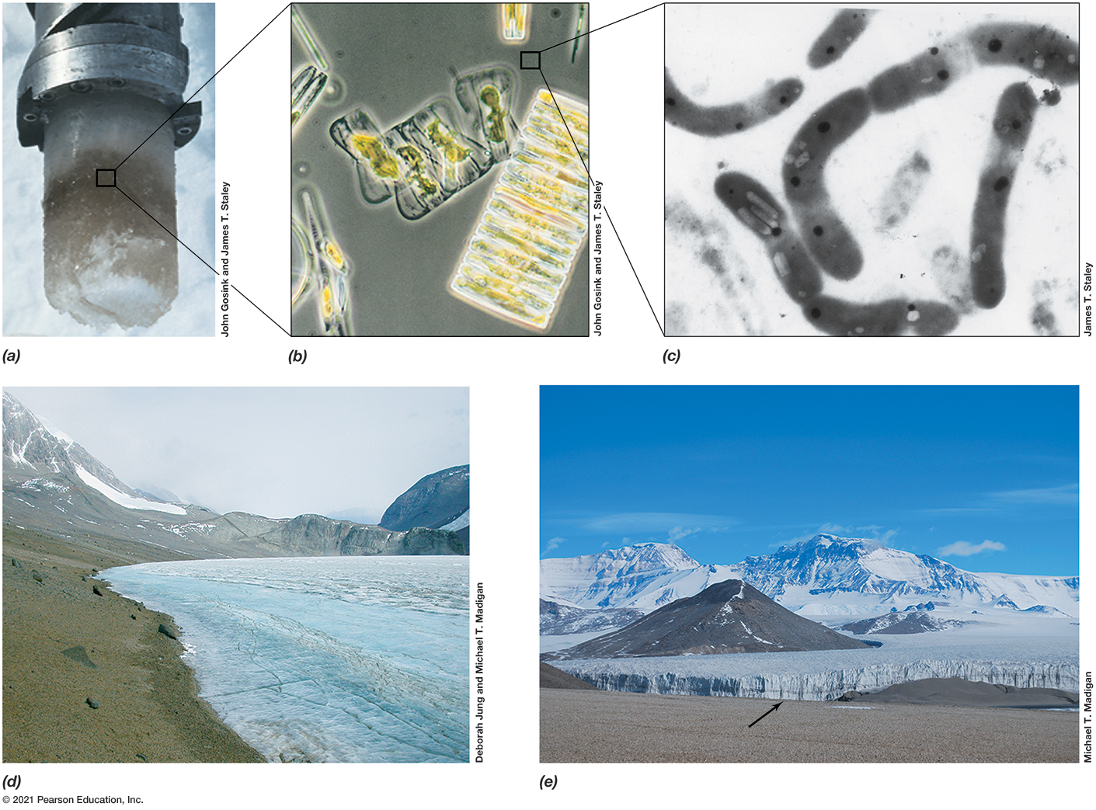
Figure 4.22 Antarctic Microbial Habitats and Microorganisms
Notes:
(a) A core of frozen seawater from McMurdo Sound, Antarctica. The core is about 8 cm wide. Note the dense coloration due to pigmented microorganisms. (b) Phase-contrast micrograph of phototrophic microorganisms from the core shown in part a. Most organisms are either diatoms or green algae (both eukaryotic phototrophs). (c) Transmission electron micrograph of Polaromonas, a gas vesiculate bacterium that lives in sea ice and grows optimally at 4 degree Celsius. Cells are about 0.8 μ m in diameter. (d) Lake Bonney, McMurdo Dry Valleys, Antarctica. Although the lake is permanently ice-covered, the water column under the ice contains a diverse array of Bacteria, Archaea, and microbial eukaryotes. (e) Garwood Glacier, McMurdo Dry Valleys, Antarctica. The edge of the glacier (arrow) is about 20 m high. Glaciers and subglacial lakes are teeming with microbial life.
Part A. A core of frozen seawater from McMurdo Sound, Antarctica a dark band is sampled for image b. Part B. A sample of microorganisms found in the frozen seawater core are enlarged and look rectangular. Part C. A sample of Polaromonas a rod shaped bacteria. Part D. Lake Bonney in the McMurdo Dry Valleys, Antarctica is covered in ice. Part E. Garwood Glacier, McMurdo Dry Valleys, Antarctica with 20 meter drop offs on the edges.

Slide 66
4.12 Microbial Life in the Cold (2 of 4)
Psychrophilic and Psychrotolerant Microorganisms
Psychrophiles: optimal growth temperature ≤ 15°Celsius, maximum < 20°Celsius, minimum ≤ 0°Celsius
Constantly cold environments
Found in polar regions, permanent snowfields, glaciers (Figure 4.23)
Psychrotolerant: can grow at 0°Celsius but have optima of 20°Celsius to 40°Celsius
More widely distributed in nature than psychrophiles
Isolated from soils and water in temperate climates and food at 4°Celsius

Slide 67
4.12 Microbial Life in the Cold (3 of 4)
Molecular Adaptations to Life in the Cold
production of enzymes that function optimally in the cold
more α-helices than β-sheets → greater flexibility for catalysis at cold temperatures
more polar and fewer hydrophobic amino acids
fewer weak bonds (e.g., hydrogen and ionic bonds)

Slide 68
4.12 Microbial Life in the Cold (4 of 4)
Molecular Adaptations to Life in the Cold
Cytoplasmic membranes function at low temperatures.
higher unsaturated and shorter-chain fatty acid content
some polyunsaturated fatty acids, which remain flexible at very low temperatures
Cold shock proteins (chaperones)
Cryoprotectants (e.g., antifreeze proteins, certain solutes) prevent formation of ice crystals.
Exopolysaccharide cell surface slime

Slide 69
4.13 Microbial Life at High Temperatures (1 of 4)
Thermal Environments
Thermophiles: growth temperature optima between 45°Celsius and 80°Celsius
Hyperthermophiles: optima greater than 80°Celsius
inhabit hot environments, including boiling hot springs and seafloor hydrothermal vents, that can experience temperatures in excess of 100°Celsius
Above 65°Celsius, only prokaryotic life forms thrive, but extensive diversity present (Table 4.3)

Slide 70
Table 4.3 Presently Known Upper Temperature Limits for Growth of Living Organisms
Group | Upper temperature limits (°Celsius)
Macroorganisms | Blank
Animals | Blank
Fish and other aquatic vertebrates | 38
Insects | 45–50
Ostracods (crustaceans) | 49–50
Plants | Blank
Vascular plants | 45 (60 for one species)
Mosses | 50
Microorganisms | Blank
Eukaryotic microorganisms | Blank
Protozoa | 56
Algae | 55–60
Fungi | 60–62
Bacteria and Archaea | Blank
Bacteria | Blank
Cyanobacteria | 73
Anoxygenic phototrophs | 70–73
Chemoorganotrophs/chemolithotrophs | 95
Archaea | Blank
Chemoorganotrophs/chemolithotrophs | 122

Slide 71
4.13 Microbial Life at High Temperatures (2 of 4)
Hyperthermophiles and Thermophiles
Hyperthermophiles
inhabit boiling hot springs (Figure 4.24)
chemoorganotrophic and chemolithotrophic species present
generation times (g) as low as one hour common
high prokaryotic diversity (both Archaea and Bacteria represented)
Methanopyrus: most thermophilic, up to 122°Celsius
Thermophiles
moderately or intermittently hot environments (Figure 4.25a)

Slide 72
4.13 Microbial Life at High Temperatures (3 of 4)
Protein and Membrane Stability at High Temperatures
Enzymes and proteins more heat-stable and function optimally at high temperatures
Heat stability from subtle amino acid substitutions resist denaturation
Increased ionic bonding and highly hydrophobic interiors
Production of solutes (e.g., di-inositol phosphate, diglycerol phosphate, mannosylglycerate) helps stabilize proteins.
Thermophilic and hyperthermophilic enzymes commercially useful
Prolong shelf life (e.g., Taq polymerase for polymerase chain reaction [P C R])

Slide 73
4.13 Microbial Life at High Temperatures (4 of 4)
Protein and Membrane Stability at High Temperatures
cytoplasmic membranes must be heat stable
Bacteria have lipids rich in long-chain and saturated fatty acids, fewer unsaturated fatty acids.
Most hyperthermophiles (Archaea) have C₄₀ hydrocarbons made of repeating isoprene units bonded by ethers to glycerol phosphate, and membrane forms lipid monolayer rather than bilayer.

Slide 74
Four Environmental Effects on Growth: p H, Osmolarity, and Oxygen
4.14 Effects of p H on Microbial Growth
4.15 Osmolarity and Microbial Growth
4.16 Oxygen and Microbial Growth

Slide 75
4.14 Effects of p H on Microbial Growth (1 of 4)
p H expresses acidity or alkalinity of a solution.
p H 7 = neutral (Figure 4.26)
acidic p H < 7, alkaline p H > 7
Each microbe has a p H range ~2–3 p H units within which growth is possible.
Most natural environments are p H 3–9 (Table 4.4)

Slide 76
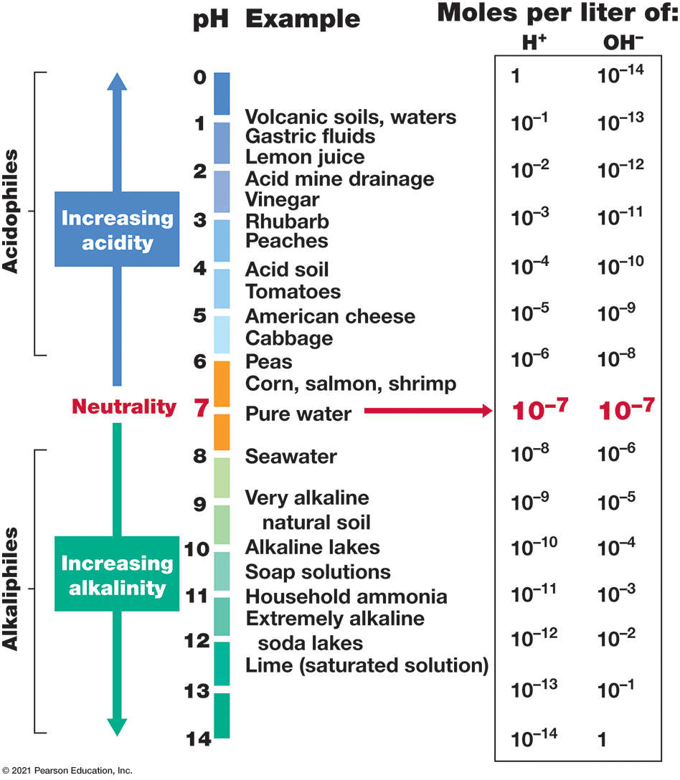
Figure 4.26 The p H Scale
Notes:
Although some microorganisms can live at very low or very high p H, the cell’s internal p H remains near neutrality.
The scale runs from 0 to 14, lower values are more acidic and higher values are more basic. A value of 7 represents neutrality. Examples of substances are given for each p H level as follows.
p H 0. No example. Moles per liter of H positive is 1 and moles per liter of 10 to the negative fourteenth power.
p H 1. Volcanic soils and waters, gastric fluids. Moles per liter of H positive is 10 to the negative first power and moles per liter of 10 to the negative thirteenth power.
p H 2. Lemon juice, acid mine drainage, vinegar. Moles per liter of H positive is 10 to the negative second power and moles per liter of 10 to the negative twelfth power.
p H 3. rhubarb, peaches. Moles per liter of H positive is 10 to the negative third power and moles per liter of 10 to the negative eleventh power.
p H 4. Acid soil, tomatoes. Moles per liter of H positive is 10 to the negative fourth power and moles per liter of 10 to the negative tenth power.
p H 5. American cheese, cabbage. Moles per liter of H positive is 10 to the negative fifth power and moles per liter of 10 to the negative ninth power.
p H 6. Peas, corn, salmon, shrimp. Moles per liter of H positive is 10 to the negative sixth power and moles per liter of 10 to the negative eighth power.
p H 7. Pure water. Moles per liter of H positive is 10 to the negative seventh power and moles per liter of 10 to the negative seventh power.
p H 8. Sea water. Moles per liter of H positive is 10 to the negative eighth power and moles per liter of 10 to the negative sixth power.
p H 9. Very alkaline natural soil. Moles per liter of H positive is 10 to the negative ninth power and moles per liter of 10 to the negative fifth power.
p H 10. Alkaline lakes, soap solutions. Moles per liter of H positive is 10 to the negative tenth power and moles per liter of 10 to the negative fourth power.
p H 11. Household ammonia. Moles per liter of H positive is 10 to the negative eleventh power and moles per liter of 10 to the negative third power.
p H 12. Extremely alkaline soda lakes, unsaturated lime solution. Moles per liter of H positive is 10 to the negative twelfth power and moles per liter of 10 to the negative second power.
p H 13. No example. Moles per liter of H positive is 10 to the negative thirteenth power and moles per liter of 10 to the negative first power.
p H 14. No example. Moles per liter of H positive is 10 to the negative fourteenth power and moles per liter of 1.

Slide 77
Table 4.4 Relationships of Microorganisms to p H
Physiological class (optima range) | Approximate p H optimum for growth | Example organism ª
Neutrophile (p H > 5.5 and < 8) | 7 | Escherichia coli
Acidophile (p H < 5.5) | 5 | Rhodopila globiformis
Acidophile (p H < 5.5) | 3 | Acidithiobacillus ferrooxidans
Acidophile (p H < 5.5) | 1 | Picrophilus oshimae
Alkaliphile (p H ≥ 8) | 8 | Chloroflexus aurantiacus
Alkaliphile (p H ≥ 8) | 9 | Bacillus firmus
Alkaliphile (p H ≥ 8) | 10 | Natronobacterium gregoryi
ª Picrophilus and Natronobacterium are Archaea; all others are Bacteria.

Slide 78
4.14 Effects of p H on Microbial Growth (2 of 4)
Acidophiles
Neutrophiles: grow optimally at p H 5.5–7.9 (circumneutral)
Acidophiles: grow best at low p H (< 5.5)
Different classes growing best at moderately acidic or very low p H
Governed by stability of cytoplasmic membrane
At neutral p H, membranes of strong acidophiles lyse; protons required for stability

Slide 79
4.14 Effects of p H on Microbial Growth (3 of 4)
Alkaliphiles
high p H optima for growth, p H ≥ 8
found in highly alkaline habitats: soda lakes and high-carbonate soils
e.g., some Bacillus species
used commercially (e.g., secreted proteases and lipases that are added to laundry detergents to remove proteins and fats)
Some have sodium (N a⁺) motive force rather than proton motive force.

Slide 80
4.14 Effects of p H on Microbial Growth (4 of 4)
Cytoplasmic p H and Buffers
Optimal p H refers to extracellular only
The intracellular p H must stay relatively close to neutral (p H 5–9), consistent with macromolecule stability
Extreme acidophiles and alkaliphiles maintain cytoplasmic p H near neutrality.
Microbial culture media typically contain buffers to maintain constant p H.

Slide 81
4.15 Osmolarity and Microbial Growth (1 of 5)
Water availability important; depends on environmental moisture/dryness and concentration of solutes
Water activity (a_{w}): water availability (Table 4.5)
ratio of vapor pressure of air in equilibrium with a substance or solution to vapor pressure of pure water
varies from zero (no free water) to one (pure water)
Osmosis: Water diffuses from high to low concentrations.

Slide 82
Table 4.5 Water Activity of Several Substances
Water activity (a _{w}) | Material | Example organisms ª
1.000 | Pure water | Caulobacter, Spirillum
0.995 | Human blood | Streptococcus, Escherichia
0.980 | Seawater | Pseudomonas, Vibrio
0.950 | Bread | Most gram-positive rods
0.900 | Maple syrup, ham | Gram-positive cocci such as Staphylococcus
0.850 | Salami | Saccharomyces rouxii (yeast)
0.800 | Fruit cake, jams | Zygosaccharomyces bailii (yeast), Penicillium (fungus)
0.750 | Salt lakes, salted fish | Halobacterium, Halococcus
0.700 | Cereals, candy, dried fruit | Xeromyces bisporus and other xerophilic fungi
ª Selected examples of Bacteria and Archaea or fungi capable of growth in culture media adjusted to the stated water activity.

Slide 83
4.15 Osmolarity and Microbial Growth (2 of 5)
Typically, the cytoplasm has a higher solute concentration than the surrounding environment; thus, the tendency is for water to move into the cell (positive water balance).
When a cell is in an environment with a higher external solute concentration, water will flow out unless the cell has a mechanism to prevent this.

Slide 84
4.15 Osmolarity and Microbial Growth (3 of 5)
Halophiles and Related Organisms
Seawater contains ~3% N a C l
Halophiles: grow best at a _{w} = 0.98 (seawater); have a specific requirement for N a C l (Table 4.6, Figure 4.27)
Halotolerant: tolerate some dissolved solutes but generally grow best in the absence of added solute
Extreme halophiles: require very high levels (15-30%) of N a C l; often unable to grow at lower concentrations

Slide 85
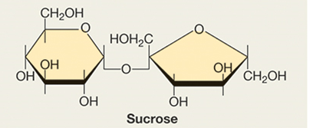
Table 4.6 Compatible Solutes of Microorganisms (1 of 2)
Organism group and example | Major cytoplasmic compatible solute(s) | Minimum a _{w} for growth ^{c}
Most nonphototrophic Bacteria (Escherichia) and freshwater cyanobacteria (Anabaena) | Amino acids (mainly glutamate or proline ª)/sucrose, trehalose ^{b} | 0.98 Sucrose
Marine cyanobacteria (Synechococcus) | α-Glucosylglycerol ^{b} | 0.92
Marine algae (Phaeocystis) | Mannitol, ^{b} various glycosides, dimethylsulfoniopropionate | 0.92 Dimethylsulfoniopropionate
Halotolerant Bacteria (Staphylococcus) | Amino acids | 0.90
Salt lake cyanobacteria (Aphanothece) | Glycine betaine | 0.75 Glycine betaine
Halophilic phototrophic purple Bacteria (Halorhodospira) | Glycine betaine, ectoine, trehalose ^{b} | 0.75 Ectoine

Slide 86
Table 4.6 Compatible Solutes of Microorganisms (2 of 2)
Organism group and example | Major cytoplasmic compatible solute(s) | Minimum a _{w} for growth ^{c}
Extremely halophilic Archaea (Halobacterium) and some Bacteria (Salinibacter) | K C l | 0.75
Halophilic green algae (Dunaliella) | Glycerol | 0.75 Glycerol
Haloalkaliphilic Archaea (Natrinema) | K C l | 0.68
Xerophilic and osmophilic yeasts (Zygosaccharomyces) | Glycerol | 0.62^{d}
Xerophilic filamentous fungi (Xeromyces) | Glycerol | 0.605^{d}
ª See Figure 6.27 for the structures of amino acids.
^{b} Structures not shown. Like sucrose, trehalose is a C₁₂ disaccharide; glucosylglycerol is a C₉ alcohol; mannitol is a C₆ alcohol.
^{c} To achieve an osmotic a_{w} lower than about 0.77, solutes other than just N a C l are necessary; for example, other salts (M g C l2, M g S O4, or C a C l2) or nonsalts, such as glycerol or sucrose. For most organisms listed (other than for the xerophiles), the lower a_{w} for growth can be extended downward somewhat by additional solutes.
^{d} Growth of Zygosaccharomyces tested in high-sucrose medium. Germination of Xeromyces spores tested using matric water potential.

Slide 87
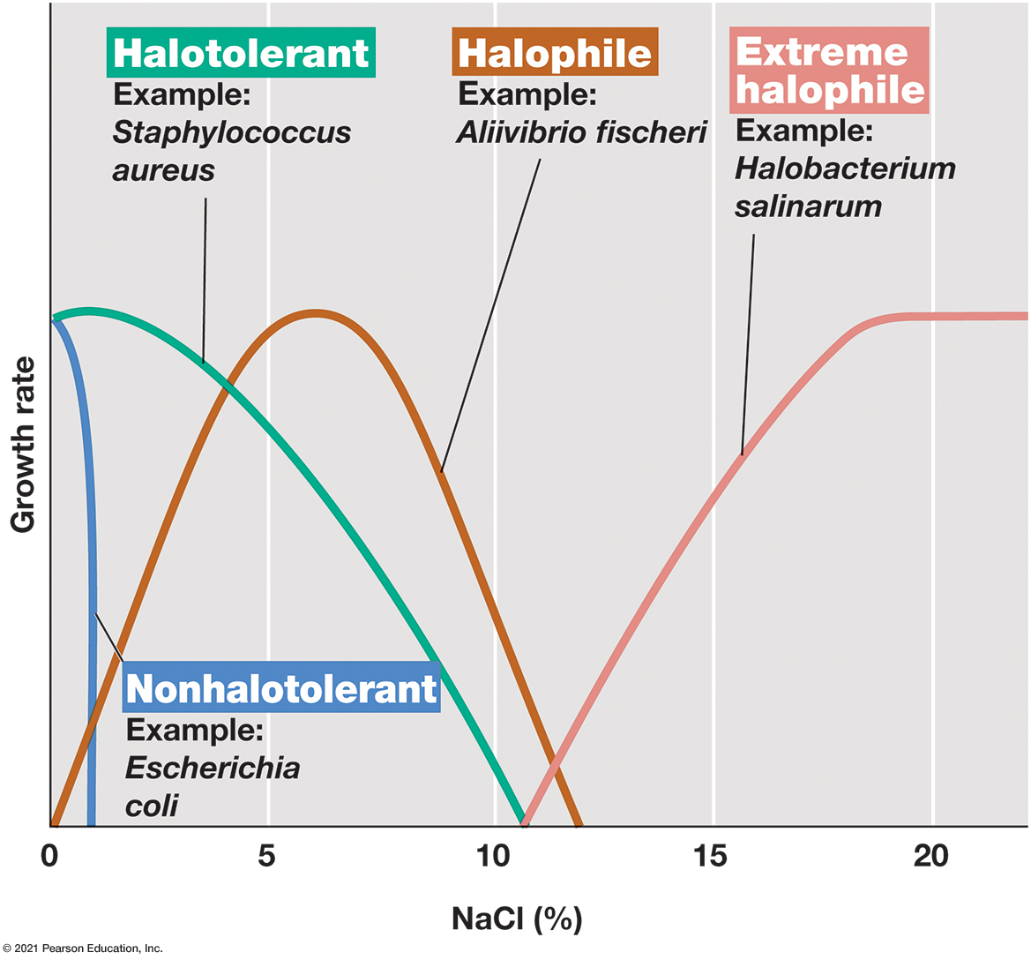
Figure 4.27 Effect of N a C l Concentration on Growth of Microorganisms of Different Salt Tolerances or Requirements
Notes:
The optimum N a C l concentration for marine microorganisms such as Aliivibrio fischeri is about 5%; for extreme halophiles, it is between 15 and 30%, depending on the organism.
A graph plots growth rate versus percent N a C l for microorganisms with different salt tolerances. Non Halophiles such as Escherichia coli have an optimum at 0 % salt and a maximum at 1 %. Halotolerant organisms, such as staphylococcus aureus, have an optimal of 1 % and a maximum of 11 %. Halophiles, such as aliivibrio fischeri, have a minimum of 0 %, an optimum of 7 %, and a maximum of 12 %. Extreme halophiles, such as halobacterium salinarum, have a minimum of 11 %, an optimum of 18 %, and no measured maximum.

Slide 88
4.15 Osmolarity and Microbial Growth (4 of 5)
Halophiles and Related Organisms (Table 4.6)
Osmophiles: live in environments high in sugar Xerophiles: able to grow in very dry environments
Lowest a _{w} = 0.61 for life; physiochemical constraints on obtaining water at lower a _{w}

Slide 89
4.15 Osmolarity and Microbial Growth (5 of 5)
Compatible Solutes
to maintain positive water balance, microbes pump solutes from environment into cell or synthesizing cytoplasmic solutes
compatible solutes do not inhibit biochemical processes
highly water-soluble (e.g., sugars, alcohols, glycine betaine, K C l) (Table 4.6)
Nonhalotolerant, halotolerant, halophilic, extremely halophilic organisms reflect genetic ability to produce or accumulate compatible solutes

Slide 90
4.16 Oxygen and Microbial Growth (1 of 5)
Oxygen Classes of Microorganisms (Table 4.7)
Aerobes: grow at full O₂ tension (~21%) and respire O₂
Microaerophiles: can use O₂ only at levels reduced from that in air (microxic) due to limited respiration or oxygen sensitivity
Facultative organisms: can live with or without oxygen

Slide 91
Table 4.7 Oxygen Relationships of Microorganisms
Aerobes
Group | Relationship to O₂ | Type of metabolism | Example ª | Habitat ^{b}
Obligate | Required | Aerobic respiration | Micrococcus luteus (B) | Skin, dust
Facultative | Not required, but growth better with O₂ | Aerobic respiration, anaerobic respiration, fermentation | Escherichia coli (B) | Mammalian large intestine
Microaerophilic | Required but at levels lower than atmospheric | Aerobic respiration | Spirillum volutans (B) | Lake water
Anaerobes
Group | Relationship to O₂ | Type of metabolism | Example ª | Habitat ^{b}
Aerotolerant | Not required, and growth no better when O₂ present | Fermentation | Streptococcus mutans (B) | Oral cavity
Obligate | Harmful or lethal | Fermentation or anaerobic respiration | Methanobacterium formicicum (A) | Sewage sludge, anoxic lake sediments
ª Letters in parentheses indicate phylogenetic status (B, Bacteria; A, Archaea). Representatives of either domain of prokaryotic cells are known in each category. Most eukaryotes are obligate aerobes, but facultative aerobes (for example, yeast) and obligate anaerobes (for example, certain protozoa and fungi) are known.
^{b} Listed are typical habitats of the example organism; many others could be listed.

Slide 92
4.16 Oxygen and Microbial Growth (2 of 5)
Oxygen Classes of Microorganisms (Table 4.7)
Anaerobes: cannot respire oxygen
Aerotolerant anaerobes: tolerate oxygen and grow in its presence even though they cannot respire
Obligate anaerobes: inhibited or killed by oxygen, (e.g., Bacteria and Archaea, few fungi, and few protozoa)
Anoxic (oxygen free) habitats: mud, bogs, marshes, animal intestines, other diverse habitats

Slide 93
4.16 Oxygen and Microbial Growth (3 of 5)
Culture Techniques for Aerobes and Anaerobes
Aerobes need extensive aeration (e.g., shaking, bubbling).
Anaerobes need oxygen excluded.
reducing agents: added to culture media to reduce oxygen to water (e.g., thioglycolate) (Figure 4.28)
Complex medium that separates microbes based on oxygen requirements
Oxygen can penetrate only the top of the tube.
Microbes grow at different heights based on oxygen exposure.
Resazurin dye indicates oxygen concentration
can flush or consume oxygen (e.g., glove bag) (Figure 4.29)

Slide 94
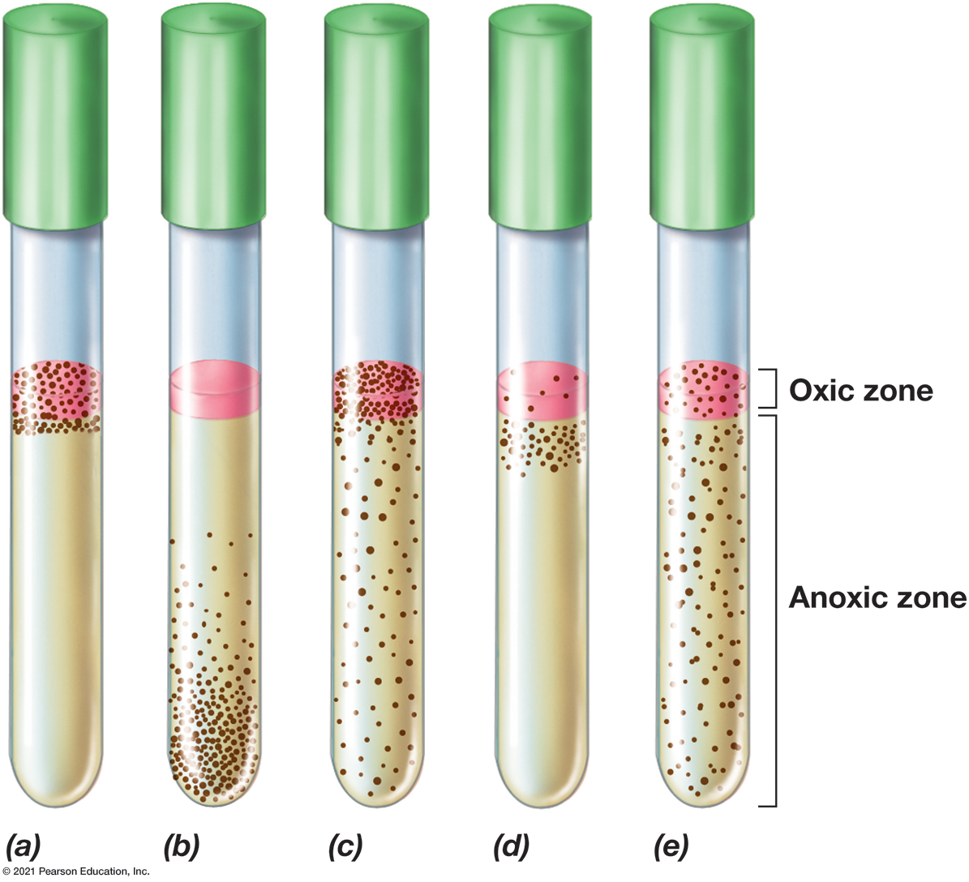
Figure 4.28 Growth Versus O₂ Concentration
Notes:
From left to right, aerobic, anaerobic, facultative, microaerophilic, and aerotolerant anaerobe growth, as revealed by the position of microbial colonies (depicted in this drawing as black dots) within tubes of thioglycolate broth culture medium. A small amount of agar has been added to keep the liquid from becoming disturbed. The redox dye resazurin, which is pink when oxidized and colorless when reduced, has been added as a redox indicator. (a) O 2 penetrates only a short distance into the tube, so obligate aerobes grow only close to the surface. (b) Anaerobes, being sensitive to O 2, grow only away from the surface. (c) Facultative aerobes are able to grow in either the presence or the absence of O 2 and thus grow throughout the tube. However, growth is better near the surface because these organisms can respire O 2. (d) Microaerophiles grow away from the most oxic zone. (e) Aerotolerant anaerobes grow throughout the tube. Growth is not better near the surface because these organisms can only ferment. In nature, many different habitats exist for each of these oxygen classes. In addition, a single habitat, such as a soil particle, may support growth of both aerobes and anaerobes.
There are 5 tubes labeled a through e. There is a pink oxic zone and a tan anoxic zone. Where the bacteria grow is noted by black dots. In tube a, the bacteria are in the oxic zone only. In tube b, the bacteria have settled at the bottom of the container, none touch the surface. In tube c, the bacteria are throughout the container but are more concentrated in the oxic zone. In tube d, there are a few in the oxic zone but most are right below the anoxic surface. In tube e, the bacteria are spread evenly.

Slide 95
4.16 Oxygen and Microbial Growth (4 of 5)
Why is oxygen toxic?
Molecular oxygen (O₂) is not toxic.
Exposure to oxygen yields toxic byproducts. (Figure 4.30)
superoxide anion (O₂⁻)
hydrogen peroxide (H₂O₂)
hydroxyl radical

Slide 96
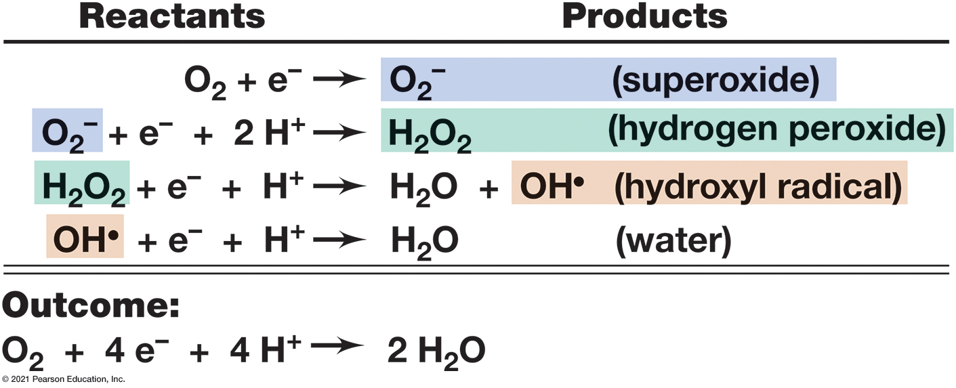
Figure 4.30 Four-Electron Reduction of O₂ to H₂O by Stepwise Addition of Electrons
Notes:
All the intermediates formed are reactive and toxic to cells; water is not.
The steps are in the table below.
A table has 4 rows and 2 columns. The columns have the following headings from left to right. Reactants, Products. The row entries are as follows. Row 1. Reactants, O 2 + electron. Products, O 2 negative, superoxide. Row 2. Reactants, O 2 + electron + 2 H positive. Products, H 2 O 2, hydrogen peroxide. Row 3. Reactants, H 2 O 2 + electron + H positive. Products, H 2 O + O H positive, hydroxyl radical. Row 4. Reactants, O H positive + electron + H positive. Products, H 2 O, water.
The outcome is O 2 + 4 electrons + 4 H positive yield 2 H 2 O.

