Slide 1
WelCOME@FEA
Prof. Hennie De Schepper – director of studies
© UGent, Jonas Vandecasteele en Yentl Vandendriessche

Slide 2
ENGINEERING@FEA
1835
first engineering programmes
1864
33% foreign students
1876
alumni association
1891
inauguration Plateau building
1926
visit King Albert I

Slide 3
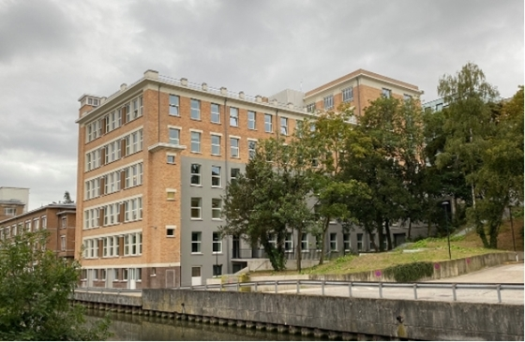
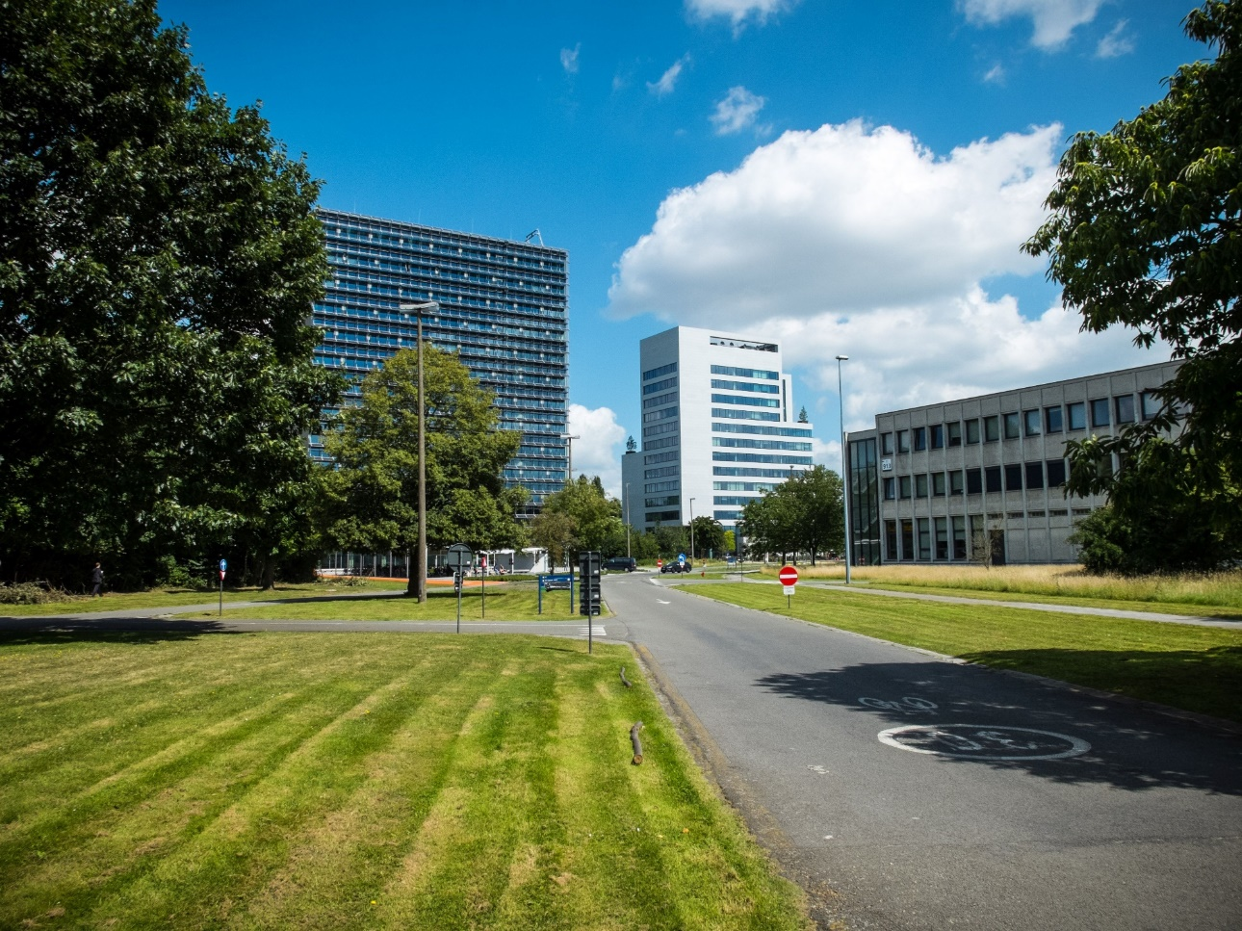
ENGINEERING@FEA
1930
Dutch as teaching language
1938
inauguration Technicum
1976
visit King Boudewijn
1979
inauguration campus Ardoyen
2035
FEA@Ardoyen

Slide 4
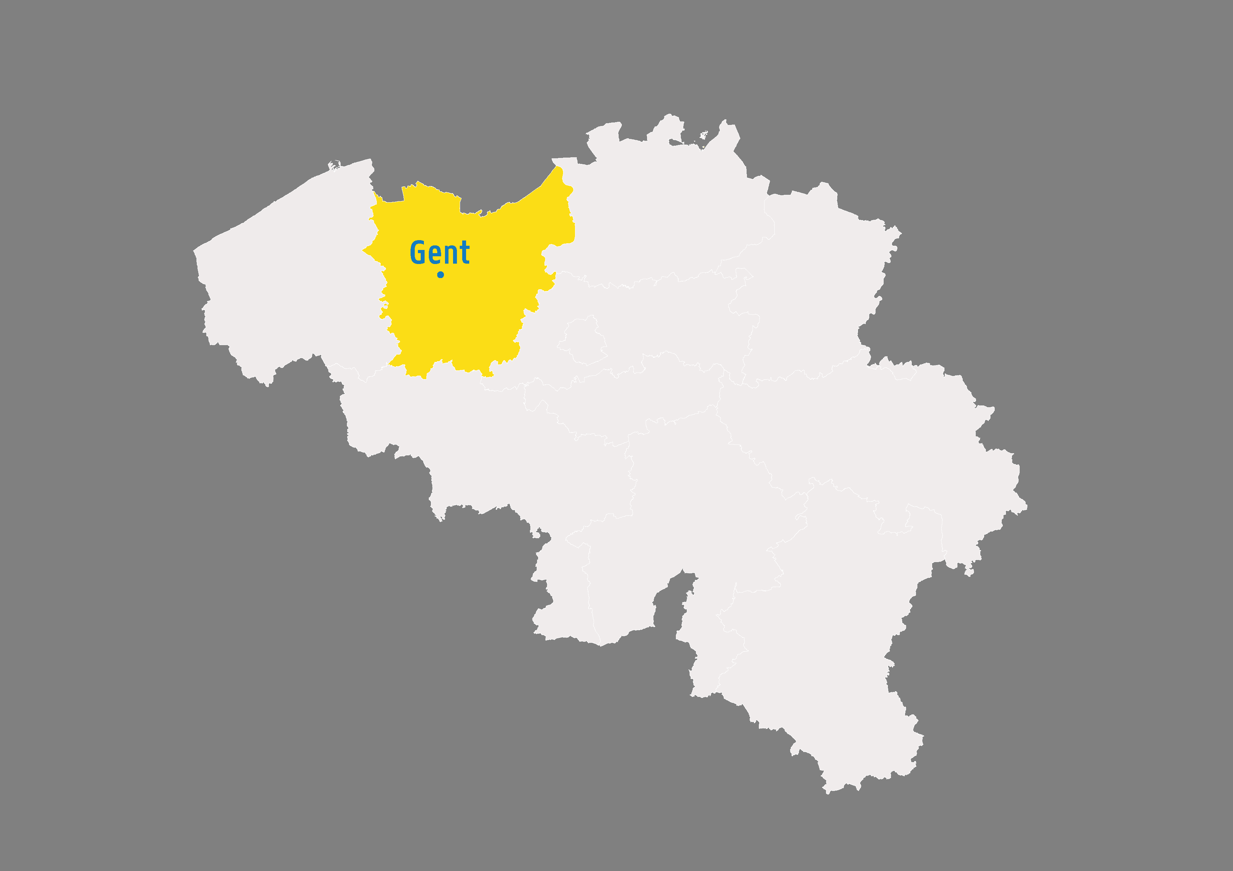
Ugent In gHent

Slide 5
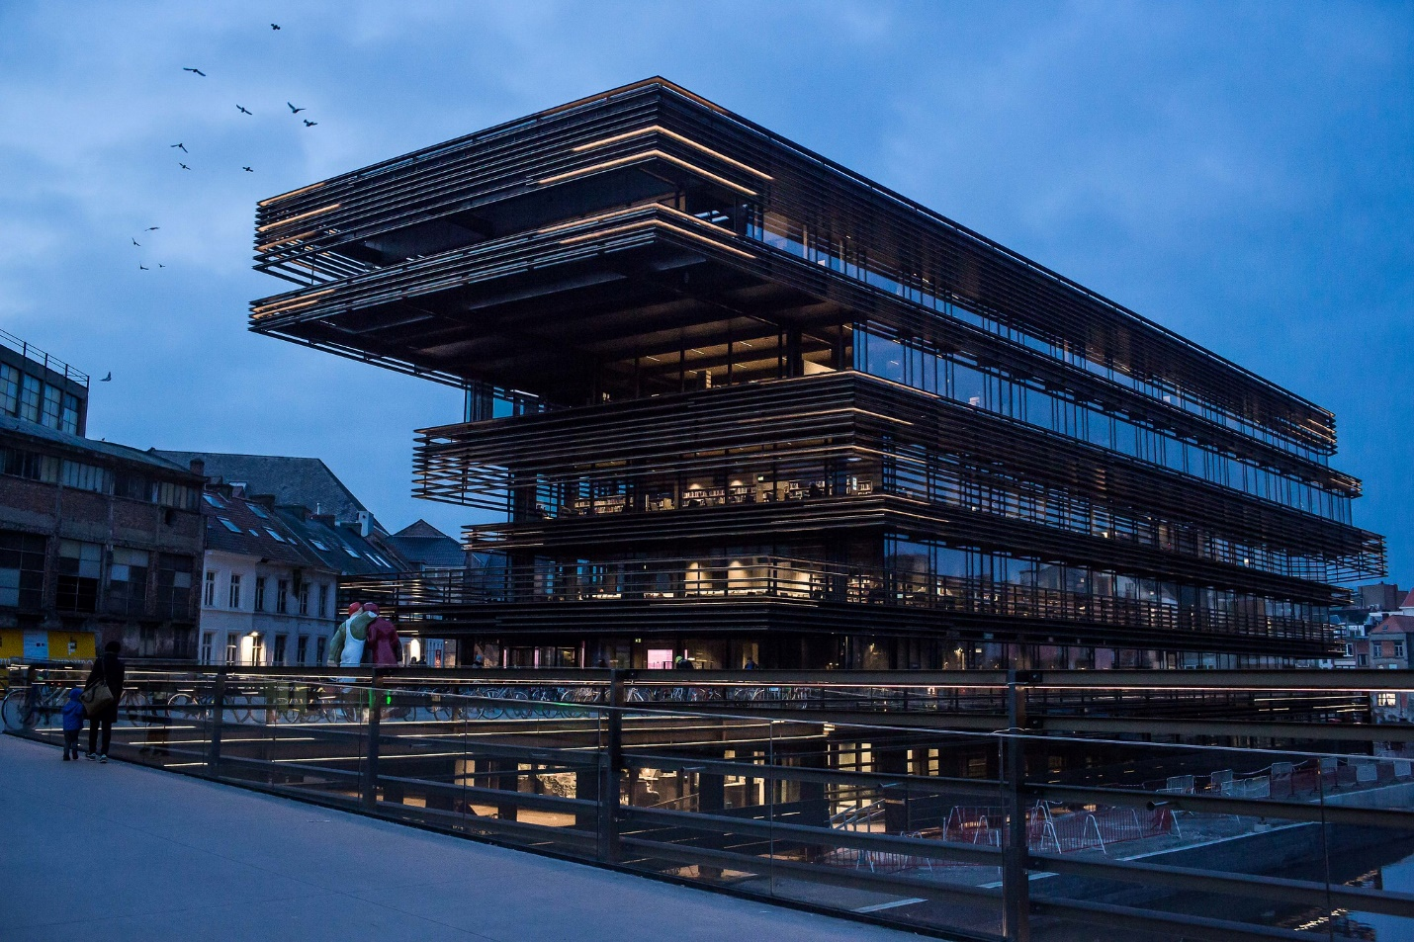
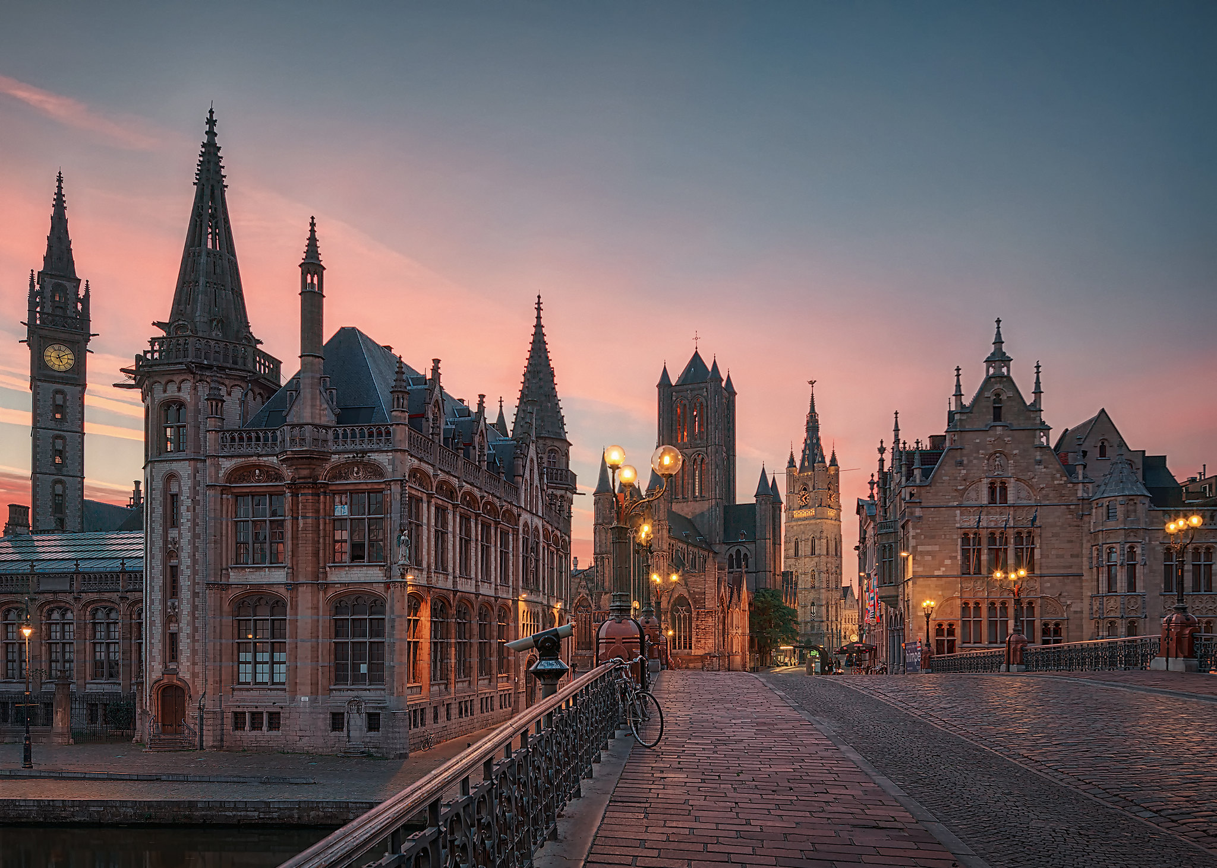
Ghent: historical city
263.600 habitants
76.500 students
167 nationalities
1.400 restaurants/pubs
3.600 starters per year
© Stad Gent - Dienst Toerisme, Bas Bogaerts
© Stad Gent - Dienst Toerisme, Bas Bogaerts

Slide 6
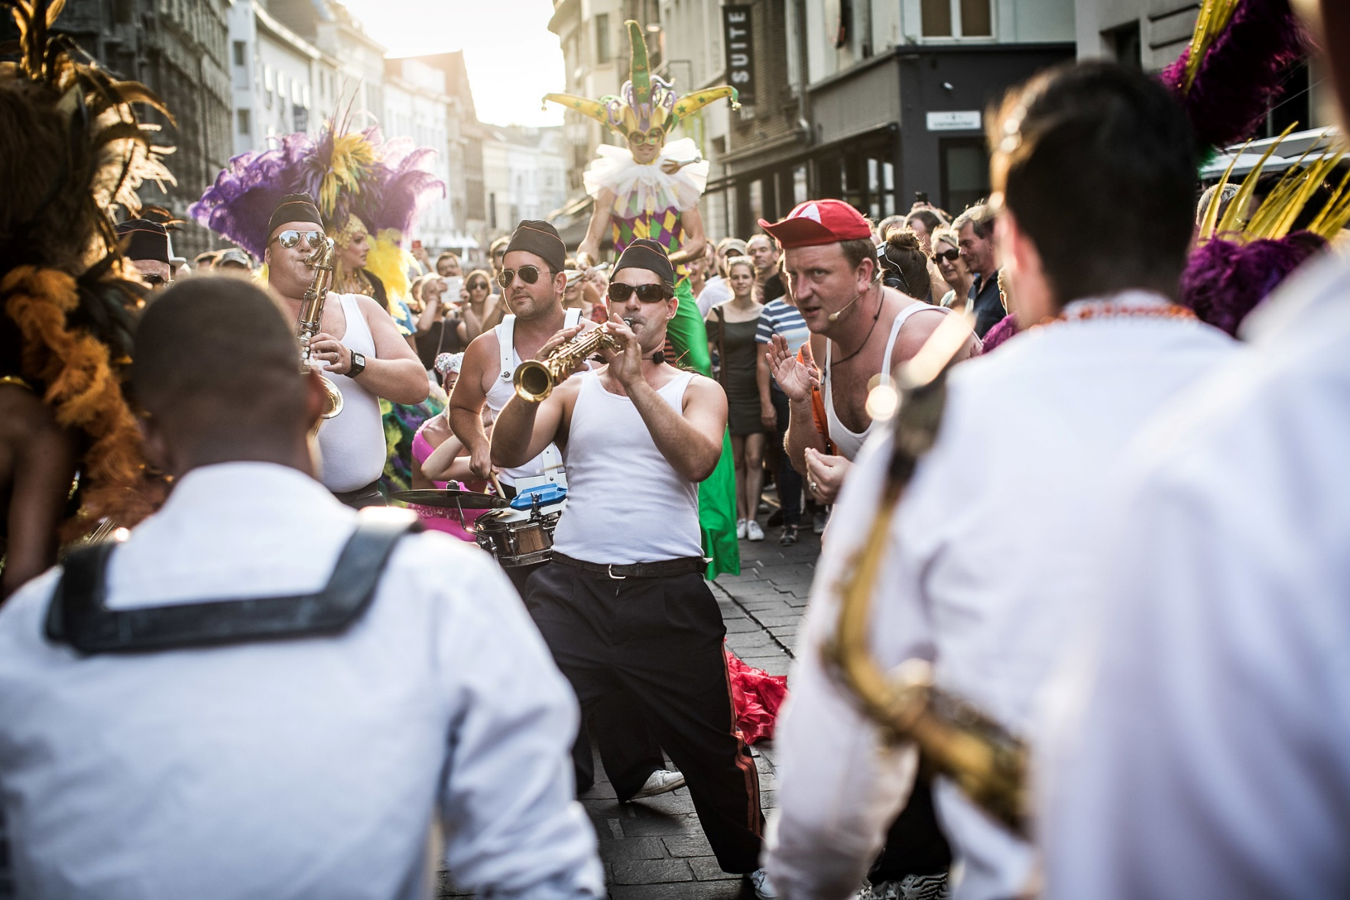
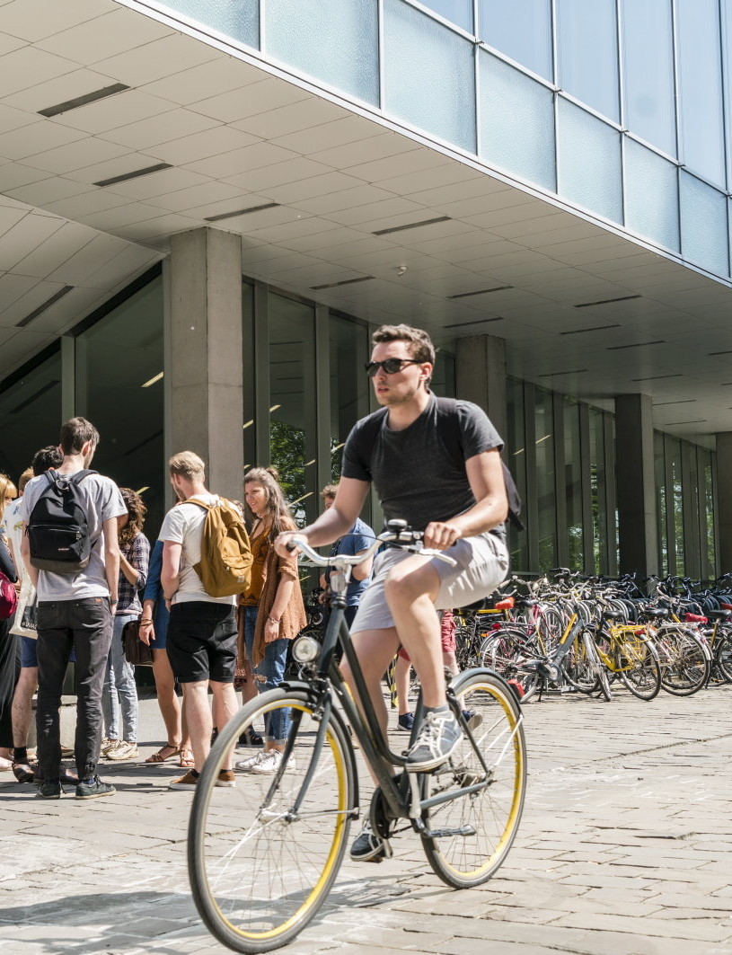
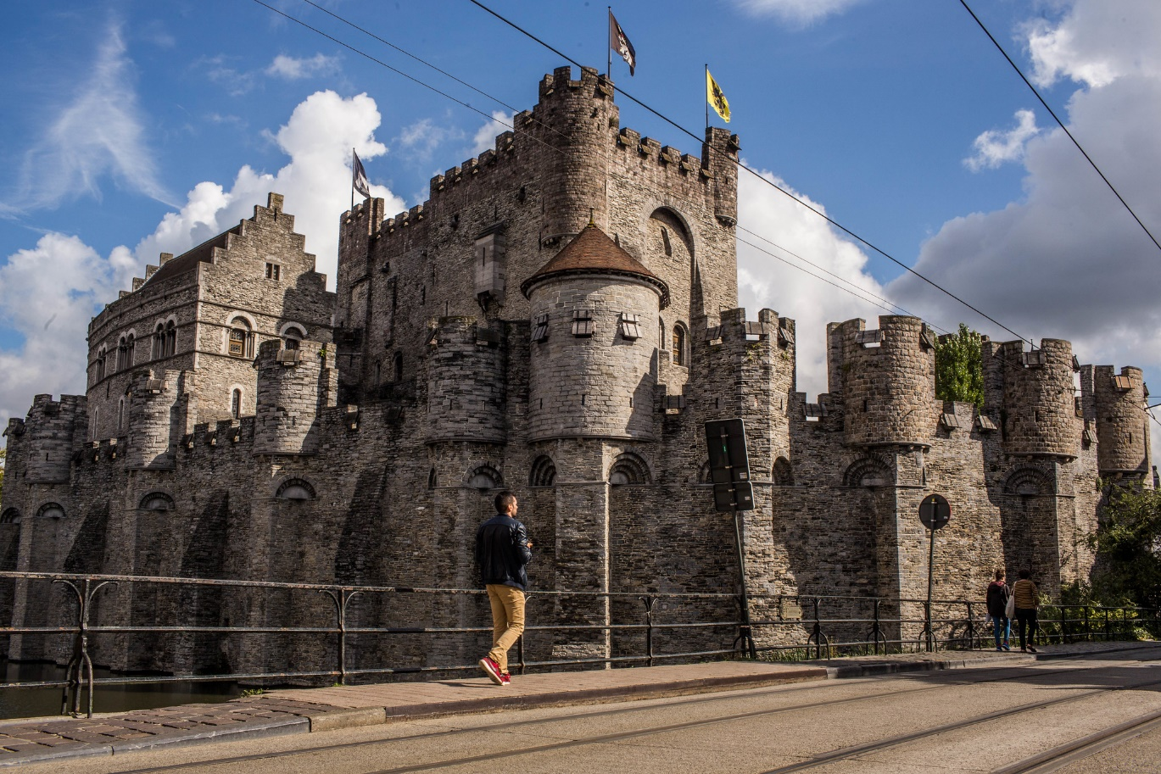
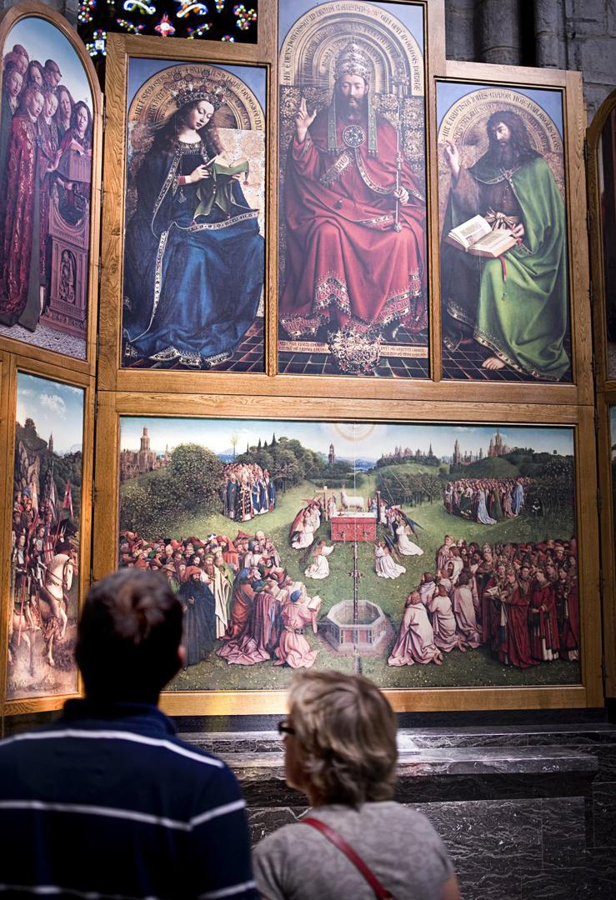
City of bikers
Gravensteen
Gentse Feesten & festivals
© UGent – Christophe Vander Eecken
© Stad Gent - Dienst Toerisme, Bas Bogaerts
Cuberdons ‘Neuzekes’
Veggie capital
of Europe
Mystic Lamb
Van Eyck
© Stad Gent - Dienst Toerisme, Bas Bogaerts
© Stad Gent - Dienst Toerisme, Bas Bogaerts
Notes:
Gent als festivalstad: Gentse feesten, Lichtfestival, 6-daagse, Gent Jazz, ...

Slide 7
What does ChatGPT say about…
the DANGERS of Ghent…
© UGent – Christophe Vander Eecken
© Stad Gent - Dienst Toerisme, Bas Bogaerts
© Stad Gent - Dienst Toerisme, Bas Bogaerts
© Stad Gent - Dienst Toerisme, Bas Bogaerts
Notes:
Gent als festivalstad: Gentse feesten, Lichtfestival, 6-daagse, Gent Jazz, ...

Slide 8
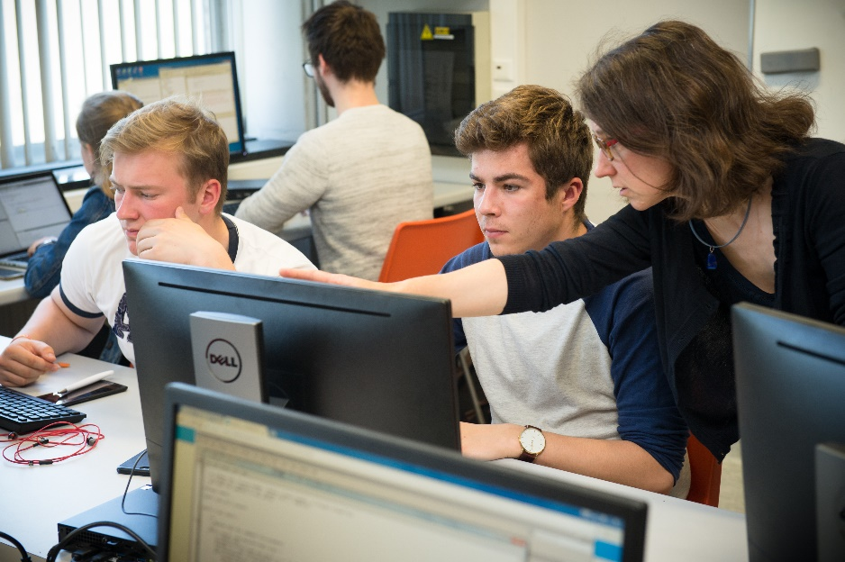
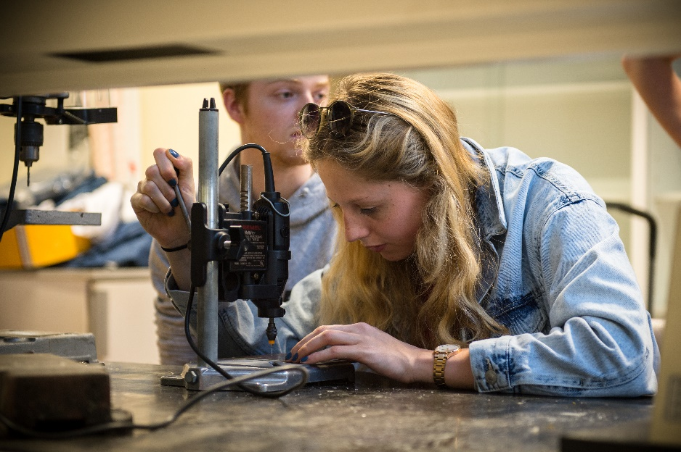
STUDIES@FEA

Slide 9
OUR MISSION & VISION
excerpt from the faculty’s educational mission statement: “The faculty of Engineering and Architecture is committed to training excellent engineers and architects, who are able to apply their technical and applied scientific skills and knowledge in any professional context, both in Belgium and abroad.
It seeks to do so by providing all of its students with a high-quality and state-of-the-art research-based education. Our engineering, engineering technology, and architectural engineering programmes meet international standards and fulfill the requirements of the work field and industry.
Our skilled graduates are able to adapt rapidly to global technological and economic changes, and contribute substantially to the socio-economic development.”

Slide 10
What does ChatGPT say about…
engineering students in Ghent…
© UGent – Christophe Vander Eecken
© Stad Gent - Dienst Toerisme, Bas Bogaerts
© Stad Gent - Dienst Toerisme, Bas Bogaerts
© Stad Gent - Dienst Toerisme, Bas Bogaerts
Notes:
Gent als festivalstad: Gentse feesten, Lichtfestival, 6-daagse, Gent Jazz, ...

Slide 11
WE ARE THErE TO SUPPORT YOU!
onderwijsdirecteur.ea@ugent.be = me
fsa.ea@ugent.be = faculty student administration
afwezig.ea@ugent.be = to register your absence
studietrajectir.ea@ugent.be = study counselor international.ea@ugent.be = international relations office

