Slide 1


Writing your data management plan: Step by step
Dienst onderzoeksaangelegenheden (DOZA)
  Boekentoren
2023/11/10 – Ziad Choueiki

Slide 2
A DMP: what & why

Slide 3

What is research data management (rdm)?
Actions to take care of data during the course of research and beyond.
An integral part of research.
“the compilation of many small practices that make your data easier to understand, less likely to be lost, and more likely to be usable during a project or ten years later”
(Briney 2015)
Collecting
Organizing
Storing
Backing up
Versioning
Preserving
Structuring
Security
Sharing
Documenting
Adapted from ‘RDM: An Overview’ by Research Support Team, IT Services (University of Oxford), licensed under CC-BY-NC-SA 4.0 and OpenClipart CC BY

Slide 4
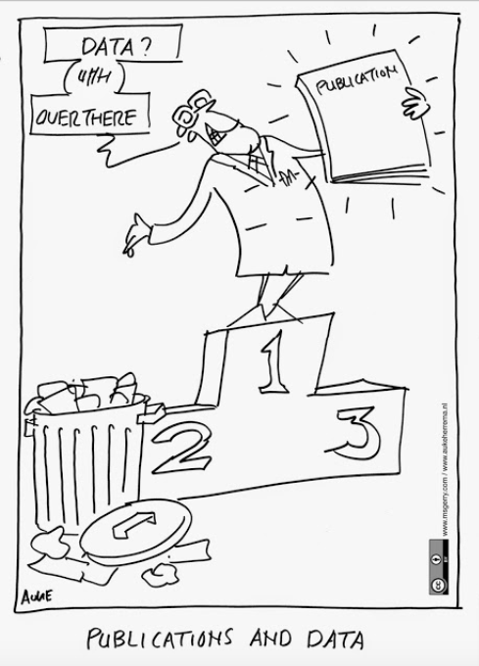
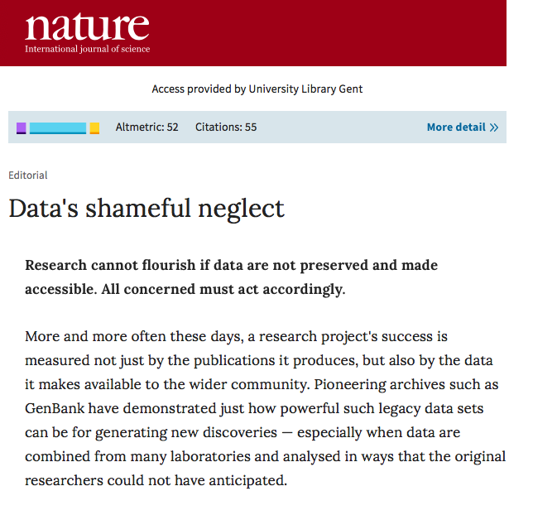
Why is RDM an issue now?
Research data have been neglected & undervalued
  poor verifiability of science
  missed opportunities for data re-use
https://doi.org/10.1038/461145a
‘Publications and Data’ by Auke Herrema, licensed under CC-BY 4.0
Notes:
The article in nature is from 2009

Slide 5
Data Management Plan (DMP)
Outlines how research data will be handled during & after a project.
Data collection
Data processing & analysis
Publication & data sharing
Data preservation
Data reuse

Slide 6
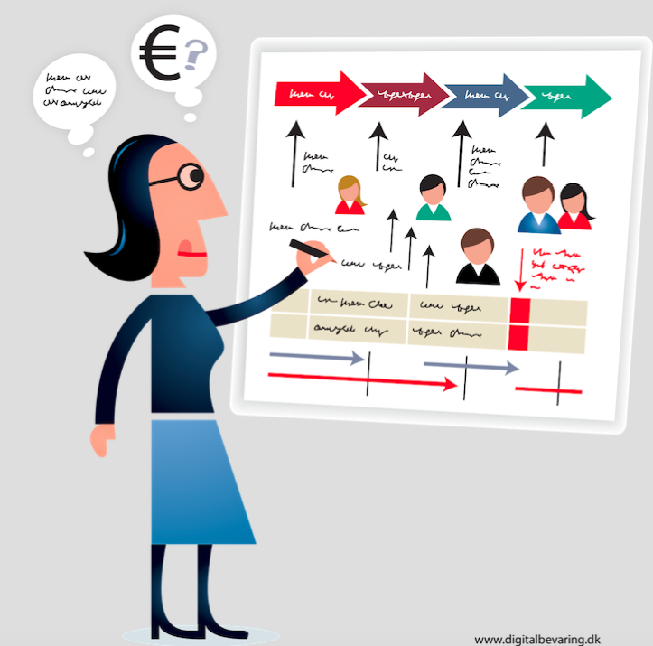
Why Data Management Plan (DMP)?
Increasingly required by research funders/institutions - as a first step towards good research data management (RDM)
Outlines how research data will be handled during & after a project.
Without planning:
  teams/labs often lose data when researchers leave
  working with data from collaborators can be problematic
  there often is no budget allocated to maintaining data(bases) beyond a project’s end
  gaining consent for archiving and sharing data is often forgotten
  ‘Planning’ by Jørgen Stamp, attribution: digitalbevaring.dk, licensed under CC-BY 2.5 DK

Slide 7
DMP’S - GOOD practice for any project
Consider it a tool to help you
  increase awareness of RDM
  ensure data are of high quality & remain usable
  comply with legal, ethical & other requirements
  identify any support & resources required
  clarify expectations & responsibilities
DMPs take some time & effort upfront, but can save you headaches later on!
But of course: a plan cannot do the work for you!

Slide 8
Changing Policy & LEGAL Landscape
Growing expectations of open & FAIR data (esp. publicly funded research)
FWO policy on RDM
Rollout
Start of H2020 Open Research Data pilot
Open science requirements in Horizon Europe
UGent Policy Framework on RDM
EU Open Data Directive includes research data
BELSPO open data mandate
2014
2015
2016
2017
2018
2019
2020
2021
DMP mandatory part of the PhD programme
PLOS
data availability policy
EC first announces European Open Science Cloud
Revised European Code of Conduct for Research Integrity (ALLEA)
Revised BOF/IOF regulation includes data as research output (FRIS);
Flemish Government open science policy plan
Foundation of Flemish Open Science Board & development of Open Science KPI’s

Slide 9
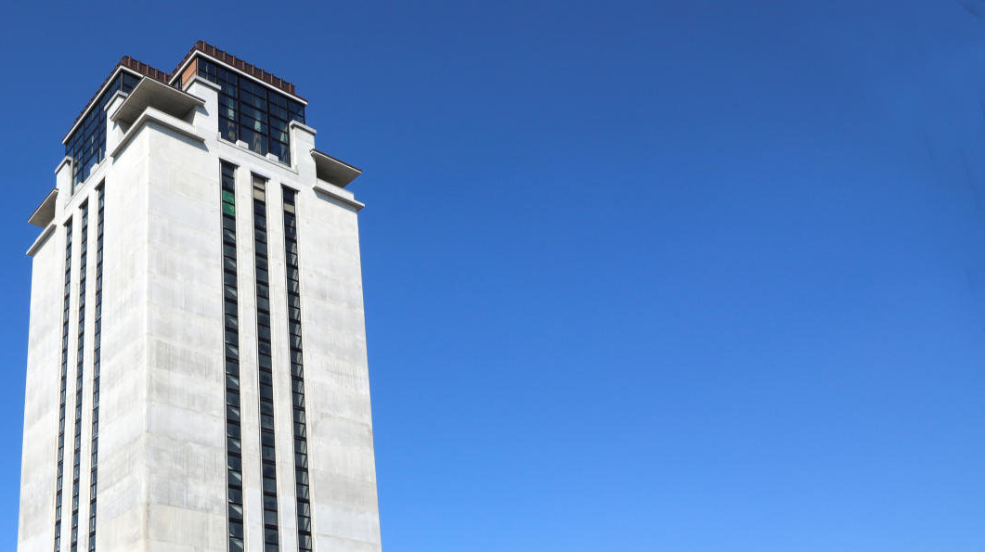
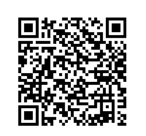
Ghent University Policy Framework on RDM (2016)
Write a Data Management Plan
Adequately document data
Securely store & process data
Preserve relevant data for min. 5 years
Provide access to data within UGent + make them openly available (unless legitimate reasons for restricting data sharing)
© UGent, foto Hilde Christiaens
Notes:
The QR code is for the Policy Framework on RDM: https://www.ugent.be/en/research/datamanagement/policies/ghent-university.htm

Slide 10
Dmp: When, how & where?

Slide 11
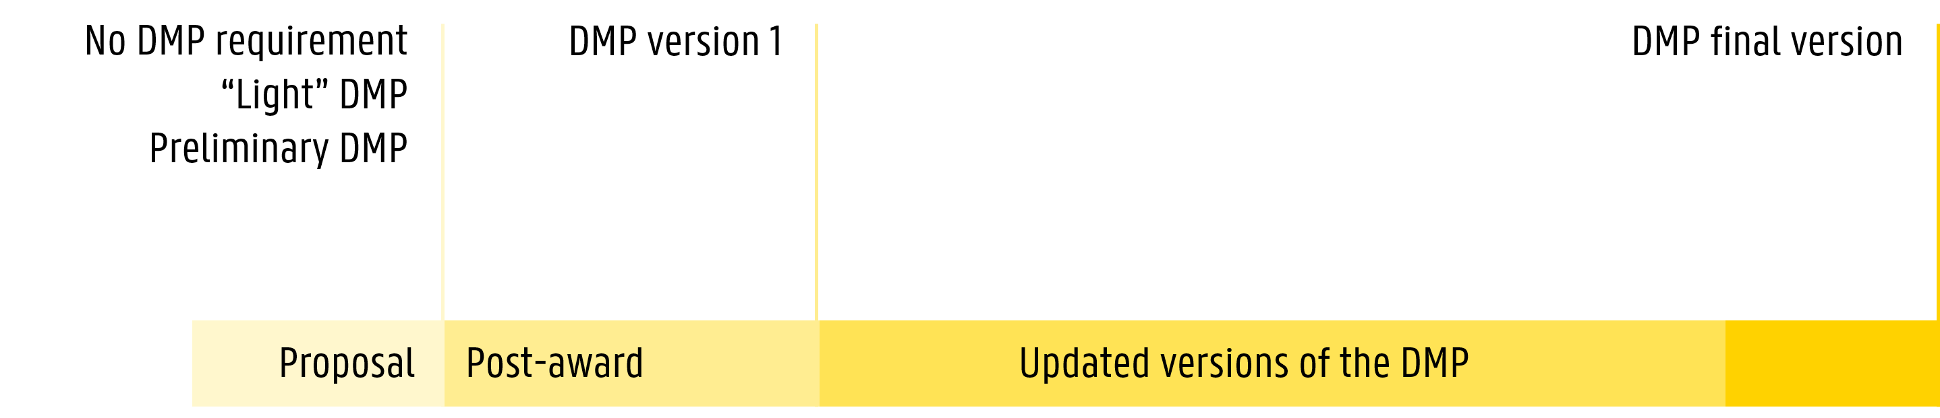
Submitting a dmp: WHEN & HOW
Submission deadlines and procedures vary: which funder, which DMP version, etc.
Check links for more details and procedures for external funders or UGent (inc. BOF & IOF)
BOF / IOF: send DMP to bof@ugent.be or iof@ugent.be
  PhD students to dmp.admin@ugent.be
UGent: PhDs send DMP to dmp.admin@ugent.be
FWO: send DMP to vlaams-federaal@ugent.be
H2020 / ERC: via the Funding & Tender Opportunities Portal
BELSPO: send DMP to BELSPO programme administrator

Slide 12
External funders & ugent: DMP and RDM requirements
 |  | HEurope | ERC | BELSPO | FWO | BOF / IOF (UGent) | PhD students (UGent)
DMP | Proposal | YES | NO | YES (Provisional DMP) | NO (5 RDM questions) | NO | NO
 | Initial DMP | YES (By M6) | YES (By M6) | YES (By M6) | YES (By M6) | YES (By M6) | YES (By M6)
 | Final DMP | YES | NO | YES | YES | YES | YES (prior to public defense)
 | Periodic report | YES (Grant agreement) | NO | NO | NO | NO | NO
 | Template* | YES (recommended) | YES (recommended) | YES (recommended) | YES (mandatory) | NO (use any template from DMPonline.be) | NO (use any template from DMPonline.be)
Other RDM | Open Data mandate | YES | YES | YES | NO | NO | NO
 | Preservation period | NO | NO | NO | YES (≥ 5y) | YES (≥ 5y) | YES (≥ 5y)
*All templates available via DMPonline.be
More info about external funders and UGent DMP requirements for new PhDs.
Notes:
The FWO proposal DMP questions are:
Describe the datatypes (surveys, sequences, manuscripts, objects …) you will collect and/or generate and/or (re)use during your research project.
Specify in which way the following provisions are in place in order to preserve the data during and at least 5 years after the end of the research.
What is the reason why you wish to deviate from the principle of preservation of data and of the minimum preservation term of 5 years?
Are there issues concerning research data indicated in the ethics questionnaire of this application form? Which specific security measures do those data require? (optional)
Which other issues related to the data management are relevant to mention?

Slide 13
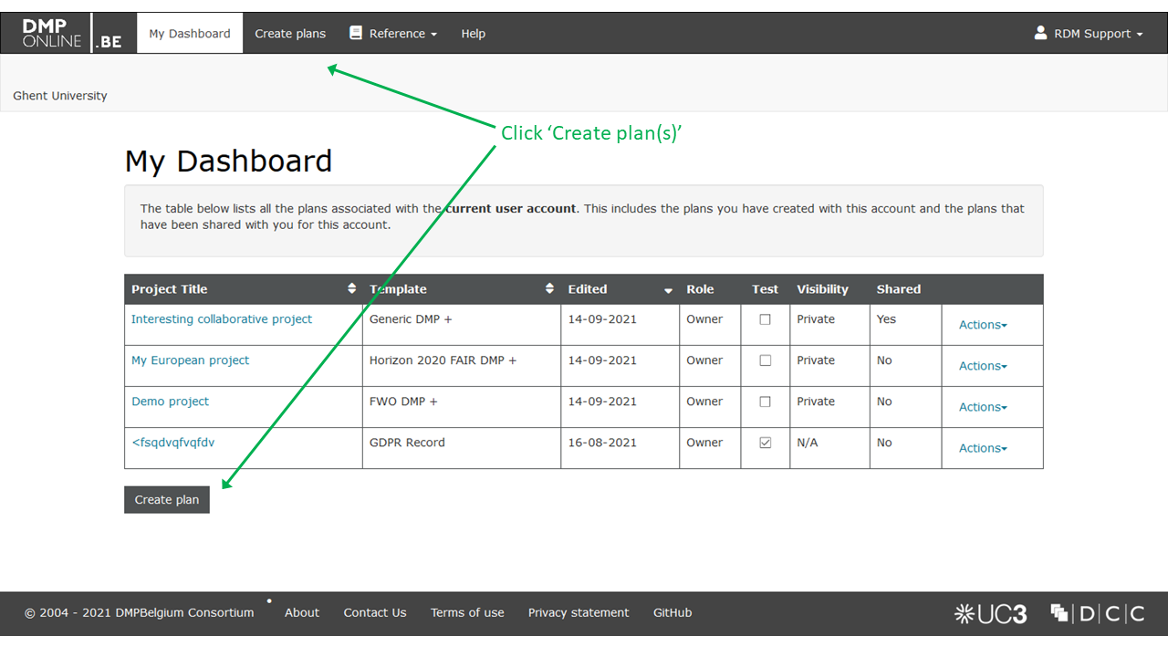
DMPonline.be – how it works
DMPonline.be: How do I write a Data Management Plan?

Slide 14
A DMP: what to cover

Slide 15








DMP sections
Data summary & description
Documentation & metadata
Roles &
responsibilities
Purpose, origin, type,
sensitiveness, format & volume
Information to keep data findable, understandable, reusable
Long-term preservation
Costs &
resources
Ethical & legal issues
What to preserve & where,
for how long, access restrictions
Intellectual property, GDPR, etc.
Data storage & security
Data sharing and reuse
Security measures, back-up, data transfers & access control
Data repositories, access conditions, licenses or agreements

Slide 16

Data collection / data description
Questions
Will you generate/collect new data and/or make use of existing data or third-party data?
Describe the origin (how will data be collected, method), type and format of the data (per dataset) and its estimated volume.
File formats:
  Are file formats suited for long-term preservation?
  Is there any specific software needed to access or use the data?
What structure and naming system will you use for your files and folders?
Do you have a strategy for version control?

Slide 17







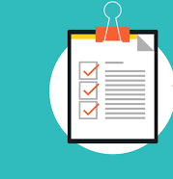
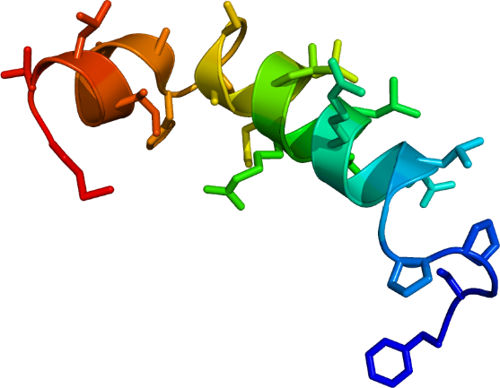
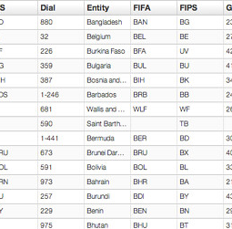
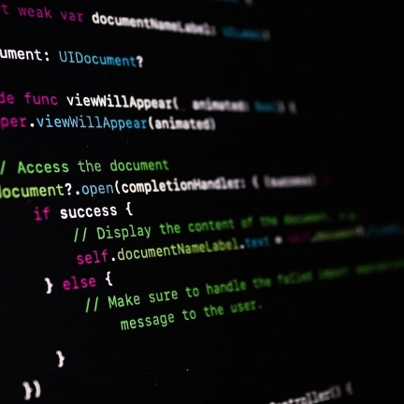
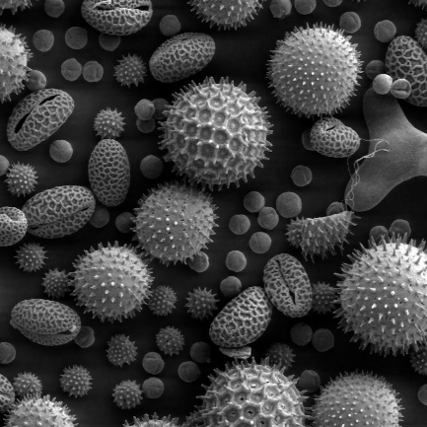

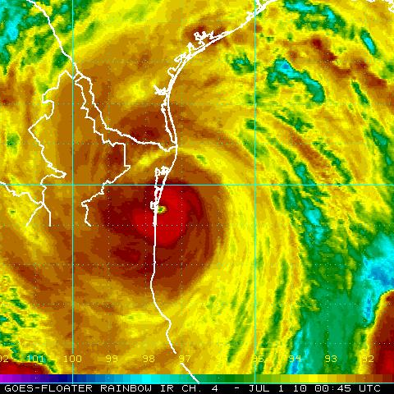
research data can mean a lot
Survey
Measurement
Observation
Code
Image
Document
Visualisation
Research data is any information that has been collected, observed, generated or created to validate original research findings.

Slide 18



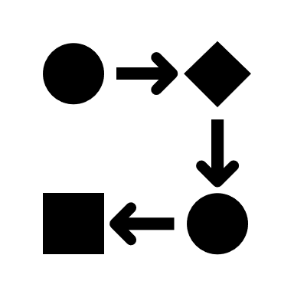

Data Description: different approaches
Write a data description paragraph
Build a project data workflow
Prepare a data summary table
Straightforward project structure
Limited number of data types
Complex project structure, small to medium number of data types.
To visualize data as input & outputs + the different processing and analysis steps.
Can help in other RDM steps: file organization & naming, documentation.
Complex project structure, medium to large number of data types.
Data sets and/or types as rows, with characteristics as columns.
To detect RDM needs: e.g. additional storage space needed, confidential data…

Slide 19
Data Description: approach 1
Straightforward project structure, limited number of datatypes
Write a description
Example
This project will produce qualitative observational data from interviews with Flemish entrepreneurs between January and June 2020. These interviews will be done by myself.
Raw data will comprise digital audio recordings of interviews and hand-written notes. Audio files will be transcribed into digital text documents and notes will be digitized to prepare them for analysis.
The audio transcription and notes digitalization will be done in MS Word M365 (.docx extension). Around 40 one-hour long interviews will be done, with file size of 250 MB per interview, giving an estimate of 10 GB for all the interviews.”

Slide 20
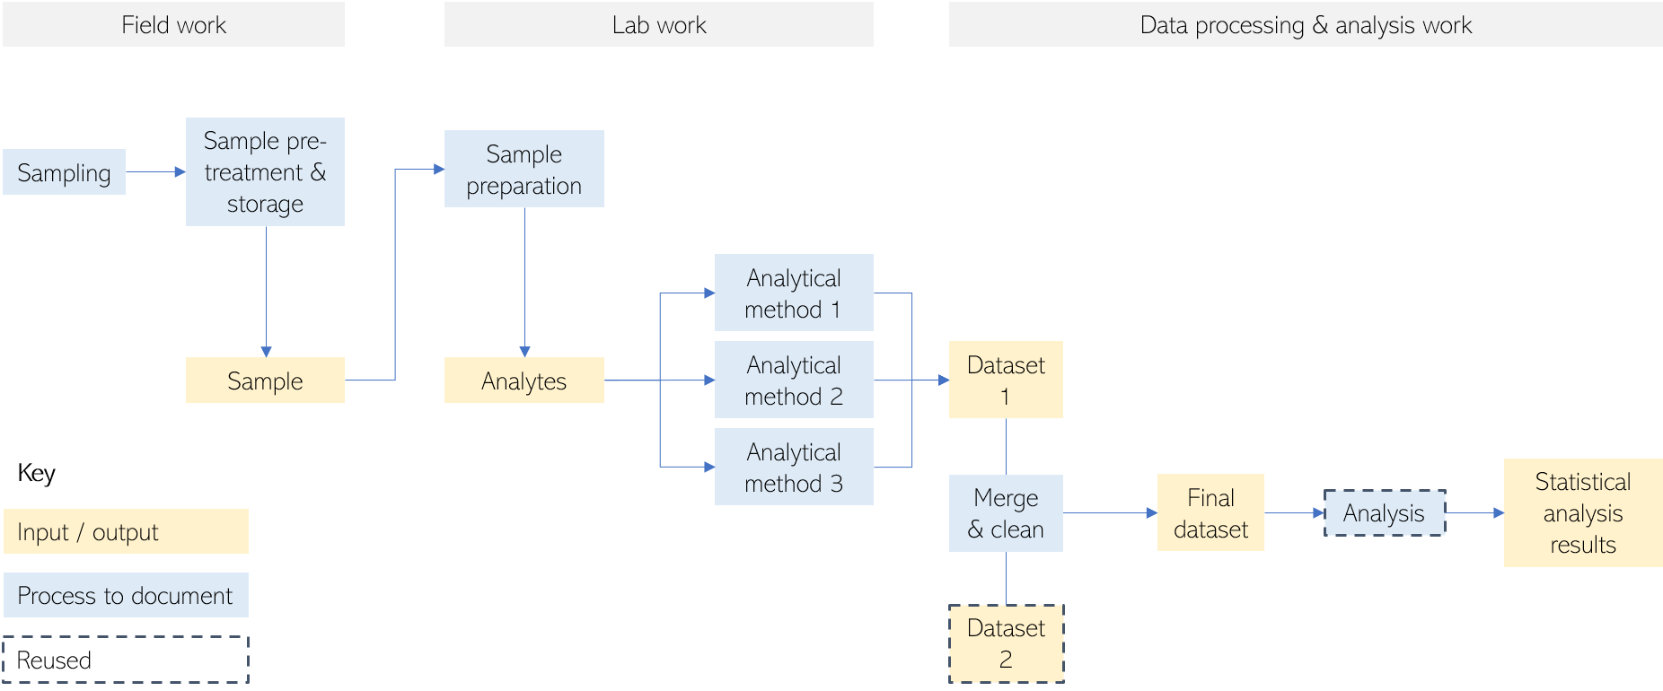
Project data flow
Complex project structure, small to medium number of datatypes
Design a data flow, add details in text or table
Example

Slide 21
Data Description: Data summary table
Work Package | Data Type | Type of data | Origin | File format | Size (estimated) | Notes
WP 1 | Qualitative | Analysis Published literature | University Library, online databases | Zotero library, MS Word .docx files | 5Gb
WP2 | Quantitative | Online questionnaire | Limesurvey | Raw extract, .csv | 500Mb
 | Quantitative | Processed data from online questionnaire | SPSS | .sav | 500Mb
WP3 | Qualitative | Raw Video recordings | Focus groups | .mp4 files | 35Gb (35 intervieuws) | Includes personal data (gdpr)
 | Qualitative | Transcriptions & processing of recordings |  | Nvivo | 1Gb | Includes personal data (gdpr)
WP4 | Quantitative | Data on household management | Data from OCMW Gent | .xlsx | 250Mb | Includes personal data (GDPR) Data received with specific terms & conditions (details in data documentation

Slide 22





Ethical & legal issues
Questions
Are there any ethical issues concerning the creation and/or use of the data (e.g. experiments on humans or animals, or dual use)? Add the reference to approval by ethical committee(s).
Is there potential for tech transfer and valorization? Will IP restrictions be claimed for the data you created? If so, for what data, and which restrictions will be asserted?
Do existing 3rd party agreements restrict dissemination or exploitation of the data you (re)use? If so, to what data do they relate and what restrictions are in place?
Will you use personal data? If so, briefly describe the kind of personal data you will use.

Slide 23
Ethical & legal issues – SOME Tips
Ethical issues
  answer ‘yes’ if e.g.
    you need permission from ethical committee and/or via informed consent for collecting & handling data (incl. archiving & sharing data)
    you work with confidential or otherwise sensitive data that need to be handled confidentially (i.e. data that could cause harm if disclosed – e.g. to endangered species, vulnerable archeological sites, national security, sensitive personal data…)
  state which ethical committee is responsible for approval + if possible, include reference to committee’s formal approval (e.g. number, approval date…)
Notes:
Ethical Committee – members
Voorzitter:
Ludovic Peferoen
Secretaris:
Damien Decorte (Damien.Decorte@UGent.be)
Leden:
Ferdinand Vieider
Evelien Opdecam
Adriaan Spruyt
Geert Poels
Frank Naert
Research ethics decision tree: here

Slide 24
Ethical & LEGAL issues – SOME tips
IP & third-party agreements
  restrictions on collecting, sharing, archiving & reusing data may be applicable, especially if
    your research has commercial potential: to valorise results, sharing may not be possible (to protect confidential knowhow) or only after embargo period (to seek patent protection first) – always contact UGent TechTransfer before disclosing anything!
    you work with third-party data/collaborate with external partners (e.g industry): check licenses/agreements to know what you can do

Slide 25
Ethical & legal issues – SOME Tips
Personal data
  = any information relating to an identified or identifiable (directly or indirectly) living individual
DMP: Will you use personal data?
If so, briefly describe the kind of personal data you will use.
  Should be coherent with (& can refer to) data description section
Will you need informed consent or permission for collecting, using, preserving and/or sharing your data?
How will you protect research participants' identities if required (e.g. anonymization, controlled access)?
How will you ensure secure transfer and storage of confidential data?
  Should be coherent with (or refer to) data storage & security questions

Slide 26
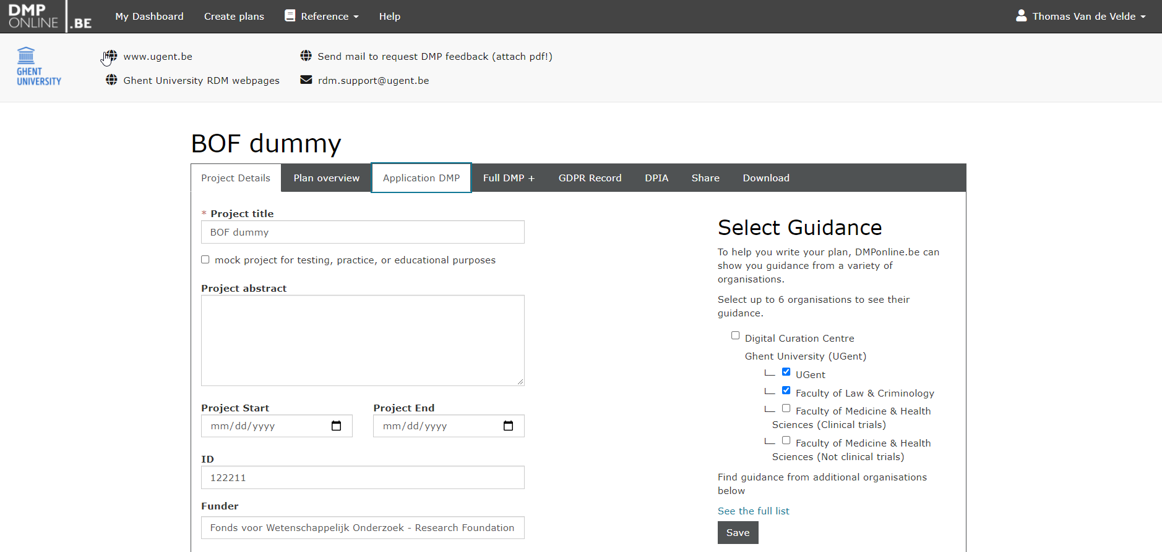

Slide 27

Data storage & security
Questions
Where will the data be stored?
Is there sufficient storage capacity?
What are the expected costs for data storage during the project? How will these costs be covered?
How will the data be backed up? What provisions are in place for data recovery?
How will you control access to the data (ensure data cannot be accessed or modified by unauthorized persons?
How will you ensure secure transfer of data?

Slide 28
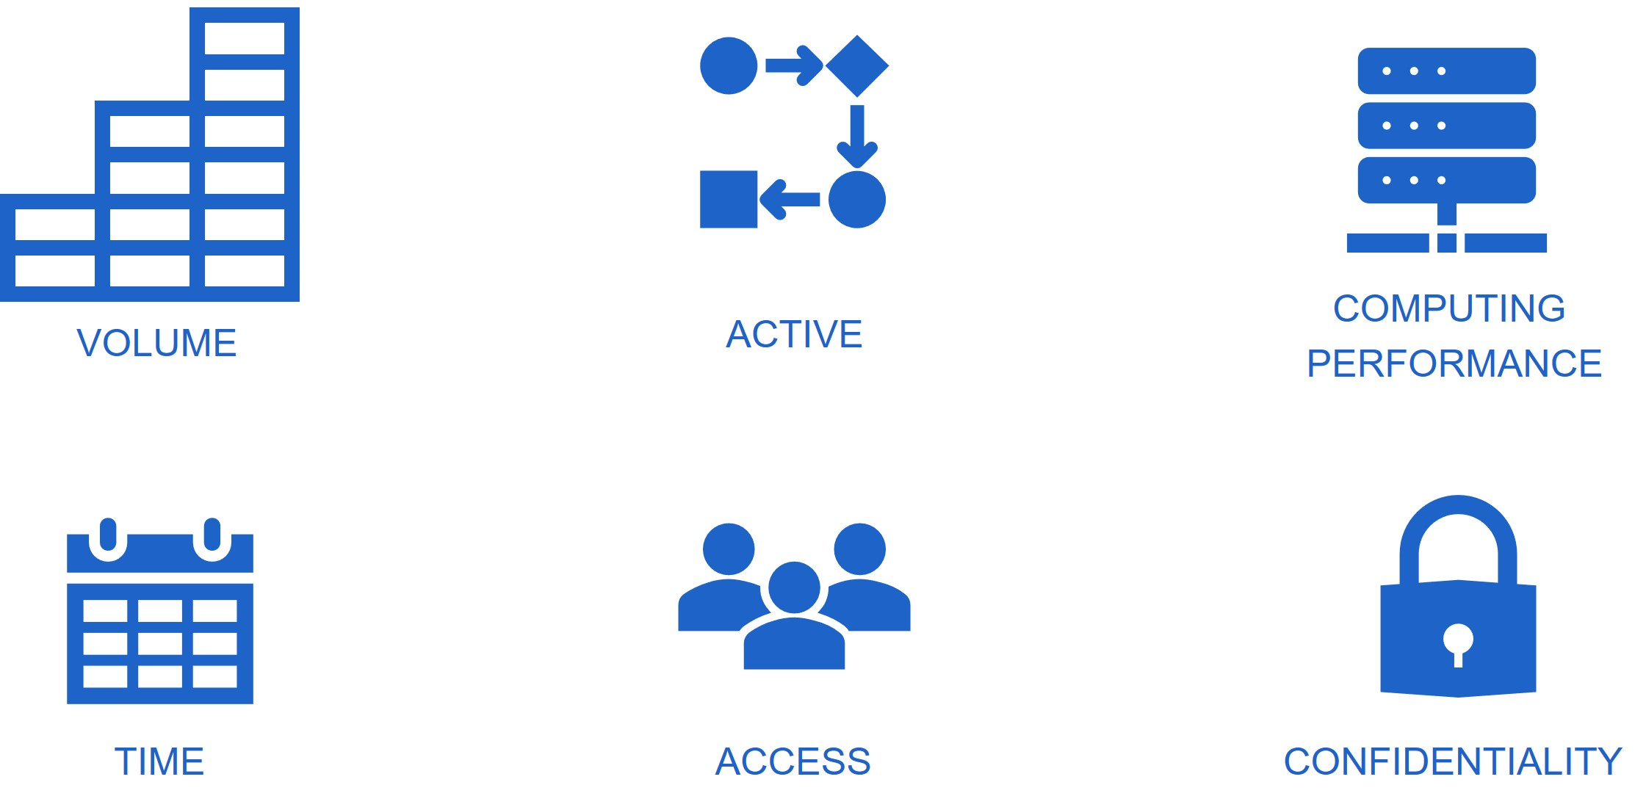
Factors influencing data storage solution
which total data volume do you expect to generate or collect?
do you want to store data that you are actively working on or do you want to preserve data?
do you need high performance computing for the analysis of the data?
how long does the data need to be stored and remain available?
who needs access to the data and how (online/offline)?
are security measures needed to safeguard the data?
Notes:
Volume: which total data volume do you expect to generate or collect?
Active: do you want to store data that you are actively working on or do you want to preserve data?
Computing performance: do you need high performance computing for the analysis of the data?
Time: how long does the data need to be stored and remain available?
Access: who needs access to the data and how (online/offline)?
Confidentiality: are security measures needed to safeguard the data?

Slide 29
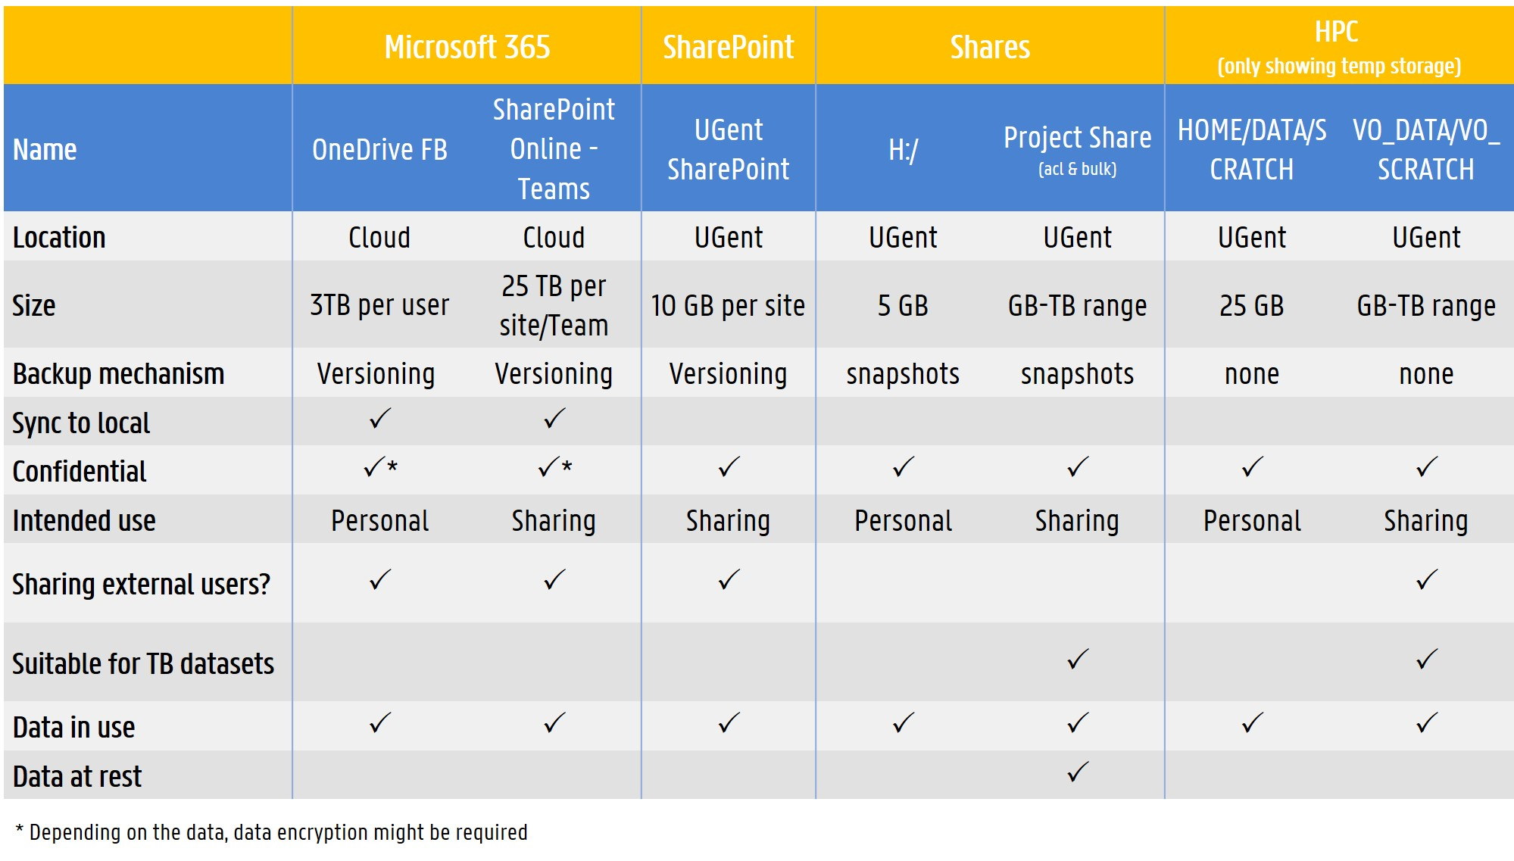
Notes:
UGent Storage options overview
ACL = access control list

Slide 30
Not one size fits all
Multiple storage solutions might be needed.
Other storage solutions:
  E.g. Other (not central) institutional storage (department or group ICT)
  E.g. multi-partner agreed storage solution
  Get informed: what provisions are in place (e.g. back-up frequency, quota, configuration of access control…)
Other (e.g. GitHub for code)

Slide 31
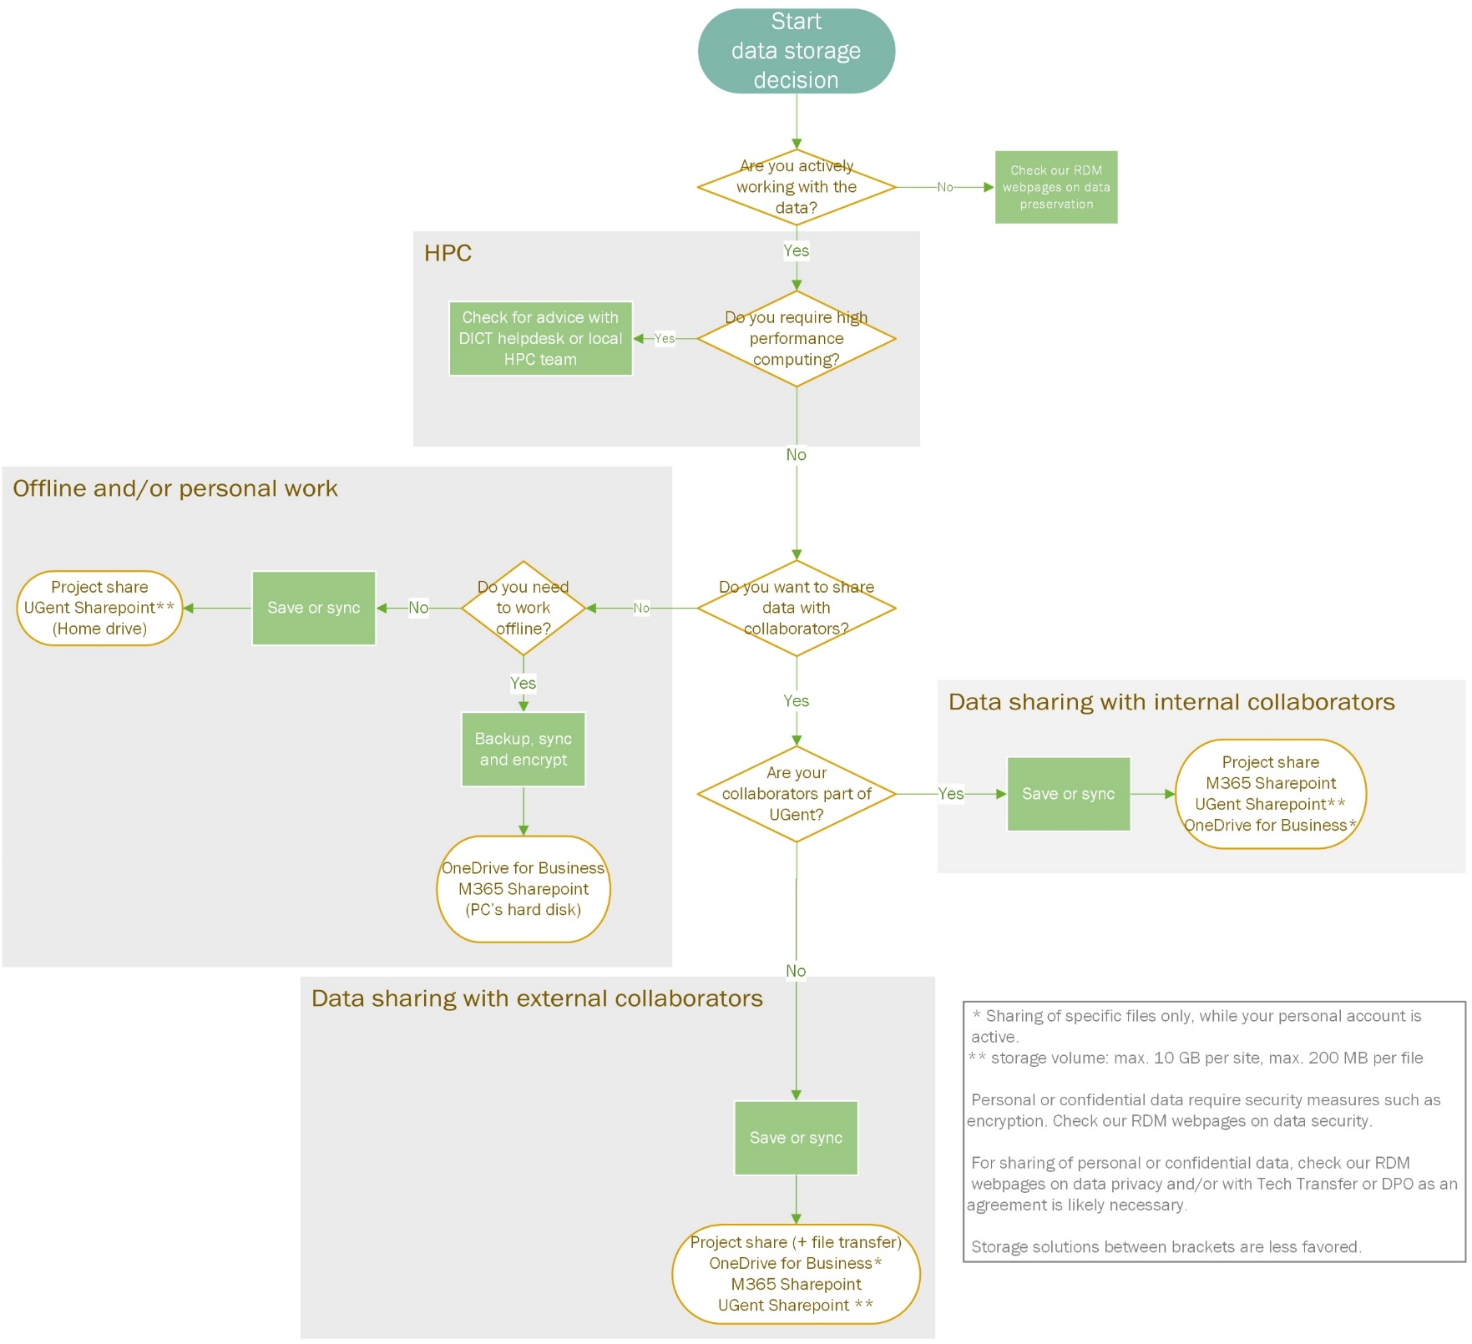
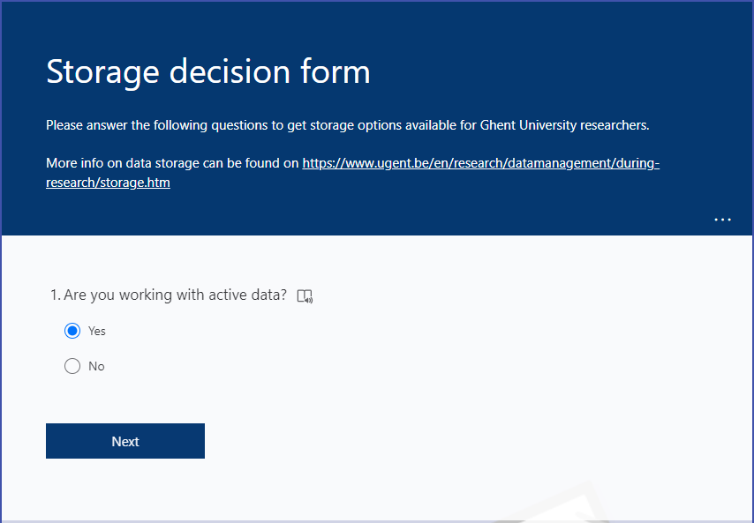
CHOOSE APPROPRIATE STORAGE SOLUTION
Decision Tree
Decision Form
https://osf.io/z73ng/
https://forms.office.com/r/AH3UBC5j3X

Slide 32
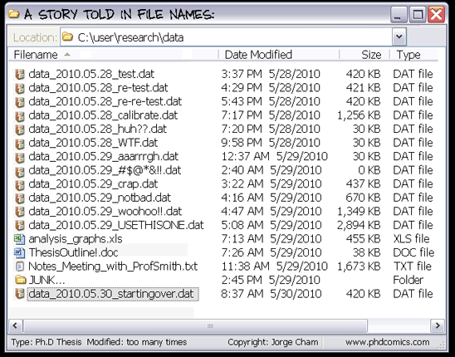
file organization: WHAT AND Why
Addressed in different sections depending on DMP template (e.g. data collection, storage, documentation.)
What?
  File naming convention
  Folder structure
  Version control
  Document your decisions!
Why?
Efficiency: to locate a file more easily
Collaboration
Avoid data loss
Keep files understandable and reusable
Harvard RDM working group, CC-BY (https://osf.io/hjntb/)
Knowledge clip: Keeping research data organized

Slide 33
Creating a file naming schema
File naming tips:
LENGTH | Avoid long names, remove unnecessary elements
SPECIAL CHARACTERS |   | Spaces Special characters: \ / : * ? " < > | ! % & - ; = () + , . Underscores camelCase |   | name date v1.txt name.date.v1.txt name/date&v1.txt name_date.txt nameDate.txt
DATES |  | Use ISO8601 YYYYMMDD |  | 20201008_name_v01.txt
NUMBERING |  | Use leading zeroes for sequential numbering |   | nameDate_1 nameData_001.txt, nameDate_010.txt

Slide 34


File naming: examples
FG1_CONS_20150309.rtf
  Interview transcript of the ﬁrst focus group with consumers, on 2015-03-09
GC-MS1_20180912_POLY03.ms
  Polymer 3 measured on GC-MS machine 1 on the September 12 2018​
FMHSurvey_Procedures_04.docx
  Version 4 of the survey procedures for the Flemish Mental Health survey​
  Health & Safety Procedures1 (no extension)
    Spaces, special character and no extension​
  SrvMthdDraft.doc, SrvMthdFinal.doc, SrvMthdFinalV4.doc
    Use consistent versioning, unable to identify the real last one​
  Focus Group consumers 12+13 Feb.mp3
    Spaces and special character​
  mydata.txt, script.R, analysis.py
    Unique?​

Slide 35
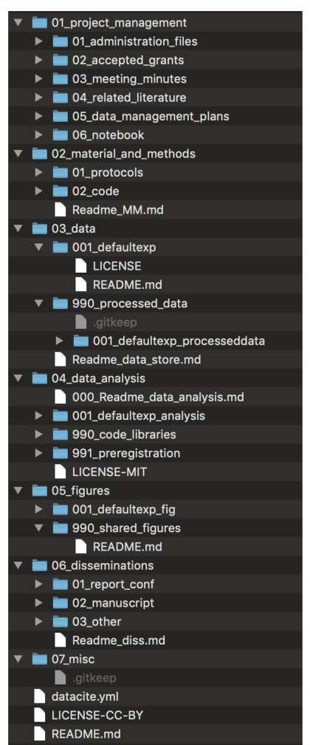
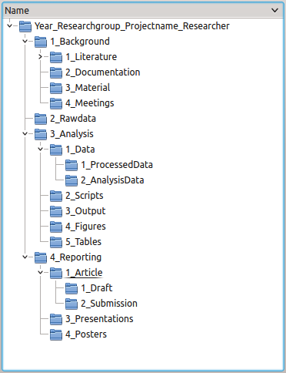
Folder hierarchy examples
README.txt (project context)
Literature
Data
  README.txt (data structure)
  01_raw
  02_processed
  03_analysed (figures and tables)
  04_external
Reports
  01_draft
  02_submission
Meetings
Scripts

Slide 36
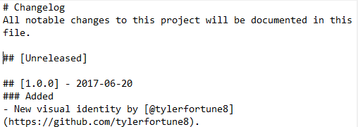


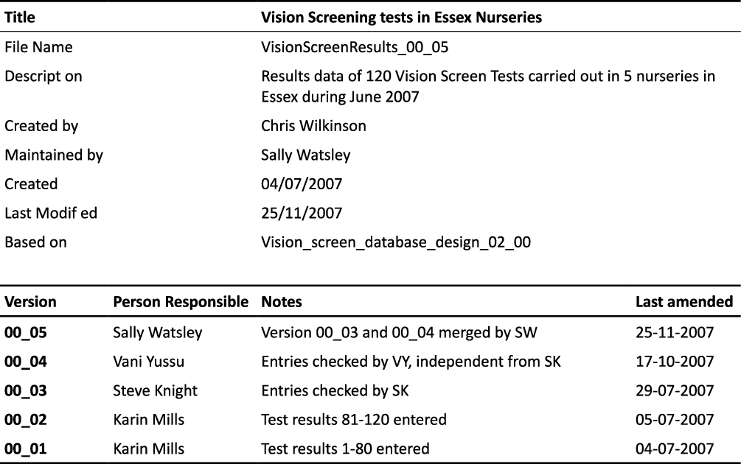


DECIDE ON Version control
  MANUAL
  AUTOMATIC
1. File name:
  based on date: HealthTest_20080406.docx
  based on version number: HealthTest_v02.docx
  Version control functionality within software (e.g. MS Ofﬁce)
  Cloud storage with version control (e.g. OneDrive, Sharepoint)
  Special purpose platforms (e.g. Open Science Framework)
  Version control software (e.g. Git and Github)
2. File header
3. Version control table within document

Slide 37

DOCUMENTATION & METADATA
Questions
How will you document the data?
  What information do your data need to make sure it remains understandable & reusable
  Where will this information be captured?
Are there any metadata standards that you intend to use?
  E.g. discipline-specific metadata standards?
  If not, what metadata will be created to make data findable & reusable?

Slide 38






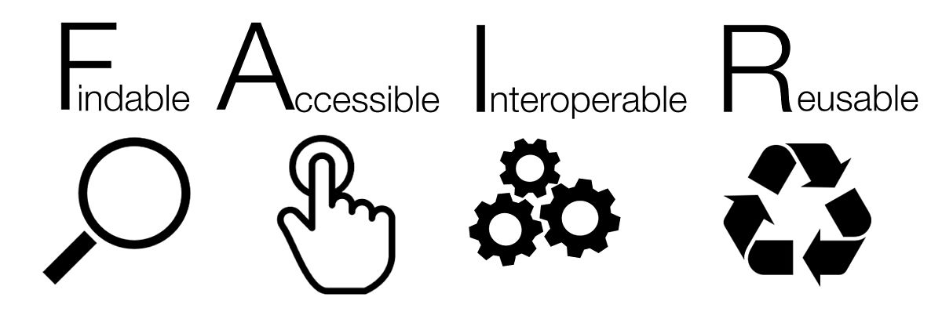
DOCUMENTATION VS. METADATA
DOCUMENTATION: any contextual information that allows data to be understandable and reusable.
WHAT
WHEN
WHERE
HOW
WHO
WHY
The dataset…
llllllllllllllll lllllllllllll
lllllllllllllllllllllllllllllllllll
llllllllll llllllllllllllllll
Metadata allows others:
  To find data
  To assess whether it is useful
  To know whether they can reuse it, and under which conditions (license), and how it can be accessed
Documentation allows others:
  To understand where the data came from and how to (re)use it
METADATA: information about data, recorded in a highly structured way, using a set of defined information fields or elements to be machine readable.
Title
llllllllllllllll lllllllllllll
Creator
lllllllllll lllllllllll
Abstract
lllllllllllllllllllllllllllllllllll
llllllllll llllllllllllllllll
Keywords
llllllllllllllllllll lllllllllllllll
Temporal scope
llllllllllllllllllll
File type
llllllll
License
lllllllllllll
Related publication
llllllllllllllllllllllllllllllllll
llllllllllllllll llllllllllllll

Slide 39
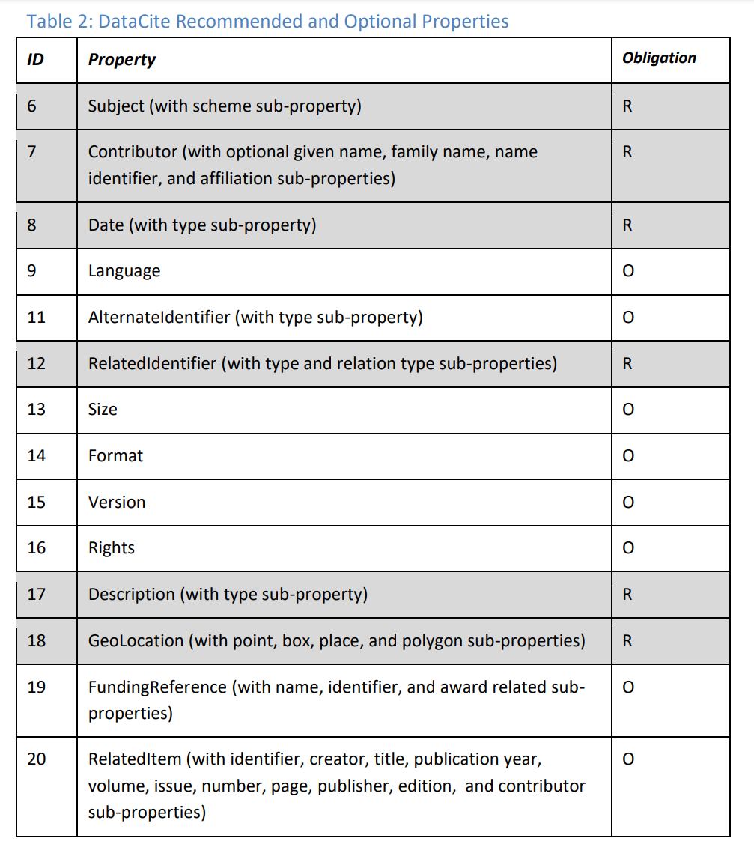
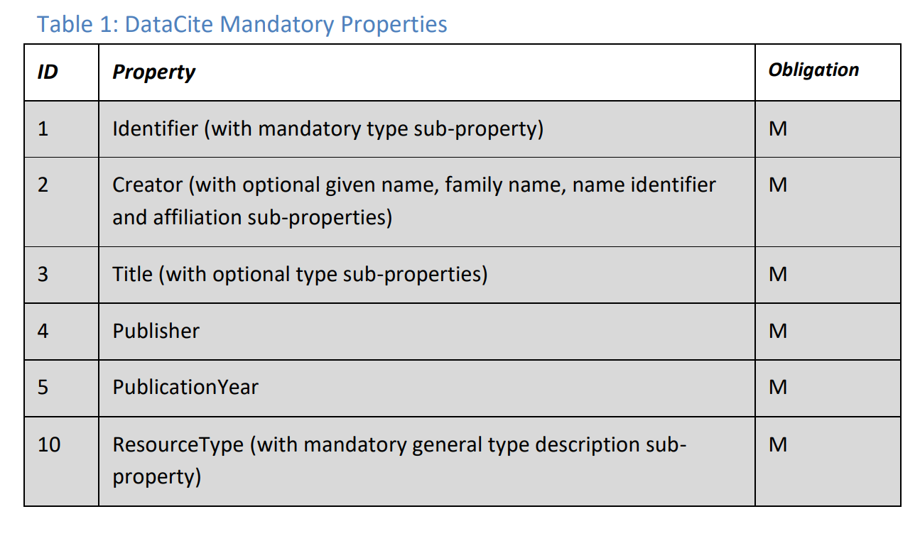
AN eXAMPLE OF mETAData Standard
The DataCite Metadata Schema
Notes:
Source: DataCite Metadata Working Group. (2021). DataCite Metadata Schema Documentation for the Publication and Citation of Research Data and Other Research Outputs. Version 4.4. DataCite e.V. https://doi.org/10.14454/3w3z-sa82
M: mandatory
R: recommended
O: optional

Slide 40
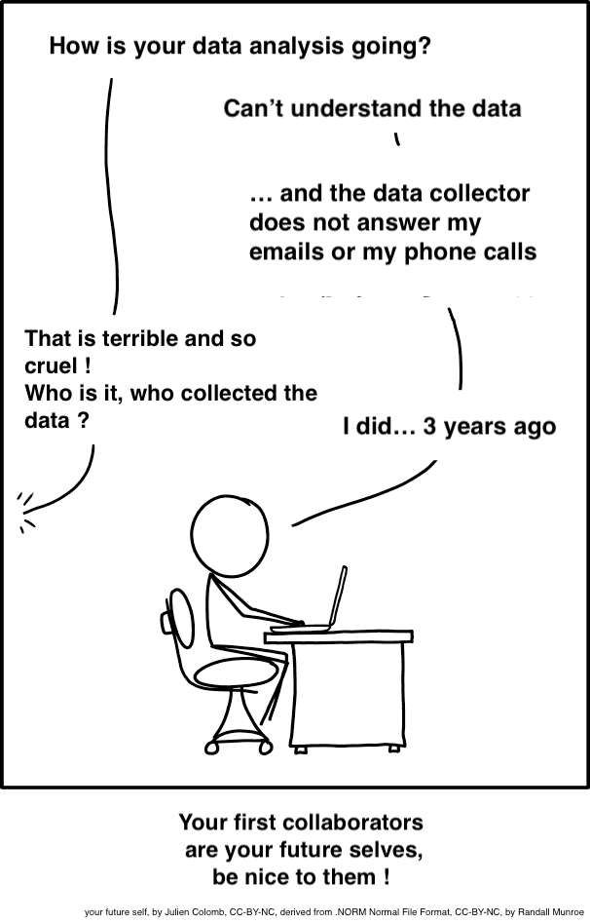
Why documenting data?
Help yourself & others:
  “Your future self will be your first collaborator”
  Will you remember or will others understand…
    what your variables mean?
      E.g. "sglmemgp" = single member of group
    the procedures used to transform or derive variables?
  Keep data understandable & reusable
Help science:
  Research review & verification
  The reproducibility crisis

Slide 41


Levels of data documentation
DOCUMENTATION LEVEL
WHAT TO DOCUMENT
WHERE TO DOCUMENT
Item
Variable
Methods, units, possible values,
synonyms, abbreviations
Codebook, data dictionary
Sample
Study object
Study object, method, instrument
settings, time, place
(Register) table, protocol, notebook
File or database
File inventory and relations, database structure
Readme, database schema,
data listings (qualitative data)
Project or study
Subject, grant, contributors, methods, process, workflow
Notebook (e-, code), document, protocol, readme, data inventory table

Slide 42
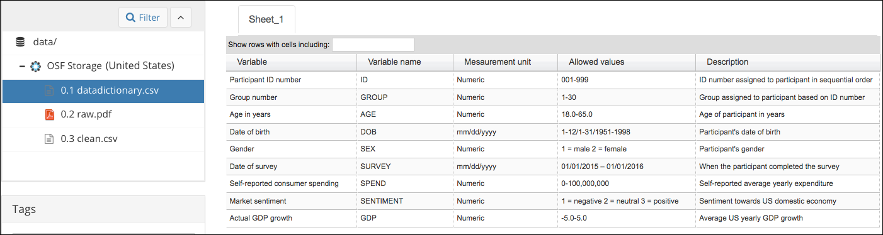
VARIABLE OR ITEM LEVEL
WHAT?
Code books or variable dictionaries
  Variable labels & meaning
  Attributes, expected values, units
  Codes, abbreviations, classification schemes
  Variable derivation & processing steps: what & why
WHERE?
Embedded in file: content limitation and conversion risks
Separate file
How to Make a Data Dictionary

Slide 43
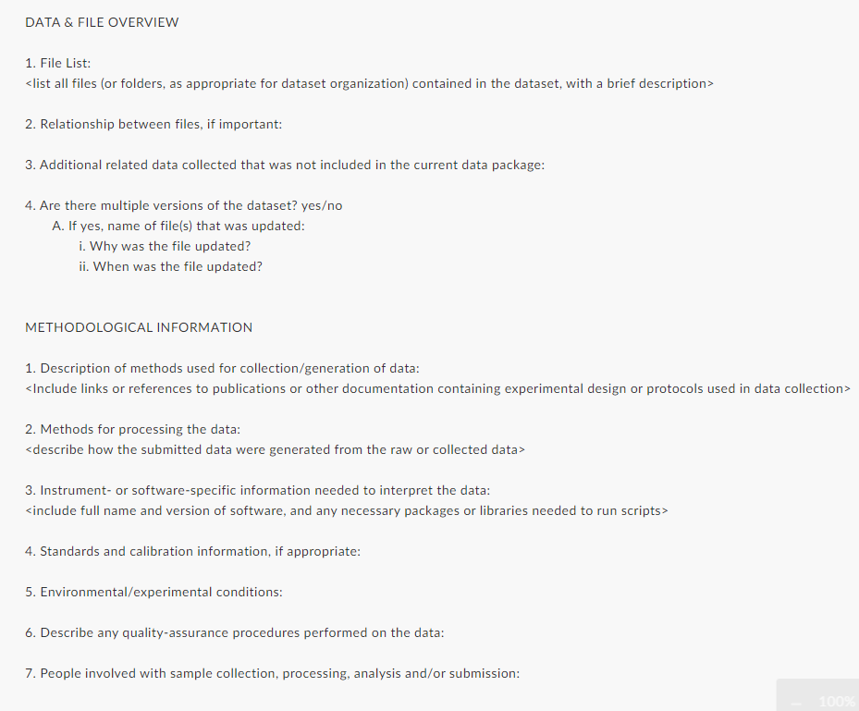
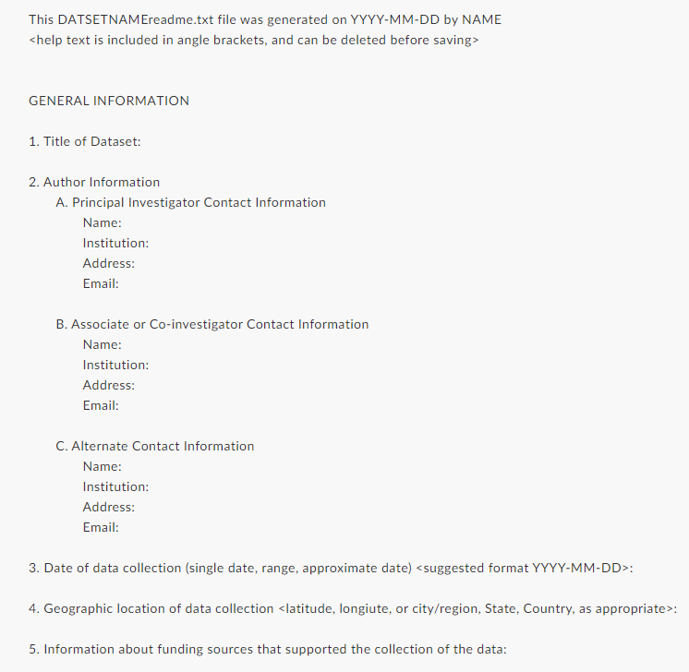
Readme files
Readme template

Slide 44

Data PRESERVATION
Questions
Which data should be retained for preservation and/or sharing?
  Explain why some data will not / cannot be preserved (this (legal or contractual restrictions, physical preservation issues, ...).
What is the long-term preservation plan for the selected datasets?
  Where will these data be archived (= stored for the long term)?
    E.g. data repository or archive?
    If not, how will you ensure effective data curation beyond the end of the research project?
Expected costs for data preservation?

Slide 45

Data Sharing
Questions
Are there any factors restricting data sharing?
  E.g. personal data, IP rights, 3rd party agreements…
  Is it possible to overcome restrictions on data sharing (e.g., anonymisation, controlled access procedures)?
Which data will be made available after the end of the project?
Where/how will the data be made available for reuse?
  E.g. Data repository.
  Will your data have persistent identifiers (e.g. DOIs) so that other users can cite them and acknowledge your work?
When will the data be made available?
  Embargo needed?
Who will be able to access the data and under what conditions?
Expected costs for data sharing?

Slide 46
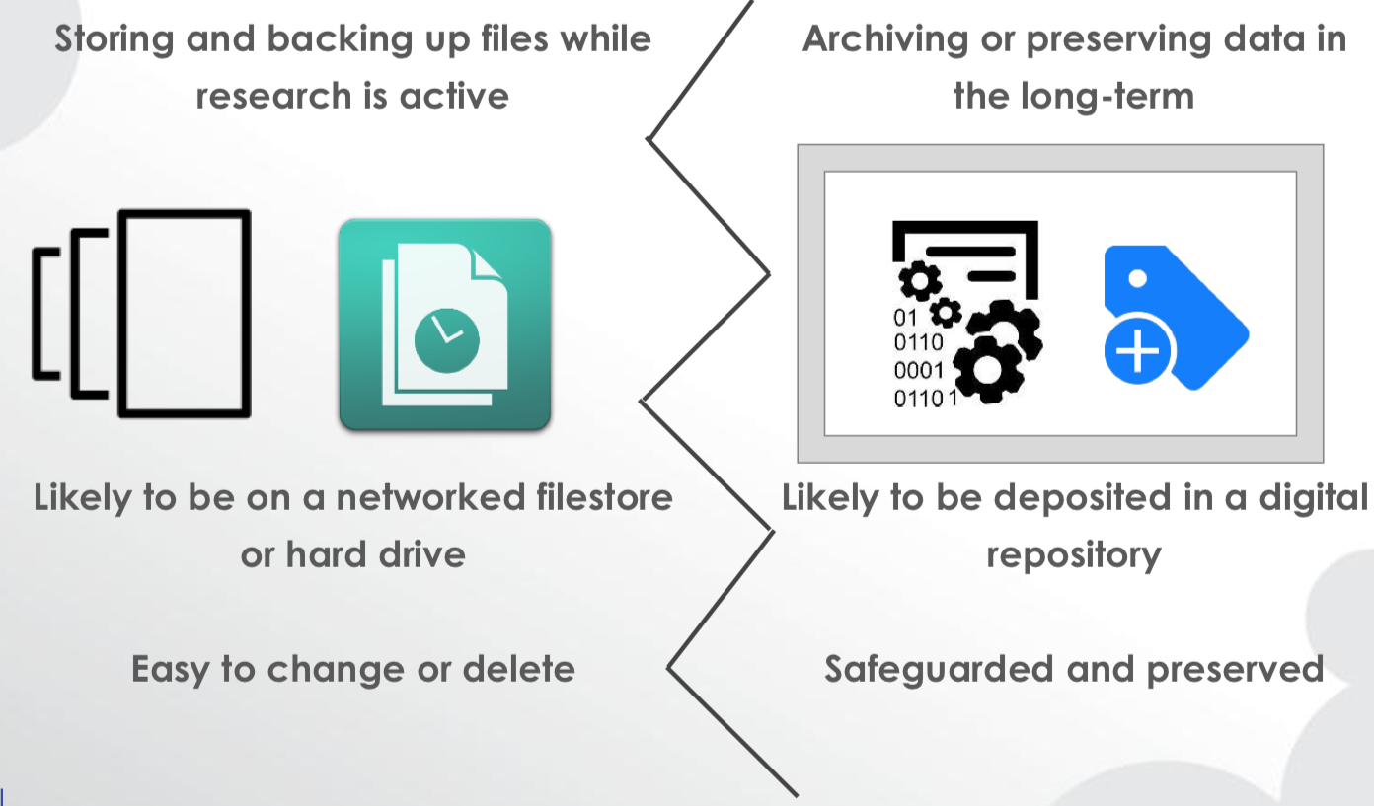
Storing vs. preserving
Keep in mind the difference between storing & preserving data!
Storing:
  Active data, while you are still busy with the project.
  Easy and quick access needed.
Preserving:
  At rest, non-active data.
  Preserving ≠ not deleting data
  Requires preparation & curation:
    Ensure long-term accessibility, keep data understandable and reusable
From ‘What you need to know to prepare a data management plan’ by Marjan Grootveld, licensed under CC-BY

Slide 47
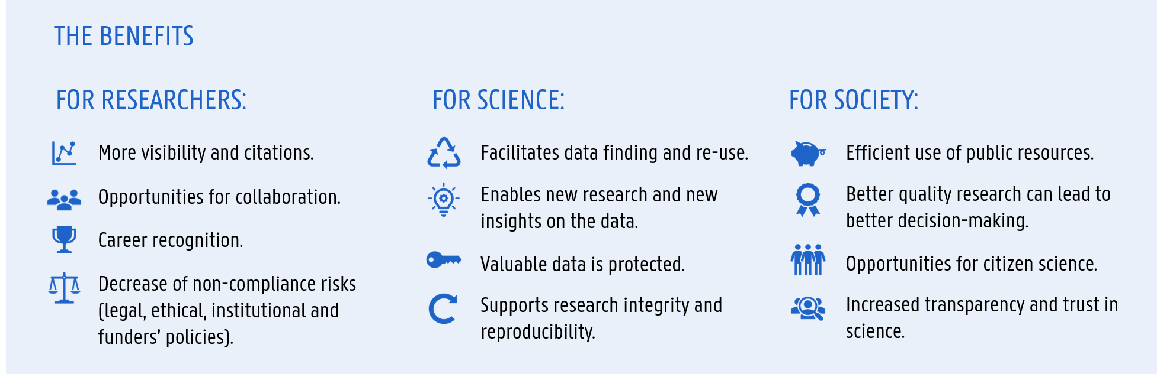
Why preserving and sharing data?
  Enabling data reuse (yourself & others)
  Research integrity: ensuring that your research can be verified and reproduced
  Increasingly required by research institution, funders, journals…
Notes:
Ghent University's RDM policy framework expects 'relevant' research data to be preserved for a minimum of 5 years. In the first place, this means data that are reasonably needed to verify and reproduce published scientific claims. Data with high reuse potential are also relevant to keep for the longer term.

Slide 48
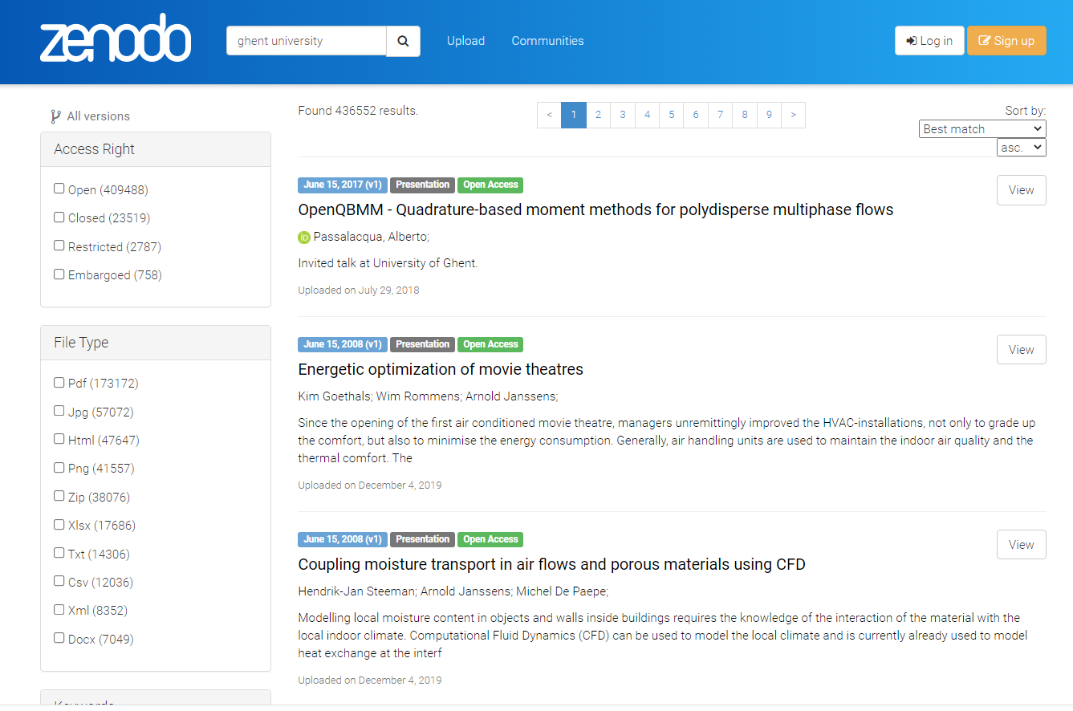
Archived
DOI
Secure
Access Rights
Able to Share
Able to cite

Slide 49
What to preserve? Selection criteria
Not all data might need to be kept, especially after the mandatory retention period.
What is required?
  Legal or ethical requirements: what and for how long.
  Institutional, funder, journal policies. E.g. UGent & FWO = min. 5 years.
For which purposes are you preserving data?
  Research verification
  Future reuse
  Other (e.g. education)
Uniqueness and value of data
Cost-benefit
You know your data best!
More: https://www.dcc.ac.uk/guidance/how-guides/five-steps-decide-what-data-keep

Slide 50
Where to preserve data?
Research data and documentation selected for retention should be kept in a suitable location and in a secure manner to ensure that they remain available and usable beyond the end of your project, with appropriate access rights, and in sustainable formats.
Suitable location -> main purpose of preservation? (verification, internal or external reuse).
Data repository
  Recommended / preferred practice.
  The option when goal is sharing & reuse.
In house
  Sometimes it is not be possible/appropriate to deposit data in an external repository, e.g. for legal, ethical, contractual, practical, or other reasons.
  Data needs to be preserved for verification purposes
  Best in-house option: project shares.
Notes:
However, sometimes it may not be possible or not appropriate to deposit data in an external repository, e.g. for legal, ethical, contractual, practical, or other reasons. In such cases, research data selected for preservation will need to be kept in-house.

Slide 51

What is data sharing?
Sharing data from
  completed (parts of) research projects
  outside your project or research team.
Not
  exchanging data with collaborators while your research is active.
  Share data with your promotor

Slide 52
ways of sharing data
Depositing in a repository explicitly required by some funders and some journal policies
Personal or project website
Data repository or archive
Article suppl. material

Slide 53
Legal aspects in data sharing
Are there any factors restricting data sharing?
Is it possible to overcome restrictions on data sharing?
Who will be able to access the data and under what conditions?

Slide 54
licenses
Licenses: means for owners of rights (in datasets) to grant permission(s).
Define what can and cannot be done with data in a clear way.
  Nature: expand rather than restrict what can be done.
  E.g, data may be ‘publicly available’ but, without license, users do not have permission to access, use and share it under copyright or database laws.
Licenses are not automatic.
Avoid custom-made licenses / agreements as much as possible (not always possible).
Standard licenses: terms and conditions are already defined.
  Creative Commons, Open Data Commons, open software licenses

Slide 55
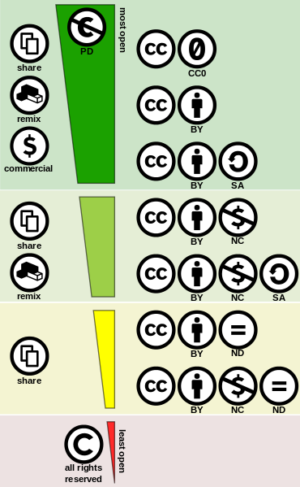
Creative commons
Permissions
Conditions
CC Licenses grant permissions under certain conditions:
  Attribution (BY): give proper credit to the original creator
    Stacking, long chain of derivations, manual inspection of contributions.
  Copyleft (Share Alike): license the new (derived) creations under the identical terms (same license).
    Can be difficult to fulfil.
  Non-commerciality: to prevent the new (derived) work to be commercially exploited.
    Subject to interpretation (“commercial use”): e.g. journal can make profit while author doesn’t.
  Non-derivatives: no adaptations can be made.
    Strong limitation for dataset reuse and/or integration..
Notes:
Creative Commons is a non-profit corporation set up in 2001 for the purpose of producing simple yet robust licences for creative works

Slide 56
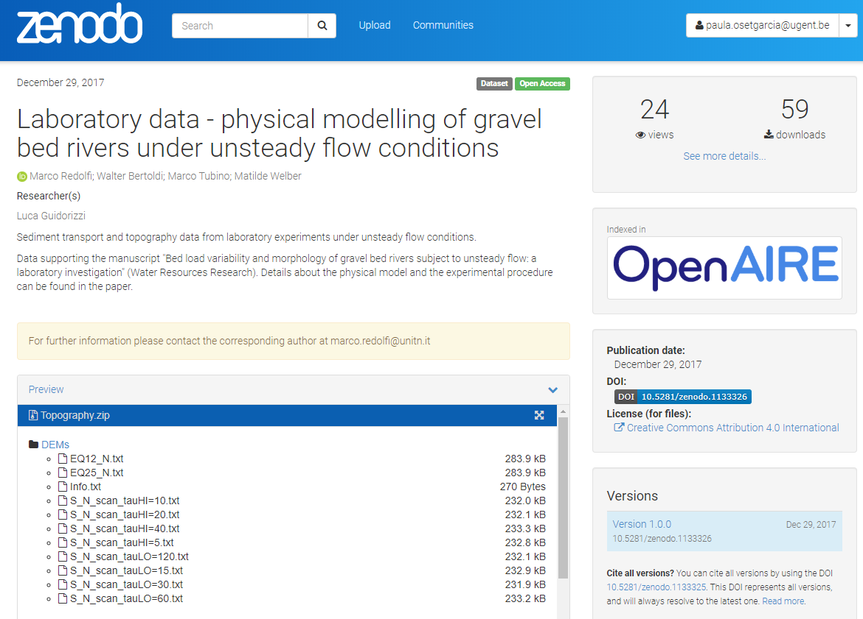

Slide 57
CLOSING REMARKS

Slide 58
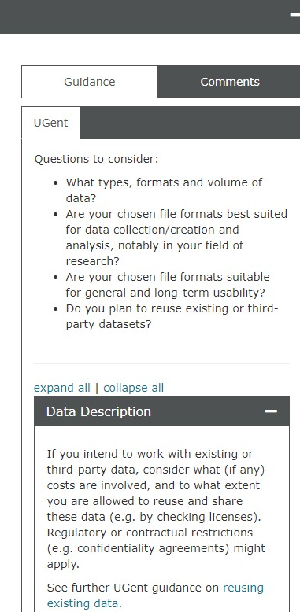
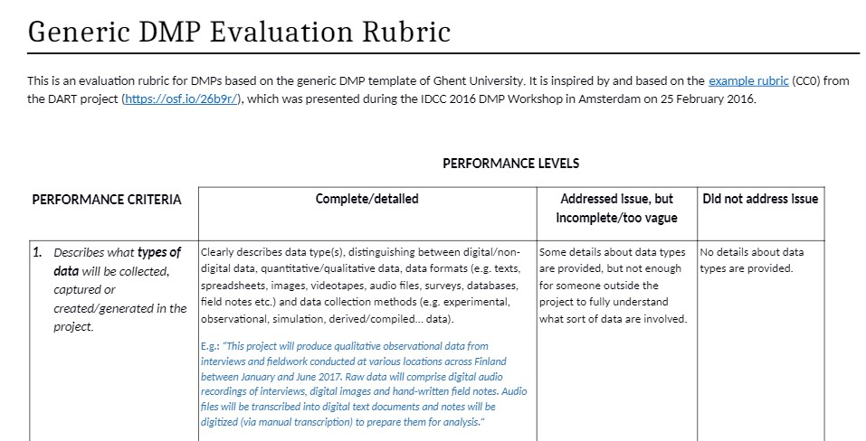
don’t GET OVERWHELMED
DMP evaluation rubrics
DMPonline.be

Slide 59
Need help or information?
Data Stewards:
https://www.ugent.be/en/research/datamanagement
rdm.support@ugent.be
UGent Tech Transfer:
https://www.ugent.be/techtransfer/nl
Via GISMO
Privacy & GDPR:
Data Protection Officer (DPO): Hanne Elsen
privacy@ugent.be
https://www.ugent.be/en/research/datamanagement/policies/privacy.htm

Slide 60



Ziad Choueiki
Data Steward
Faculty of Economics and Business administration
Faculty of Psychology and Educational Sciences
Faculty of Political and Social Sciences
E rdm.support@ugent.be www.ugent.be https://www.ugent.be/en/research/datamanagement
Universiteit Gent
@ugentRDM
UGent Data Stewards

