Slide 1
Citizen science @ ITM
2023
Notes:
Jef: inleiding tot en met dia 23

Slide 2
What to expect
A bit of theory
Examples of different citizen science projects
The tip of the iceberg
Notes:
Inleiding en voorbeelden (20') 13:30-13:50
Tip of the iceberg: there is so much to talk about!
Motivations for doing CS, available networks and infrastructure, communication and long term engagement with participants...

Slide 3
?
Have you heard of ‘citizen science’ before?

Slide 4
?
Have you been involved in CS?
As a citizen scientist?
As an initiator or facilitator?

Slide 5
?
Do you know of any examples of citizen science?

Slide 6
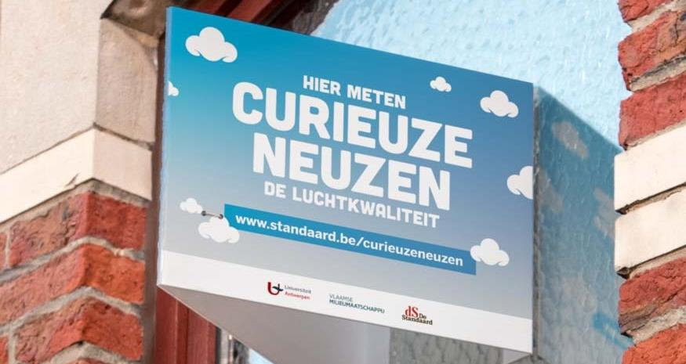
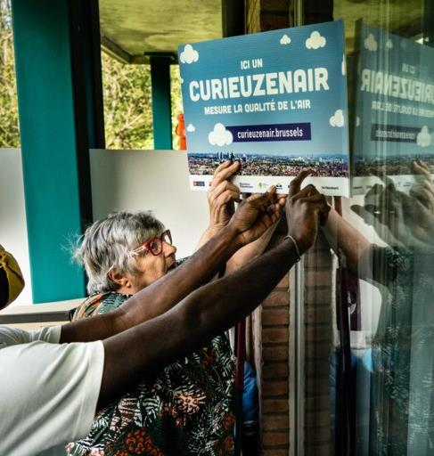
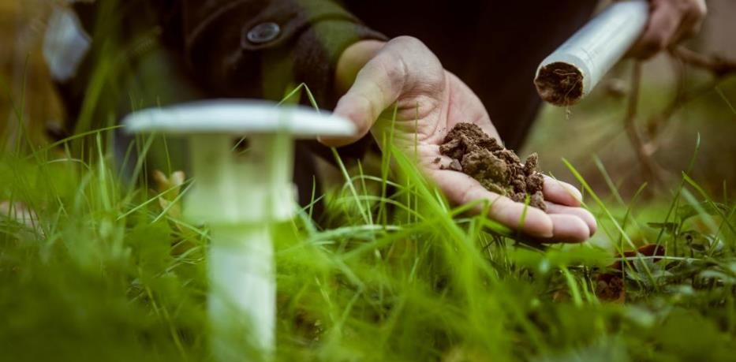
Notes:
Most famous example of CS in Flanders

Slide 7
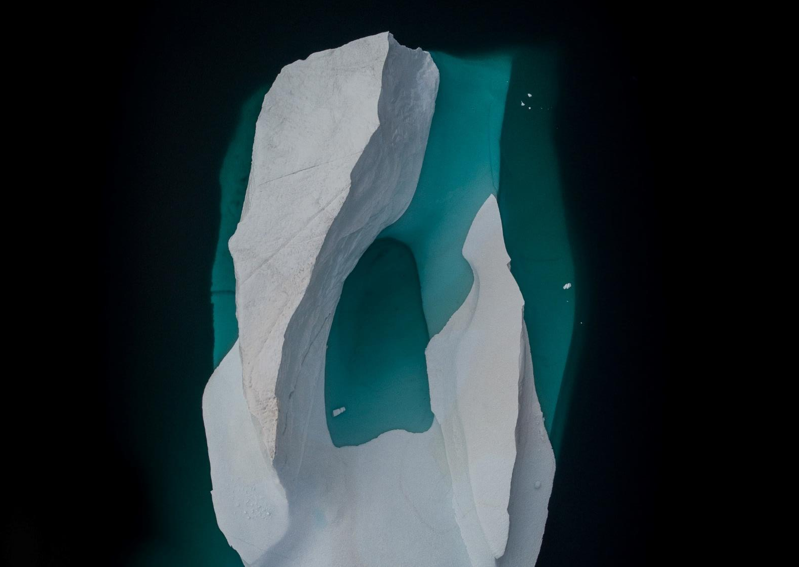
Research domains
Air quality
Mobility
Biodiversity
Water quality
Noise
Archaeology
Astronomy
Genealogy
History
Health
Art
Sociology
Wellbeing
Paleontology
...
Research actions
Sensors
Measure
Count
Observe
Photograph
Analyse
Annotate
Transcribe
Interpret
Communicate
Determine research question
Design research protocol
...
Notes:
But citizen science is also much more than curiosities or air quality. It can be about any topic (...list). And it's also about much more than just measuring things and using sensors. It can be about ... (enumerate). It can be about co-determining or self-determining research questions or developing a research protocol. So the actions that citizens perform within a citizen science project can be very diverse. So all in all, citizen science projects are actually very diverse

Slide 8
Citizen Science
What?
Noun
Citizen Science is scientific research conducted, in whole or in part, by nonprofessional scientists (citizens). Citizen science is often (but not always) conducted in collaboration with professional scientists.
Oxford English Dictionary
Citizens conducting scientific actions
Formulate
RQ
Datacollection
Designing
methods
Data-analysis
Reporting and dissemination
Notes:
Wanneer spreken we dan van citizen science? Voor ons spreken we van citizen science wanneer er wetenschappelijk werk door het brede publiek wordt uitgevoerd. Dat is vaak – maar niet altijd – in samenwerking met professionele wetenschappers. De kern is dat het gaat om burgers die wetenschappelijke acties uitvoeren, en meestal kaderen die binnen data-collectie of data-analyse maar eigenlijk kan dat gaan over eender welke stap in het onderzoeksproces. Het kan zeker ook gaan om burgers die mee of zelf een onderzoeksvraag opstellen, die een onderzoeksmethode of sensor ontwikkelen of burgers die meewerken aan de rapportering en communicatie van een onderzoek. Dat zijn ook allemaal mogelijke aspecten van citizen science.
Public participation
What's a nonprofessional scientist?

Slide 9
What?
Citizen
Science
Notes:
Burger → participatorische rol, maar niet enkel zomaar iets doen
Ook Science → bijdragen aan de ontwikkeling van nieuwe wetenschappelijk onderbouwde kennis

Slide 10
ECSA 10 principles of Citizen Science
Citizens are actively involved as contributors, collaborators or project leader
Citizen science projects have a genuine science outcome
Both scientists & citizens benefit from taking part
Citizen scientists receive feedback & acknowledgment from the project
Citizen science is considered a research approach like any other
Citizen science project leaders consider the legal, ethical and privacy implications of their activities
https://ecsa.citizen-science.net/

Slide 11
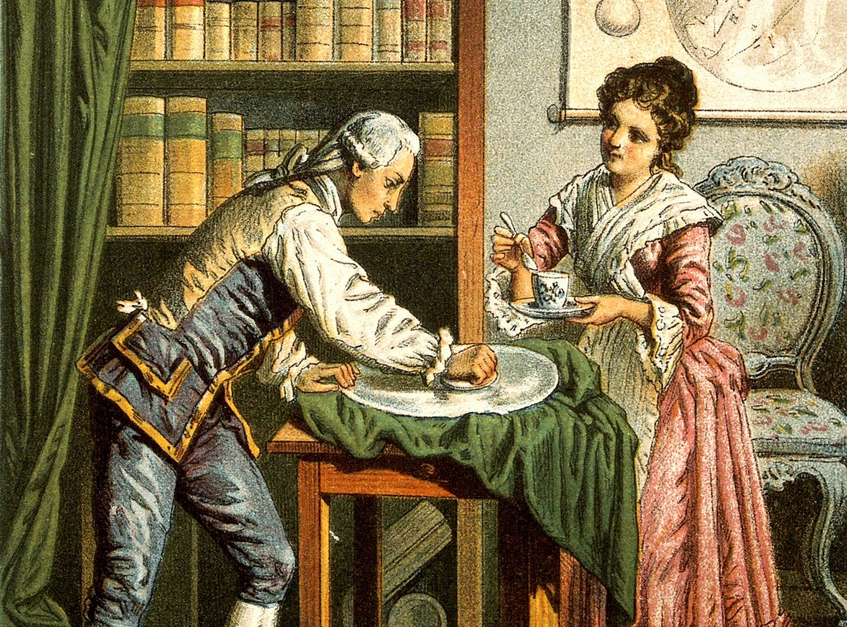
Citizen Science
nothing new
Notes:
Before the late 19th century: very little ‘institutionalised science’.
Science was not a professional activity
AngloSaxon world 18th – 19th C.: performed by ‘gentlemen scientists’ (people, mostly males, rich, with enough free time to dedicate to science, almost like a hobby.)
EG :William Herschel: a succesful German organist, composer and conductor living in England at the end of the 18th C, started to develop an interest in astronomy, built his own telescopes, which led to the discovery of Uranus.
Dragged along his sister Caroline into his passion for Astronomy. Ultimately, she came into her own as a renowned astronomer herself, focusing on the discovery and cataloging of comets, nebulae and star clusters.
Both scientists are actually on a turning point in science history: both (!) ended up earning a salary for their scientific work and became members of the national (royal) science societies and academies (in the Herschels case: the Royal Astronomical Society), bodies at the forefront of directing and rewarding scientific efforts.

Slide 12
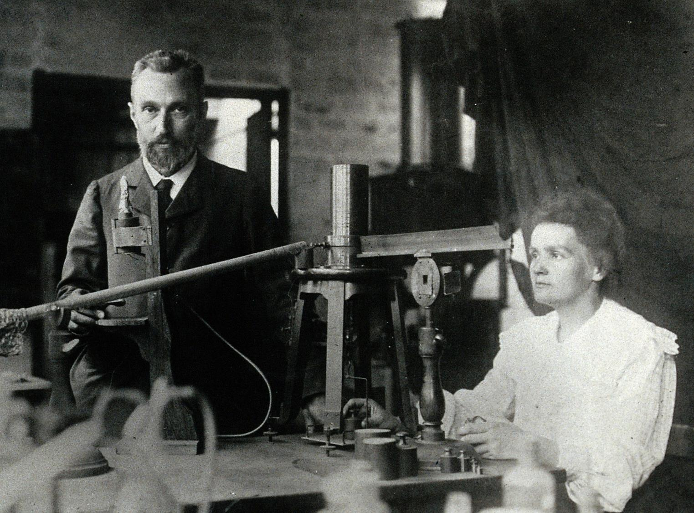
Maria Sklodowska & Pierre Curie (1904)
Notes:
Maria Sklodowska & Pierre Curie (1904)
Formally educated to become scientists, perform their work in a laboratory
Rise of science as a professional activity, while it allowed democratisation in regularly paying scientists for their work, only performed by experts in their fields and caused an increasing gap with society.
(although it could be argued that well to do ‘gentleman scientists’ of the centuries before were in some ways just as (if not more) detached from huge parts of society.)

Slide 13
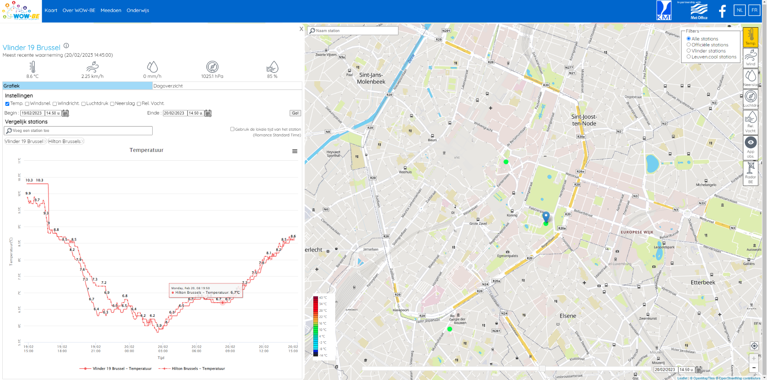
Notes:
Going even further back, the Belgian Royal meteorological institute has been gathering data by volunteer weather observers since the 19th century.
Since a few years, data from automatic weather stations are recorded on Belgium’s WOW (Weather Observations Website)

Slide 14
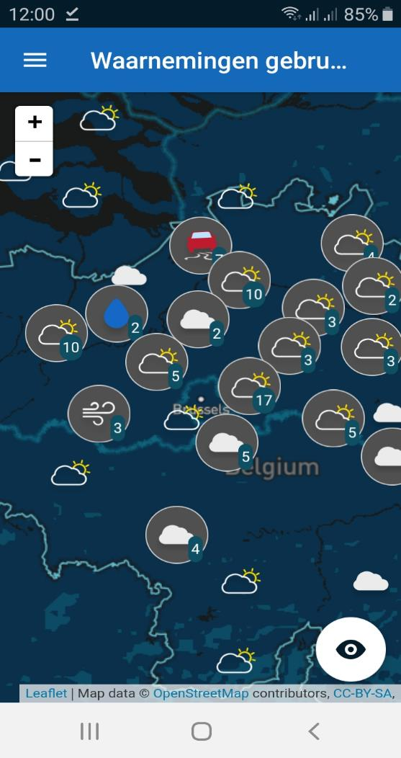
KMI weather app: available for android and IOS
Notes:
In addition to this, users of the KMI’s weather app can also upload their own ‘on the spot observations.
Technological innovations, like the widespread use of internet and of mobile phones as sensors, have been an important driving force for innovations in CS the past decade(s)

Slide 15
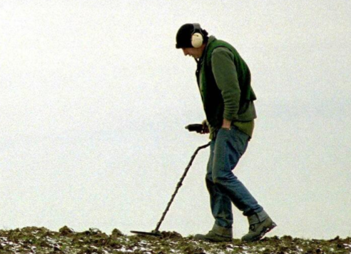
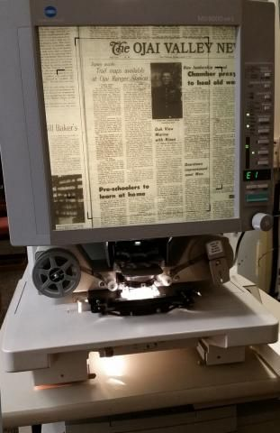
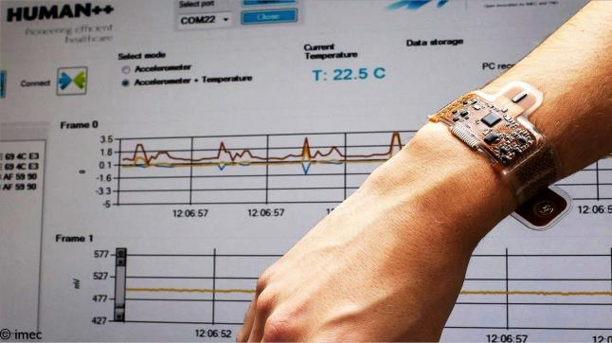
What’s in a name?
Notes:
What’s in a name: verwantschap met andere participatieve processen (co-design, participatieve democratie, smart city,...)
What’s in a name: niet elke burgerwetenschapper noemt zichzelf zo
Metaaldetectie: bijdragen aan Onderzoek via musea/medea.
Archief: heemkundige kring etc...

Slide 16
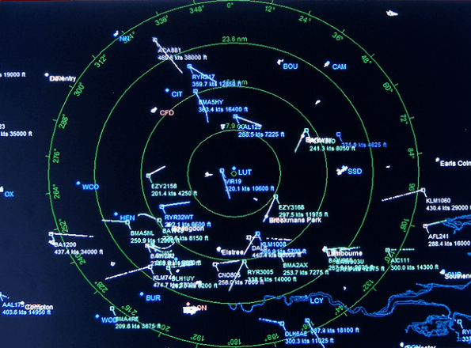
Notes:
Daarom blijven veel projecten onder onze radar:
ze zijn klein en begeven zich niet in het netwerk dat we de afgelopen 4 jaar uitbouwden
Ze noemen zichzelf geen ‘citizen science’, en voelen daarom ook geen link met een organisatie als Scivil

Slide 17
Why?
Lots of data New places
New questions
Research
Societal impact
Education
Learning
Research Process
Critical Thinking
Awareness
Policy influencing
Behavioral change
Notes:
So, CS engages the public in research or monitoring processes. Not only does it allow for extensive data collection, relying on the ‘wisdom of the crowd’. It’s also a powerful method for education, awareness and community building.
Why does one engage in citizen science? First of all, there must always be research. Citizen science is a way to involve citizens in research or to initiate research from within the citizens themselves, but there must always be a research question. Citizen science opens up new possibilities for research, for example because more data can be collected, new types of data can be collected, new places where data can be collected, new types of research questions that can be addressed, especially when citizens are involved in formulating the research questions. Research can be done in new ways
(research:
In addition, there is almost always an educational component to such a project. The people who participate in such a project learn a great deal, both in terms of content, for example about air quality or biodiversity, ... whatever the project is about. But they also learn about the research process by actively participating in it. They also develop a critical mind about data, about scientific research, by learning more about the different steps involved in doing research, and so they are also a little better armed against, for example, fake news.
The final component, which is often present but not always, is social impact. Many projects - such as projects on air quality or mobility - that strive for a social impact, for example, under awareness of a problem and possibly linked to it behavioral change and putting things on the map so that something in society changes or improves. And in that sense, citizen science can also be a powerful tool to evidence-based policy.

Slide 18
Who?
Researchers
Citizens and citizen movements
Schools
Governments
Companies
NGOs
Notes:
Wie doet er allemaal aan cititzen science of wie kan er citizen science projecten opzetten? In eerste instantie denken we dan aan de wetenschappers en de individuele burgers, maar daarnaast is er zeker ook plaats voor heel veel andere groepen of sectoren binnen citizen science.
Citizen science kan zeker ook voor overheden en voor het beleid een interessant instrument zijn om aanvullende data te verzamelen boven op de beleidsmonitoring die al gebeurt. Maar evengoed voor NGO’s, vzw’s, bedrijven, die een lokaal probleem willen aanpakken, zich willen inzetten om maatschappelijke impact te bereiken of om bepaalde dingen in kaart te brengen en daarbij het brede publiek te betrekken.
CS is ook een hele mooie aanpak binnen het onderwijs om leerlingen in contact te laten komen met actueel wetenschappelijk onderzoek en het onderzoeksproces zo van binnenuit te kunnen ervaren. Zo leren ze Wetenschap op een hele andere manier kennen, niet enkel vanuit de theoretische lessen maar ook vanuit de praktijk, vanuit concrete ervaringen. Projecten die zich op het onderwijs richten kunnen steeds rekenen op veel enthousiasme van de leerkrachten en leerlingen. Daar komen we straks voor de onderzoeksvraag nog op terug.
BUT OFTEN SAME PEOPLE
--> white highly educated males --> inclusiveness?

Slide 19
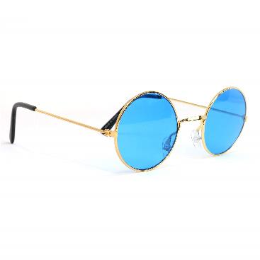
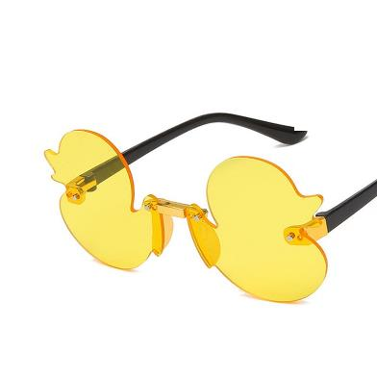
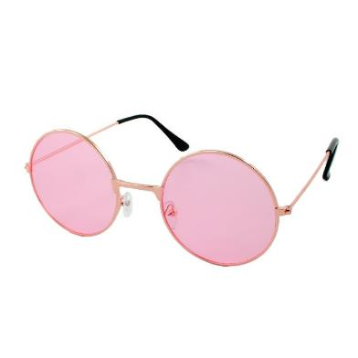
Different actors = Different perspectives
Who?
Notes:
Verschillende perspectieven
Bvb: Burger wil lokale data verzamelen en toepassen op eigen situatie
Bvb: wetenschapper wil zo veel mogelijk correcte data verzamelen
Bvb: wetenschapseducator wil dat mensen bijleren over wetenschap

Slide 20
?
Which advantages and opportunities do you see in citizen science?

Slide 21
?
Which disadvantages and risks do you see in citizen science?

Slide 22
Examples of citizen science

Slide 23
Examples of citizen science
1. Grey area

Slide 24
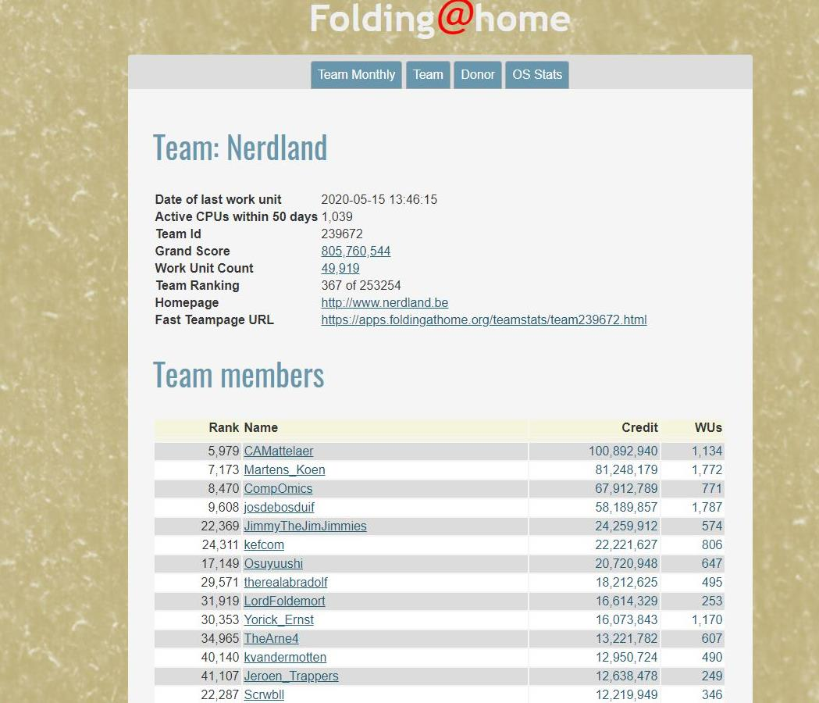
Crowd computing: Folding@home
Notes:
Klik: Team nerdlan: statistieken niet vergeten: competitie en gamification worden vaak gebruikt in CS

Slide 25
Examples of citizen science
2. Citizen sensors

Slide 26
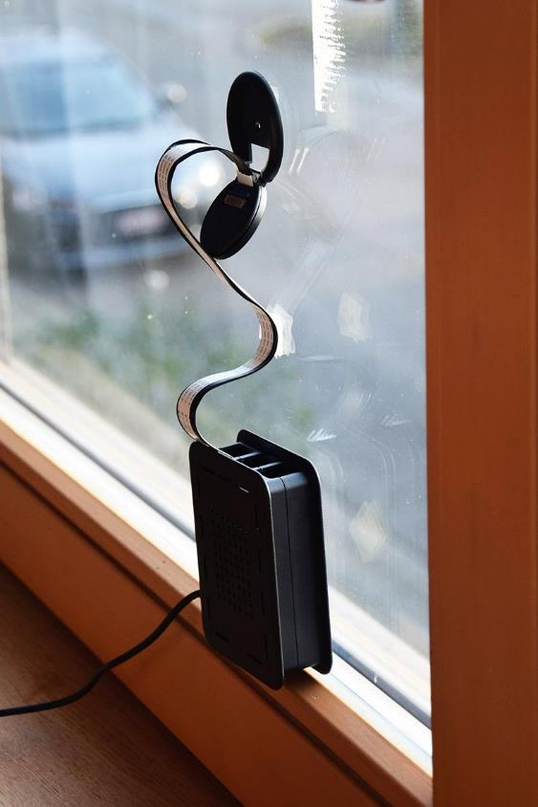
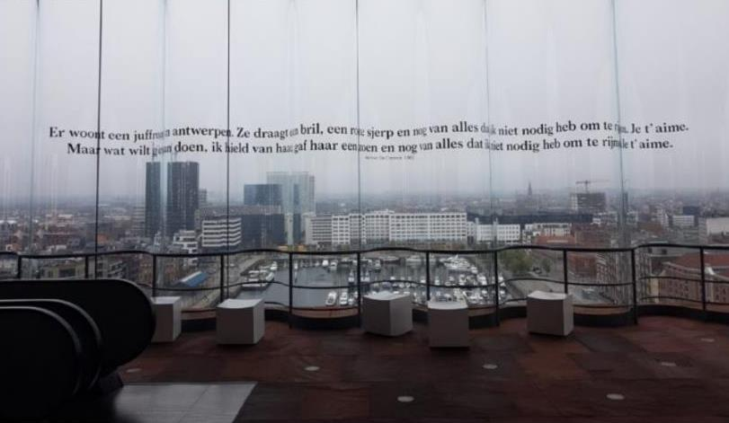
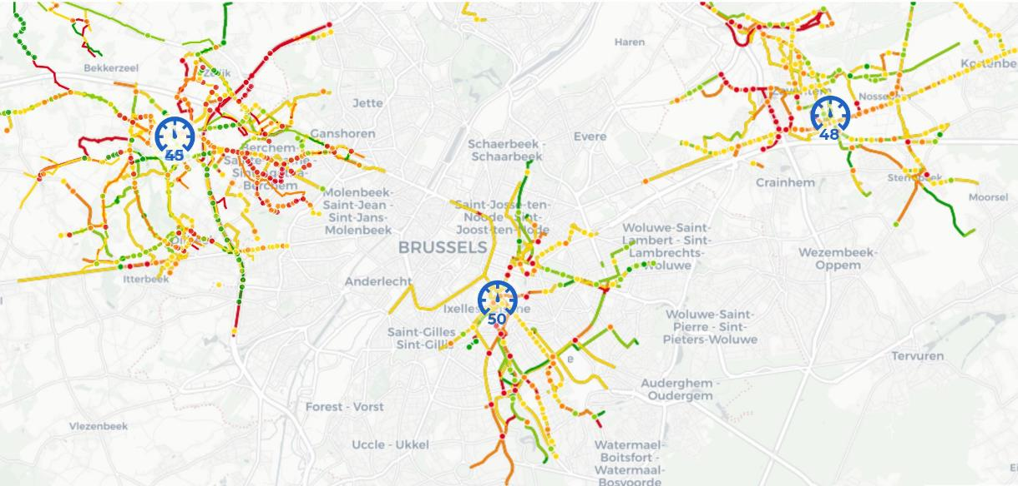
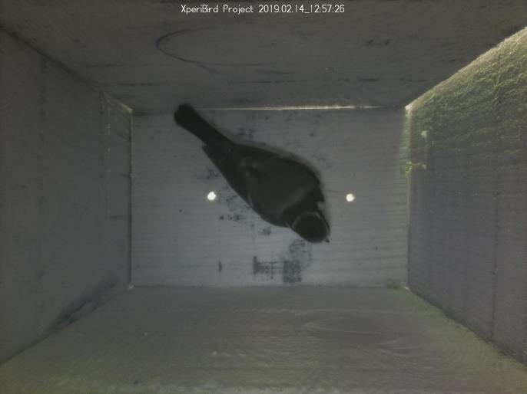
Straatpoezie.nl
Citizen scientists
as sensors
Telraam
Fietsbarometer
Xperibird.be
Notes:
Xperibird, Fietsbarometer: scholen: enorm potentieel voor CS

Slide 27
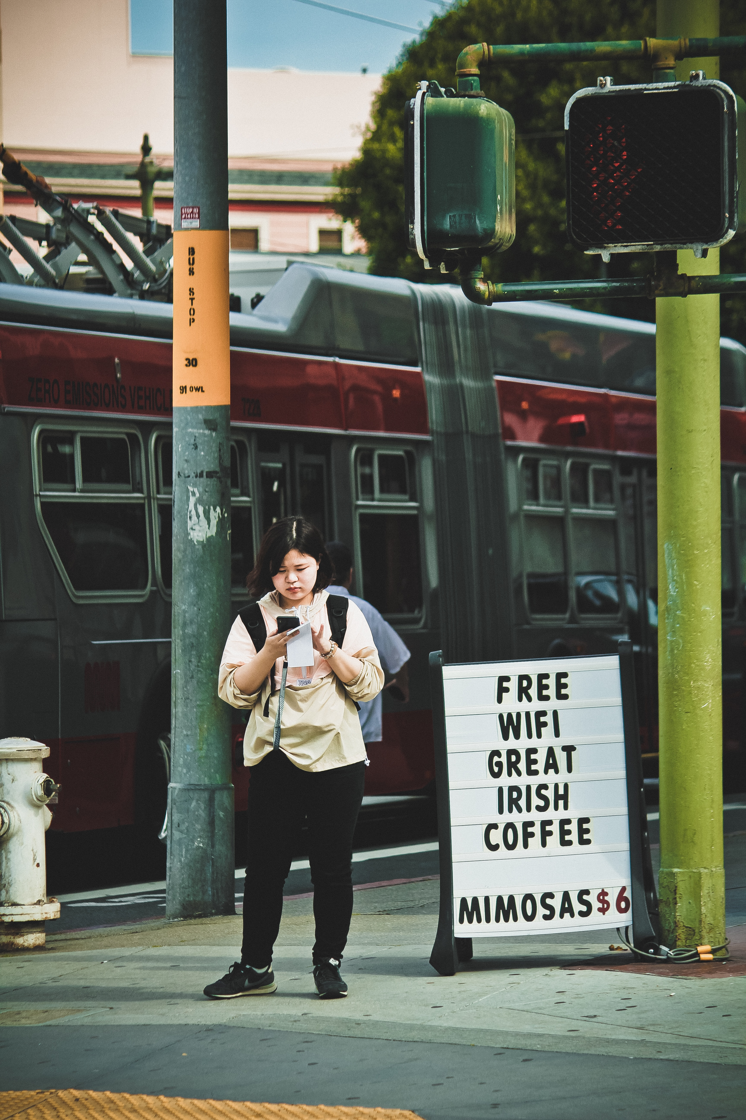
‘Our Voice’ method
(Stanford Medicine)
Isala project (UAntwerpen)
Our Voice
Notes:
Largest reesearch into the female microbiome worldwide, 6000 CS’s sent in swabs

Slide 28
Examples of citizen science
3. Citizen analysts

Slide 29
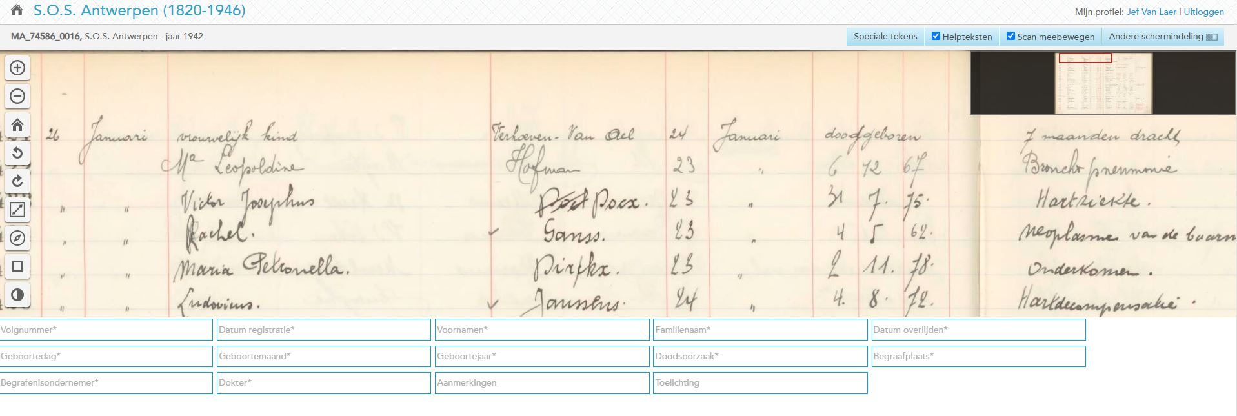
Citizen scientists annotating, transcribing or analysing data
S.O.S Antwerpen (velehanden.nl)

Slide 30
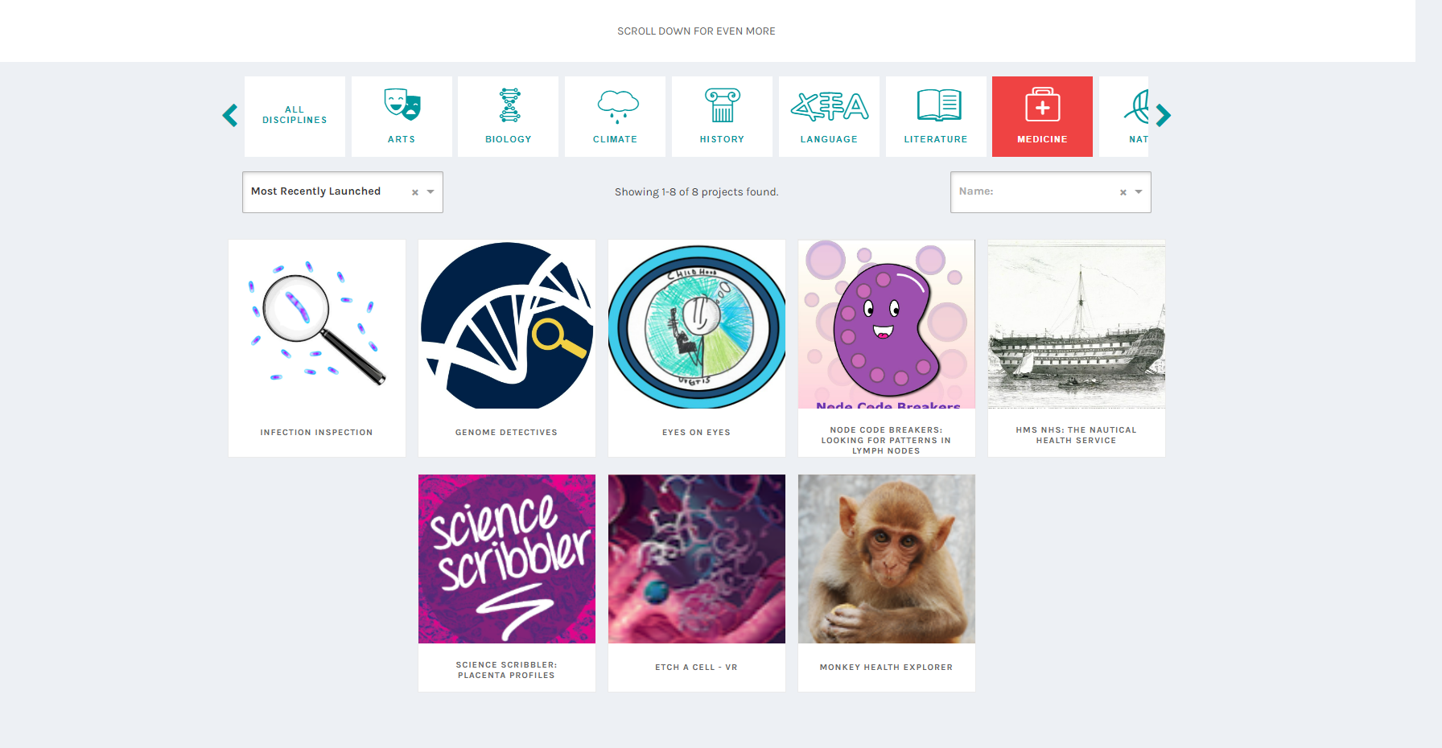
Zooniverse.org

Slide 31
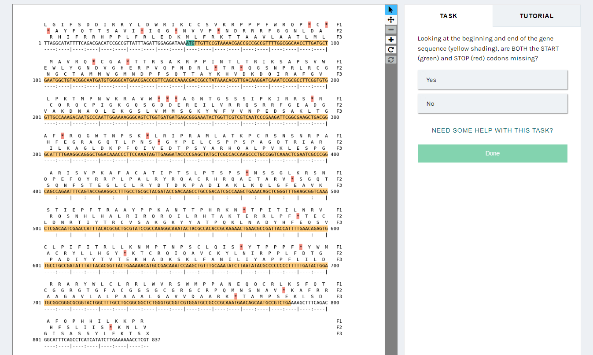
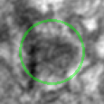
Mito Mapper
Genome detectives

Slide 32
Examples of citizen science
3. Gamification

Slide 33
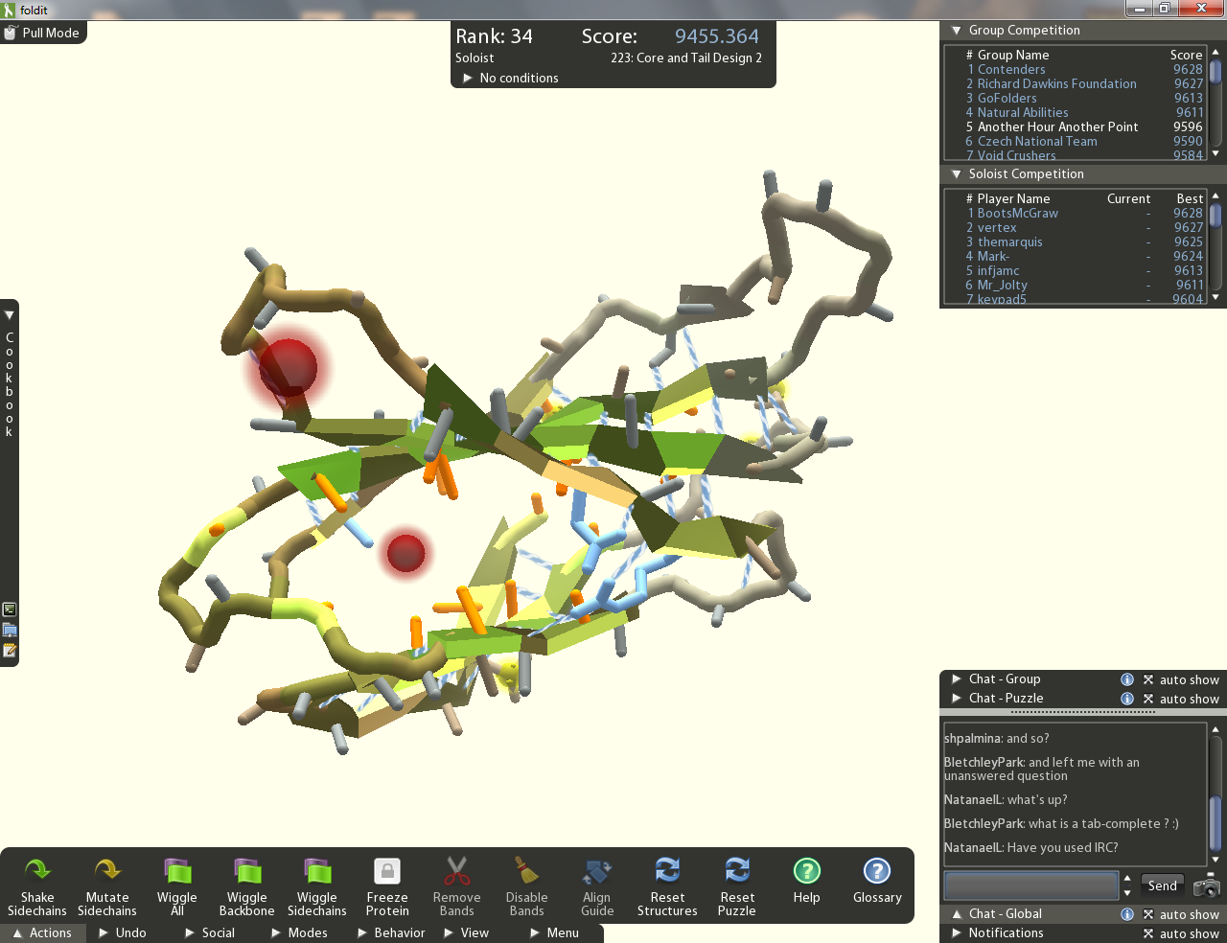
Gamification
Fold.it

Slide 34
Ultimate gamification:
CS in video games
Notes:
Eve: Project Discovery:
- Analyse fluoresence microscopy images
Search for ExoPlanets
Help COVID research by tracing cell clusters (analyse immune response)
Borderlands 3:
Solve puzzles matching coloured blocks in order to train AI to match & sequence microbial RNA (gut bacteria)

Slide 35
Examples of citizen science
4. Co-research

Slide 36
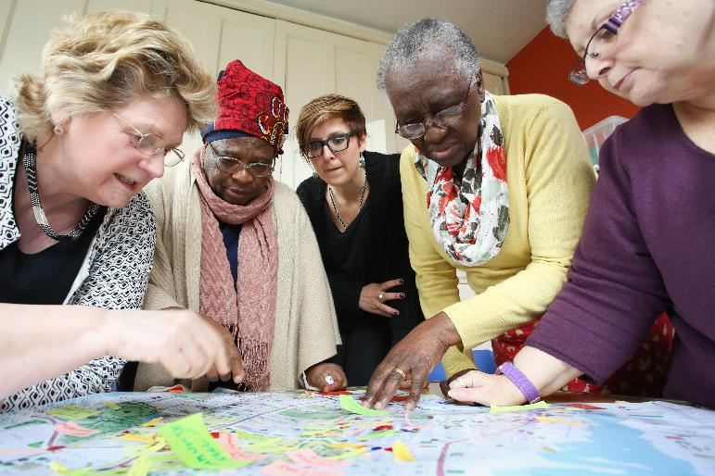
Researching Age-friendly Neighbourhoods
(Manchester, 2016)
Notes:
Gezond Slotermeer: Lokaal bestuur ‘stadsdeel nieuw-west’ gaf opdracht.

Slide 37
Crowdience
Notes:
Crowdience

Slide 38
Examples of citizen science
5. ‘Independent’ CS

Slide 39
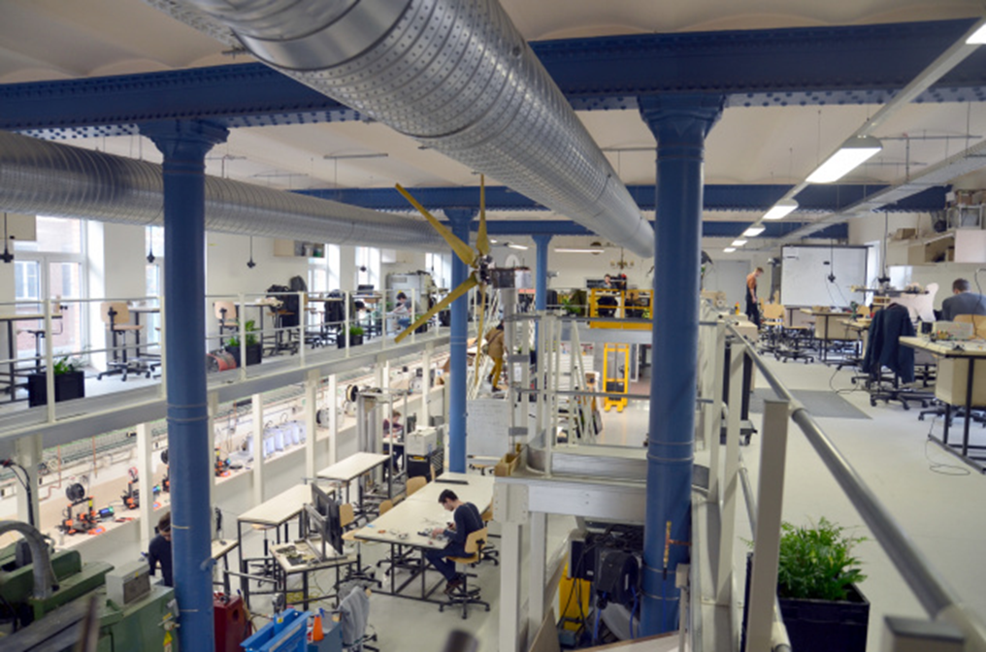
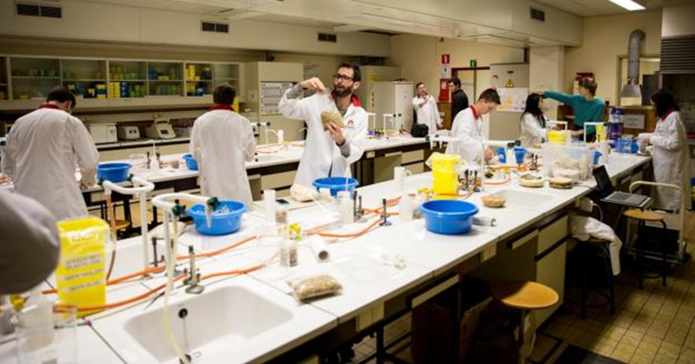
Bottom-up citizen science
Open Biolab Brussels
Fablab Brussels
Notes:
Maker spaces

Slide 41
Examples of citizen science
6. CS celebrities

Slide 42
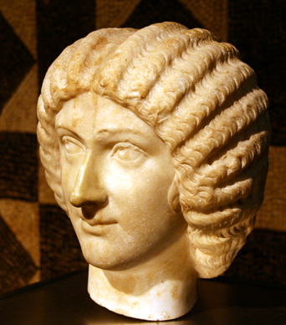
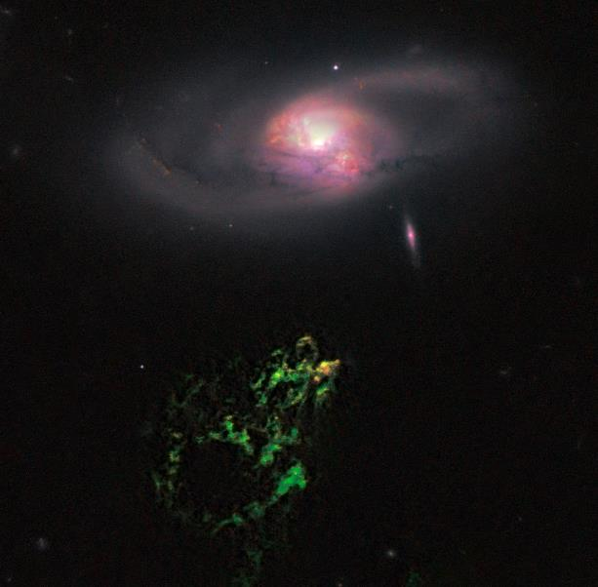
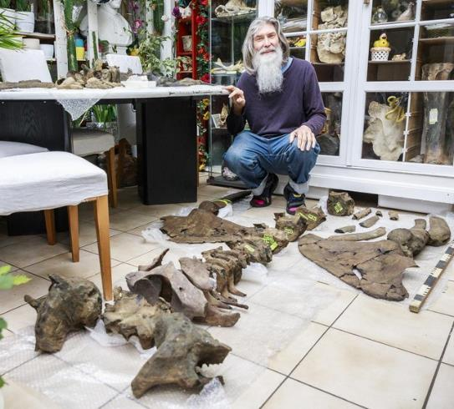
Ancient Roman hairstyling
(Janet Stephens)
Hanny’s voorwerp
(Hanny Van Arkel)
Fossilized whale skeletons
(Mark Bosselaers)
Notes:
Voorbeelden van individuele burgerwetenschappers met grote impact
Styliste Janet Stephens werd tijdens een bezoek aan het museum geprikkeld door het standbeeld van een Romeinse keizerin. Ze vroeg zich af hoe het kapsel van de vrouw in elkaar zat. Ze ging op zoek in historisch bronnenmateriaal en sloeg aan het experimenteren in haar eigen kapsalon. Ze ontdekte dat de complexe haartooi van Romeinse vrouwen gemaakt kon worden met behulp van naald en draad. Daarmee doorbrak ze de heersende consensus onder archeologen dat deze kapsels alleen maar mogelijk waren als Romeinse vrouwen pruiken droegen.
https://www.academia.edu/31430226/_Ancient_Roman_hairdressing_on_hair_pins_and_needles_
Foto: Public Domain, via Wikimedia Commons. https://commons.wikimedia.org/wiki/File:Julia_Domna_-_Cologne.jpg
Hanny's Voorwerp is een reflectienevel ontdekt in 2007 door de Nederlandse onderwijzeres Hanny van Arkel uit Heerlen, toen ze als 24-jarige deelnam aan het Galaxy Zoo-project. De ontdekking werd bekend door haar vraag: "What's the blue stuff below. Anyone?"^{[1]} De nevel werd naar haar vernoemd, nadat een andere vrijwilliger van het online astronomieproject 'Hanny's Object' had vertaald naar 'Hanny's Voorwerp'.
Het is een reflectienevel dicht bij het sterrenstelsel IC 2497 in het sterrenbeeld Kleine Leeuw. In beelden, opgenomen met de 2,5 meter Isaac Newton Telescoop, is de verschijning ongebruikelijk groen. De afstand ernaartoe is zo'n 700 miljoen lichtjaren. De nevel is ongeveer 15.000 °C en is ook al onderzocht door de Hubble Space Telescope.^{[1]}
In 2012 werden nog eens negentien van dergelijke nevels ontdekt; deze werden "voorwerpjes" genoemd. Acht daarvan, nabij de stelsels Mkn 1498, NGC 5252, NGC 5972, SDSS 1510+07, SDSS 2201+11, SDSS 1430+13 (Teacup), UGC 7342 en UGC 11185, werden in 2014 nader onderzocht door William C. Keel et al.^{[2]}
https://nl.wikipedia.org/wiki/Hanny%27s_Voorwerp
Mark Bosselaers is kunstleraar en als paleontoloog de Belgische authoriteit op vlak van fossiele walvisskeletten.

Slide 43
What do citizen scientists do?
Notes:
Maar... Geen volledig overzicht! Wat met mensen die helpen bij archeologisch of paleontologisch onderzoek?
Amateuronderzoekers in biodiversiteit, geschiedenis of paleontologie?
(Hans De Blauwe: amateuronderzoeker viel in de prijzen bij Linnean Society of London. Brandweerman die onderzoek doet naar ongewervelde zeedieren.
Vb: Wagenmakers: opleiding bij Histories vzw, coaching, resultaten & publicaties kunnen breder historisch onderzoek mogelijk maken
Truienair: ingenieur/informaticus die de luchtkwaliteit in Sint-Truiden meet met een hele groep andere stadsbewoners.

Slide 44
Determine research question
Gather data
Develop method
Analyse data
Disseminate
Notes:
Contribute in every step of the research process, from formulating RQ to dissemination and communication of the results

Slide 45
Participation pyramid
Citizens and scientists are equal partners in the project from start to end.
Co-creation
Participants contribute in multiple phases of the project. Research question is usually determined by professional scientists.
Collaborative
Participants are involved in data gathering or analysis.
Contributory
Citizens are contributing sensor data or computing power.
Minimal involvement
Based on http://www.openscientist.org/2013/01/the-levels-of-citizen-science.html
Notes:
- different degrees of participation
- not one level of participation much better than another
- all levels useful, depending on your research question
- different degrees of participation suit different goals
- bottom degrees --> larger audience than top degrees because of less engagement of participants
- top degrees --> only limited group, bc much more intensive to supervise
--> DEPENDS ON PROJECT GOALS

Slide 46
Participation
Large participation base
Lower engagement level
Higher engagement level
Smaller participation base
Notes:
- No best choice, what fits your research best
-

Slide 47
Participation
Large participation base
Lower engagement level
Higher engagement level
Smaller participation base
Sensor price
Quality
Quantity
Data
Homogenous data
Strict protocols
Autonomous citizen scientists
Heterogenous data
Notes:
- No best choice, what fits your research best
-

Slide 48
?
Which advantages and opportunities do you see in citizen science?

Slide 49
?
Which disadvantages and risks do you see in citizen science?

Slide 50
Things to look out for
Choosing citizen science
Communication & engagement
Data, privacy & ethics
Notes:
Start om 16:00 tot 16:10
Recap

Slide 51
Choosing citizen science
You don’t have to choose citizen science!
Authenticity
Sustainability
Enlist expertise from others.
Notes:
- don't have to, has to fit RQ, much time and energy --> deliberate decision
- in that way also has to be authentic, NOT promotional stunt or market study/survey. RQ en method has to be 'sound'
- --> protect term CS, avoid CSts dropping out, and avoid not taking serious
- largest impact achieved through good RD, transp comm, --> credible to all partners of the project.
-think abt long term, results, infrastrutcter, participants

Slide 52
Communication & engagement
Don’t underestimate
Be prepared for a drop in participation
Preaching to the choir
Go where the citizens are
Notes:
- upper the most important, regular communication, not all: lots of questions, takes lot of work, thus time
- drop: take in mind different motivations (take in mind, also while setting goal of participants)
- go where cit: existing communicatis, tap into local networks,
Local projects have the advantage of having an edge right from the start: people care about their neighborhoods

Slide 53
Data
Privacy
Ethics
Tackle early
Go beyond informed consent
Who owns the data?
Transparency
Notes:
- think abt it at the beginning, but it will be imporant during every phase of the research.
Not cover inform cons beginnning enough, more than that
- if citizens collect data, if it's sensor data or picture, important who is owner after reseach? Shared? Dashboard? Citizens must know what happens with their data,
- so be transparant abt research: research goals, method,
-

Slide 54
Useful links
Scivil.be
Iedereenwetenschapper.be
eu-citizen.science

Slide 55
Notes:
16:25-16:30
Slides over onze doelstellingen erin? OF enkel focus op citizen science?

Slide 56
Flemish Knowledge Centre for CS
Promote citizen science approach
Connect citizen science stakeholders
Support citizen science initiatives
Innovate citizen science methods
Notes:
- promote citizen science as a research method so that actively contributing to the solutions of scientific and social issues is accessible to everyone (fe expo library )
- connect citizenscience stakeholders so that together they can realize more impactful citizenscience projects (fe yearly networking day)
- support Flemish citizenscience initiatives so that they are diverse, qualitative, impactful. (guides, individual advise)
- innovate citizen science so that the research method remains adapted to the latest scientific and social evolutions (fe AMAI,

Slide 57
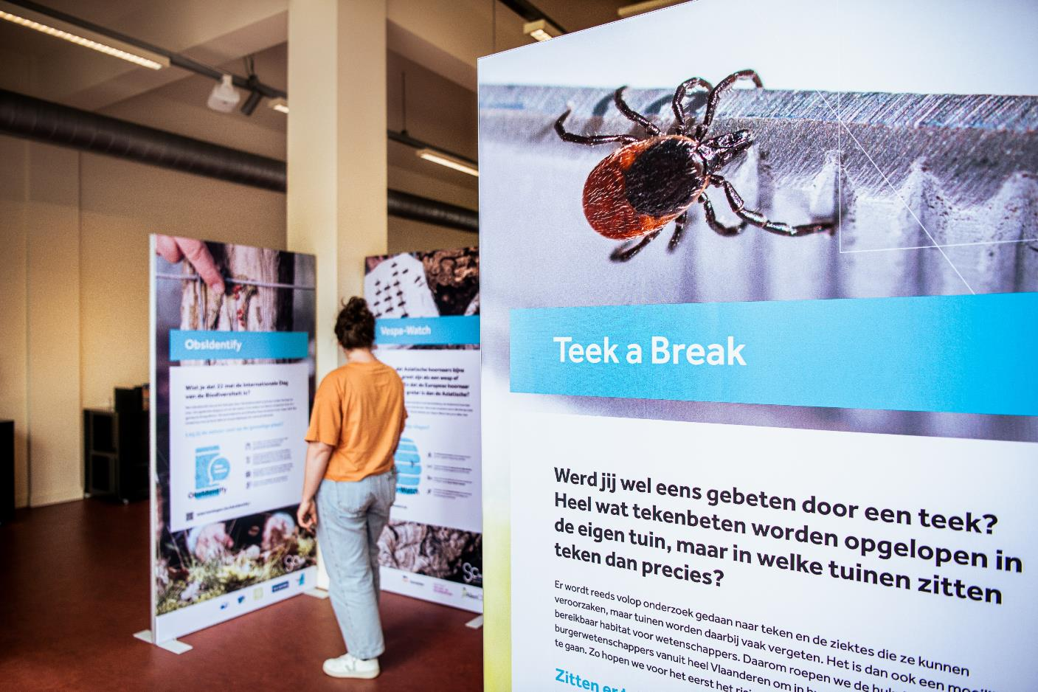
Promote citizen science
Notes:
In kader van doelstelling Ondersteuning → verschillende gidsen uitgebracht
In 22: educatiegids: waarom? veel potentieel in zo’n samenwerking, beide partijen weten niet altijd goed hoe aan te pakken, gids kan inspireren en aanzetten tot samenwerkingen
(link onderwijs: dia 6: educatie belangrijk doel (onderwijs: onderzoekscompetenties, bepaalde burgerschapscompetenties, ..)

Slide 58
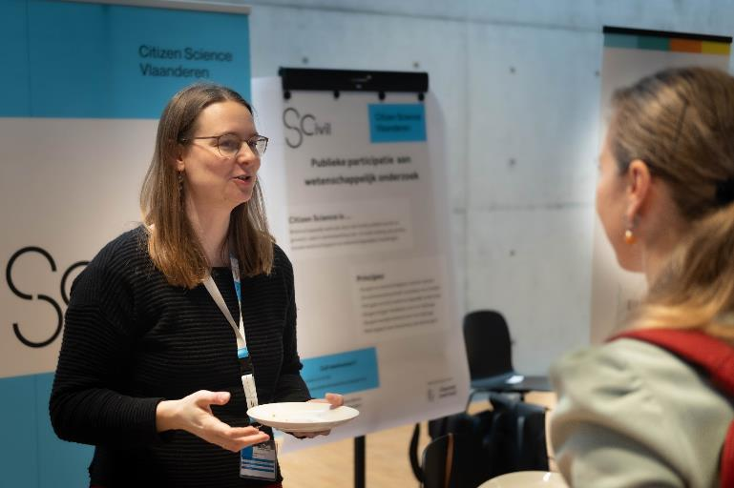
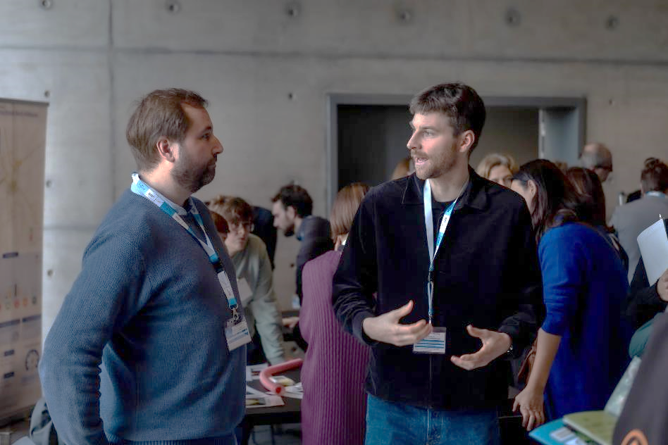
Connect citizen science stakeholders
Notes:
In kader van doelstelling Ondersteuning → verschillende gidsen uitgebracht
In 22: educatiegids: waarom? veel potentieel in zo’n samenwerking, beide partijen weten niet altijd goed hoe aan te pakken, gids kan inspireren en aanzetten tot samenwerkingen
(link onderwijs: dia 6: educatie belangrijk doel (onderwijs: onderzoekscompetenties, bepaalde burgerschapscompetenties, ..)

Slide 59
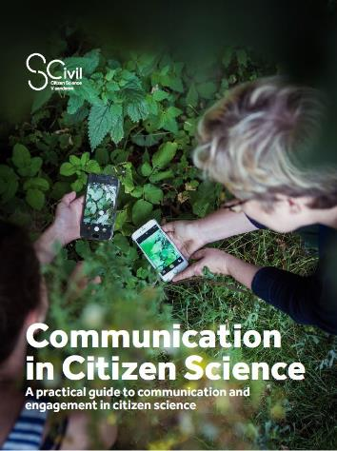
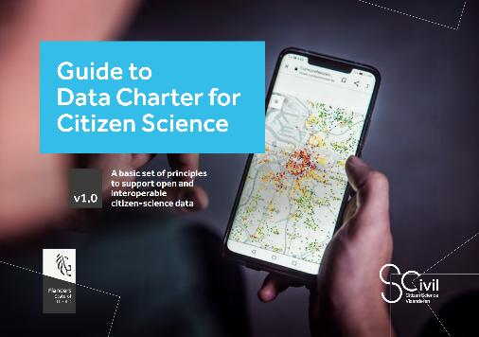
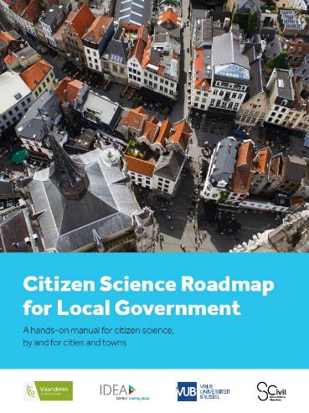
Support citizen science initiatives
Notes:
In kader van doelstelling Ondersteuning → verschillende gidsen uitgebracht
In 22: educatiegids: waarom? veel potentieel in zo’n samenwerking, beide partijen weten niet altijd goed hoe aan te pakken, gids kan inspireren en aanzetten tot samenwerkingen
(link onderwijs: dia 6: educatie belangrijk doel (onderwijs: onderzoekscompetenties, bepaalde burgerschapscompetenties, ..)

Slide 60
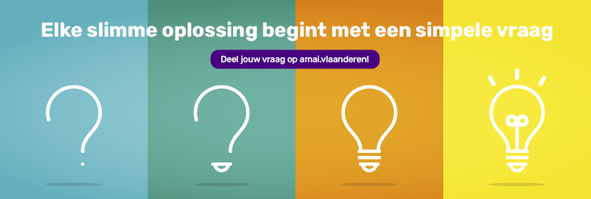
Innovate citizen science methods
Notes:
In kader van doelstelling Ondersteuning → verschillende gidsen uitgebracht
In 22: educatiegids: waarom? veel potentieel in zo’n samenwerking, beide partijen weten niet altijd goed hoe aan te pakken, gids kan inspireren en aanzetten tot samenwerkingen
(link onderwijs: dia 6: educatie belangrijk doel (onderwijs: onderzoekscompetenties, bepaalde burgerschapscompetenties, ..)

Slide 61
Info@scivil.be
/scivil.vlaanderen
@scivil_flanders www.scivil.be
With the support of:

