Slide 1
(CO-)CREATING IMPACT
RESEARCH DEPARTMENT
Faculteit Geneeskunde en Gezondheidswetenschappen - Commissie Maatschappelijke Outreach
15 SEPTEMBER 2022

Slide 2




RESEARCH IMPACT
SCIENTIFIC & SCHOLARLY ACTIVITIES
SOCIETAL VALUE CREATION & TEACHING
TECH TRANSFER & INNOVATION
PLATFORMS
PEOPLE & PARTNERSHIPS
POLICY
Notes:
Impact is the effects of research in the real world. Impact is the changes we can see (demonstrate, measure, capture), beyond academia (in society, economy, environment) which happen because of our research (caused by, contributed to, attributable to). Impact may look and operate slightly differently across disciplines, and for fundamental vs. applied research, but ultimately is about connecting academic research to changes in the real world.
At Ghent University we want our research and researchers to have impact. For this aim we have introduced infrastructure, human capacity, and policy – because creating an impactful research environment and impact literate researchers needs interventions on different levels and collaboration across the university.

Slide 3

RESEARCH IMPACT
SCIENTIFIC & SCHOLARLY ACTIVITIES
SOCIETAL VALUE CREATION & TEACHING
TECH TRANSFER & INNOVATION
PLATFORMS
PEOPLE & PARTNERSHIPS
POLICY
Notes:
Impact is often used as a capture-all term to describe the part of the research process beyond the knowledge generation. This talk will focus in particular on Ghent University’s efforts to increase its societal impact and innovation power – although we need to approach this area with an open mind since the boundaries between different concepts and processes are increasingly shifting and overlapping as a result of changing attitudes and methods. Evolutions such as open science and increased citizen involvement, research integrity and do-no-harm principles, or worldwide crises are having their own impact on how resilient and adaptive universities and their academic systems need to be.
Impact is driven by a number of factors including funders’ requirements and research assessment. I will be addressing how we – given the breadth of impact possibilities – tackle our responsibilities in the processes of societal value creation and innovation. Because it is important to focus on making impact meaningful to you, your stakeholders and your research, not just delivering on these higher level agendas. We want our researchers to take charge of mapping the impact of their research, have them pursue the most valuable an realistic paths for their research and maximise the benefit their work can have.

Slide 4

















RESEARCH IMPACT
Impact may be big or small, local or global, instrumental (direct change) or conceptual (ideas, feelings), quantitative (products, jobs, revenues) or qualitative.
There is no single type of impact nor a single type of impact pathway.
Notes:
Research impact offers a plethora of possibilities.
It is therefore important to not limit how we view and sustain it.
Ghent University has chosen for a broad approach in which we try to link up all these different elements.
Broad in how we define and measure impact.
Broad in which disciplines we want to reach.
Broad in which researcher at all career stages we want to inspire.
Broad in which stakeholders we deem relevant. Broad in which support we want to offer.

Slide 5

POLICY
Institutional policy plan on societal value creation of research (2015)
https://www.ugent.be/en/research/science-society/impact/soc-impact.htm
Taxononomy of different types of societal value creation (pathways to impact)
Strategic five-year plan for IOF and interface activities
https://www.ugent.be/techtransfer/en
Mission: generating socio-economic impact with knowledge as raw material
SOCIETAL VALUE CREATION
INNOVATION
TECH TRANSFER & INNOVATION
Notes:
Two complementary policy and support frameworks make up the spectrum of socio-economic value creation and impact. Both are needed to address the broad approach.
The framework for tech transfer and innovation (the more linear economic end of value creation) has a more mature character, being a national/regional/institutional strategy for a longer period of time.
In 2015 policy action for societal value creation of research was launched – an area equally important to the mission of the university but less well developed until then (and maybe still?). Main driver for this policy development wasn’t just intrinsic but the international shift towards impact as well (funders, research assessment systems, policy makers, stakeholders).

Slide 6
POLICY
Institutional policy plan on societal value creation of research (2015)
https://www.ugent.be/en/research/science-society/impact/soc-impact.htm
Taxononomy of different types of societal value creation (pathways to impact)
Strategic five-year plan for IOF and interface activities
https://www.ugent.be/techtransfer/en
Mission: generating socio-economic impact with knowledge as raw material
SOCIETAL VALUE CREATION
INNOVATION
TECH TRANSFER & INNOVATION
Defining the scope, terminology, and methods Building impact literacy
New approach to research(er) assessment
Holistic
Quality
Responsible
Signatory of DORA
Progression model for professorial staff
Focus on process
Group level
Value creation integrated in Research
Narrative & case studies
Notes:
Cross-cutting these policies was the need for clarity. We were convinced many researchers already engaged in impact creation but we needed to speak the same language, provide ample inspiration and develop the necessary skills. In short, we need to build an impact literate community.
Equally important was tackling the challenge of indicator- and results-driven assessment and skewed incentives and rewards.
Within impact and its assessment the focus has to be more on the process, the stakeholder interactions. Impact is a group effort, something which takes time, which is inherently serendipidous, which needs a story rather than a bean-counting checklist.

Slide 7

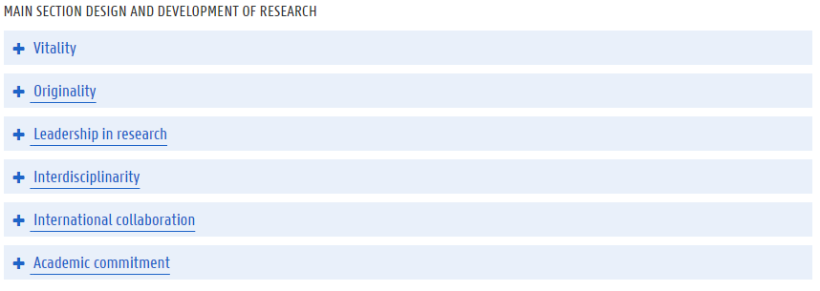
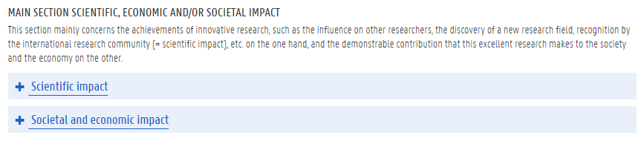
POLICY
https://www.ugent.be/en/research/research-strategy/evaluation/portfolio-research.htm
SOCIETAL VALUE CREATION
INNOVATION
TECH TRANSFER & INNOVATION
RESPONSIBLE RESEARCH ASSESSMENT
Notes:
At Ghent University value creation activities are no longer seen as separate, as an add-on to research. Impact is integrated within the research dimensions. Professors have the opportunity to focus on value creation activities within their career without being/feeling penalised for this choice.
The indicators and descriptors illustrating value creation as a process are varied and can be chosen according to one’s discipline, personal talents, specific research stakeholders. We welcome creativity and ambition in that respect too.
We also value more than just results – there is merit in creating value throughtout the entire lifecycle of research.

Slide 8
POLICY
Open science & Open innovation
Collaboration & Transdisciplinarity
Talent-driven HR
PR
SSH & STEMM
internationalisation
Enterpreneurship
SOCIETAL VALUE CREATION
INNOVATION
TECH TRANSFER & INNOVATION
HOLISTIC RESEARCH POLICY
Notes:
Impact needs holistic research policy. This is not about flicking just one lever or creating a big bang.
This is about addressing many challenges – fostering small revolutions: from recruitment to progression models; from how we strategically communicate as a university to how we set up long-lasting and trustworthy relationships with our partners and end-users; from how we develop and assess our research projects to how we prepare our researchers for a career outside academia and care about their wellbeing.
It is about providing policy and support which speaks to all research disciplines and all researchers.
It is about protect and managing the intellectual property and knowhow of the university while allowing for co-creation and transdisciplinarity.
It is about moving research into societal, commercial or industrial use in order to strengthen economic development and supporting innovation for companies (without disrupting the market).
It is about making our community a growing international innovation hub with challenging jobs for knowledge workers.

Slide 9
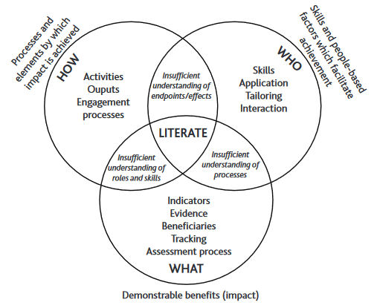
POLICY
SOCIETAL VALUE CREATION
INNOVATION
TECH TRANSFER & INNOVATION
BUILDING IMPACT LITERACY
Notes:
It is important to understand how impact operates for you and your research. More specifically, it is important to be able to understand, appraise and make decisions about how to connect your research to the outside world. That is impact literacy.
In simple terms, being impact literate means understanding:
what changes (impacts) happen, for whom, and how you can demonstrate it
how you can push your research into action (i.e. the process of value creation)
who is needed, with what skills, to make this happen
Being more impact literate will not only open up your research attitude or help you develop personal ans profession skills, it will also allow you to navigate the many different flavours of research funding.

Slide 10
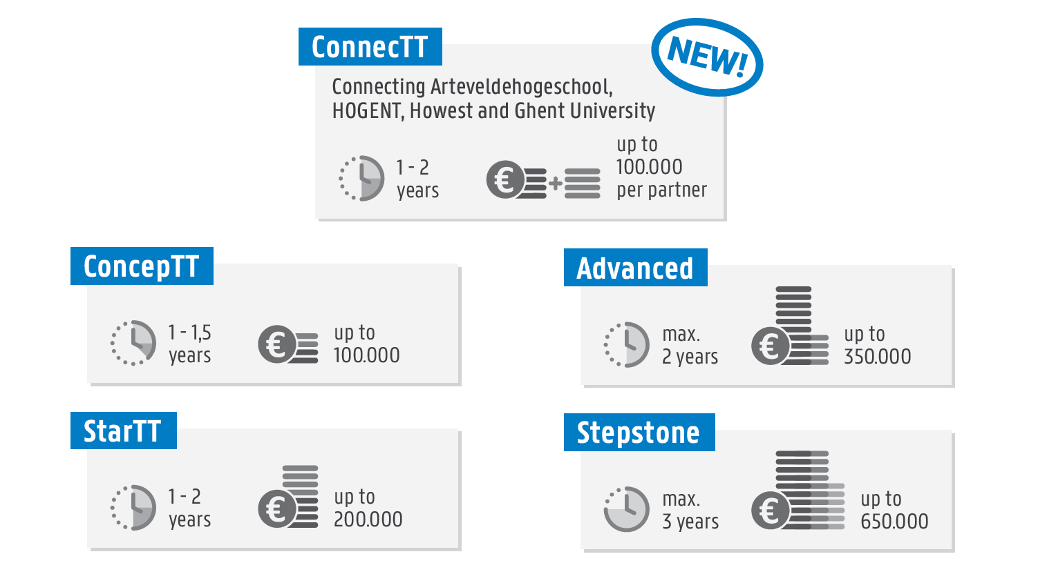
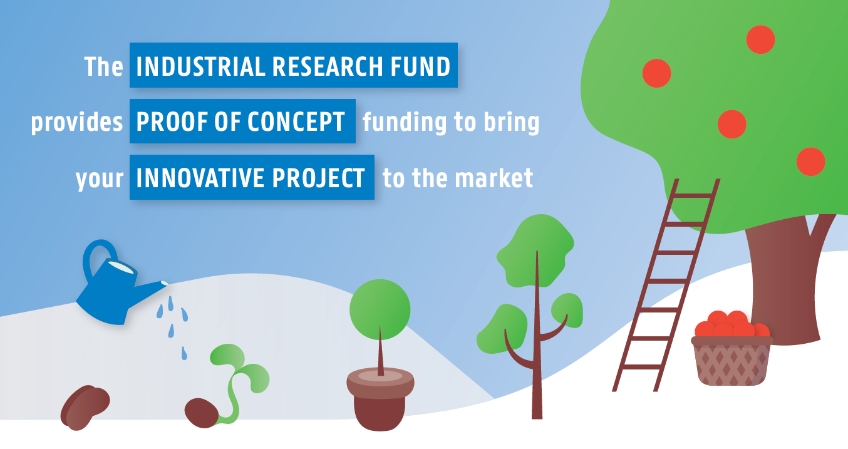
POLICY: FUNDING
Societal Value Creation Fund (Special Research Fund)
https://www.ugent.be/en/research/funding/bof/socvalfund
Industrial Research Fund
https://www.ugent.be/techtransfer/en/support-for-academics/iof
SOCIETAL VALUE CREATION
INNOVATION
TECH TRANSFER & INNOVATION
Notes:
Within the funding landscape, opportunities for value creation are becoming more widely available and impact is gradually working its way into the requirements of national and international funders.
Ghent University has a long and succesful tradition in value creation with the internally managed Industrial Research Fund.
Depending on your technology readiness level, you can choose between different project types. We spend about 10 milion euros each year on IRF projects, divided over 4 different open calls.
2021 eventually saw the creation of the Societal Value Creation Fund, specifically designed to support societal impact potential through humble budgets, spread across two calls a year.

Slide 11

PEOPLE & PARTNERS
Research Department
Policy development
Funding support
Knowledge exchange
Training
SOCIETAL VALUE CREATION
INNOVATION
TECH TRANSFER & INNOVATION
https://www.ugent.be/en/ghentuniv/organization/doza
Policy Advisor on societal impact
Generic and specific advice
Financial management
IP
Legal
Research communication
Knowledge exchange skills
Communication skills
Grant writing
…
Notes:
Across the different offices of the Research Department (Research Co-ordination, Tech Transfer, University Library) units collaborate – creating policy, offering support to researchers to help them obtain funding, fostering knowledge exchange in order to maximise scientific and socio-economic impact, developing training on numerous research (admin) skills.
The Research Department is not an isolated service but works in close contact with the research community, the faculty administration, university leadership, and many external partners.

Slide 12
PEOPLE & PARTNERS
Interdisciplinary Research Centres aimed at Societal Impact (IDC)
https://www.ugent.be/en/research/science-society/idc
IDC co-ordinator
Industrial Research Fund Business Development Centres
https://www.ugent.be/techtransfer/en/support-for-academics/iof
Business development manager
SOCIETAL VALUE CREATION
INNOVATION
Complementary set-up for socio-economic impact
Dual structure: benefits of central co-ordination and expert support but close to researchers
Importance of intermediaries acting as business liaison or knowledge broker
Specific career model
Notes:
Unique element to how Ghent University has organised impact and value creation support: the complementary set-up of IDC and IRF Business Development Centres, co-ordinated by the Research Department.

Slide 13
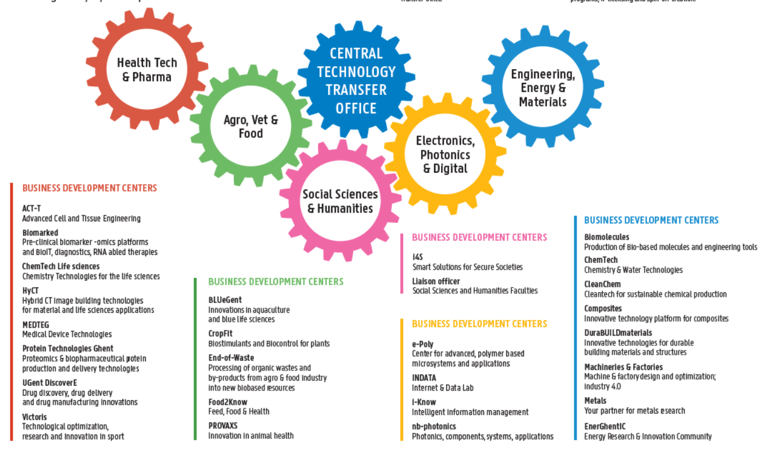
PEOPLE & PARTNERS
Industrial Research Fund Business Development Centres
SOCIETAL VALUE CREATION
INNOVATION
Notes:
The network consists of a number of business development centers that group complementary research departments by application area or domain of expertise.
Each center is responsible for technology transfer within its area of competence. A center is headed by a business development manager who can act as direct point of contact for industrial partnerships, be it research, services, collaborative research, or IP licensing.

Slide 14
PEOPLE & PARTNERS
Interdisciplinary Research Centres aimed at Societal Impact (IDC)
SOCIETAL VALUE CREATION
Henri Pirenne Institute for Medieval Studies (HPIMS)
Ghent Centre for Global Studies
Crime, Criminology and Criminal Policy
GRAY - Ghent University Research for Aging Young
UGent @ Work
Urban Academy: a collaboratorium for sustainability issues in Ghent
DELTA - Digital innovation for man and society
Human Rights Research Network
CESSMIR – Centre for the Social Study of Migration and Refugees
PSYNC - working together for mental health
Notes:
The IDC are funded through the university's own Special Research Fund. Interdisciplinarity is at the core of the IDC initiative, fostering cross-faculty collaboration both within and between SSH and STEMM. Also transdisciplinarity and co-creation with non-academic stakeholders are key. The IDC co-ordinator acts as a knowledge broker and works in close collaboration with the central Research Department, especially on societal impact and European Public Affairs.

Slide 15





PEOPLE & PARTNERS
SOCIETAL VALUE CREATION
INNOVATION
SPECIFIC PARTNERS
Notes:
Springboards for value creation and co-creation
UGent Tech Transfer also invest heavily in fostering network possibilities with the start-up community, industry and sector organisations, alumni, …

Slide 16
PEOPLE & PARTNERS
SOCIETAL VALUE CREATION
https://www.ugent.be/intranet/en/research/career/training
INNOVATION
Doctoral Schools training offer
Online information sessions
Entrepreneurial skills – Research to Market
TT & Knowledge Exchange skills
SSH Breakfast Sessions
Funding Academy
Toolkits on Ghent Uni website
…
TRAINING
Notes:
Something for everyone!

Slide 17

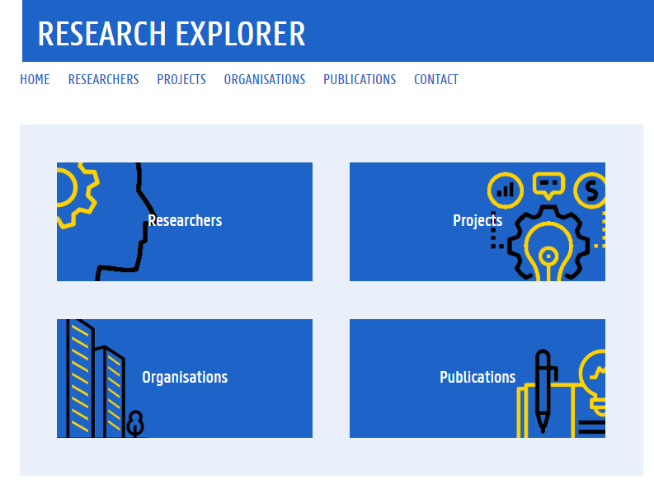

PLATFORMS
SOCIETAL VALUE CREATION
INNOVATION
MAKING VALUE CREATION MORE VISIBLE
Notes:
Showcasing the breadth and impact of Ghent University research via the Research Explorer
Logging and managing information on value creation activities via GISMO
Tracking the online attention and reach using Altmetric

Slide 18
RESEARCH IMPACT
Impact may be big or small, local or global, instrumental (direct change) or conceptual (ideas, feelings), quantitative (products, jobs, revenues) or qualitative.
There is no single type of impact nor a single type of impact pathway.
Let’s have a closer look…

Slide 19
1. SCOPE
INSTITUTIONAL CONTEXT > FACULTY or GROUP LEVEL
  https://www.emeraldpublishing.com/wordpress/wp-content/uploads/Emerald-Resources-Institutional-Healthcheck-Workbook.pdf
  Commitment: strategy, incentives & rewards, funding & support
  Connectivity: connected teams, co-ordinated activities
  Co-production: support for partnerships & engagement, knowledge on co-creation
  Competencies: available expertise, training
  Clarity: transparant strategy, transparant support, responsibilities, transparant evaluation
→ context influences how you support researchers, how you have conversations with them
→ what in-house services/support/platforms are available? (makes for more feasible proposals)

Slide 20
1. SCOPE
SOME CHARACTERISTICS to complicate the conversation:
  Non-linear – iterative – throughout research lifecycle
  Relationships rather than demonstrable effect? (‘productive interactions’)
  Timelag – attribution
  Planable versus serendipity & context-dependent

Slide 21
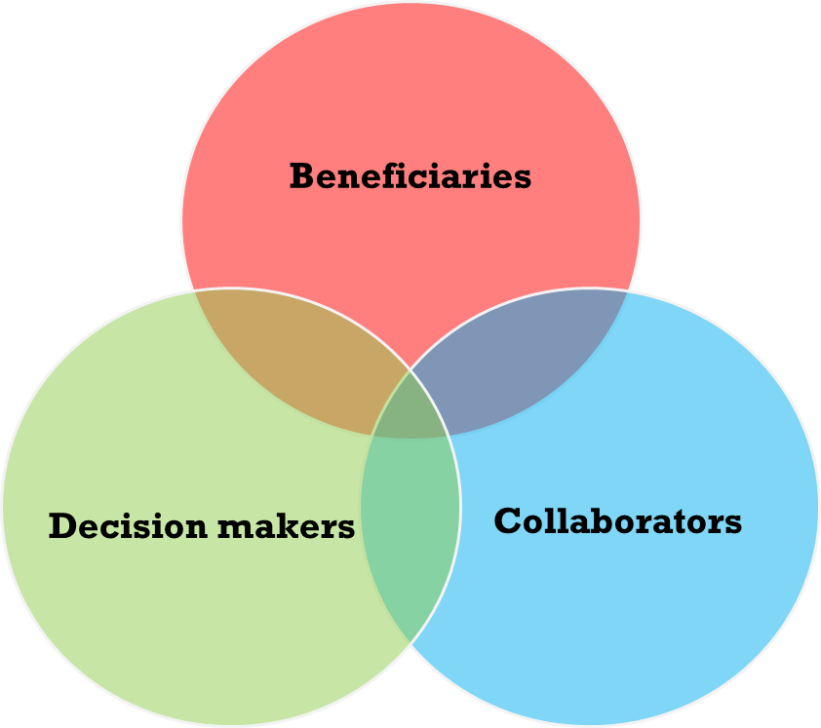
2. DECISIVE DUO
STAKEHOLDER ANALYSIS:
  Who has an interest in the research?
    Help frame the problem/research question
    Co-produce the research
    Help communicate the work
    Provide data
    Benefit from the work
    Use the work (end-user)
  How and when are you going to engage these people?
  Be specific!

Slide 22
2. DECISIVE DUO
COMMUNICATION STRATEGY:
  Linked to stakeholders
    What is relevant for them?
    How can they help?
    Public or stakeholder?
  What platforms/support is available in-house?
  Storytelling
  Attention and reach is NOT impact

Slide 23
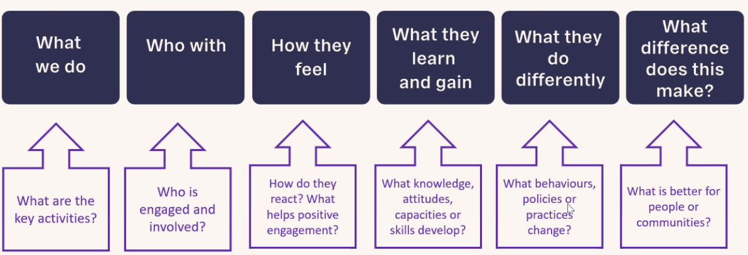
2. DECISIVE DUO
RESPONSIBILITIES & COMPETENCIES:
  Who has the impact?
  What skills do you need to make the impact happen?
    Do not forget about ethical and legal issues
  What challenges are you or your stakeholders likely to experience?
From: Sarah Morton

Slide 24
3. Structured approach
PLANNING FOR IMPACT:
  All of the above
  Define your pathway(s): choose a model
  (allow for opportunities along the way: leaky pipeline of impact planning)

Slide 25
3. STRUCTURED APPROACH
Choose a model to help you out
FLIPPING YOUR APPROACH
OTHER POSSIBILITIES
  Theory of Change
  Logic model
  …
HOW?
Activities
Outputs
Outcomes
Impact
Problem
SO WHAT?

Slide 26
3. Structured approach
IMPACT PLAN:
  All of the above
  Define your pathway(s): choose a model > FLIP YOUR APPROACH
  (allow for opportunities along the way: leaky pipeline of impact planning)
FEASIBLE & SPECIFIC
  More about the ‘how’
  Do not overlook the realities of implementation and context
WHAT IS SUCCESSFUL?

Slide 27
3. Structured approach
Frame the problem
  2 levels: the overall problem + specific part of this problem you are focused on
Frame the impact by flipping the problem
Identify indicators & evidence
  What changes, how will you know, how can you demonstrate it?
Identify stakeholders & beneficiaries
  Who – be specific. Why are they important? What role do they play in your research/impact?
Co-produce impact
  When do these stakeholders need to be involved (research, dissemination, uptake, implementation)?
  How are you going to engage them? What skills do you need?

Slide 28

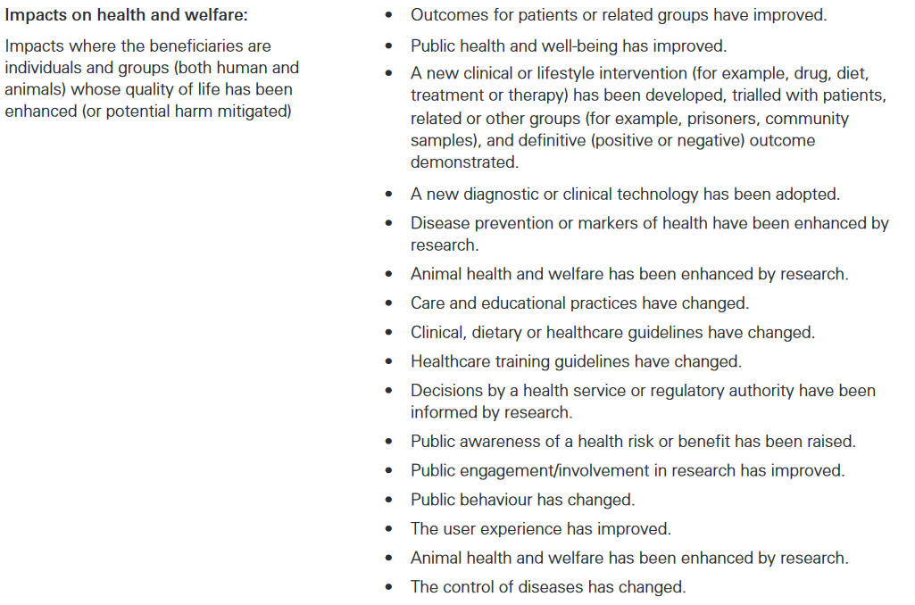
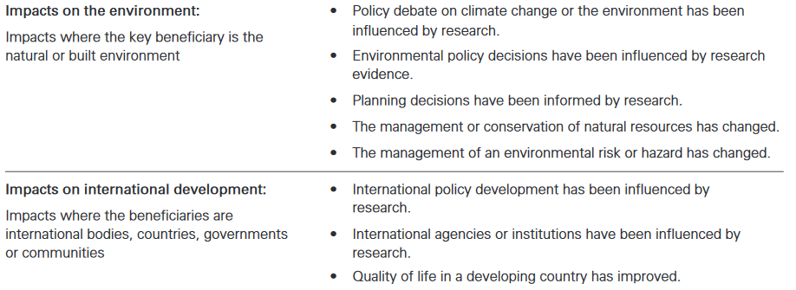
From: REF 2014 Guidelines

Slide 29
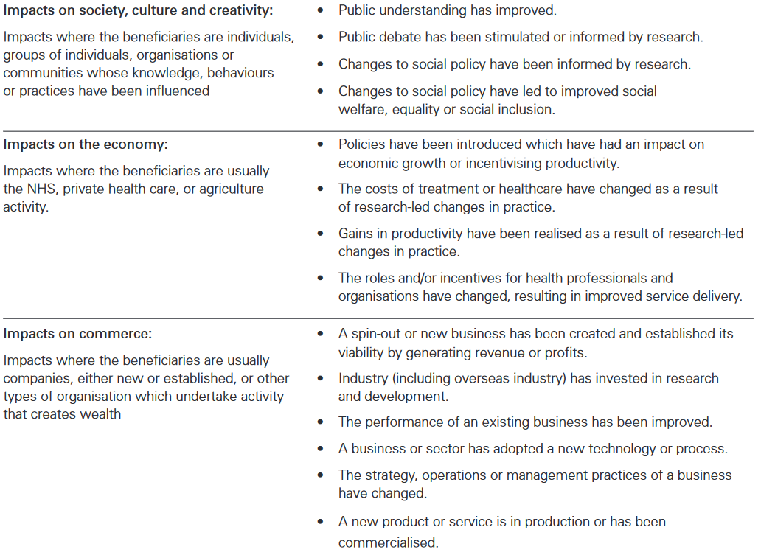
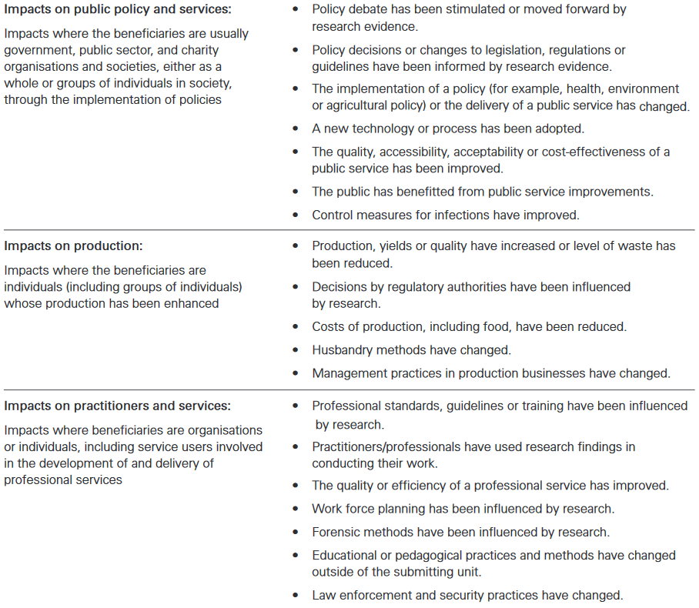
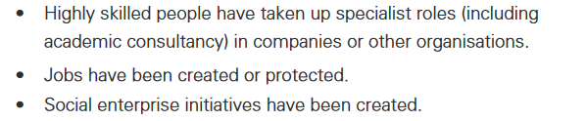

Slide 30
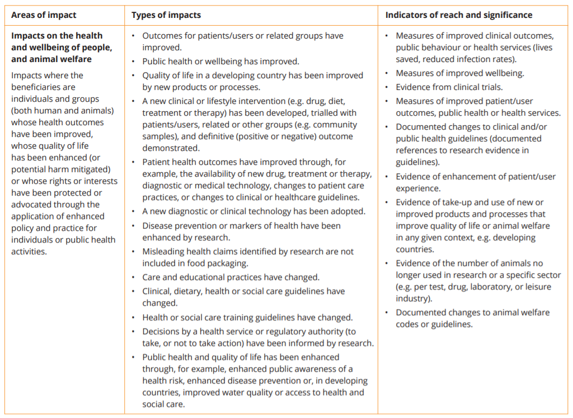
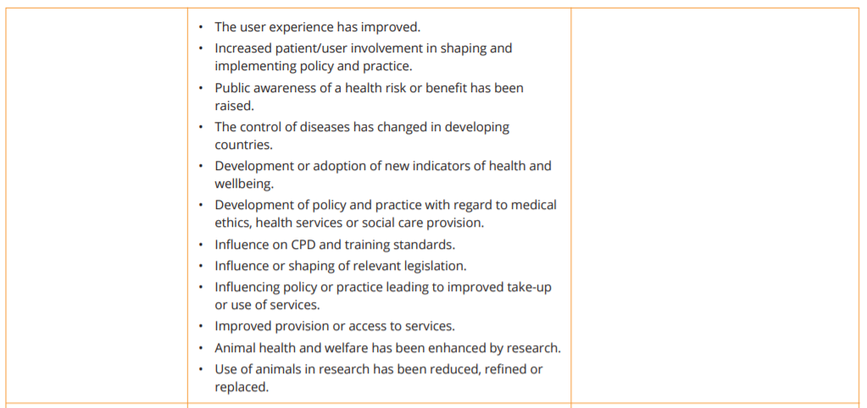
From: REF 2021 Guidelines

Slide 31
3. Structured approach
ASSESSING IMPACT:
  PRE: Assessing your impact plan (see next two slides)
  What are you assessing? Results or process?
  POST: Holistic and blended (qualitative + quantitative) assessment
  Responsible use of metrics and indicators
GHENT UNI:
  https://www.ugent.be/intranet/nl/op-het-werk/onderzoek-onderwijs/onderzoek/impact/maatschappelijke-valorisatie/planning-eval/impactevaluatie.htm
  First case: IDC evaluation
    Using the SCOPE method (https://inorms.net/scope-framework-for-research-evaluation/)
  Interesting developments on narrative case studies

Slide 32
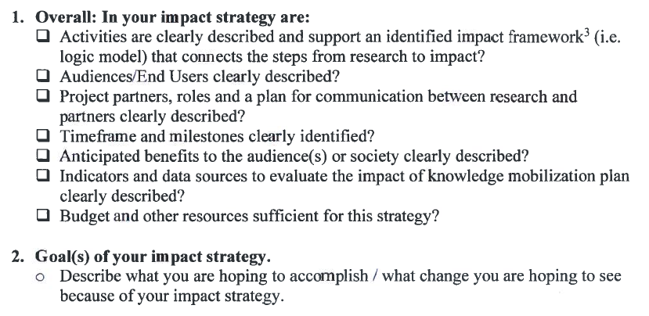
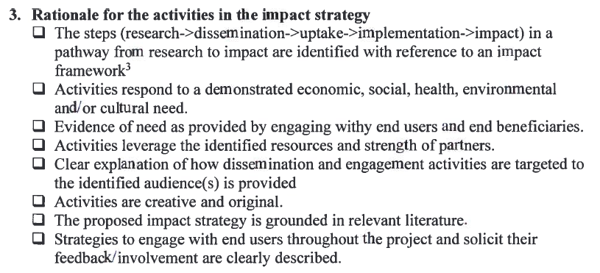
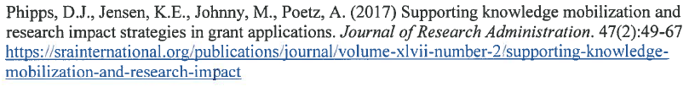
IMPACT PLAN CHECKLIST

Slide 33
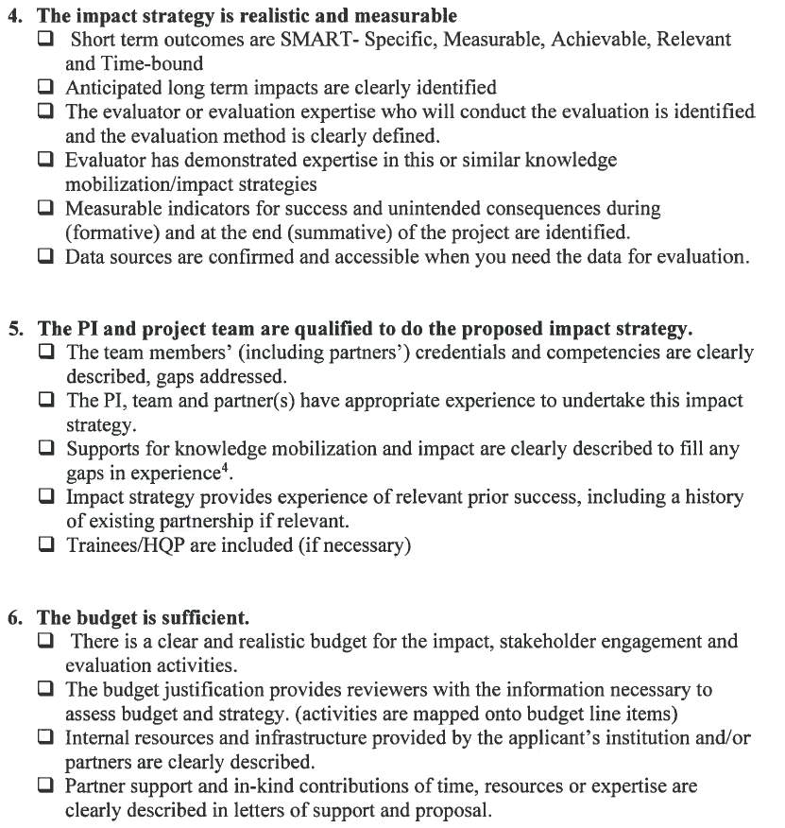
IMPACT PLAN CHECKLIST

Slide 34

THANK YOU FOR LISTENING!
Esther De Smet
Research Department
June 2022
@ResearchUGent

