Slide 2
UGent TT Organizational structure
Tech Transfer Office
IP and licensing
Business
Development
Legal
Industrial Research Fund
Grants and incubators
IOF-liaison →
hogescholen
8 Platformmedewerkers
IOF-liaison → Alfa-fac.
6 IOF-innovation officers
Network of Business Developers (IOF-BD): ± 25 people
Financed by IOF
Interdisciplinary research consortia (IDC): ± 10 people
Financed by BOF
Notes:
Leen
Our valorisation structure is characterized by a dual model, tandem model
Central TTO: About 30 employees - Four main departments
Decentralized Business developers, active within the faculties
The university strategically invested in the expansion of its industrial R&D network in 20 multidisciplinary research areas.
Unique model in Belgium!
We don’t only sell, we collaborate and the technology is placed centrally.

Slide 3
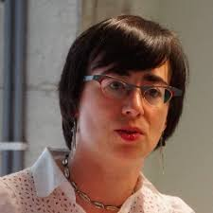
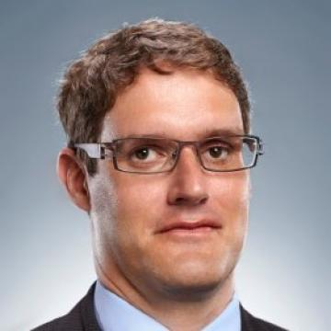
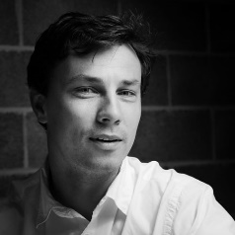
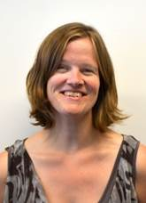
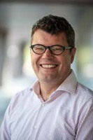
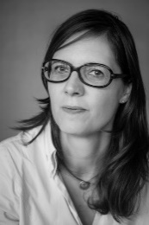
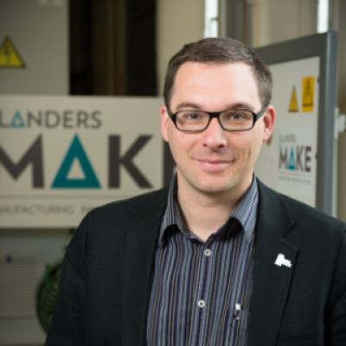
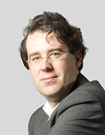
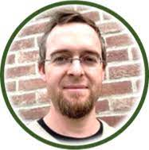
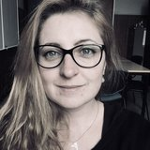
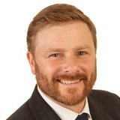
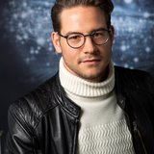
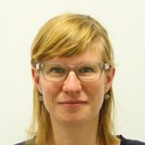
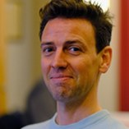
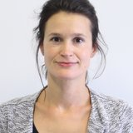
Network of Business Developers+ Innovation officers + platformmedewerkers
…
Focus on technology transfer
IOF-liaison Alfa-faculteiten
Focus on financial revenu of scientific research
Valorisation with a focus on the economical finality
IOF-liaison
hogescholen
Interdisciplinary research consortia: 10 people
Focus on knowledge transfer
…
Focus on social impact of scientific research
Valorisation with a focus on the societal finality
Sanne Stegen
Consortium: Grey

Slide 4
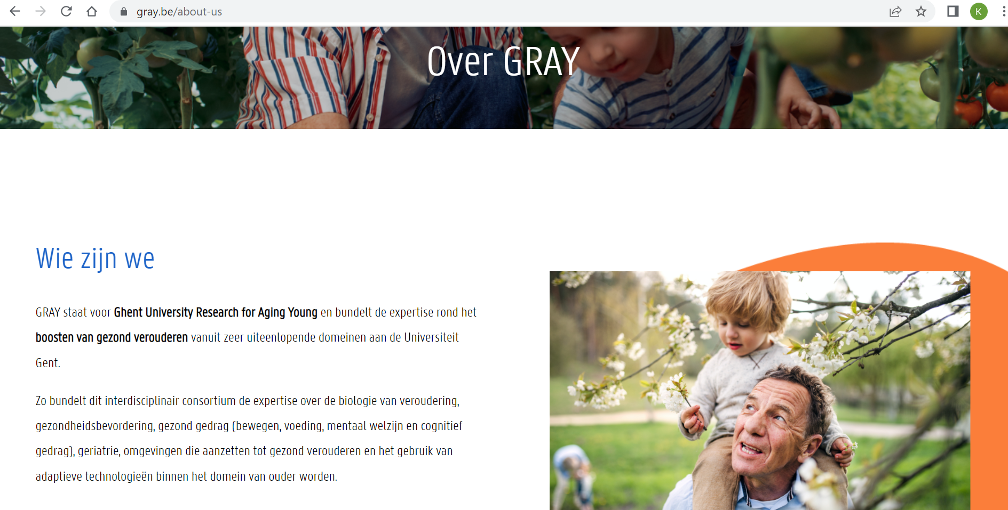
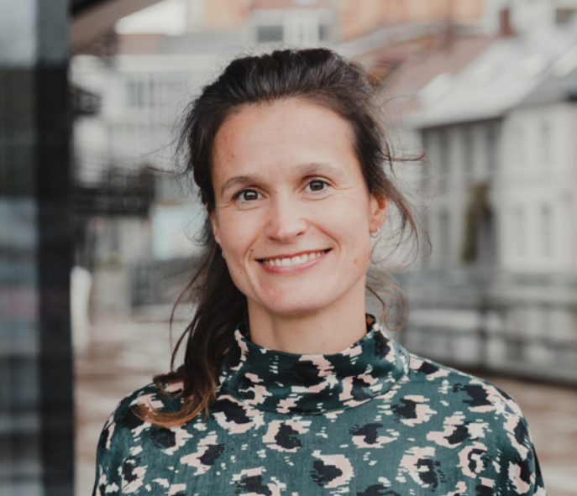

Slide 5
funding for Social finality
department of research affairs
Ugent techtransfer
Social / Economical

Slide 6
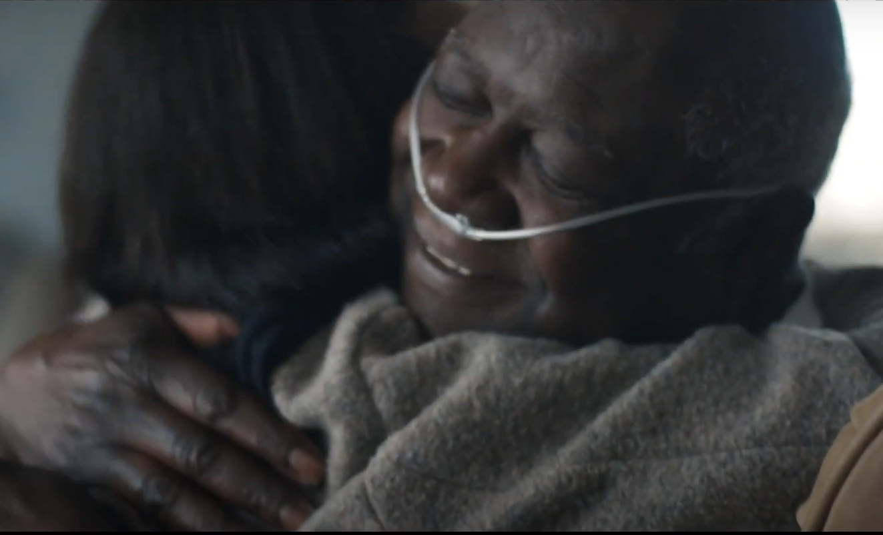
Vision/business model
A future where disease is a thing of the past

Slide 7
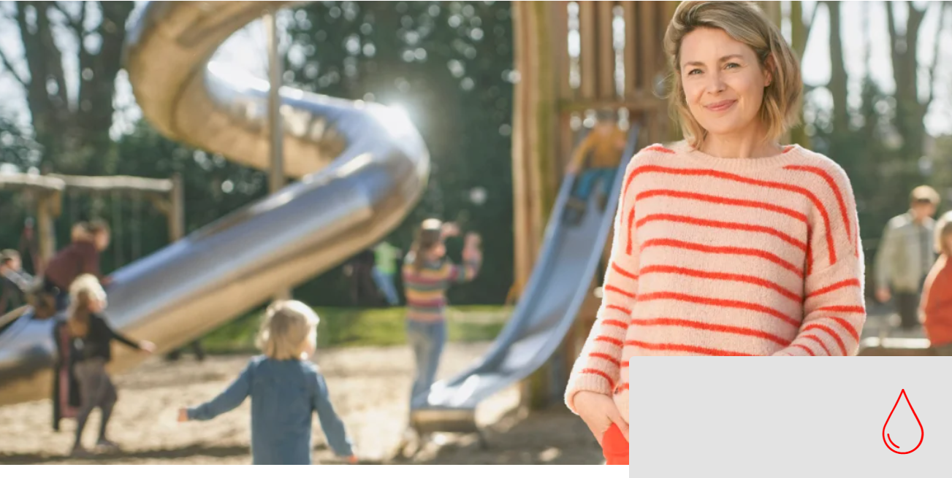
Vision/business model
Onze dienst staat in voor de continue bevoorrading van veilige producten aan de meeste ziekenhuizen in Vlaanderen.
Zo helpen we dokters levens redden.

Slide 8
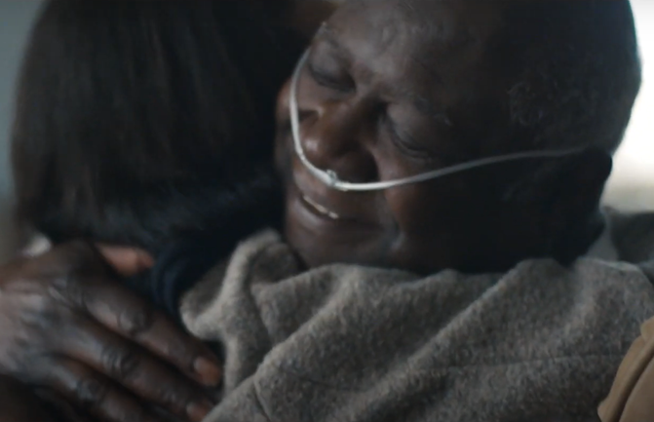
Business model/finality
Janssen Pharmaceutica – Vlaanderen
Turnover: 17 miljard Euro
> 5000 employees
Red Cross – Belgium
Turnover: 200 milion Euro
1600 employees
> 13.0000 volonteers
“Economic” finality
“Social” finality

Slide 9
Content
FWO-projects
SBO-projects with a societal finality
TBM-projects
VLAIO-project
VLAIO-projects
TETRA-projects
Medvia

Slide 10
FWO-projects
SBO/TBM

Slide 11
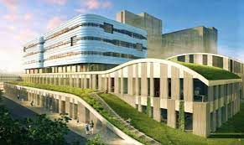
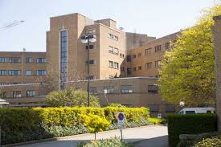
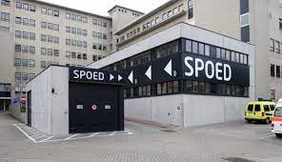
FWO
According to FWO:
Hospitals are research institutes
Can recieve 100% funding for R&D&I
According to UGent/UZGent:
Scientific research (PhD’s) can be financed at UGent
Clinical trials, use of clinical material and data: UZGent

Slide 12
FWO
Economical finality: towards companies (Janssen Pharma…)
An SBO project that will enable companies to develop new medicines through follow-up R&D for the purpose of economic value creation, fits within the economic finality component. The fact that the use of these medicines is societally relevant is not a determining factor for the primary finality of the project.
Social finality: towards social profit organisations (Red Cross, Hospitals)
A (macro)economic SBO project whose results are used as inputs by governmental actors or societal partners to develop new societal policy visions and strategies fits within the societal finality component. The research discipline in itself is not determining for the primary finality of the project.

Slide 13
SBO
Valorisation
Partner 1
Partner 2
Partner 3
Project
Lead users
School
Company
Health insurance agency
Company
Policy maker
Impact
End users
End users
End users

Slide 14
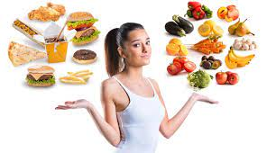
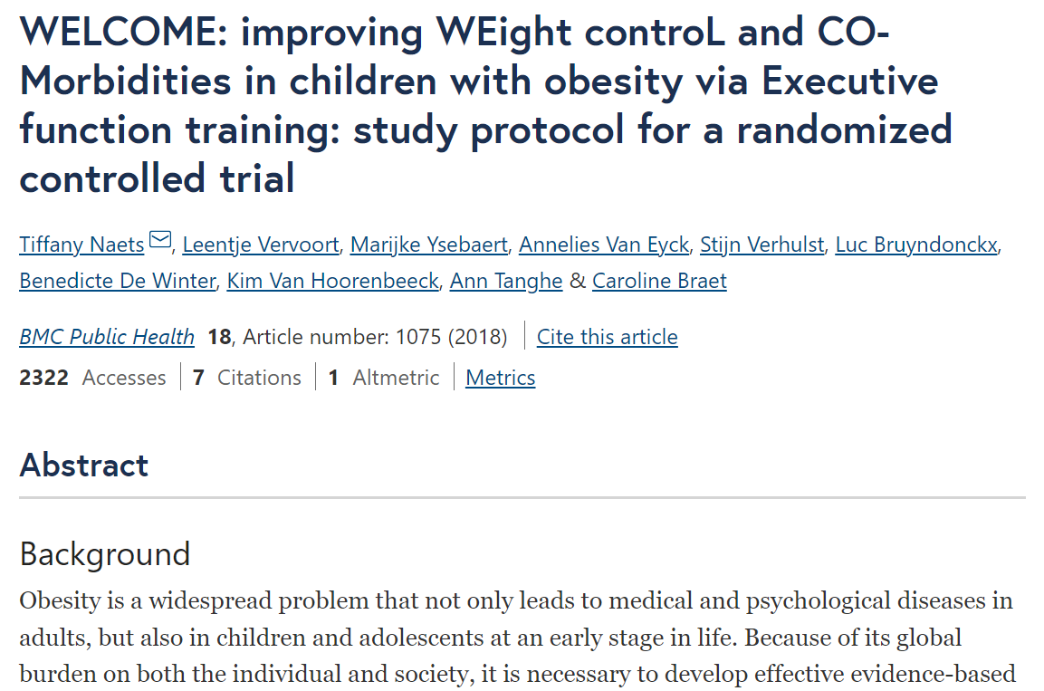
FWO
FWO-SBO-societal
FWO-TBM

Slide 15
Vlaio-projects
Baekeland/TETRA/Medvia

Slide 16
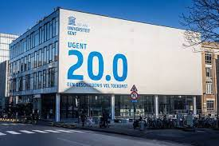
VLAIO
According to VLAIO:
Hospitals:
Hospitals, vzw’s are economic actors, like companies
Can’t recieve 100% funding for R&D&I, co-funding needed
Universities:
Universities are non-economic actors (>80% - 100% funding)
When working for companies, vzw’s: no PhD-grants, WP (geen bursaal statuut mogelijk)

Slide 17
vlaio
Economical finality: companies / non profit organisation → money
De globale economische impact wordt beschreven in termen van tewerkstelling, investeringen, kostenbesparing, rendementsverbetering en/of efficiëntieverhoging
Social finality: → societal goals
Maatschappelijke meerwaarde wordt beschreven in termen van eco-innovatie (duurzaam materiaalbeheer, kringloopeconomie, cleantech), groene energie, zorg (vergrijzing, gezondheid), duurzame mobiliteit en logistiek, sociale innovatie in arbeids- en werkorganisatie, …
First: economical finality
Second order: social finality

Slide 18
VLAIO
VLAIO- Baekeland /IM
Call: 2/year: Sept – March
Industrial PhD
Bottom-up topics (anything)
Funding: 1 person – 4 years
Both Science + Valorisation are important
Company/non-profit driven
Economical (social benefit is a nice add on)
Success rate: 50%
Non profit organisation, company, hospital…
In partnership with a university

Slide 19
Examples of BAEKELAND projects
Psychiatrisch ziekenhuis: Emotionele ontwikkeling bij personen met een verstandelijke beperking in forensische hulpverlening
Ziekenhuis: Ontwikkeling operationele benchmark ter ondersteuning van procesoptimalisaties
Vzw: Developing and testing a systemic assessment tool and intervention protocol for burnout
Company: Long distance education

Slide 20
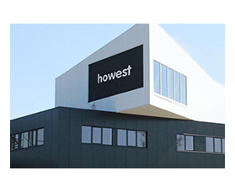
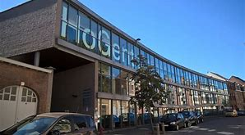
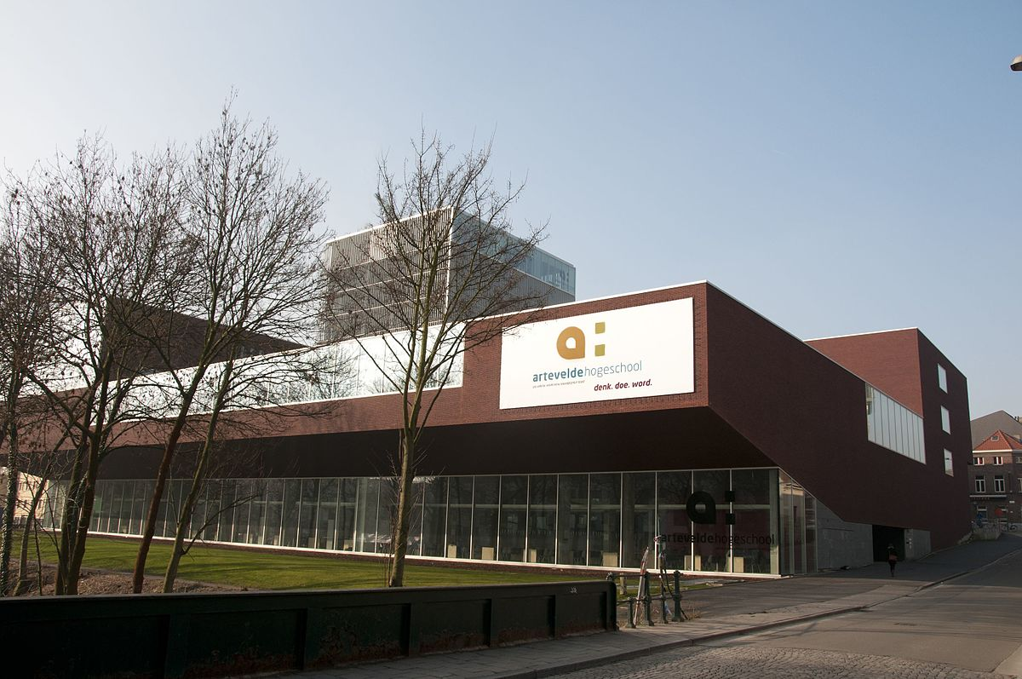
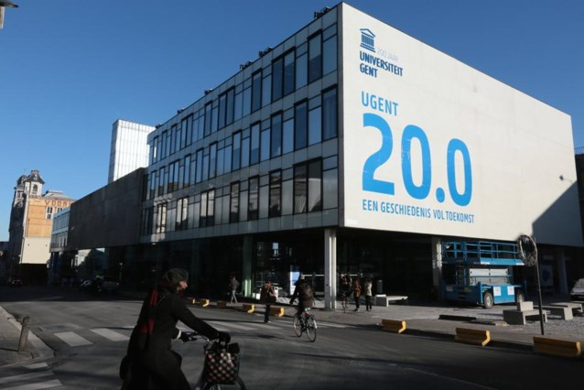
VLAIO
VLAIO- TETRA
Call: 1/year: September
University college: Practice oriented research
Bottom-up but also top-down (health, AI)
Budget: 100 k€ till 480 k€ for 2 years
92,5% subsidy + 7,5% cofunding sector
SME’s and non-profit
Economical and optional Societal finality
(societal finality should be claimed, can be a bonus, but in can also be evaluated negatively)
Success rate: 25%
University colleges in the lead.
UGent can participate. UZGent only in the user group

Slide 21
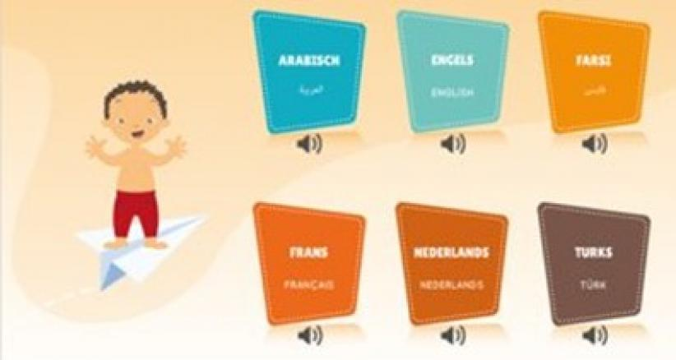
Examples of TETRA projects
https://www.acusticare.be/
https://www.matchen.org/

Slide 22
impact
How to claim economical impact for a societal driven project?
Baekeland: (1 organisation)
In case of succesful results, the organisation will be able to employ more persons (how many?)
The organisation will be able to attract more subsidy/ sponsoring (how much?)
The organisation will invest in new facilities …(how much?)
TETRA: (many organisations)
The organisations will be able to work more efficiently (how much?)
The organisations will be able to atract more clients, patients, students? (how many?)
In case you claim societal impact: also measure this (how much better will life be…)?
Quantify!!!

Slide 23
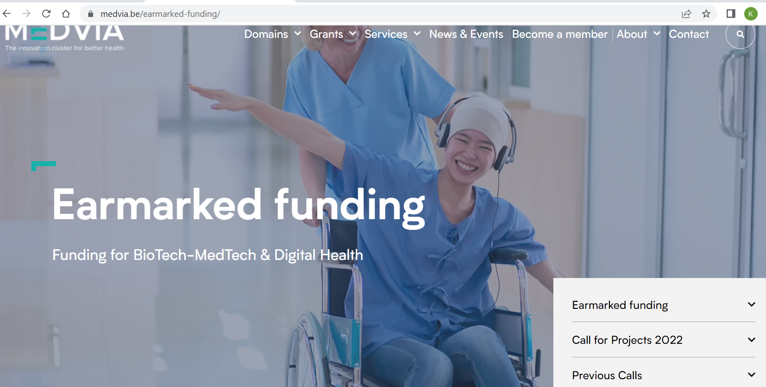
Sp-cluster: Medvia

Slide 24
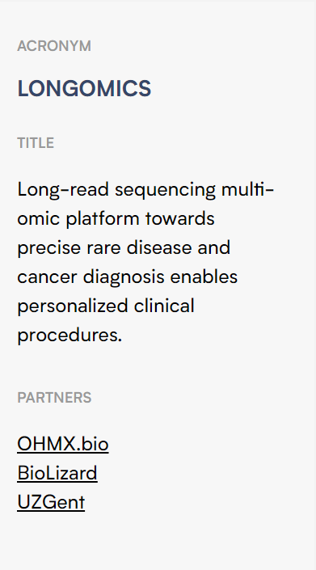
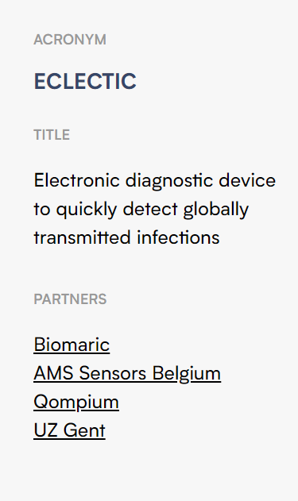
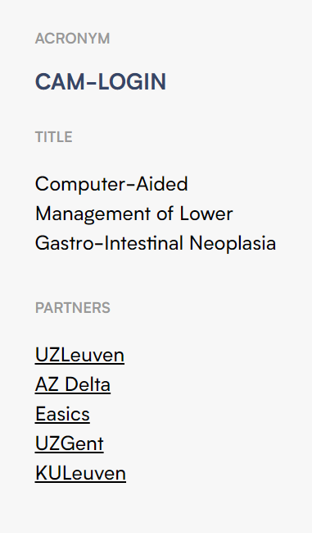
Examples

Slide 25
Karen Curé Dienst TechTransfer Karen.cure@ugent.be www.ugent.be/techtransfer
Ghent University @ugenttt Ghent University

