Slide 1
Python for data processing & analysis
Geert Jan Bex
geertjan.bex@uhasselt.be
Acknowledgements: thanks to Stefan Becuwe, Universiteit Antwerpen
for suggestions and corrections
License: this presentation is released under the Creative Commons, see
http://creativecommons.org/publicdomain/zero/1.0/

Slide 2
Introduction

Slide 3
Motivation
Why yet another programming language?
  Programming languages have strong & weak points
  Pick language for task at hand
Why Python?
  Useful for data processing
  Terse language: express a lot in few lines of code
  Short time to solution
  Extensive standard library
  Cross platform
Anybody who comes to you and
says he has a perfect language is
either naïve or a salesman.
— Bjarne Stroustrup

Slide 4
Python applications
Python is general purpose programming language, but strong for
  Data transformation: rewrite data into another format
    Preprocessing/postprocessing/aggregating data
  Prototyping
    Experiment easily in Python, fast implementation later
    Explorative programming
  Glue/coordination language
    Use Python as "scaffolding" for libraries in C/C++/Fortran
  In-application scripting language
    E.g., Kitware ParaView, Dassault Systèmes Abaqus™, Adobe Photoshop™
  Graphical user interfaces
    Wrap GUI around C/C++/Fortran code

Slide 5
Python versions
Current 3.x
  More clean than 2.x
  Almost all Python libraries supported
Version 2.7.x
  Last of the 2.x releases
  Many Python 3.x features have been retrofitted
  All libraries support it
Here, version 3.6
Note: in-application scripting
may be stuck at Python 2.7!
Python 2 countdown:
https://pythonclock.org/

Slide 6
Scope
Teach programming in Python
  prerequisite: you should know how to program in some other language, if not consider first completing
    CodeAcademy
    http://www.codecademy.com/tracks/python
    LearnPython
    http://www.learnpython.org/
Highlight Python's strong points
Discuss Python's weak points and how to mitigate
These sessions won't teach you how to program,
how to find algorithms, that's beyond the scope

Slide 7
Training material
All material available on GitHub
  Google for 'gjbex github'
  https://github.com/gjbex/training-material/
  repository name: training-material
    Python directory
Slides
  https://github.com/gjbex/training-material/blob/master/Python/python_intro.pptx
  click Download button
  section title slides have links to relevant material for section

Slide 8
Typographical conventions I
Shell commands are rendered as
  Do not type $, it represents your shell prompt!
Python shell commands are rendered as
  Do not type >>>, it represents the prompt!
iPython interpreter is rendered as
$ python –m doctest data_parsing.py
>>> names = 'bob alice carol'.split()
In[3]: names = 'bob alice carol'.split()

Slide 9
Typographical conventions II
Inline code fragments and file names are rendered as, e.g., hello_world.py
Longer code fragments are rendered as
Data files are rendered as
#!/usr/bin/env python
…
if __name__ == '__main__':
print('hello world!')
case dim temp
1 1 -0.5
2 1 0.0
3 1 0.5
4 2 -0.5
…
fragment
not shown

Slide 10
Syntax versus semantics
syntax: form, grammar
  correct:
  The dog is barking.
  incorrect:
  The dog barking.
semantics: meaning, interpretation
  correct:
  The dog barked.
  incorrect:
  The dog spoke.
Except in fairy tales!

Slide 11
What do you want to do today?

Slide 12
Running Python I
Running Python from the command line
  goals: run Python scripts in a shell
  prerequisites: none
  relevant sections: How to run Python from the shell?
Interactive Python
  goals: using Python for explorative programming using iPython & Jupyter notebooks
  prerequisites: none
  relevant sections: How to run Python from the shell?, How to run Python using Anaconda?

Slide 13
Running Python II
Managing Python environment
  goals: installing, updating packages, creating & sharing environments
  prerequisites: none
  relevant sections: How to run Python from the shell?, How to run Python using Anaconda?
Recommended software

Slide 14
Basic Python programming
Core Python programming
  goals: Python syntax & semantics, control flow, data types, functions
  prerequisites: experience in some programming language
  relevant sections: data types & statements, standard I/O & command line arguments, additional datatypes, file I/O

Slide 15
Intermediate Python programming
Object oriented programming
  goals: creating Python classes, inheritance
  prerequisites: core Python programming
  relevant sections: object oriented programming, data representation (case study)
Functional programming
  goals: writing code using functional programming paradigm
  prerequisite: core Python programming
  relevant sections: list transformations, Iiterators

Slide 16
Software engineering I
Code organization
  goals: organizing code of a non-trivial software project
  prerequisites: core Python programming
  relevant sections: code organization
Documentation
  goals: how to document Python code?
  prerequisites: core Python programming
  relevant sections: docstring & doctest

Slide 17
Software engineering II
Testing
  goals: tests are integral part of software development
  prerequisites: core Python programming, object oriented programming for unit testing
  relevant sections: doctest, unit testing
Error handling
  goals: catch & handle runtime errors
  prerequisites: core Python programming, object oriented programming to define your own exceptions
  relevant sections: error handling

Slide 18
Development I
Debugging
  goals: using the Python debugger
  prerequisites: core Python programming
  relevant sections: debugging
Profiling
  goals: using the Python profiler to identify optimization opportunities
  prerequisites: core Python programming
  relevant sections: profiling

Slide 19
Development II
Python 2 versus Python 3
  goals: compare Python versions, porting from Python 2 to 3
  prerequisites: core Python programming
  relevant sections: Python 2 to 3

Slide 20
Application development I
Command line arguments & configuration files
  goals: handling options, flags specified on command line, reading configuration files
  prerequisites: core Python programming
  relevant sections: argparse, ConfigParser
Logging
  goals: writing application events to log files, using log levels
  prerequisites: core Python programming
  relevant sections: logging

Slide 21
Application development II
Interacting with the operating system
  goals: file system operations, executing external commands
  prerequisites: core Python programming
  relevant sections: file system operations, external commands
Web applications
  goals: basic concepts of web application development
  prerequisites: core Python programming, HTML + CSS
  relevant section: GUI on the cheap

Slide 22
File formats
Text-based formats
  goals: reading & writing text-based file formats
  prerequisites: core Python programming, file I/O
  relevant sections: CSV & XML, regular expressions, web scraping, parsing regular languages, pyparsing for context-free languages, string formatting
Scientific file formats
  goals: reading & writing HDF5
  prerequisites: core Python programming, numpy
  relevant sections: HDF5

Slide 23
Numerical computing
Linear algebra, numerical analysis
  goals: various numerical analysis algorithms
  prerequisites: core Python programming
  relevant sections: numpy & scipy
Scientific visualization
  goals: creating 2D and 3D plots from Python
  prerequisites: core Python programming, numpy
  relevant sections: matplotlib, HoloViews, Bokeh

Slide 24
Symbolic computing
Computer algebra
  goals: various symbolic computations
  prerequisites: core Python programming
  relevant sections: sympy

Slide 25
Data analysis I
Relational database interaction
  goals: querying relational database systems
  prerequisites: core Python programming, object oriented programming for SQLAlchemy
  relevant sections: Relational databases
Data analysis
  goals: analysis using transforming & filtering tabular data, pivot tables, visualization
  prerequisites: core Python programming
  relevant sections: pandas

Slide 26
Data analysis II
Image & video analysis
  goals: analyzing and transforming images & videos
  prerequisites: core Python programming, numpy, scipy
  relevant sections: Image and video processing
Machine learning
  goals: analyzing and predicting from data
  prerequisites: core Python programming, numpy, pandas
  relevant sections: Machine learning

Slide 27
Data analysis III
GIS data processing
  goals: analyzing, transforming and creating GIS data
  prerequisites: core Python programming, numpy, pandas
  relevant sections: Graphical Information Systems data processing

Slide 28
Other training sessions
High performance Python
  Cython
  Integrating C/C++/Fortran code, wrapping libraries
    SWIG
    f2py3
  Shared memory programming
    multiprocessing
    futures
  Distributed programming with mpi4py
  PySpark
Biopython (on demand)

Slide 29
How to run Python from the terminal?
https://github.com/gjbex/training-material/tree/master/Python/Jupyter

Slide 30
Say hello to Python: terminal
Write script using your favorite editor (gedit/vim/emacs) and save to file, e.g., hello_world.py
Run script using Python interpreter
Make script executable
Run script directly
$ python hello_world.py
hello world!
For Linux/macOS:
2.7.x comes with
distribution
$ chmod u+x hello_world.py
$ ./hello_world.py
hello world!

Slide 31
Interactive: interpreter in terminal
Useful for experimentation, prototyping
Quit using quit() function or Ctrl-d
$ python
Python 3.6.1 (default, Apr 4 2017, 05:16:07)
[GCC 5.4.0] on linux2
Type "help", "copyright", "credits" or "license"…
>>> t = (3, 7)
>>> a, _ = t
>>> a
3

Slide 32
Interactive: iPython
More features than standard python shell
Not standard, requires install
$ ipython
Python 3.6.1 (default, Apr 4 2017, 15:28:02)
Type "copyright", "credits" or "license" for more information.
IPython 4.0.3 -- An enhanced Interactive Python.
? -> Introduction and overview of IPython's features.
%quickref -> Quick reference.
help -> Python's own help system.
object? -> Details about 'object', use 'object??' for extra
details.
In [1]:

Slide 33
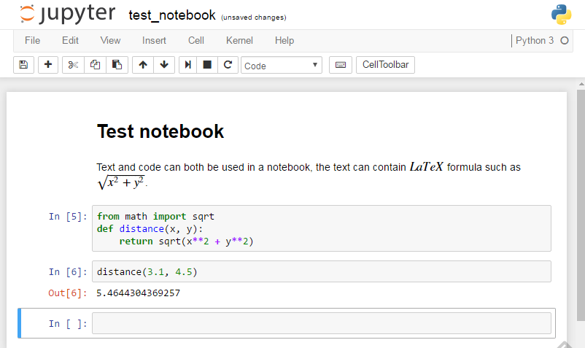
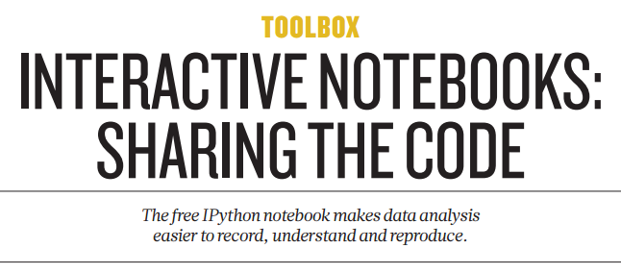
Interactive: jupyter notebooks
Styled text
Typeset LaTeX
formulas
Python input
Output
Interface in web browser

Slide 34
Jupyter use cases
Excellent for
  Explorative programming
  Data exploration
  Communication, especially across domains
Problems
  What was (re-)executed, what not?
  Version control?

Slide 35
Python help
Built-in help: interpreter/iPython
Works also in Jupyter notebooks
>>> import sys
>>> help(sys.exit)
Help on built-in function exit in module sys:
exit(...)
exit([status])
Exit the interpreter by raising SystemExit(status).
If the status is omitted or None, it defaults to ze…

Slide 36
Installing & upgrading packages
Use pip
  Install new package
  Upgrade a package
  Install a package only for yourself
To check for upgrades, use yolk
$ pip install pandas
$ pip install -U pandas
$ pip install --user -U pandas
$ yolk -U

Slide 37
Conda: environments
Install miniconda (http://conda.pydata.org/miniconda.html)
Create new environment
Use environment
Deactivate environment
environment name
$ conda create -n science python=3 \
numpy scipy matplotlib
packages to install
Python version
$ source activate science
$ source deactivate

Slide 38
Conda: installing & updating
Install new package
Update package
Update environment
Uninstall package
List all installed packages
$ conda install holoviews
Note: will also install
dependencies locally,
including non-python
libraries
$ conda update holoviews
$ conda update --all
$ conda remove holoviews
$ conda list

Slide 39
Conda: multiple environments
Clone environment
List all environments
Remove environment
environment name
$ conda create -n data_science --clone science \
pandas seaborn
additional packages to install
base environment
$ conda env list
$ conda remove --name data_science --all

Slide 40
Conda: sharing environments
Export environment description
  Export to YAML file
Create new environment based on description, portable across systems
$ source activate science
$ conda env export > science_environment.yml
$ conda env create -n science_env \
-f science_environment.yml

Slide 41
Conda: caveats
Conda installs dependencies
  Easy & fast
  System specific distribution: no compiles
  Library dependencies, e.g., zlib, mpich,…
Upgrading Python version: clone first!

Slide 42
Further reading
Conda cheat sheet
https://conda.io/docs/_downloads/conda-cheatsheet.pdf
Jupyter notebook tips
https://www.dataquest.io/blog/jupyter-notebook-tips-tricks-shortcuts/

Slide 43
How to run Python using Anaconda?
https://github.com/gjbex/training-material/tree/master/Python/Jupyter

Slide 44



: Anaconda
spyder IDE
  Editor: write scripts/modules
  Console, i.e., iPython interpreter: execute code snippets, run scripts
  Object inspector: from editor/console
Standalone Qt iPython console
jupyter notebooks
Manage environments
Platforms: Windows/macOS/Linux
License: free for academic use

Slide 45
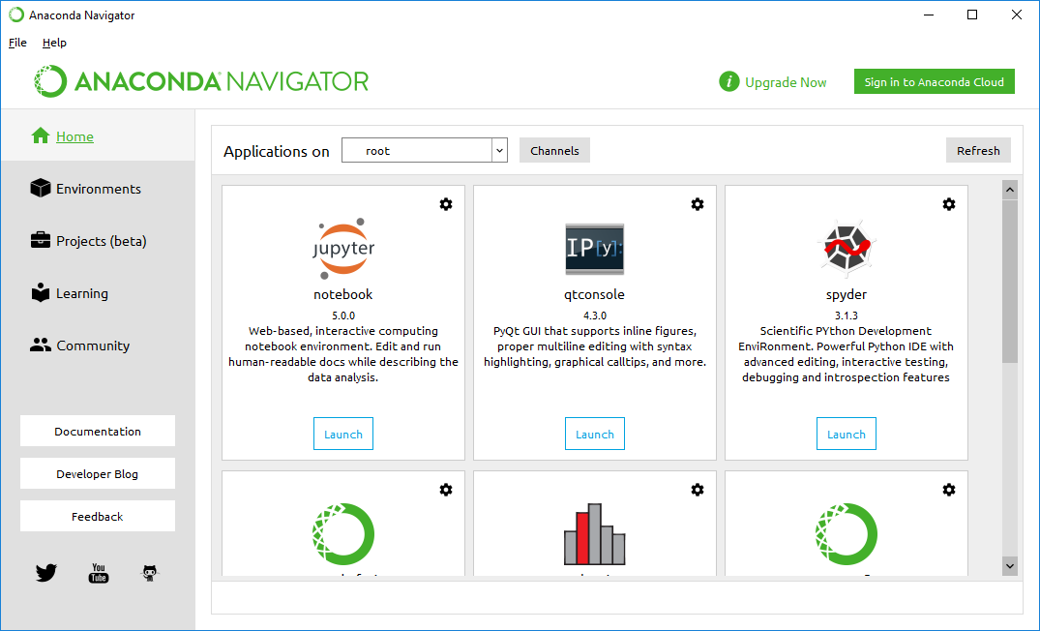
Anaconda navigator

Slide 46
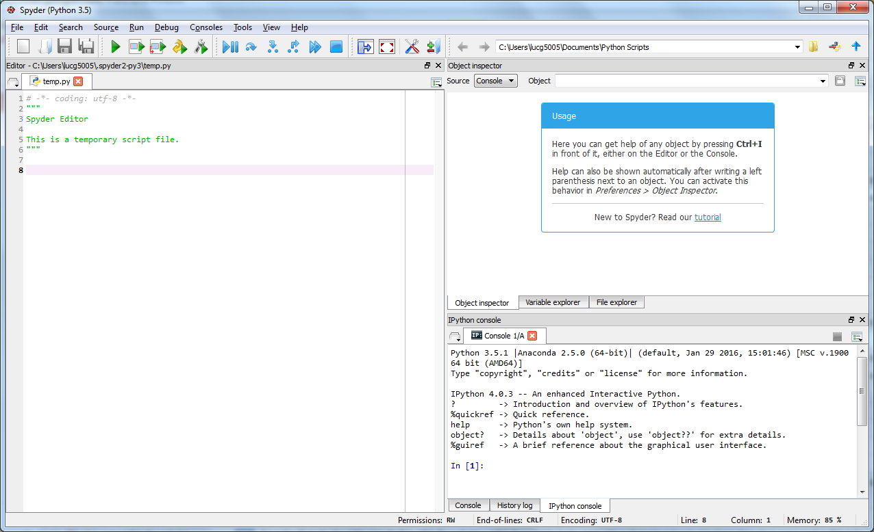
spyder
object inspector
editor
console

Slide 47
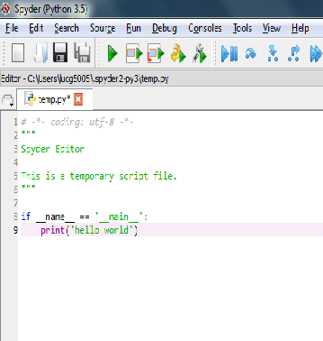
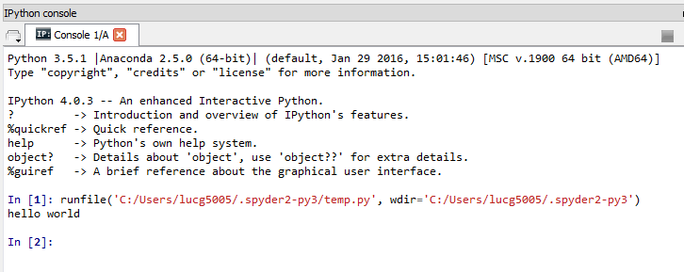
spyder: work cycle
Repeat until done
  Edit code
  Safe file
  Run file
  Check results

Slide 48
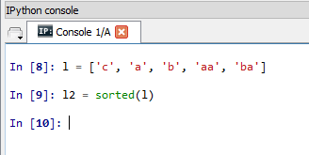
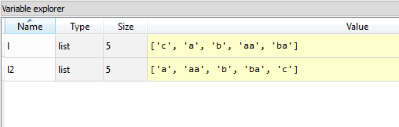
spyder: object inspector
Executing code snippets
Variable values in inspector

Slide 49
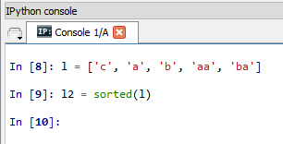
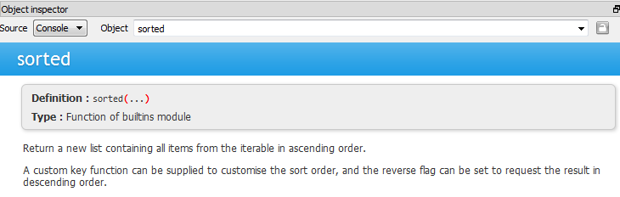
spyder: getting help
Select function/method/… in editor/console, press ctrl-i
Help in object inspector

Slide 50
spyder: more features
Project/file manager
Debug code
Profile code

Slide 51
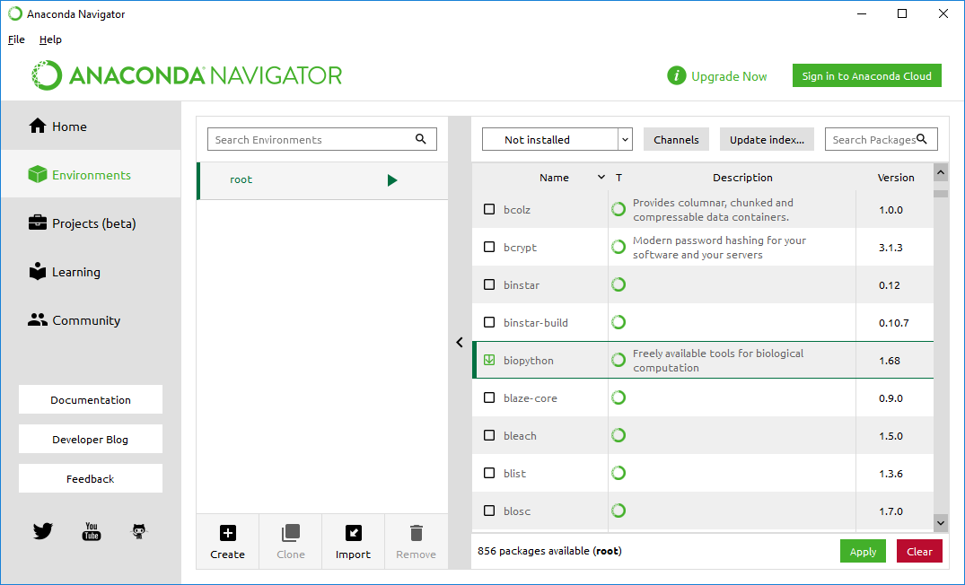
Anaconda environments

Slide 52
Python fundamentals: data types & statements
https://github.com/gjbex/training-material/tree/master/Python/Fundamentals

Slide 53
Hello world!
Minimal code for Python script
“shebang”: tells the shell this is python code
#!/usr/bin/env python
if __name__ == '__main__':
print('hello world!')
Python interpreter executes all code in body
Indentation is relevant!
Code structure
Python Is case-sensitive!

Slide 54
Say hello!
Save script in file hello_world.py
Run script using Python interpreter
Make script executable
Run script directly
$ python hello_world.py
hello world!
$ chmod u+x hello_world.py
$ ./hello_world.py
hello world!
That's what the shebang is for:
#!/usr/bin/env python

Slide 55
Hello again!
Encapsulate script in main function
#!/usr/bin/env python
import sys
def main():
print('hello world!')
return 0
if __name__ == '__main__':
status = main()
sys.exit(status)
Simple function, no arguments, return
status only
Function call

Slide 56
Generating data
Need some data?
  first column, case number: sequential number
  second column, dimension number: integer 1, 2, 3
  third column, temperature: float value -0.5, 0.0, 0.5
case dim temp
1 1 -0.5
2 1 0.0
3 1 0.5
4 2 -0.5
5 2 0.0
…
9 3 0.5
def main():
print('case', 'dim', 'temp')
case_nr = 0
for dim_nr in [1, 2, 3]:
for temp in [-0.5, 0.0, 0.5]:
case_nr += 1
print(case_nr, dim_nr, temp)
return 0

Slide 57
for loop
Semantics: for each element in list do…
Actually, not only lists, anything one can iterate over (e.g., sets, dictionaries, I/O streams,…)
variable
list
Note colon!
for dim_nr in [1, 2, 3]:
…
loop body
statement(s)
Note indentation

Slide 58
while loop
Semantics: while boolean condition holds do…
condition
Note colon!
while n > 0:
…
loop body
statement(s)
Note indentation

Slide 59
Skipping and quitting
Skipping loop iterations: continue
for n in range(100):
if is_prime(n):
continue
print(n)
Ending loop execution: break
n = 100
while n < 1000:
if is_prime(n):
break
n += 1
Works for both
for and while loops

Slide 60
Data types
str: sequence of characters, e.g., 'temp'
int: integer, e.g., 2, -1234, 1_203_107
float: floating point number, e.g., -0.5
complex: complex number, e.g., 1.3 + 4.8j
3.6+
def main():
print('case', 'dim', 'temp')
case_nr = 0
for dim_nr in [1, 2, 3]:
for temp in [-0.5, 0.0, 0.5]:
case_nr += 1
print(case_nr, dim_nr, temp)

Slide 61
Lists
Very useful data structure
Elements can be of same, or different type
Literal list
  [-0.5, 0.0, 0.5]
  ['alpha', 'beta', 'gamma', 'delta']
Empty list: [] or list()
List constructor
  list(range(3)) ≡ [0, 1, 2]
  list(range(1, 4)) ≡ [1, 2, 3]
  list(range(1, 8, 2)) ≡ [1, 3, 5, 7]
  list(range(0, -9, -3)) ≡ [0, -3, -6]
Note: explicit list construction can often be avoided,
range(…) returns iterable

Slide 62
More list operations
Example list: l = ['a', 'b']
Number of elements: len(l) == 2
Append to a list:
l.append('c'), l ≡ ['a', 'b', 'c']
Remove last element:
l.pop() == 'c', l ≡ ['a', 'b']
Insert element at position:
l.insert(1, 'c'), l ≡ ['a', 'c', 'b']
Remove element at:
l.pop(1) == 'c', l ≡ ['a', 'b']
Extend a list:
l.extend(['c', 'd']),
l ≡ ['a', 'b', 'c', 'd']

Slide 63
Using list elements
Example list: l = ['a', 'b', 'c']
Use first element: a = l[0], a == 'a'
Use second element: a = l[1], a == 'b'
Use last element: a = l[-1], a == 'c'
One before last: a = l[-2], a == 'b'
Assignment:
l[2] = 'de', l ≡ ['a', 'b', 'de']
Note: list index is 0-based!

Slide 64
Slicing & dicing
Example list: l = list(range(1, 6)),
l ≡ [1, 2, 3, 4, 5]
Creating sublists:
  l_sub = l[2:4], l_sub ≡ [3, 4]
  l_sub = l[:4], l_sub ≡ [1, 2, 3, 4]
  l_sub = l[2:], l_sub ≡ [3, 4, 5]
  l_sub = l[0:4:3], l_sub ≡ [1, 4]
  l_sub = l[::2], l_sub ≡ [1, 3, 5]
  l_sub = l[4:1:-1], l_sub ≡ [5, 4, 3]
  l_r = l[::-1], l_r ≡ [5, 4, 3, 2, 1]
Assigning to slices: l[::2] = ['a', 'b', 'c'],
l ≡ ['a', 2, 'b', 4, 'c']

Slide 65
Iterating over lists
Example list: data = list(range(1, 6))
Straightforward iteration
for e in data:
f(e)
Need index?
for i in range(len(data)):
g(i, data[i])
Better
for i, e in enumerate(data):
g(i, e)
√
√

Slide 66
Generating data revisited
Use range(…)
How to do lists of floats?
  [0.5*x for x in range(-1, 2)]
  list comprehensions: construct list from list
looks a lot like math
def main():
print('case', 'dim', 'temp')
case_nr = 0
for dim_nr in range(1, 4):
for temp in [0.5*x for x in range(-1, 2)]:
case_nr += 1
print(case_nr, dim_nr, temp)
return 0
consider using numpy

Slide 67
Formatting strings
Use tabs as separator
Increase number of digits after decimal point to 4
f-string: f'{case_nr}\t{dim_nr}\t{temp:.4f}'
'{0}\t{1}\t{2:.4f}'.format(
case_nr, dim_nr, temp)
tab
3.6+

Slide 68
Objects & methods
a string is an object (class str), format is a method on that object
object
method
'{0}\t{1}\t{2:.4f}'.format(
case_nr, dim_nr, temp)
method arguments
methods on strings produce new strings

Slide 69
Modifying data
Replace negative temperatures by 0.0
case dim temp
1 1 -0.5
2 1 0.0
3 1 0.5
4 2 -0.5
5 2 0.0
…
case dim temp
1 1 0.0000
2 1 0.0000
3 1 0.5000
4 2 0.0000
5 2 0.0000
…
import sys
def main():
print(sys.stdin.readline().rstrip('\r\n'))
for line in sys.stdin:
data = line.rstrip('\r\n').split()
if float(data[2]) < 0.0:
data[2] = '0.0'
print('{0} {1} {2:.4f}'.format(
data[0], data[1], float(data[2])))

Slide 70
Getting things in and out:
I/O & command line arguments

Slide 71
Reading lines from file handles
Standard file handles:
  sys.stdin: standard input (keyboard, pipe in)
  sys.stdout: standard output (screen, pipe out)
  sys.stderr: standard error (screen, pipe out)
Reading a single line:
  sys.stdin.readline(): returns str
Reading all lines at once:
  sys.stdin.readlines():
  returns list of str
Note: line endings,
e.g., \n or \r\n are
included
Note: readline(), readlines() are methods on file handles

Slide 72
Reading & memory consumption
Remember, readlines() method reads whole file at once
  For large files, creates long list = lots of memory
Avoid:
Use:
…
for line in sys.stdin.readlines():
…
Returns iterator, not list
Memory friendly!
…
for line in sys.stdin:
…

Slide 73
Writing to file handles
print function writes objects to sys.stdout, adds '\n' (or '\r\n') and applies str() conversion function by default
write(…) method writes str to file handle, e.g.,
  sys.stderr.write('### error: number is negative\n')
  sys.stdout.write(output_str)
flush() method flushes output to disk
  At least, tells OS to do so

Slide 74
More on print
print has some useful optional arguments
  file: allows to print to any open file handle, e.g., sys.stderr (default: sys.stdout)
  print("# error: number should be positive",
  file=sys.stderr)
  sep: character to separate multiple objects to print
  (default: ' '), e.g.,
  print('alpha', 3, 5.7, sep='\t')
  end: character to add when all arguments are printed
  (default: '\n'), e.g.,
  print('next print will be on same line',
  end='')
  flush: whether to combine print with a flush on the file handle (default: False),
  print('read done', file=sys.stderr,
  flush=True)

Slide 75
Simple command line arguments
Script name & command line arguments in sys.argv
import sys
if __name__ == '__main__':
print(sys.argv)
Note:
all values
are str
$ python cla_printer.py
['cla_printer.py']
$ python cla_printer.py alpha beta 3.5
['cla_printer.py', 'alpha', 'beta', '3.5']
$ python cla_printer.py 'alpha beta' 3.5
['cla_printer.py', 'alpha beta', '3.5']
Okay for very simple cases, better: use argparse

Slide 76
Python fundamentals continued
https://github.com/gjbex/training-material/tree/master/Python/Fundamentals

Slide 77
Some more str methods: strip
Getting rid of line endings: rstrip('\r\n')
  method will strip all combinations of \r and \n from right end of string
  Similar methods:
    lstrip: strips from left end of string
    strip: strips from both ends of string
  no arguments, strips: space, \t, \r, \n, …
Note that strings are not modified, new string is created!

Slide 78
str method: split
Splitting string: split()returns list of strings
  no argument: split on (multiple) whitespace
  otherwise, split on provided string
  limit number of splits by providing extra argument
E.g., read file, and print only end times
start 1: 2013-03-27 14:20:13
end 1: 2013-03-28 03:05:57
start 2: 2013-03-28 04:30:17
start 3: 2013-03-28 04:30:17
end 2: 2013-03-28 05:45:17
end 3: 2013-03-28 09:15:38
…
Split on ':', but note
time format!!!

Slide 79
More str methods: startswith, endswith
startswith(prefix), endswith(suffix) return True if str starts with prefix/ends with suffix respectively, False otherwise
…
for line in sys.stdin:
event_str = line.strip()
if event_str.startswith('end'):
event, time_str = event_str.split(':', 1)
print(time_str)
Only single split, otherwise time is split as well

Slide 80
Even more str methods: is<something>
Test str is uppercase/lowercase: s.isupper()/s.islower()
  'ABC'.isupper() == True
  'A19'.isupper() == True
  'Abc'.isupper() == False
  '19'.isupper() == False
Test str has only whitespace: s.isspace()
Test str has only digits: s.isdigit()
Test str is alphabethic/alphanumeric: s.isalpha()/s.isalnum()

Slide 81
Searching & replacing in str
Does str contain substring?
('ab' in 'ABabCD') == True
Find position of first occurrence of substring in str:
'ABabCD'.find('ab') == 2
  returns -1 when not found
  can search between given start and final position
Replace all occurrences of substring by other substring
'3.14'.replace('.', ',') == '3,14'
  maximum number of replacements can be specified
More methods, but this will do

Slide 82
str operations
Concatenating strings:
'abc' + 'def' == 'abcdef'
  Works for list as well
  [0, 1] + [3, 4] == [0, 1, 3, 4]
Multiplying strings:
'x' * 4 == 'xxxx'
  Works for list as well
  [0.0] * 4 == [0.0, 0.0, 0.0, 0.0]
    However, bear in mind that this may not always do what you think

Slide 83
Joining list elements
Often, data contained in list data structure
  Needs to be represented as delimited string
  Example:
  [3.1745, 18.14, -6.49043]
  3.1745,18.14,-6.49043
Use list comprehension, str function and str's join(…) method
>>> data = [3.1745, 18.14, -6.49043]
>>> print(','.join([str(number) for number in data]))
3.1745,18.14,-6.49043
type

Slide 84
str & list are sequences
characters (elements for list) accessed by position, e.g., s = 'abc':
s[0] == 'a', s[2] == 'c',
s[-1] == 'c', s[-2] == 'b'
Substrings (slices for list), e.g.,
s = 'abcde':
s[0:3] == 'abc', s[2:4] == 'cd',
s[1:] == 'bcde', s[:3] == 'abc'
s[::-1] == 'edcba'

Slide 85
str & list length revisited
Function len() computes str length (number of elements for list)
len('') == 0, len('abc') == 3
len([]) == 0, len([3, 5, 7]) == 3
Length & truth
  Empty string is False, non-empty string True
  Empty list is False, non-empty list is True
…
if len(line.strip()) > 0:
…
…
if line.strip():
…
≡

Slide 86
Type conversion
Convert str s to floating point: float(s)
  necessary for comparison:
  float(data[2]) < 0.0
Convert str s to integer: int(s)
Convert number x to str: str(x)
Convert float x to integer: int(x)
  takes integer part of float, e.g., int(-3.8) == -3
Determining type of expression e: type(e)
  e.g., type(3 + 0.1) == float

Slide 87
if statement
if …:
…
elif …:
…
else:
…
General form:
Nesting: structure through indentation
Conditional expression:
Note colon!
Note indentation
…
n = 10 if r > 1.0 else 0
…

Slide 88
Conditionals
Boolean values: True, False
Boolean operators: not, and, or
Comparison operators: ==, !=, <, <=, >, >=
  work on str, float, int,…
List membership: in, e.g.,
  'a' in ['c', 'a', 'd'] == True
  'e' not in ['c', 'a', 'd'] == True

Slide 89
Which dimension numbers?
Which dimension numbers occur in file?
import sys
def main():
sys.stdin.readline()
dim_nrs = set()
for line in sys.stdin:
dim_nrs.add(int(line.rstrip('\r\n').split()[1]))
print(dim_nrs)
return 0

Slide 90
Yuck, what's that?!?
dim_nr = int(line.rstrip('\r\n').split()[1])
≡
line_str = line.rstrip('\r\n')
data = line_str.split()
dim_str = data[1]
dim_nr = int(dim_str)
Python can be terse, but stick to what's comfortable for you!
However, use functions…

Slide 91
Reasonable compromise
One additional variable simplifies code
import sys
def main():
sys.stdin.readline()
dim_nrs = set()
for line in sys.stdin:
data = line.rstrip('\r\n').split()
dim_nrs.add(int(data[1]))
print(dim_nrs)
return 0

Slide 92
Sets
set is Python data type, acts like set in math
  empty set: s = set()
  number of elements: len(s)
  add element: s.add('a')
  check membership: 'b' in s
  remove element: s.remove('b'), s.discard('b')
  remove and return arbitrary element: s.pop()
  iterating over elements:
  for element in s:
  …
No set of sets, set of lists
Set comprehensions:
{i for i in range(3)} ≡ {0, 1, 2}

Slide 93
Set operations
s1 = {3, 5, 7}
s2 = {7, 11}
To modify set, use:
s1.<op>_update(s2)
For union, use:
s1.update(s2)
s1 & s2
Intersection:
s1.intersection(s2) == {7}
Union:
s1.union(s2) == {3, 5, 7, 11}
Difference:
s1.difference(s2) == {3, 5}
Symmetric difference:
s1.symmetric_difference(s2) == {3, 5, 11}
Is subset of?
s1.issubset(s2) == False
Is disjoint from?
s1.isdisjoint(s2) == False
s1 | s2
s1 |= s2
s1 - s2
s1 ^ s2
s1 <= s2

Slide 94
More modularity
Same code copied and pasted, modified
Make it generic
…
for line in sys.stdin:
data = line.rstrip('\r\n').split()
dim_nr = int(data[1])
…
def parse_line(line):
data = line.rstrip('\r\n').split()
return (int(data[0]), int(data[1]), float(data[2]))
…
for line in sys.stdin:
case_nr, dim_nr, temp = parse_line(line)
…

Slide 95
Functions
Call by reference
  however, remember that str, int, float et al. are immutable
Arguments can have default values
Arguments can be positional, or by keyword
Higher order
  functions can have functions as arguments
  function can return functions (closures)

Slide 96
Anatomy of function definition
Function definition
return statement to… return results, if any, and return control to caller
function name
argument list
Note colon!
def parse_line(line):
…
function body
statement(s)
Note indentation

Slide 97
Adding flexibility
Optional column separator
argument separator
default value
def parse_line(line, sep=None):
data = line.rstrip('\r\n').split(sep)
return (int(data[0]), int(data[1]), float(data[2]))
…
for line in sys.stdin:
(case_nr, dim_nr, temp) = parse_line(line)
…
call with single argument,
use default for sep (i.e., None)
…
(case_nr, dim_nr, temp) = parse_line(line, sep=';')
…

Slide 98

Default value pitfall
def filter(new_values, values=[]):
for new_value in new_values:
if new_value > 0:
values.append(new_value)
return values
if __name__ == '__main__':
value_list = [
[1, -3, 5],
[13, 33, -15],
]
for values in value_list:
print(f'filtering {values}')
filtered_values = filter(values)
print(f'filtered: {filtered_values}')
default values are
created on import,
reused for calls:
mutable types == surprise!
filtering [1, -3, 5]
filtered: [1, 5]
filtering [13, 33, -15]
filtered: [1, 5, 13, 33]
def filter(new_values, values=None):
if values is None:
values = []
…

Slide 99
Tuples (YADS ☺)
tuple is (kind of) fixed length list, immutable
tuple with two elements: t = ('a', 'b')
  first element: t[0] == 'a', second element t[1] == 'b'
def parse_line(line, sep=None):
data = line.rstrip('\r\n').split(sep)
return (int(data[0]), int(data[1]), float(data[2]))
…
for line in sys.stdin:
case_nr, dim_nr, temp = parse_line(line)
…
tuple of int, int, float
1-tuple: ('a', )
3-tuple unpacked into 3 variables

Slide 100
Returning to dimension numbers…
Which dimension numbers occur in file?
…
def main():
_ = sys.stdin.readline()
dim_nrs = set()
for line in sys.stdin:
_, dim_nr, _ = parse_line(line)
dim_nrs.add(dim_nr)
for dim_nr in dim_nrs:
print(dim_nr)
_ is wildcard in tuple unpacking:
tuple elements at those positions are ignored

Slide 101
Named tuples, Python 2.6+
collections.namedtuple is tuple, but elements have names
type name
from collections import namedtuple
…
Line_Data = namedtuple('Line_Data', 'case_nr dim_nr temp')
def parse_line(line, sep=None):
data = line.rstrip('\r\n').split(sep)
return Line_Data(case_nr=int(data[0]),
dim_nr=int(data[1]),
temp=float(data[2]))
…
for line in sys.stdin:
line_data = parse_line(line)
dim_nrs.add(line_data.dim_nr)
…
element names
constructor
access by name

Slide 102
Named tuples, Python 3.5+
typing.NamedTuple acts as tuple, but
  elements have names
  elements have type hints
  can have methods
  can serve as base class
from typing import NamedTuple
…
class Line_Data(NamedTuple):
case_nr: int
dim_nr: int
temp: float
type name
element names + type hints

Slide 103
Using named tuples
…
def parse_line(line, sep=None):
data = line.rstrip('\r\n').split(sep)
return Line_Data(case_nr=int(data[0]),
dim_nr=int(data[1]),
temp=float(data[2]))
…
for line in sys.stdin:
line_data = parse_line(line)
dim_nrs.add(line_data.dim_nr)
…
element values
can be specified
by name in
any order
access by name

Slide 104
Counting dimension numbers
How many times does a dimension number occur in file?
  maximum & minimum not known a-priori!
…
import sys
def main():
_ = sys.stdin.readline()
counter = {}
for line in sys.stdin:
line_data = parse_line(line)
if line_data.dim_nr not in counter:
counter[line_data.dim_nr] = 0
counter[line_data.dim_nr] += 1
for dim_nr, count in counter.items():
print('{0}: {1}'.format(dim_nr, count))

Slide 105
Dictionaries
Data structure that maps a key onto a value
  e.g., map a name to an age
  Keys can have any (hashable) type (mixed too)
  Values can have any type (mixed too)
  Dictionary comprehensions:
  {k: k**2 for k in range(3)} ≡
  {0: 0, 1: 1, 2:4}
ages = {
'alice': 35,
'bob': 32,
}
Curly brackets for dict
key/value pair separated by comma
key
value
key, value separated by colon

Slide 106
Using dictionaries
ages = {
'alice': 35,
'bob': 32,
}
Empty dictionary: {} or dict()
Number of key/value pairs: len(ages)
Storing values
ages['caro'] = 45
Retrieving values
35 == ages['alice']
Removing key/value, and return value
35 == ages.pop('alice')
Does ages have an age for 'dave'?
ages.has_key('dave') ≡ 'dave' in ages

Slide 107
Iterating over dictionaries
Iterate over keys:
for name in ages.keys():
…
for name in ages:
…
Iterate over values:
for age in ages.values():
…
Iterate over key/value pairs:
for name, age in ages.items():
…
Note:
creates views
Python 3.6+ implementation: keys in insertion order!

Slide 108
Counting again…
Using collections.Counter instead of dict: simpler, less error prone
…
import collections
import sys
def main():
_ = sys.stdin.readline()
counter = collections.Counter()
for line in sys.stdin:
line_data = parse_line(line)
counter[line_data.dim_nr] += 1
for dim_nr, count in counter.items():
print('{0}: {1}'.format(dim_nr, count))
bonus method: most_common()

Slide 109
More special data types
collections.namedtuple: tuples with named elements
collections.Counter: count elements
collections.OrderedDict: remembers insertion order
collections.deque: (bounded) double-ended queue
collections.defaultdict: dictionary with computed default values
array.array: faster than lists, however, use numpy

Slide 110
Summary: data types
int
float
complex
bool
str
tuple
list
set
dict
immutable,
hashable
simple types
More types in Python
mutable,
not hashable
complex types
Picking the right data type is
crucial to produce good code

Slide 111
Summary: control structures
Conditional statement:
if …:
…
elif …:
…
else:
…
Iteration statements:
  for-loop:
  for … in …:
  …
  while-loop:
  while …:
  …

Slide 112
Summary: mathematics
Usual operators: +, -, *, /, %
  for int, division is floating point division, i.e., 3/5 == 0.6
Raise to power: **
  e.g., 2**4 == 16
Floor division: //
  e.g., 7.3//5.7 == 1.0, but 6//4 == 1
Mathematical functions in module math
  First import module (usually at top of file):
  import math
  Use functions, e.g., math.sqrt(3.0)
  Or import specific function(s):
  from math import sqrt
  Use function(s), e.g., sqrt(3.0)
For complex numbers, functions in cmath
changed from 2.x to 3.x!

Slide 113
Code organization

Slide 114
Python modules & packages
Code organization
  Functions common to multiple scripts can be put in separate file = module
  Modules can be organized hierarchically in directory structure = packages
Python standard library is organized in packages
Don't forget __init__.py in package directories!

Slide 115
Example module & use
Module file:
Using the module in script:
from collections import namedtuple
Line_Data = namedtuple('Line_Data', 'case_nr dim_nr temp')
def parse_line(line, sep=None):
data = line.rstrip('\r\n').split(sep)
return Line_Data(case_nr=int(data[0]),dim_nr=int(data[1]),
temp=float(data[2]))
data_parsing.py
import data_parsing
def main():
…
for line in sys.stdin:
line_data = data_parsing.parse_line(line)
…
counting.py

Slide 116
Importing functions directly
Importing function parse_line from module data_parsing in script counting.py:
…
from data_parsing import parse_line
def main():
…
for line in sys.stdin:
data = parse_line(line)
…
counting.py
More concise, but name
clashes can occur!
E.g., math.sqrt versus
cmath.sqrt
from math import sqrt
from cmath import sqrt as csqrt

Slide 117
Double duty
#!/usr/bin/env python
from collections import namedtuple
Line_Data = namedtuple('Line_Data',
['case_nr', 'dim_nr', 'temp'])
def parse_line(line, sep=None):
data = line.rstrip('\r\n').split(sep)
return Line_Data(case_nr=int(data[0]),
dim_nr=int(data[1]),
temp=float(data[2]))
if __name__ == '__main__':
…
for line in sys.stdin:
line_data = parse_line(line)
…
data_parsing.py
Only executed when
run as script

Slide 118
Package layout & use example
…
from vsc.parameter_weaver.c.formatter import Formatter
…
weave.py
vsc
  __init__.py
  util.py
  parameter_weaver
    __init__.py
    artifact.py
    base_formatter.py
    c
      __init__.py
      formatter.py
      …
    fortran
      __init__.py
      formatter.py
      …
    …
…
from vsc.parameter_weaver.base_formatter import BaseFormatter
…

Slide 119
Writing documentation & simple testing
https://github.com/gjbex/training-material/tree/master/Python/CodeTesting

Slide 120
Writing documentation
Documentation is very important!
  use DocString
def parse_line(line, sep=None):
'''Split a line into its fields, convert to the
appropriate types, and return as a tuple.'''
# using \r, \n should work for Windows & *nix
data = line.rstrip('\r\n').split(sep)
return (int(data[0]), int(data[1]), float(data[2]))
>>> import data_parsing
>>> help(data_parsing.parse_line)
Help on function parse_line in module validator:
parse_line(line)
Split a line into its fields, convert to the
appropriate types, and return as a tuple

Slide 121
Formatting docstrings
def parse_line(line, sep=None):
'''Split line into fields,
converted to appropriate types
Parameters
----------
line: str
line of input to parse
sep: str
field separator, default
whitespace
Returns
-------
tuple (int, int, float)
data fields: case number,
dimension number, temperature
'''
…
Many options
  Google
  reStructured Text
  numpy/scipy
numpy/scipy

Slide 122
What to document and how?
DocString for
  functions
  classes
  methods
  modules
  packages
Comments
  particular code fragments you had to think about
see later

Slide 123
Assertions
Testing pre and post conditions
  Programming by contract
def fac(n):
assert type(n) == int, 'argument must be integer'
assert n >= 0, 'argument must be positive'
if n < 2:
return 1
else:
return n*fac(n - 1)
Optional
$ python -c 'from fac import fac; print(fac(-1))'
…
assert n >= 0, 'argument must be positive'
AssertionError: argument must be positive

Slide 124
Assert use cases
For development only, not production!
Not a substitute for error handling, i.e., exception handling
Run without assertions, run optimized: -O
$ python -O -c 'from fac import fac; print(fac(-1))'
1
Useful feature, but don't abuse!

Slide 125
Testing: meeting expectations
A program that has not
been tested does not work.
Tests are important!
  unittest: more features, but harder
  doctest: simple
Run tests
— Bjarne Stroustrup
def parse_line(line):
'''Split a line into its fields, convert to the
appropriate types, and return as a tuple.
>>> parse_line('5 3 3.7')
(5, 3, 3.7)
'''
data = line.rstrip('\r\n').split()
return (int(data[0]), int(data[1]), float(data[2]))
Statement
to execute
Expected result
No output: hooray, all tests passed!
$ python -m doctest data_parsing.py
$

Slide 126
Failing tests
def parse_line(line):
'''Split a line into its fields, convert to the
appropriate types, and return as a tuple.
>>> parse_line('5 3 3.7')
(5, 3, 3.7)
>>> parse_line('5 3 3')
(5, 3, 3)
'''
data = line.rstrip('\r\n').split()
return (int(data[0]), int(data[1]), float(data[2]))
$ python -m doctest data_parsing.py
*********************************************
File "./data_parsing.py", line 9, in __main__.parse_line
Failed example:
parse_line('5 3 3')
Expected:
(5, 3, 3)
Got:
(5, 3, 3.0)
**********************************************
1 items had failures:
1 of 2 in __main__.parse_line
***Test Failed*** 1 failures.$

Slide 127
Further reading: documentation
Documenting Python: a complete guide
https://realpython.com/documenting-python-code/#docstring-formats

Slide 128
Object-oriented Python
https://github.com/gjbex/training-material/tree/master/Python/Fundamentals

Slide 129
Object-orientation
Python types are classes
  e.g., (14).bit_length() == 4
    14 is an object of class int
    bit_length is object method defined in class int
Objects of simple Python types are immutable
  Operations/methods instantiate new objects
You are using objects all the time!

Slide 130
Value versus object identity
Simple Python types
  Value identity: (14 == 14) == True
  Object identity: (14 is 14) == True
    However, Python version dependent!
Other Python types, general classes
  e.g., two set objects:
  a = {'alpha'}, b = {'alpha'}
    Value identity: (a == b) == True
    Object identity: (a is b) == False

Slide 131
Defining your own classes
Class definition:
class Point:
…
Objects are instances of classes
  instantiated by calling constructor
  have
    attributes
    methods
Classes have
  attributes
  methods

Slide 132
A simple point…
from math import sqrt
class Point:
def __init__(self, x, y):
self.x = float(x)
self.y = float(y)
def distance(self, other):
return sqrt((self.x - other.x)**2 +
(self.y - other.y)**2)
def __str__(self):
return f'({self.x}, {self.y})'
constructor for
Point objects
method to
compute
distance
creates string representation for Point object

Slide 133
Making a point… or two
…
def main():
p = Point(3, 4)
q = Point(-2, 5)
print(p.x, p.y)
print(p, q)
print(p.distance(q))
p.x = 12.3
print(p)…
create Point p at 3, 4
create Point q at -2, 5
access p's x- and y-coordinates
calls __str__ method indirectly
on p and q
compute distance from p to q
$ python point_driver.py
3.0 4.0
(3.0, 4.0) (-2.0, 5.0)
5.0990195136
(12.3, 4.0)
modifying p
distance method invoked on Point p, with Point q as argument

Slide 134
More to the point…
What if points should not be moved?
class Point:
def __init__(self, x, y):
self.__x = float(x)
self.__y = float(y)
@property
def x(self):
return self.__x
@property
def y(self):
return self.__y
…
constructor for
Point objects
getter for object's
__x attribute
getter for object's
__y attribute

Slide 135
Making a definite point
…
def main():
p = Point(3, 4)
print(p.x, p.y)
p.x = 12.3
…
create Point p at 3, 4
try to access p's x-coordinate
$ python point_driver.py
3.0 4.0
Traceback (most recent call last):
File "<stdin>", line 1, in <module>
AttributeError: can't set attribute

Slide 136
Object attributes
Make object attributes "private" by hiding them, by convention, use __ prefix
self.__x = x
Create getter/setter method to control access to object attributes
@property
def x(self):
return self.__x
Determine object's state
Object attribute can not accidently be modified, i.e., read-only

Slide 137
Object attributes: control
Getter, but no setter
…
def main():
p = Point(3, 4)
print(p.x)
p.x = 4.4
print(p.x)
…
Protects against modification
of read-only attributes
$ python point_driver.py
3.0
Traceback (most recent call last):
File "<stdin>", line 1, in <module>
AttributeError: can't set attribute

Slide 138
Object attribute: setter
Implementing setters improves control, assignment to attribute is "intercepted" by setter method
class Point:
…
@x.setter
def x(self, value):
self.__x = float(value)
…
E.g., ensures proper type conversion:
p.x = 3 results in float, not int for __x attribute

Slide 139
Non-trivial getter/setter
Derived attribute: coordinates as 2-tuple
class Point:
…
@property
def coords(self):
return (self.x, self.y)
@coords.setter
def coords(self, value):
self.x = value[0]
self.y = value[1]
…
# Use coords getter/setter
print(p.coords)
p.coords = (3.5, 7.1)
returns a 2-tuple
2-tuple as argument

Slide 140
More object methods
from math import sqrt, isclose
class Point:
…
def on_line(self, p, q, tol=1.0e-6):
if not isclose(p.x, q.x, abs_tol=tol):
a = (q.y - p.y)/(q.x - p.x)
b = p.y - a*p.x
return isclose(self.y, a*self.x + b, abs_tol=tol)
else:
return isclose(self.x, p.x, abs_tol=tol)
…
# check whether r is on line defined by p and q
if r.on_line(p, q):
…
Python 3.5+
on_line method invoked on Point r, with Point p and q as argument

Slide 141
Object methods
Used to
  retrieve information on object
  modify or manipulate object
  derive information from object with respect to other objects
  …
Determine what objects can do, or can be done with

Slide 142
Static methods
…
class Point:
…
@staticmethod
def all_on_line(p, q, *points):
for r in points:
if not r.on_line(p, q):
return False
return True
…
# check whether p, q, r, v and w are on a line
if Point.all_on_line(p, q, r, v, w):
…
all_on_line method invoked on Point class
with Point p, q, r, v, w as arguments, class ignored
Notes:
What about *points?

Slide 143
Variable length argument lists
Arbitrary positional arguments: *argv
Arbitrary keyword arguments: **argv
  Available as dictionary
@staticmethod
def all_on_line(p, q, *points):
for r in points:
if not r.on_line(p, q):
return False
return True
arguments
available as tuple
Note: not specific to object oriented programming

Slide 144
More elegant solution
Semantics: True if True for all elements in points
More elegant: all(…)
Similar: any(…)
@staticmethod
def all_on_line(p, q, *points):
for r in points:
if not r.on_line(p, q):
return False
return True
@staticmethod
def all_on_line(p, q, *points):
return all(r.on_line(p, q) for r in points)

Slide 145
Quick interlude
What attributes/methods does a class have?
>>> from point import Point
>>> p = Point(3.7, 5.1)
>>> dir(p)
['__class__', '__delattr__', '__dict__', '__doc__',
'__format__', '__getattribute__', '__hash__',
'__init__', '__module__', '__new__', '__reduce__',
'__reduce_ex__', '__repr__', '__setattr__',
'__sizeof__', '__str__', '__subclasshook__',
'__weakref__', '_Point__x', '_Point__y',
'all_on_line', 'coords',
'distance', 'on_line', 'x', 'y']

Slide 146
Inheritance
Class can extend other class
For Python 2: make classes inherit from object, ensure they can be extended later:
class Point(object):
New class inherits attributes & methods from parent class
New class can implement new methods, define new attributes
New method can override methods of parent class
New class can inherit from multiple parent classes

Slide 147
Points with mass
class PointMass(Point):
def __init__(self, x, y, mass):
super().__init__(x, y)
self.__mass = float(mass)
@property
def mass(self):
return self.__mass
def __str__(self):
return '{0}: {1}'.format(
super().__str__(),
self.mass)
constructor
of Point
overridden
new object
method
str method
of Point
overridden
PointMass objects have x, y, distance, on_line methods as well
PointMass class has all_on_line methods

Slide 148
Base classes & derivation
create Point is base class for PointMass
class PointMass(Point):
def __init__(self, x, y, mass):
super().__init__(x, y)
self.__mass = float(mass)
first call Point's __init__ method
do PointMass-specific initialization

Slide 149
Point with mass is still Point
create PointMass p at 3, 4
and mass 1
def main():
p = PointMass(3, 4, 1)
q = Point(-2, 5)
print(p.x, p.y, p.mass)
print(p.distance(q))
create Point q at -2, 5
p is a Point, so has distance method
$ python point_driver.py
3.0 4.0 1.0
5.09902

Slide 150
Class attributes
class PointMass(Point):
__default_mass = 1.0
def __init__(self, x, y, mass=None):
super().__init__(x, y)
if mass is not None:
self.__mass = float(mass)
else:
self.__mass = PointMass.__default_mass
…
@classmethod
def set_default_mass(cls, mass):
cls.__default_mass = float(mass)
class variable
__default_mass
setter for class'
__default_mass
attribute
Determine state of class

Slide 151
All those methods
Object methods
  work on individual objects
  take object as first argument (self)
Class methods
  @classmethod
    work at class level
    take class as first argument (cls)
  @staticmethod
    work at class level
    ignores object or class it is called on

Slide 152
Files:
I/O and data formats
https://github.com/gjbex/training-material/tree/master/Python/DataFormats
https://github.com/gjbex/training-material/tree/master/Python/XmlGenerator

Slide 153
Reading from files
Reading from text files, line by line
  E.g., read file line by line, convert to uppercase, and print
Reading from a binary file, value by value
  E.g., read doubles (8 bytes) and print
1 with open(file_name, 'r') as text_file:
2 for line in text_file:
3 print(line.upper())
with …: context manager
Not portable!!!:
data type size?
Encoding?
little /big endian?
1 from struct import unpack
2 with open(file_name, 'rb') as bin_file:
3 double_bytes = bin_file.read(8)
4 while double_bytes:
5 print(unpack('d', double_bytes)[0])
6 double_bytes = bin_file.read(8)

Slide 154
Libraries & data formats
Standard library (Python 3.x)
  Comma separated value files: csv
  Configuration files: ConfigParser
  Semi-structured data: json, htmllib, sgmllib, xml
Non-standard libraries
  Images: scikit-image
  HDF5: pytables
  pandas
  Bioinformatics: Biopython
Use the "batteries"
that are included!

Slide 155
Data formats: CSV
Let Sniffer figure out
CSV dialect (e.g., Excel)
0 from csv import Sniffer, DictReader
1 with open(file_name, 'rb') as csv_file:
2 dialect = Sniffer().sniff(csv_file.read(1024))
3 csv_file.seek(0)
4 sum = 0.0
5 csv_reader = DictReader(csv_file, fieldnames=None,
6 restkey='rest', restval=None,
7 dialect=dialect)
8 for row in csv_reader:
9 print('{name} --- {weight}'.format(name=row['name'],
10 weight=row['weight']))
11 sum += float(row['weight'])
12 print('sum = {0}'.format(sum))
DictReader uses first
row to deduce field names
Access fields by name,
thanks to DictReader
Drawback: you still need to know field types

Slide 156
Writing to files
Writing to text files
  E.g., compute and write to file
Append to text files
  E.g., add some more squares to same file
Writing binary files: don't go there...
Note: 'w' replaces existing
file, use 'x' to avoid
1 with open(file_name, 'w') as text_file:
2 for i in range(0, 10):
text_file.write('{0}: {1}\n'.format(i, i*i))
1 with open(file_name, 'a') as text_file:
2 for i in range(10, 20):
text_file.write('{0}: {1}\n'.format(i, i*i))

Slide 157
... unless you have to
byte representation of
name truncated to 6
characters
Writing to binary files
1 from struct import pack
2 with open(file_name, 'wb') as bin_file:
3 for name, age in people:
bin_file.write(pack(‘6si',
bytes(name, 'ascii'),
age))
2 byte padding
for alignment
2 byte padding
for alignment
6 bytes
4 bytes
6 bytes
4 bytes
a
l
i
c
e
\0
\0
\0
0
0
0
x20
b
o
b
\0
\0
\0
\0
\0
0
0
0
x25
\0 character padding
\0 character padding

Slide 158
Data formats: XML output
<?xml version="1.0" ?>
<blocks>
<block name="block_01">
<item>
0.1
</item>
<item>
1.1
</item>
</block>
<block name="block_02">
<item>
0.2
</item>
<item>
1.2
</item>
</block>
</blocks>

Slide 159
Data formats: creating XML
1 from xml.dom.minidom import Document
2 nr_blocks = 2
3 nr_items = 2
4 doc = Document()
5 blocks = doc.createElement('blocks')
6 doc.appendChild(blocks)
7 for block_nr in range(1, nr_blocks + 1):
8 block = doc.createElement('block')
9 block_name = 'block_{0:02d}'.format(block_nr)
10 block.setAttribute('name', block_name)
11 blocks.appendChild(block)
12 for item_nr in range(0, nr_items):
13 item = doc.createElement('item')
14 text = '{0}.{1}'.format(item_nr, block_nr)
15 text_node = doc.createTextNode(text)
16 item.appendChild(text_node)
17 block.appendChild(item)
18 print(doc.toprettyxml(indent=' '))

Slide 160
Web scraping: gathering data from the web
https://github.com/gjbex/training-material/tree/master/Python/WebScraping

Slide 161
Introduction
Caveat: web scraping code is brittle, typically not robust against
  page layout changes (unless proper use of CSS)
  page content changes
  site redesign
Many frameworks available, here Beautiful Soup
However, for tables only, consider pandas
Use site APIs (e.g., REST interface) whenever available!

Slide 162
Beautiful Soup
Open web page using urllib
Cook soup out of opened page
Eat soup
import urllib
…
page = urllib.request.urlopen(page_url)
Note: urllib2 for Python 2.x
from bs4 import BeautifulSoup
…
soup = BeautifulSoup(page, "html5lib")
print('looking at {0}'.format(soup.title.string))
Assumes page has a title element

Slide 163
Finding stuff
First element with tag, e.g., a
All element with tag, e.g., a
Element content, e.g., a
Element attribute, e.g., href in a
print('looking at {0}'.format(soup.a))
for a in soup.find_all('a'):
print('a element: {0}'.format(a))
for a in soup.find_all('a'):
print('link text: {0}'.format(a.string))
for a in soup.find_all('a'):
print('link url: {0}'.format(a.get('href')))

Slide 164
Errors: dealing with exceptions
https://github.com/gjbex/training-material/tree/master/Python/CodeTesting

Slide 165
Errors
…
def main():
file_name = sys.argv[1]
with open(file_name) as in_file:
for line in in_file:
print('|{0}|'.format(line.rstrip('\r\n')))
return 0
…
$ python quote.py
Traceback (most recent call last):
File "./quote.0.py", line 13, in <module>
status = main()
File "./quote.py", line 6, in main
file_name = sys.argv[1]
IndexError: list index out of range
exception
thrown
Either check length of sys.argv, or deal with error!

Slide 166
Playing catch
…
def main():
try:
file_name = sys.argv[1]
except IndexError as e:
sys.stderr.write('### error: no input file\n')
return 1
with open(file_name) as in_file:
for line in in_file:
print('|{0}|'.format(line.rstrip('\r\n')))
return 0
…
$ python quote.py
### error: no input file

Slide 167
More trouble
$ python quote.py bla
Traceback (most recent call last):
File "./quote.py", line 17, in <module>
status = main()
File "./quote.py", line 11, in main
with open(file_name) as in_file:
IOError: [Errno 2] No such file or directory: 'bla'
exception
thrown

Slide 168
Catching more
…
def main():
try:
file_name = sys.argv[1]
in_file = open(file_name)
with in_file:
for line in in_file:
print('|{0}|'.format(line.rstrip('\r\n')))
except IndexError as e:
sys.stderr.write('### error: no input file\n')
return 1
except IOError as e:
msg = "### I/O error on '{0}': {1}".format(e.filename,
e.strerror)
sys.stderr.write(msg)
return 2
return 0
…

Slide 169
All handled!
Now all exceptions are handled
Note that code size increased from 5 to 16 lines
  Handling errors takes effort
  Worthwhile if others are using your software!
One can create own exceptions, derive class from Exception
$ python quote.py bla
### I/O error on 'bla': No such file or directory

Slide 170
Unit testing
https://github.com/gjbex/training-material/tree/master/Python/Unittest
https://github.com/gjbex/training-material/tree/master/Python/PyParsing

Slide 171
Unit testing
Key concepts
  Implementation tested through API
  Testing should be easy
  Tests are independent of one another
Find problems early/fast
Facilitates change
  Make small change, run tests
TDD: Test Driven Development
  Write tests first, then implement
Programming framework, e.g., Python's unittest
"How to test?" is a question that
cannot be answered in general.
"When to test?" however, does have
a general answer: as early and as
often as possible.
— Bjarne Stroustrup

Slide 172
Test case
Subclass of unittest.TestCase
Methods test_<name> are tests
unittest provides driver for running tests
import unittest
from func_lib import fib
class FibTest(unittest.TestCase):
def test_fib4(self):
'''test for fib(4)'''
self.assertEqual(3, fib(4))
if __name__ == '__main__':
unittest.main()
Test case
Individual test
Result to test
Expected result
Test driver
fib_test.py

Slide 173
Running tests
Run Python script
$ python ./fib_test.py
F
================================================
FAIL: test_fib4 (__main__.FibTest)
test a number computations for small arguments
------------------------------------------------
Traceback (most recent call last):
File "./fibber.py", line 13, in test_fib4
self.assertEqual(expected, fib(4))
AssertionError: 3 != 5
------------------------------------------------
Ran 1 test in 0.001s
FAILED (failures=1)

Slide 174
Assert methods
Many methods: provide accurate feedback
  assertEqual for int, str
  assertAlmostEqual for float, complex
  assertTrue, assertFalse for bool
  assertListEqual, assertSetEqual, assertDictEqual, assertTupleEqual
  assertIn
  assertIsNone
  assertIsInstance
  assertRegex
+ negations, e.g.,
assertNotEqual, …

Slide 175
Checking for expected failure
Exceptions
Also useful: assertRaisesRegex
Warnings: assertWarns
from func_lib import fib, InvalidArgumentException
…
def test_negative_values(self):
'''test for call with negative argument'''
with self.assertRaises(InvalidArgumentException):
fib(-1)
…

Slide 176
Subtests
To check for a series of values
…
def test_low_values(self):
'''test a number computations for small arguments'''
expected = [0, 1, 1, 2, 3, 5, 8, 13]
for n in range(len(expected)):
with self.subTest(i=n):
self.assertEqual(expected[n], fib(n))
…

Slide 177
Fixtures
Prepare for test(s), clean up after test(s), e.g.,
  Open/close a file
  Open/close a database connection, initialize a cursor
  Initialize data structures/objects
Three levels
  Before/after any test in module is run
    setUpModule()/tearDownModule()
  Before/after any test in test case class is run
    setUpClass(cls)/tearDownClass(cls) (mark as @classmethod)
  Before/after each individual test
    setUp(self)/tearDown(self)

Slide 178
Module-level
setUpModule: create and fill database
tearDownModule: remove database
import init_db
…
def setUpModule():
'''create and fill the database'''
conn = sqlite3.connect(master_name)
init_db.execute_file(conn, 'create_db.sql')
init_db.execute_file(conn, 'fill_db.sql')
def tearDownModule():
'''remove database file once testing is done'''
os.remove(master_name)

Slide 179
Test case-level
setUpClass: create copy of database
tearDownClass: remove copy of database
test_name = 'test.db'
@classmethod
def setUpClass(cls):
'''copy original database'''
shutil.copyfile(master_name, cls.test_name)
Test cases must
be independent!
@classmethod
def tearDownClass(cls):
'''remove test database'''
os.remove(cls.test_name)

Slide 180
Test-level
setUp: create connection & cursor
tearDown: close connection
def setUp(self):
'''open connection, create cursor'''
self._conn = sqlite3.connect(self.__class__.test_name)
self._conn.row_factory = sqlite3.Row
self._cursor = self._conn.cursor()
Tests must be
independent!
def tearDown(self):
'''close database connection'''
self._conn.close()

Slide 181
Flow for fixtures
Create projects.db
setUpModule for tests
  setUpClass for ContentsTest
    setUp for test_num_projects
      test_num_projects
    tearDown for test_num_projects
    setUp for test_num_researchers
      test_num_researchers
    tearDown for test_num_researchers
    …
  tearDownClass for ContentsTest
  setUpClass for ConstraintsTest
    setUp for test_project_name_uniqueness
      test_project_name_uniqueness
    tearDown for test_project_name_uniqueness
    …
  tearDownClass for ConstraintsTest
tearDownModule for tests
Copy projects.db to test.db
Connect to database
Run test
Disconnect from database
Remove test.db
Remove projects.db

Slide 182
Running all tests
In module
In all modules
…
if __name__ == '__main__':
unittest.main()
fib_test.py
$ python ./fib_test.py
$ python -m unittest discover -p '*_test.py'

Slide 183
Test coverage
Easy to overlook
  functions/methods
  code paths
Use code coverage tool
https://coverage.readthedocs.io/
Steps
  run code using coverage run
  create create detailed report using coverage annotate
  add tests until covered
A program that has not
been tested does not work.
— Bjarne Stroustrup

Slide 184
Coverage usage
Run code
Report
$ coverage run ./prog.py
…
show line numbers missed
$ coverage report -m
coverage report -m
Name Stmts Miss Cover Missing
--------------------------------------------
functions.py 9 3 67% 2-5
prog.py 14 2 86% 17-18
--------------------------------------------
TOTAL 23 5 78%
line numbers
missed

Slide 185
Coverage usage
Create annotated source code
Remove coverage data
directory for reports
$ coverage annotate -d coverage_report
…
> if options.no_iter:
> n = options.max_n
> print(f'fac({n}) = {func(n)}')
! else:
! for n in range(options.max_n + 1):
! print(f'fac({n}) = {func(n)}')
…
run
not run
$ coverage erase

Slide 186
Further reading
B. Kernighan & R. Pike (1999) The practice of programming, Addison-Wesley
M. Fowler (1999) Refactoring: improving the design of existing code, Addison-Wesley

Slide 187
Icing on application:
Python's argparse, ConfigParser
https://github.com/gjbex/training-material/tree/master/Python/ArgParse
https://github.com/gjbex/training-material/tree/master/Python/ConfigParser

Slide 188
Handling command line arguments
Many tools start out as short script, evolve into applications used by many
Model after Unix tools
  Arguments
  Flags
  Options
Python's argparse benefits
  Easy to use
  Self-documenting

Slide 189
Defining command line arguments
Use argparse library module
Add positional argument(s)
Add flag(s)
Add option(s)
Parse arguments
from argparse import ArgumentParser
arg_parser = ArgumentParser(description='Gaussian random number generator')
arg_parser.add_argument('nr', metavar='n', type=int, nargs='?', default=1,
help='number of random numbers to generate')
arg_parser.add_argument('-idx', action='store_true', dest='index',
help='print index for random number')
arg_parser.add_argument('-mu', type=float, default=0.0,
help='mean of distribution')
dest='mu' is implicit
args = arg_parser.parse_args()

Slide 190
Using command line arguments
for i in range(args.nr):
if args.index:
prefix = '{0}\t'.format(i + 1)
else:
prefix = ''
print('{0}{1}'.format(prefix, random.gauss(args.mu, args.sigma)))
$ ./generate_gaussians –h
usage: generate_gaussians.py [-h] [-mu MU] [-sigma SIGMA] [-idx] [n]
Gaussian random number generator
positional arguments:
n number of random numbers to generate
optional arguments:
-h, --help show this help message and exit
-mu MU mean of distribution
-sigma SIGMA stddev of distribution
-idx print index for random number
Autogenerated
help message
$ ./generate_gaussians –idx 3.0
usage: generate_gaussians.py [-h] [-mu MU] [-sigma SIGMA] [-idx] [n]
generate_gaussians.py: error: argument n: invalid int value: '3.0'

Slide 191
ConfigParser configuration files
Configuration files
  save typing of options
  Document runs of applications
Easy to use from Python: configparser module
Configuration file (e.g., 'test.conf')
[physics]
# this section lists the physical quantities of interest
T = 273.15
N = 1
[meta-info]
# this section provides some meta-information
author = gjb
version = 1.2.17
section physics
section meta-info
Note:
at least one section
key = value
comments

Slide 192
Reading & using configurations
Reading configuration file
Using configuration values
from configparser import ConfigParser
cfg = ConfigParser()
cfg.read('test.conf')
temperature = cfg.getfloat('physics', 'T')
number_of_runs = cfg.getint('physics', 'N')
version_str = cfg.get('meta-info', 'version')
if cfg.has_option('physics', 'g'):
acceleration = cfg.getfloat('physics', 'g')
else:
acceleration = 9.81

Slide 193
Further reading: argparse
Argparse tutorial
https://docs.python.org/3.5/howto/argparse.html

Slide 194
More icing on application:
GUI on the cheap
https://github.com/gjbex/training-material/tree/master/Python/Flask

Slide 195
Introduction
Micro-services
  single user web application
  can act as API (REST interface)
  can act as GUI (HTML/Javascript)
Many frameworks, e.g., Flask
  easy to install
  nice for simple applications
Note: security!

Slide 196

Did I mention that you should really, really know what you are doing?
Do not (and I mean never ever)
use this for production or die!

Slide 197
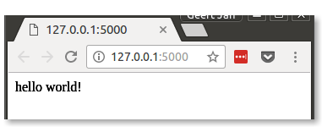
Hello Flask
Web application
Run
from flask import Flask
app = Flask(__name__)
@app.route('/')
def hello_world():
return 'hello world!'
if __name__ == '__main__':
app.run()
Handles request for /
$ python ./hello_world.py
* Running on http://127.0.0.1:5000/
(Press CTRL+C to quit)

Slide 198
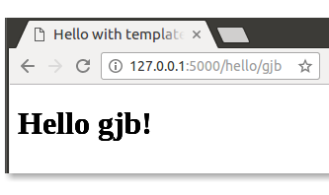
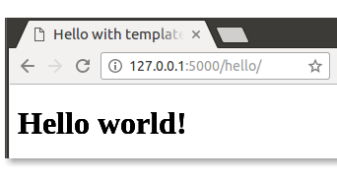
Hello yourself
Routing with variables
@app.route('/hello/')
@app.route('/hello/<name>')
def hello(name=None):
return 'hello {0}!'.format(name if name else 'world')
variable
default route: name == None
Variable types: int, float, path, uuid

Slide 199
Templates
Templates: Flask uses jinja2
Using template
templates/hello.html
<!doctype html>
<title>Hello with templates</title>
<body>
{% if name %}
<h1>Hello {{name}}!</h1>
{% else %}
<h1>Hello world!</h1>
{% endif %}
<p> This is a jinja2 template. </p>
</body>
variable substitution
if name defined
if name undefined
from Flask import render_template
…
@app.route('/hello/<name>')
def hello(name=None):
return render_template('hello.html', name=name)

Slide 200
Form template
Form template (ugly, use CSS for style)
templates/sum.html
<!doctype html>
<title>EasySum</title>
<body>
<h1>EasySum</h2>
{% if result %}
<p> The result of {{op1}} + {{op2}} is {{result}}. </p>
{% else %}
<p> This web aplication computes the sum of two numbers
, the can even be floating point values. </p>
<form method="POST">
First operand: <input type="text" name="op1"/> <br/>
Second operand: <input type="text" name="op2"/> <br/>
<input type="submit" value="Compute"/>
</form>
{% endif %}
</body>

Slide 201
Form handling
Use request & specify methods
Note: always validate input!
from flask import Flask, request, render_template
…
@app.route('/', methods=['GET', 'POST'])
def start():
if request.method == 'POST':
op1 = float(request.form['op1'])
op2 = float(request.form['op2'])
result = op1 + op2
return render_template('sum.html', op1=op1, op2=op2,
result=result)
else:
return render_template('sum.html')
Methods to handle
Check method
Retrieve input values

Slide 202
Sessions
Keep track of application state with session
app.secret_key = 'A1Zr38g/3yZ R~XGH!jlN]3WX/,?RT'
@app.route('/reset')
def reset():
session['fib'] = 1
session['fib_prev'] = 1
session['number'] = 0
return render_template('fib.html', number=None)
@app.route('/')
def start():
if 'number' in session:
session['number'] += 1
fib = session['fib']
session['fib'] += session['fib_prev']
session['fib_prev'] = fib
return render_template('fib.html',
number=session['number'],
fibonacci=session['fib'])
else:
return reset()
Note: Flask server is single session
⇒ no multi-user, multi-session!
Persistent variables
Check state
Retrieve/update
session values

Slide 203

Further reading
Flask
http://flask.pocoo.org/docs/latest
Jinja2 0.25 (check for latest version)
http://jinja.pocoo.org/docs/latest
Did I mention security is an issue?
http://flask.pocoo.org/docs/latest/advanced_foreword/#develop-for-the-web-with-caution
There be dragons!

Slide 204
Debugging Python

Slide 205
Errors & warnings: pylint, flake8
Static cod analysis, errors, warnings, code quality suggestions
flake8 can be invoked from
vim, as git hook
$ pylint add.py
************* Module add
C: 1, 0: Missing module docstring (missing-docstring)
E: 4,10: Undefined variable 'x' (undefined-variable)
Report
======
3 statements analysed.
…
#!/usr/bin/env python
if __name__ == '__main__':
print(x + 3)

Slide 206
Use debugger
Bugs are ubiquitous…
Debugging by print?
  easy to do
  takes a long time for complex situations
  unstructured process
  pollutes code
Use debugger (pdb for Python): it can
  step through code, statement by statement
  inspect variable values
  …

Slide 207
Okay, what's this?!?
def main():
n = int(sys.argv[1])
matrix = [[0] * n] * n
for i in range(n):
for j in range(n):
matrix[i][j] = i*n + j + 1
print('\n'.join([' '.join(['{:2d}'.format(e) for e in row])
for row in matrix]))
return 0
In your dreams!
$ python buggy.py 5
1 2 3 4 5
6 7 8 9 10
11 12 13 14 15
16 17 18 19 20
21 22 23 24 25
$ python buggy.py 5
21 22 23 24 25
21 22 23 24 25
21 22 23 24 25
21 22 23 24 25
21 22 23 24 25

Slide 208
Starting & viewing source
Starting the debugger
Listing source code: l [<line-nr>] (list)
$ python -m pdb buggy.py 5
> ./buggy.py(3)<module>()
-> import sys
(Pdb)
Statement about to be executed
debugger prompt
(Pdb) l
1 #!/usr/bin/env python
2
3 -> import sys
4
5 def main():
6 n = int(sys.argv[1])

Slide 209
Stepping
Execute statement: n (next)
Step into function: s (step)
(Pdb) n
> ./buggy.py(5)<module>()
-> def main():
(Pdb)
> ./buggy.py(14)<module>()
-> if __name__ == '__main__':
(Pdb)
> ./buggy.py(15)<module>()
-> status = main()
r (return): run
until current
function returns
(Pdb) s
> ./buggy.py(5)<module>()
-> def main():

Slide 210
Printing values: variables
Print variable values: p <var> (print)
(Pdb) n
> ./buggy.py(6)main()
-> n = int(sys.argv[1])
(Pdb)
> ./buggy.py(7)main()
-> matrix = [[0] * n] * n
(Pdb) p n
5
(Pdb) n
-> for i in range(n):
(Pdb) p matrix
[[0, 0, 0, 0, 0], [0, 0, 0, 0, 0], [0, 0, 0, 0, 0],
[0, 0, 0, 0, 0], [0, 0, 0, 0, 0]]

Slide 211
Using external functions
Create a module print_matrix.py
Import function from module into debugger and use it
def print_matrix(matrix):
print('\n'.join([' '.join(['{:2d}'.format(e) for e in row])
for row in matrix]))
(Pdb) from print_matrix import print_matrix
(Pdb) print_matrix(matrix)
0 0 0 0 0
0 0 0 0 0
0 0 0 0 0
0 0 0 0 0
0 0 0 0 0

Slide 212
And now it gets weird…
Execute some iterations and print matrix
(Pdb) n
> ./buggy.py(9)main()
-> for j in range(n):
(Pdb)
> ./buggy.py(10)main()
-> matrix[i][j] = i*n + j + 1
(Pdb) p i, j
(0, 0)
(Pdb) n
(Pdb) print_matrix(matrix)
1 0 0 0 0
1 0 0 0 0
1 0 0 0 0
1 0 0 0 0
1 0 0 0 0

Slide 213
Alternative: watch for change
display <expr> shows changes on halt
(Pdb) display matrix[-1][1]
display matrix[-1][1]: 0
(Pdb) c
> ./buggy.py(15)init_matrix()
-> matrix[i][j] = i*n + j + 1
(Pdb) c
> ./buggy.py(15)init_matrix()
-> matrix[i][j] = i*n + j + 1
display matrix[-1][1]: 1 [old: 0]
-> matrix[i][j] = i*n + j + 1
(Pdb) p i, j
(0, 1)
(Pdb) print_matrix(matrix)
1 2 0 0 0
…
1 2 0 0 0
Python 3.2+!
≠ watch point in GDB

Slide 214
Let's see…
It seems that all the rows are the same thing…
Can we fix this, let's restart using restart <argv> and break after matrix initialization using b <line-nr> (break)
(Pdb) matrix[0] is matrix[1]
True
Oops!?!
(Pdb) restart 5
Restarting buggy.py with arguments:
5
> ./buggy.py(3)<module>()
-> import sys
(Pdb) b 8
Breakpoint 1 at ./buggy.py:8

Slide 215
Try a fix
Continue up to the first breakpoint: c (continue)
Reinitialize matrix and check
(Pdb) c
> ./buggy.py(8)main()
-> for i in range(n):
(Pdb) matrix = [[0] * 5 for _ in range(5)]
(Pdb) matrix[0] is matrix[1]
False
Looks good!

Slide 216
Let's check
Only break in loop, when two rows updated:
b <line-nr>, <cond> (conditional breakpoint), continue and check
(Pdb) b 10, i == 2
Breakpoint 2 at ./buggy.py:10
(Pdb) c
> ./buggy.py(8)main()
-> for i in range(n):
(Pdb) print_matrix(matrix)
1 2 3 4 5
6 7 8 9 10
0 0 0 0 0
0 0 0 0 0
0 0 0 0 0
Note: we
never left
debugger!
Looks good!

Slide 217
Managing breakpoints
List breakpoints: b
Ignore breakpoint <n> times: ignore <bp-nr> <n>
Disable breakpoint: disable <bp-nr>
Re-enable breakpoint: enable <bp-nr>
Delete breakpoint: cl <bp-nr> (clear)
Associate debug commands with breakpoint:
commands <bp-nr> …
(Pdb) b
Num Type Disp Enb Where
1 breakpoint keep yes at ./buggy.py:8
breakpoint already hit 2 times
2 breakpoint keep yes at ./buggy.py:10
stop only if i == 2
breakpoint already hit 4 times
breakpoint
numbers

Slide 218
In practice
In fact, print_matrix() was not necessary, print data structures with pp (pretty print)
Run until a line number: until <line-nr>
  often more convenient than breakpoint
(Pdb) pp matrix
[[1, 0, 0, 0, 0],
[1, 0, 0, 0, 0],
[1, 0, 0, 0, 0],
[1, 0, 0, 0, 0],
[1, 0, 0, 0, 0]]

Slide 219
Last, but not least: call traces
View call stack: bt (back trace)
Moving up or down in stack: up/down
  helps to look at context of function call
Very useful workflow: run till crash, do bt, look around, move up,…
(Pdb) bt
/usr/lib/python3.4.3/bdb.py(387)run()
-> exec cmd in globals, locals
<string>(1)<module>()
./buggy.py(15)<module>()
-> status = main()
> ./buggy.py(10)main()
-> matrix[i][j] = i*n + j + 1
calling
context
current
function
current
statement

Slide 220
In closing…
Leave the debugger: q (quit)
Get help on debugger commands: help
Debugger is very useful
  Concepts are universal
    gdb for C/C++/Fortran
    Eclipse debugger for Java/C/C++/Fortran
    Allinea DDT parallel debugger for C/C++/Fortran
  Worth to invest time to learn to use it

Slide 221
Fixed program
def main():
n = int(sys.argv[1])
matrix = [[0] * n for _ in range(n)]
for i in range(n):
for j in range(n):
matrix[i][j] = i*n + j + 1
print('\n'.join([' '.join(['{:2d}'.format(e) for e in row])
for row in matrix]))
return 0

Slide 222
Further reading
B. Kernighan & R. Pike (1999) The practice of programming, Addison-Wesley

Slide 223
Profiling

Slide 224

If you don't profile…

Slide 225
Profiling approaches
Microbenchmarking, i.e., timing functions
  Easy
  Can lead to premature optimization
  = waste of time
Profiling with profiling tool
  Slightly more complicated
  Identifies true bottlenecks
Both are useful, when used appropriately

Slide 226
Timing functions
ipython: use magic %time or %timeit
Command line: use timeit module
In [1]: from primes import primes
In [2]: %timeit result = primes(1000)
10 loops, best of 3: 172 ms per loop
multiple
runs
timing result
module
to use
statements to execute, string per line
$ python -m timeit 'from primes import primes' 'primes(1000)'
10 loops, best of 3: 174 msec per loop
Don't forget indentation!

Slide 227
Profiler
Use the cProfile module
module to use
sort order
$ python -m cProfile -s time primes.py 1000
2914 function calls (2878 primitive calls) in 0.261 seconds
Ordered by: internal time
ncalls tottime percall cumtime percall filename:lineno(function)
1 0.250 0.250 0.251 0.251 primes.py:6(primes)
1 0.002 0.002 0.002 0.002 {built-in method loads}
1194 0.001 0.000 0.001 0.000 {'append' of 'list'}
43 0.001 0.000 0.001 0.000 {'join' of 'str'}

Slide 228
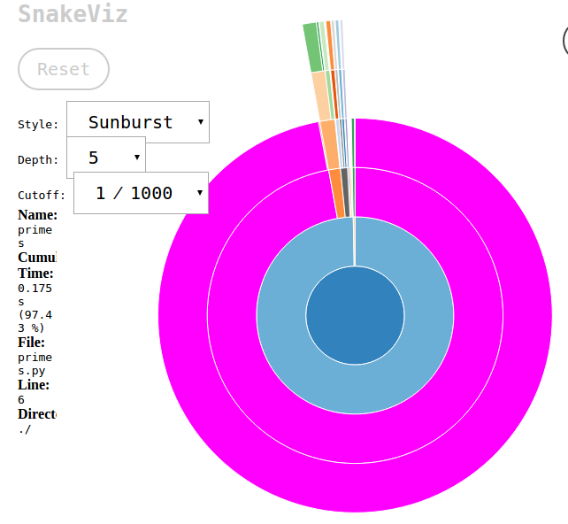
Visual profiles: snakeviz
Use the cProfile module
module to use
sort order
output file
$ python -m cProfile -s time -o primes.prof \
primes.py 1000
$ snakeviz primes.prof

Slide 229
line_profiler
line by line
show profile on screen
decorate function to profile
$ kernprof -l -v primes.py 1000
imer unit: 1e-06 s
Total time: 1.01724 s
File: /home/gjb/Documents/Projects/training-material/Python/Profiling/primes.py
Function: primes at line 4
Line # Hits Time Per Hit % Time Line Contents
==============================================================
4 @profile
5 def primes(kmax):
6 1 2 2.0 0.0 max_size = 1000000
7 1 72903 72903.0 7.2 p = array('i', [0]*max_size)
8 1 4 4.0 0.0 result = []
9 1 2 2.0 0.0 if kmax > max_size:
10 kmax = max_size
11 1 1 1.0 0.0 k = 0
12 1 0 0.0 0.0 n = a2

Slide 230
Logging
https://github.com/gjbex/training-material/tree/master/Python/Logging

Slide 231
Logging: motivation
Useful to verify what an application does
  in normal runs
  in runs with problems
Helps with debugging
  alternative to print statements
Various levels can be turned on or off
  see only relevant output
Good practice

Slide 232
Initialize & configure logging
import logging
…
logging.basicConfig(level=level, filename=name, filemode=mode,
format=format_str)
…
level: minimal level written to log
filemode
  'w': overwrite if log exists
  'a': append if log exists
format, e.g.,
'{asctime}:{levelname:{message}'

Slide 233
Log levels
CRITICAL: non-recoverable errors
ERROR: error, but application can continue
WARNING: potential problems
INFO: feedback, verbose mode
DEBUG: useful for developer
User defined

Slide 234
Selecting log level
CRITICAL
ERROR
WARNING
INFO
DEBUG
level = logging.ERROR
level = logging.INFO

Slide 235
Log messages
Log to DEBUG level
Log to INFO level
Log to CRITICAL level
logging.debug('function xyz called with "{0}"'.format(x))
ignored at level INFO or above
logging.info('application started')
ignored at level WARNING or above
logging.critical('input file not found')

Slide 236
Logging destinations
File
Rotating files
syslog
…

Slide 237
Further reading: logging
Logging how-to
https://docs.python.org/3.5/howto/logging.html
Logging Cookbook
https://docs.python.org/3.5/howto/logging-cookbook.html

Slide 238
File system operations:
Handling files and directories
https://github.com/gjbex/training-material/tree/master/Python/OsFileSystem

Slide 239
Working with files in directories
Directory contains files data_001.txt, data_002.txt,…
data_all.txt
case dim temp
1 1 -0.5
2 1 0.0
3 1 0.5
4 2 -0.5
5 2 0.0
6 2 0.5
7 3 -0.5
8 3 0.0
9 3 0.5
10 4 -0.5
11 4 0.0
12 4 0.5
…
data_001.txt
data_002.txt
case dim temp
1 1 -0.5
2 1 0.0
3 1 0.5
4 2 -0.5
5 2 0.0
6 2 0.5
case dim temp
7 3 -0.5
8 3 0.0
9 3 0.5
10 4 -0.5
11 4 0.0
12 4 0.5
…

Slide 240
Using glob
from argparse import ArgumentParser, FileType
from pathlib import Path
…
def main():
arg_parser = ArgumentParser(description='…')
arg_parser.add_argument('-o', dest='output_file',
type=FileType('w'), help='…')
arg_parser.add_argument('-p', dest='pattern', help='…')
options = arg_parser.parse_args()
is_header_printed = False
path = Path('.')
for file_name in path.glob(options.pattern):
with open(file_name, 'r') as input_file:
header = input_file.readline()
if not is_header_printed:
options.output_file.write(header)
is_header_printed = True
for line in input_file:
if line.strip():
options.output_file.write(line)
return 0
Same as in Bash shell
$ python concat_data.py –o data.txt –p 'data_*.txt'

Slide 241
Path operations
Many operations in pathlib package
  Current working directory: Path.cwd()
  Create path:
  path = Path.cwd() / 'data' / 'output.txt'
  path == '/home/gjb/Tests/data/output.txt'
  Dissecting paths:
    filename = path.name
    name == 'test.txt'
    dirname = path.parent
    dirname == '/home/gjb/data'
    parts = path.parts
    parts == ('/', 'home', 'gjb', 'data', 'output.txt')
    ext = path.suffix
    ext == '.txt'
    dirname = Path('/home/gjb/Tests').name
    dirname == 'Tests'
    ext = Path('/home/gjb/Tests/').suffix
    ext == ''
Will do the right thing for each OS

Slide 242
File system tests
File tests:
  path.exists(): True if path exists
  path.is_file(): True if path is file
  path.is_dir(): True if path is directory
  path.is_symlink(): True if path is link
  pathlib.os.access(path,
  pathlib.os.R_OK): True if path can be read
    pathlib.os.R_OK: read permission
    pathlib.os.W_OK: write permission
    pathlib.os.X_OK: execute permission
However: ask forgiveness, not permission!

Slide 243
Copying, moving, deleting
Functions in os and shutil modules
  copy file: shutil.copy(source, dest)
  copy file, preserving ownership, timestamps: shutil.copy2(source, dest)
  move file: path.replace(dest)
  delete file: path.unlink()
  remove non-empty directory: path.rmdir()
  remove directory: shutil.rmtree(directory)
  create directory: path.mkdir()

Slide 244
Temporary files
Standard library tempfile package
  Creating file with guaranteed unique name:
  tempfile.NamedTemporaryFile(…)
import tempfile
…
tmp_file = tempfile.NamedTemporaryFile(mode='w', dir='.',
suffix='.txt', delete=False)
print("created temp file '{0}'".format(tmp_file.name))
with tmp_file.file as tmp:
…
tmp.write(…)
…
File names such as tmpD45x.txt

Slide 245
Walking the tree
Walking a directory tree: os.walk(…), e.g., print name of Python files in (sub)directories
For each directory, tuple:
  directory name
  list of subdirectories
  list of files in directory
import os
…
for directory, _, file_names in os.walk(dir_name):
for file_name in file_names:
_, ext = os.path.splitext(file_name)
if ext == target_ext:
print(os.path.join(directory, file_name))
…
For simple cases, use
path.rglob(…)

Slide 246
Manipulating strings:
Python regular expressions
https://github.com/gjbex/training-material/tree/master/Python/Regexes

Slide 247
Regular expressions: definition
Regular expression
= description of a language
≡ set of strings
Language can be
  Finite
  Infinite
    Remember, set of all strings is infinite, countable
Chomsky hierarchy
  regular languages
  ⊂ context-free languages
  ⊂ context-sensitive languages
  ⊂ recursively enumerable languages
Python regular expressions can express more than regular languages

Slide 248
Regular expressions: expressive power
Never parse HTML or XML with regular expressions!!!
  HTML & XML are context-free languages
  Even if you think you can, don't, there be dragons
Can you write a regular expression to match all regular expressions?
  No: the language of regular expressions is context-free
Can you parse English using a regular expression
  No: English is a little bit context-sensitive

Slide 249
Regular expressions: examples I
DNA: [ACGT]+
  [ACGT] = one out of {A, C, G, T}
  expr+ = one or more repetitions of expr
  language = {A, C, G, T, AA, AC,…,GAATTCAA,…}
DNA containing AAT: [ACGT]*AAT[ACGT]*
  expr₁ expr₂ = expr₁ followed by expr₂
  expr* = zero or more repetitions of expr
  language = {AAT, AAAT, CAAT,…, AATA, CGTAATGGAT,…}
DNA containing AAT or TAT:
[ACGT]*(AAT|TAT)[ACGT]*
  expr₁ | expr₂ = either expr₁, or expr₂
  language = {AAT, TAT, AAAT, ATAT, CAAT,.., CAATGTATGT,..}
DNA containing AA or AACC: [ACGT]*AA(CC)?[ACGT]*
  expr? = zero or one of expr
  language = {AA, AACC, AAA, CAA, CAACC,…, AGATAACCTTA}

Slide 250
Regular expressions: examples II
Belgian phone number: 0[1-9]\d?/[1-9]\d{5,6}
  [c₁-c₂] = any character from c₁ to c₂
  \d = [0-9]
  expr{m,n} = m to n repetitions of expr
All strings, including empty string: .*
  . = any character
Email address: \w+(?:\.\w+)?@\w+(?:\.\w+)+
  \w = [A-Za-z0-9_]
  expr+ = one or more repetions of expr
  \. = character '.'
  (?: expr) = grouped expr
Don't use this
in practice!!!
Similar to brackets in math expressions

Slide 251
Regular expressions: characters
Characters that have to be escaped
  tab : \t
  new line : \n
  carriage return : \r
  \ : \\
  brackets : \(, \), \[, \], \{, \}
  operators : \+, \-, \*, \?
  . (dot) : \.
All other characters literal

Slide 252
Regular expressions: character classes
x = {'x'}
[xyz] = {'x', 'y', 'z'}
[x-z] = {c | 'x' ≤ c ≤ 'z'}
[^xyz] = {any} \ {'x', 'y', 'z'}
\w = {'A',…,'Z', 'a',…,'z', '0',…,'9', '_'}
\W = {any} \ {'A',…,'Z', 'a',…,'z', '0',…,'9', '_'}
\d = {'0',…,'9'}
\D = {any} \ {'0',…,'9'}
\s = {' ', '\t', '\f', '\r', '\n', '\v'} (white space)
\S = {any} \ {' ', '\t', '\f', '\r', '\n', '\v'}
. = {any} \ {'\n'}
Note: strings are Unicode, so, e.g., \d matches numerals
in any script, not only Arabic numerals

Slide 253
Regular expressions: operators
    Concatenation: expr₁ expr₂ (implicit)
    Choice: expr₁ | expr₂ = either expr₁, or expr₂
    Repetition:
      expr{n} = exactly n repetitions of expr
      expr{m,n} = minimum m, maximum n repetitions of expr
      where m ≤ n
      expr{,n} = minimum zero, maximum n repetitions of expr
      expr{m,} = minimum m repetitions of expr
      expr? = zero or one occurrence of expr
      expr* = zero or more repetitions of expr
      expr+ = one or more repetitions of expr
Longest match semantics

Slide 254
Greedy vs. non-greedy operators
Consider string '<var name="x">15</var>'
  <.+> will match substring …
Use non-greedy operator
  <.+?> will match substring '<var name="x">'
      expr<op>? = operator <op> with shortest
      match semantics (i.e., non-
      greedy) applied to expr
      Alternative: <[^>]+>
'<var name="x">15</var>'
Longest match semantics!

Slide 255
Why not parse XML with REs?
Task: match start tag in
  '<var name="x">15</var>'
  <.+?> will match substring
  '<var name="x">'
  '<var name="a->b">15</var>'
  <.+?> will match substring
  '<var name="a->'
√
Oops!
Use a parser for context free language, or,
better still, use Python's xml.dom, xml.sax, …

Slide 256
Regular expressions: examples III
String of digits only: ^\d+$
  ^: matches empty string at start of string, or after new line
  $: matches empty string at end of string, or before new line
Year in 20th or 21st century: \b(?:19|20)]\d{2}\b
  \b: matches empty string at "word" boundary
Words starting, but not ending with 'py': \bpy\B
  \B: matches empty string in "word"

Slide 257
Regular expressions: anchors
All anchors match empty string
At start of string: \A
At end of string: \Z
At start of string, or after newline: ^
At end of string, or before newline: $
Before or after alphanumeric sequence: \b
Within alphanumeric sequence: \B

Slide 258
Regular expressions: matching
Import re module!!!
re.match(pattern, s)
  Matches pattern from start of string s
  Returns match object, or None if no match
re.search(pattern, s)
  Matches pattern anywhere in string s
  Returns match object, or None if no match
>>> print(re.match(r'<.+>', '<abc>') is not None)
True
>>> print(re.match(r'<.+>', 'data: <abc>') is not None)
False
Use raw Python strings, i.e.,
r'…' for regular expressions
>>> print(re.search(r'<.+>', 'data: <abc>') is not None)
True

Slide 259
Raw strings
Yet more strings: raw string, e.g.,
'hello\n+world!' versus
'hello\\n+world!' versus
r'hello\n+world!'
>>> print('hello\n+world!')
hello
+world!
>>> print('hello\\n+world!')
hello\n+world!
>>> print(r'hello\n+world!')
hello\n+world!
'\' is just a regular character
in a raw string,
very convenient for
regular expressions!

Slide 260
Ignoring case
Ignoring case
  E.g., match DNA, [AaCcGgTt]+:
    cumbersome, error prone, hard to read!
  Better: use original pattern [ACGT]+, but match while ignoring case, i.e., using re.IGNORECASE (or re.I) modifier
  re.match(r'[ACGT]+', s, re.IGNORECASE)
  or
  re.match(r'[ACGT]+', s, re.I)

Slide 261
More readable regular expressions
Sophisticated regular expressions are hard to read
r'0[1-9]\d?/[1-9]\d{5,6}'
Reformat as
r'''0 # area codes always
# start with 0
[1-9]\d? # area codes: 1-2
# digits
/ # separator
[1-9]\d{5,6} # 6 or 7 digits for
# number'''
Use re.VERBOSE (or re.X) modifier

Slide 262
Regular expression performance
Regular expression may be
evaluated many times
Don't use
for line in sys.stdin:
if re.match(r'0[1-9]\d?/[1-9]\d{5,6}', line):
…
Do use
regex = re.compile(r'0[1-9]\d?/[1-9]\d{5,6}')
for line in sys.stdin:
if regex.match(line):
…
regex is compiled
regular expression object,
reused many times
Substantial performance benefit!

Slide 263
Regular expressions: extracting I
Part(s) of regular expressions can be captured
  Example: regular expression
  begin (\w+)
  if matched against
    string 'begin data', substring 'data' is captured
    String 'begin block', substring 'block' is captured
  Use match object returned by re.match or re.search
group 1
group 2
>>> m = re.match(r'(begin|end) (\w+)', 'begin data')
>>> print('{1} {0}s here'.format(m.group(1), m.group(2)))
data begins here

Slide 264
Capturing vs. grouping
Don't confuse grouping and capturing
  (?:…): syntactic grouping for operator priority
  (…): capturing, use partial match later
Capturing instead of grouping will work, but is slower

Slide 265
Named groups
More robust to name groups
Even better
However, regular expression harder to read?
>>> m = re.match(r'(?P<event>begin|end) (?P<name>\w+)',
'begin data')
>>> print('{1} {0}s here'.format(m.group('event'),
m.group('name')))
data begins here
>>> m = re.match(r'(?P<event>begin|end) (?P<name>\w+)',
'begin data')
>>> print(f'{m.group('name')} {m.group('event')}s here')
data begins here

Slide 266
Finding repetitions
Match sequences that code for leucine (codons UUA, UUG, CUA, CUC, CUG, CUU):
(?:[ACGU]{3})* # any codons
(?:UU[AG]|CU[ACGU]) # leucine
Match sequences that code for leucine twice with the exact same codon, at most 5 codons apart
(?:[ACGU]{3})* # any codons
(UU[AG]|CU[ACGU]) # first leucine
(?:[ACGU]{3}){,5}? # codons
\1 # second leucine
Repetition of
capture 1
Note: non-greedy match operator!

Slide 267
Regular expressions: extracting II
Extract all words from a text
'This is a short text. It has
words, but also punctuation,
and even numbers like 12 and 7.'
Pattern for word: [A-Za-z]+
re.findall(pattern, s) returns list of all matches of pattern in s
>>> s = 'This is a short text. It has words,...'
>>> m = re.findall(r'[A-Za-z]+', s)
>>> print(m)
['This', 'is', 'a', 'short', 'text', 'It', 'has', 'words']

Slide 268
Regular expressions: extracting III
Splitting a string on a delimiter
'a ; list; of ; words '
Pattern for delimiter: \s*;\s*
re.split(pattern, s) splits string s
>>> s = 'a ; list; of ; words '
>>> parts = re.split(r'\s*;\s*', s.strip())
>>> print(parts)
['a', 'list', 'of', 'words']
or
>>> parts = map(lambda x: x.strip(), s.split(';'))
>>> print(list(parts))
['a', 'list', 'of', 'words']

Slide 269
Regular expressions: substitution
Values should be quoted
17,13.3,AGCGT,-1.4
'17','13.3','AGCGT','-1.4'
Pattern for values ([^,]+), replace by '\1'
re.sub(pattern, repl, s) replaces all occurrences of pattern in s by repl
Corresponds to
group(1)
>>> s = '17,13.3,AGCGT,-1.4'
>>> result = re.sub(r'([^,]+)', r"'\1'", s)
>>> print(result)
'17','13.3','AGCGT','-1.4'

Slide 270
Named group substitution
More robust
>>> s = '17,13.3,AGCGT,-1.4'
>>> result = re.sub(r'(?P<item>[^,]+)', r"'(?P=item)'", s)
>>> print(result)
'17','13.3','AGCGT','-1.4'

Slide 271
Further reading: regular expressions
Regular expression how-to
http://docs.python.org/3/howto/regex.html
You should learn regex
https://blog.patricktriest.com/you-should-learn-regex/

Slide 272
Formatting data: revisiting string formatting

Slide 273
Formatting: templates
Use template strings
  Template consists of text, interspersed with replacement fields
  'found {word}: {count}'
Fill out the template using format(…) method
>>> tmpl = 'found {word}: {count}'
>>> print(tmpl.format(word='computer', count=15))
found computer: 15
>>> print(tmpl.format(word='human', count=0))
found human: 0

Slide 274
Formatting: format specifiers
Replacement field can contain format specifiers
  Resemble C I/O format specifiers without %
  'found {word:>10s}: {freq:.2f}'
alignment
width
type
precision
type
>>> data = {'computer': 0.17, 'human': 0.0084, 'alpha': 0.3}
>>> tmpl = 'found {word:>10s}: {freq:.2f}'
>>> for word in data.keys():
… print(tmpl.format(word=word, freq=data[word]))
computer: 0.17
human: 0.01
alpha: 0.30

Slide 275
Formatting: types
Types
  s or none: string
  c: character (converts integer to unicode)
  d: integer (decimal)
  b, o, x: integer (binary, octal, hexadecimal)
  e, f, g, E, F, G: floating point numbers
  %: percentage
Can have
width
Can have
precision

Slide 276
Relational databases:
Python DB API & SQLAlchemy ORM
https://github.com/gjbex/training-material/tree/master/Python/DbAccess

Slide 277
Accessing relational databases
Relational databases:
  great to store structured data, table-oriented
  can be accessed easily via command line, programming language, GUI
  can be queried using SQL
  examples: MySQL, PostgreSQL, Oracle, DB2, SQLite3,…
Using DB from Python via standard interface
  Support for sqlite3 built-in, ok for simple applications
For non-trivial stuff, use SQLAlchemy
  Object-relational mapping (ORM)
  Connectors to many RDBMS

Slide 278
SQL
Create table to store data
Store data
Query data
Modify data
CREATE TABLE IF NOT EXISTS weather (
city_name TEXT NOT NULL,
date TEXT NOT NULL,
temperature REAL NOT NULL);
INSERT INTO weather (city_name, date, emperature
VALUES ('London', '2012-03-14', 13.2);
SELECT city_name, AVG(temperature) FROM weather
WHERE date BETWEEN '2012-01-01' AND '2012-01-31'
GROUP BY city_name;
UPDATE weather SET city_name = 'St. Petersburg'
WHERE city_name = 'Leningrad';

Slide 279
Python DB access: inserting data
Connect to a database & create cursor
Insert data tuples
import sqlite3
conn = sqlite3.connect('weather-db')
cursor = conn.cursor()
for data in generate_data(nr_cities, start, end):
cursor.execute('''INSERT INTO weather
(city_name, date, temperature)
VALUES (?, ?, ?)''',
data)
conn.commit()
cursor.close()
tuple

Slide 280
Python DB access: querying
Compute average temperature for period per city
conn = sqlite3.connect('weather-db')
conn.row_factory = sqlite3.Row
cursor = conn.cursor()
cursor.execute(
'''SELECT city_name, AVG(temperature) AS 'temperature'
FROM weather WHERE date BETWEEN ? AND ?
GROUP BY city_namee''',
(start, end))
for row in cursor:
print('{city}\t{tmp}'.format(city=row['city_name'],
tmp=row['temperature']))
cursor.close()

Slide 281
SQLAlchemy: ORM
Define classes/tables
from sqlalchemy import (Column, ForeignKey, UniqueConstraint,
Integer, String, DateTime, Float)
from sqlalchemy.ext.declarative import declarative_base
from sqlalchemy.orm import relationship
Base = declarative_base()
class City(Base):
__tablename__ = 'cities'
city_id = Column(Integer, primary_key=True)
name = Column(String(100), nullable=False, unique=True)
class ≡ table
object attributes
column properties
class attribute ≡ column definition

Slide 282
SQLAlchemy: relationships
Define relationship
table constraint
class Measurement(Base):
__tablename__ = 'measurements'
__table_args__ = (
UniqueConstraint('time', 'city_id'),
)
measurement_id = Column(Integer, primary_key=True)
time = Column(DateTime, nullable=False)
temperature = Column(Float, nullable=False)
city_id = Column(Integer, ForeignKey('cities.city_id'))
city = relationship(City)
column properties
relationship for ORM queries

Slide 283
SQLAlchemy: create tables
To interact, create engine
Creating tables ≡ setting metadata
from sqlalchemy import create_engine
…
engine = create_engine('sqlite:///{0}'.format(db_name))
Base.metadata.create_all(engine)
That's it!

Slide 284
SQLAlchemy: inserts
Create engine, session
Create and add objects
…
from sqlalchemy.orm import sessionmaker
…
engine = create_engine('sqlite:///{0}'.format(db_name))
Base.metadata.bind = engine
DBSession = sessionmaker(bind=engine)
db_session = DBSession()
…
…
for city_name in ['New York', 'Leningrad', 'Paris']:
city = City(name=city_name)
db_session.add(city)
db_session.commit()

Slide 285
SQLAlchemy: inserting relationships
Use objects to express relationships
…
for city in city_list:
temperature = measuree_temperature(city)
date = determine_date()
measurement = Measurement(time=date,
temperature=temperature,
city=city)
db_session.add(measurement)
db_session.commit()
…
use actual object

Slide 286
SQLAlchemy: queries
Queries as method calls
Natural join query
…
city_list = db_session.query(City).all()
class ≡ table
join on relationship
…
measurements = db_session.query(Measurement) \
.join('city') \
.filter(City.name == city_name,
s_date <= Measurement.time,
Measurement.time <= e_date) \
.all()
Note: class attributes!!!
SELECT * FROM … WHERE …

Slide 287
SQLAlchemy: updates
Modify object attribute(s) ≡ update
…
leningrad = db_session.query(City) \
.filter(City.name == 'Leningrad') \
.one()
leningrad.name = 'Saint Petersburg'
db_session.commit()
don't forget commit!

Slide 288
SQLAlchemy: just classes
Classes representing tables can have methods
class Measurement(Base):
…
def __str__(self):
fmt_str = '{city:s}: {time:s}\n\tT = {temp:.1f} C'
return fmt_str.format(city=str(self.city),
time=str(self.time),
temp=self.temperature)
…

Slide 289
Pitfalls
ORM "hides" database interaction
  Easy to be inefficient
  Object creation takes time
  Can comsume a lot of memory
  Still necessary to understand
    Relational model
    How RDBMS works

Slide 290
Further reading: relational databases
Introduction to relational database design
http://www.ntu.edu.sg/home/ehchua/programming/sql/relational_database_design.html

Slide 291
Transforming list data:
Python sorting & list comprehensions
https://github.com/gjbex/training-material/tree/master/Python/OperatorsFunctools

Slide 292
Sorting a simple list
Two ways to sort
  Create new list: sorted(…)
  In-place sort list.sort() method
Sorts in ascending order, add reverse=True for descending
>>> data = [3.1745, 18.14, -6.49043]
>>> sorted(data)
[-6.49043, 3.1745, 18.14]
>>> data = [3.1745, 18.14, -6.49043]
>>> data.sort()
>>> print(data)
[-6.49043, 3.1745, 18.14]

Slide 293
Sorting a complex list: key function
List of tuples, e.g., word counts
Sort by
  Word:
  Count:
Simpler using operator
>>> data = [('table', 15), ('chair', 5), ('bed', 19)]
>>> sorted(data, key=lambda x: x[0])
[('bed', 19), ('chair', 5), ('table', 15)]
>>> sorted(data, key=lambda x: x[1])
[('chair', 5), ('table', 15) , ('bed', 19)]
>>> from operator import itemgetter
>>> sorted(data, key=itemgetter(0))
[('bed', 19), ('chair', 5), ('table', 15)]

Slide 294
Reversing a list
Two ways to reverse
  Create new list: use slices
  In-place reverse list.reverse() method
>>> data = [3.5, 5.7, 7.3]
>>> data[::-1]
[7.3, 5.7, 3.5]
works for str as well!
>>> data = [3.5, 5.7, 7.3]
>>> data.reverse()
>>> data
[7.3, 5.7, 3.5]

Slide 295
Going functional: mapping
list comprehensions: construct list from elements of other list by applying function
  E.g., [str(x) for x in [0.15, 3.145]]
  == ['0.15', '3.145']
>>> data = [3.1745, 18.14, -6.49043]
>>> print(','.join([str(number) for number in data]))
3.1745,18.14,-6.49043
>>> data = [3.1745, 18.14, -6.49043]
>>> print(','.join(map(str, data)))
3.1745,18.14,-6.49043
>>> data = [3.1745, 18.14, -6.49043]
>>> print(','.join(['{0:.2f}'.format(f) for f in data]))
3.17,18.14,-6.49

Slide 296
Going functional: filtering
list comprehensions: construct list from elements of other list for elements that pass test
  E.g., [x for x in [0.15, -3.45, 1.3]
  if x >= 0.0]
  ≡ [0.15, 1.3]
  E.g., [sqrt(x) for x in [4.0, -4.0, 9.0]
  if x >= 0.0]
  ≡ [2.0, 3.0]
  Alternative:
  list(map(sqrt,
  filter(lambda x: x >= 0.0,
  [4, -4, 9])))
iterators
Don't forget from math import sqrt

Slide 297
Going functional: aggregating
Data in a list should be aggregated, e.g.,
  Summation: use sum(…)
  Minimum: use min(…)
  Maximum: use max(…)
More sophisticated, use reduce(…) and lambda functions
work on str
have optional key argument
>>> from functools import reduce
>>> data = [3, 12, 7]
>>> reduce(lambda x, y: x*y, data, 1)
252
lambda function
list
initializer
Lambda functions: very small functions (expression) used once,
not worth giving a name

Slide 298
Going functional: zip it
Two (or more) lists should be processed element wise
  E.g., [x*y for x, y in zip(a, b)]
  As many tuples as length of shortest list
>>> a = [3.5, 7.3, 5.7]
>>> b = [2.0, 1.5]
>>> [x*y for x, y in zip(a, b)]
[7.0, 10.95]
iterator produces tuples

Slide 299
Further reading: functional style
Sorting how-to
http://docs.python.org/2/howto/sorting.html
Functional programming how-to
http://docs.python.org/2/howto/functional.html

Slide 300
Facing infinity: iterators
https://github.com/gjbex/training-material/tree/master/Python/Iterators

Slide 301
Large data (structures)
Compare
  for line in data_file.readlines():
  …
  for line in data_file:
  …
How to deal with arbitrary many prime numbers?
Constructs a
list of all lines
at once = BIG
iterator: line by line

Slide 302
Primes version 1.0: iterator
Function to check whether n is prime
Work with all primes up to 10⁶? Simple…
def is_prime(n):
for i in range(2, int(math.sqrt(n)) + 1):
if n % i == 0:
return False
return n > 1
for n in (i for i in range(1000000) if is_prime(i)):
…

Slide 303
List comprehensions vs. generators
List comprehension
[i for i in range(1000000) if is_prime(i)]
  all prime numbers up to 1000000 (≈ 78,500)
Generator
(i for i in range(1000000) if is_prime(i))
  get next prime number when needed, much more memory efficient

Slide 304
Primes version 2.0: yield
What if we want the first 10⁶ prime numbers?
  Guess range?
Function that returns next prime at each call?
  use yield
Iterator: first call yields 2, second 3, third 5, …
def all_primes():
i = 2
while True:
if is_prime(i):
yield i
i += 1
for n in all_primes():
…

Slide 305
yield statement
Somewhat like return
  returns control to the calling function
  returns a value
However, callee function state is retained
  on next call, continues at the point it was when it yielded
Allows to build your own iterators

Slide 306
Primes version 3.0: filter
Standard library package itertools provides a lot of useful iterators, check it out!
  itertools.count(): iterator over integers
import itertools
…
nr_primes = 0
for n in filter(is_prime, itertools.count()):
if nr_primes > 1000000:
break
nr_primes += 1
…

Slide 307
Other useful functions in itertools
Permutations of an iterable:
itertools.permutations(…)
Combinations r out of an iterable:
  Without replacement:
  itertools.combinations(…, r)
  With replacement:
  itertools.combinations_with_replacement(…, r)
Carthesian product of two (or more) iterables:
itertools.product(…, …)
Take while boolean predicate pred is true:
itertools.takewhile(pred, …)
Cycle through values of iterable:
itertools.cycle(…)

Slide 308
Generating data (again)
from itertools import product as iproduct
…
print('case', 'condition', 'temperature')
for i, data in enumerate(iproduct(range(1, 4),
map(lambda x: 0.5*x,
range(-1, 2)))):
print(i + 1, *data)
case dim temp
1 1 -0.5
2 1 0.0
3 1 0.5
4 2 -0.5
5 2 0.0
…
9 3 0.5

Slide 309
Further reading: functional style
Functional programming how-to
http://docs.python.org/2/howto/functional.html

Slide 310
Data representation:
Python classes case study
https://github.com/gjbex/training-material/tree/master/Python/FiniteStateParser

Slide 311
Going OO: data abstraction
begin block_1
0.322617473156
0.369558068115
0.732467264353
0.584389170786
end block_1
begin block_2
0.0705959106085
0.65856743041
0.526762713499
0.823193820644
end block_2
begin block_3
0.476180897605
0.783168943997
0.0172156882251
0.755582680088
end block_3
block
Data consists of multiple blocks
Blocks have
  Name
  One or more data values
How to represent?
  Python class

Slide 312
Class Block: attributes
Class is abstract definition: attributes represent data
"abstract" Block has attributes
  __name: string
  __data: list
Block instance block1 has
  'my block' as _name
  No values (yet) as _data
Store some data, block1 now has two data values: 3.14 and -7.18
Create new block block2
1 class Block:
2 def __init__(self, name):
3 self.__name = name
4 self.__data = []
>>> block1 = Block('my block')
object of type Block
>>> block1.__data.append(3.14)
>>> block1.__data.append(-7.18)
>>> block2 = Block('another')
second object of type Block
Object is container for specific data: attribute values hold data

Slide 313
Class Block: methods
What do we want to do with a block?
  Convert it to a string
  Retrieve its name
  Add data to it
  Sort its data
  Retrieve its data
How?
  Define methods for the class Block
Class is abstract definition: methods represent actions on objects

Slide 314
Class Block: method implementations
1 class Block:
2 def __init__(self, name):
3 self.__name = name
4 self.__data = []
5
6 def __str__(self):
7 header = 'begin {0}'.format(self.name())
8 data = '\n\t'.join([str(item) for item in self.data()])
9 footer = 'end {0}'.format(self.name())
10 return '{0}\n\t{1}\n{2}'.format(header, data, footer)
11
12 def name(self):
13 return self.__name
14
15 def add_data(self, data):
16 self._data.append(data)
17
18 def sort_data(self):
19 self._data.sort()
20
21 def data(self):
22 return self.__data
>>> block1.add_data(12.5)
>>> print(block1.name())
my_block
>>> print(block1)
begin my_block
3.14
-7.18
12.5
end my_block

Slide 315
Parsing an (almost) regular language: finite state automata
https://github.com/gjbex/training-material/tree/master/Python/FiniteStateParser

Slide 316
Task: convert data
begin block_1
0.322617473156
0.369558068115
0.732467264353
0.584389170786
end block_1
begin block_2
0.0705959106085
0.65856743041
0.526762713499
0.823193820644
end block_2
begin block_3
0.476180897605
0.783168943997
0.0172156882251
0.755582680088
end block_3
sort!
block_1: "0.322617473156"
block_1: "0.369558068115"
block_1: "0.584389170786"
block_1: "0.732467264353"
block_2: "0.0705959106085"
block_2: "0.526762713499"
block_2: "0.65856743041"
block_2: "0.823193820644"
block_3: "0.0172156882251"
block_3: "0.476180897605"
block_3: "0.755582680088"
block_3: "0.783168943997"

Slide 317
Model the data
begin block_1
0.322617473156
0.369558068115
0.732467264353
0.584389170786
end block_1
begin block_2
0.0705959106085
0.65856743041
0.526762713499
0.823193820644
end block_2
begin block_3
0.476180897605
0.783168943997
0.0172156882251
0.755582680088
end block_3
file := block…
block := begin name
data
…
end name
name := string
data := real

Slide 318
Annotated data
text before first block
This data was produced using SomeSoftware™
begin block_1
0.322617473156
0.369558068115 # this value is suspicious
0.732467264353
0.584389170786
end block_1
There can be anything between blocks,
all kind of useful information or inane chatter.
begin block_2
0.0705959106085
# this is a comment about all values below
0.65856743041
0.526762713499
0.823193820644
end block_2
…
inline comments
blank lines
text between
blocks
line comments

Slide 319
Improved model
file := junk* (block junk*)+
block := begin name comment?
(comment | empty line)*
data comment?
(comment | empty line)*
…
end name comment?
Notation:
?: zero or one
*: zero or more
+: one or more
|: either, or (choice)
name := string
This data was produced using SomeSoftware™
begin block_1
0.322617473156
0.369558068115 # this value is suspicious
0.732467264353
0.584389170786
end block_1
There can be anything between blocks,
all kind of useful information or inane chatter.
begin block_2
0.0705959106085
# this is a comment about all values below
0.65856743041
0.526762713499
0.823193820644
end block_2
…
data := real
comment := # string
junk := string |
empty line

Slide 320
Computable model
file := junk* (block junk*)+
Finite state automaton
block := begin name comment?
(comment | empty line)*
data comment?
(comment | empty line)*
…
end name comment?
create block
comment
or
empty line
begin block
junk
add data
to block
name := string
not in block
in block
data
data := real
comment := # string
end block
begin block
or
end wrong block
or
end of file
junk := string |
empty line
end block
return block
error
raise error

Slide 321
Class BlockParser
class BlockParser:
1 def __init__(self):
2 self.__states = ['in_block', 'not_in_block', 'error']
3 self.__comment_pattern = re.compile(r'#.*')
4 self.__block_begin_pattern = re.compile(r'begin\s+(\w+)')
5 self.__block_end_pattern = re.compile(r'end\s+(\w+)')
6 self.__state = None
7 self.__current_block = None
8 self.__blocks = None
9 self.__match = None
10 self.__reset()
1 def __reset(self):
2 self.__set_state('not_in_block')
3 self.__current_block = None
4 self.__blocks = []
5 self.__match = None
Must be called before parsing a new file

Slide 322
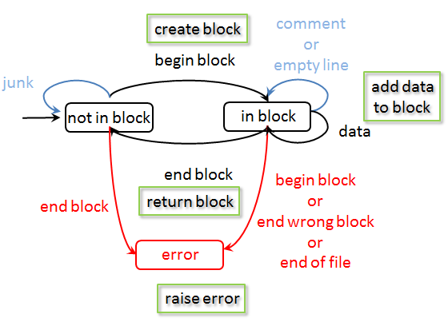
From model to code
1 for line in block_file:
2 line = self.__preprocess(line)
3 if self.__is_in_state('not_in_block'):
4 if self.__is_begin_block(line):
5 self.__init_block()
5 self.__set_state('in_block')
6 elif self.__is_end_block(line):
7 raise DanglingEndBlockError(self)
8 elif self.__is_in_state('in_block'):
9 if self.__is_begin_block(line):
10 raise NestedBlocksError(self)
11 elif self.__is_end_block(line):
12 if self.__end_matches_begin():
13 self.__finish_block()
14 self.__set_state('not_in_block')
15 else:
16 raise NonMatchingBlockDelimitersError(self)
17 elif self.__is_data(line):
18 self.__add_data(line)
19 else:
20 raise UnknownStateError(self.get_state())
21 if self.__s_in_state('in_block'):
22 raise NonClosedBlockError(self)

Slide 323
Parsing a context-free language: pyparsing
https://github.com/gjbex/training-material/tree/master/Python/PyParsing
https://github.com/gjbex/training-material/tree/master/Python/FiniteStateParser

Slide 324
Task: computing branch lengths
(
taxa1: 0.1,
(
(
taxa2: 0.2,
taxa3: 0.3
): 0.11,
taxa4: 0.4
): 0.12
);
0.1
0.12
Branch length
to taxa2 = 0.43
taxa1
0.11
0.4
taxa4
0.2
0.3
taxa2
taxa3
Data is tree-structured,
structure is significant
Actual data:
(taxa1: 0.1, ((taxa2: 0.2, taxa3: 0.3): 0.11, taxa4: 0.4): 0.12);

Slide 325
Model Newick data: nodes
Node attributes
  Branch length (0.0 for root node)
  Label: taxa name (only leaf nodes)
  List of children (empty for leaf nodes)
Node methods
  Set/get label
  Set/get branch length
  Add child node
  Get list of children

Slide 326
Attributes: Python decorators
class NewickNode(node.Node):
1 def __init__(self, name=None):
2 super().__init__()
3 self.__label = None
4 self.__length = None
5 self.__children = []
6 @property
7 def label(self):
8 return self.__label
9 @label.setter
10 def label(self, label):
11 self.__label = label
…
12 def add_child(self, child):
13 self.__children.append(child)
14 def children(self):
15 for child in self.__children:
16 yield child
Getter: provide read
access to attribute
Setter: provide write
access to attribute
Prevent accidental write
to attribute, validate values,…

Slide 327
Model Newick data format
(
taxa1: 0.1,
(
(
taxa2: 0.2,
taxa3: 0.3
): 0.11,
taxa4: 0.4
): 0.12
);
tree := ( siblings ) ;
siblings := node ( , node )*
node := leaf | children
leaf := name : length
children := ( siblings ) : length
name := string
length := real
Recursion: siblings → node → children → siblings
Context-free language, not regular:
use, e.g., recursive descent parser

Slide 328
pyparsing: parser generator
Advantages
  Easy to use
  Recursive descent parser grammars are simpler
  Lexical definitions are part of grammar
  Grammar are Python code
  No parser generation phase
Disadvantages
  Can only parse strings (files are read to string first)
    Issue for large files
  Recursive descent parser are slow compared to, e.g., LR parsers
    Issue for large files/many files
  pyparsing module must be present to use
Alternative: PLY

Slide 329
pyparsing: how to use?
Define the grammar
  Expressed in Python, using pyparsing objects
Add actions to various grammar elements
  Python functions taking tokens as input, returning
  tokens or objects (or whatever)
Call parseString(…) method on top-level grammar element
  Result is (nested) list of tokens, or objects (depends on actions)

Slide 330
pyparsing: Newick grammar
1 name = Word(alphanums)
2 length = Regex(r'(\d+\.\d+)')
3 lb = Literal('(')
4 rb = Literal(')')
5 end = Literal(';')
6 sep = Literal(':')
7 leaf = name + sep + length
8 node = Forward()
9 siblings = Group(delimitedList(node, ','))
10 children = lb + siblings + rb + sep + length
node << (leaf | children)
tree = lb + siblings + rb + end
name := string
length := real
leaf := name : length
siblings := node ( , node )*
children := ( siblings ) : length
node := leaf | children
tree := ( siblings ) ;

Slide 331
pyparsing: some details
Set a name for use in
action functions
1 name = Word(alphanums).setResultsName('taxa_name')
2 length = Regex(r'(\d+\.\d+)').setResultsName('length')
3 lb = Literal('(').suppress()
4 rb = Literal(')').suppress()
5 end = Literal(';').suppress()
6 sep = Literal(':').suppress()
7 leaf = name + sep + length
8 node = Forward()
9 siblings = Group(delimitedList(node, ',')).setResultsName('children')
10 children = lb + siblings + rb + sep + length
node << (leaf | children)
tree = lb + siblings + rb + end
Significant, but
uninteresting
This would just produce a list of tokens,
we want a tree → add actions

Slide 332
pyparsing: actions
def leaf_action(toks):
'''create a node, and add label, length'''
leaf_node = NewickNode()
leaf_node.label = toks['taxa_name']
leaf_node.length = float(toks['length'])
return leaf_node
def children_action(toks):
'''create a node, add children, length'''
parent_node = NewickNode()
if 'length' in toks.keys():
parent_node.length = float(toks['length'])
for child in toks['children']:
parent_node.add_child(child)
return parent_node
Add actions to
relevant grammar
elements
leaf.addParseAction(leaf_action)
children.addParseAction(children_action)
tree.addParseAction(children_action)

Slide 333
pyparsing: actual parsing
Call parseString(…) method on top-level grammar element, i.e., tree
result is list of ParseResults objects,
here the root node of the tree, i.e., a
NewickNode instance
Now branch lengths can be calculated by walking tree, starting from root
results = tree.parseString(str)
root = results[0]

Slide 334
Task solved
Function
Use
def compute_branch_lengths(node, branch_lengths=None, length=0.0):
if branch_lengths is None:
branch_lengths = {}
compute_branch_lengths(node, branch_lengths, length)
return branch_lengths
if node.is_leaf():
branch_lengths[node.label] = length + node.length
else:
if node.length is not None:
length += node.length
for child in node.children():
compute_branch_lengths(child, branch_lengths, length)
branch_lengths = compute_branch_lengths(root)
for taxa, length in branch_lengths.items():
print('{taxa}: {length}'.format(taxa=taxa, length=length))

Slide 335
Using shell commands:
Python subprocess
https://github.com/gjbex/training-material/tree/master/Python/Subprocess

Slide 336
Counting words in a file
Using shell utilities: subprocess module
Convenient high-level API
  subprocess.call(…) returns exit code of command as integer
  subprocess.check_output(…) returns output of command as bytes (decode to get Python str)
$ wc text.txt
4 12 52 text.txt
Python 3 strings
are unicode
from subprocess import check_output
output = check_output(['wc', 'test.txt'])
output_str = output.decode(encoding=‘utf-8’)
lines, words, chars, _ = output_str.strip().split(' ')

Slide 337
Counting words in a string
Low-level API: input & output
$ wc -
This is a single line.
1 5 23 -
from subprocess import Popen, PIPE
text = bytes('This is a single line.\n‘, encoding=‘utf-8’)
cmd = Popen(['wc', '-'], stdin=PIPE, stdout=PIPE)
cmd.stdin.write(text_str)
cmd.stdin.close()
output = cmd.stdout.readline().decode(encoding=‘utf-8’)
lines, words, chars, _ = output.strip().split(' ')
Make sure wc knows
it received all data!!!
Popen(…, stdin=PIPE, stdout=PIPE) creates file objects
stdin/stdout for writing/reading, analogous to pipes in Unix
Remember, stdin/stdout/stderr use bytes!

Slide 338
Python for scientific computing: numpy
https://github.com/gjbex/training-material/tree/master/Python/Matrices
https://github.com/gjbex/training-material/tree/master/Python/Numpy

Slide 339
Out of the box
Python is interpreted
  Python is slow
  Python is really slow
Okay for one-offs, prototypes, short runtimes
Not okay for computationally intensive tasks!
Don't use vanilla Python for computations!!!

Slide 340
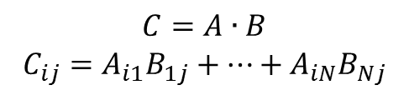
Python performance
def init_matrix(n):
m = []
for i in range(n):
m.append([])
for j in range(n):
m[i].append(random.random())
return m
def matmul(a, b, c):
n = len(a)
for i in range(n):
for j in range(n):
c[i][j] = 0.0
for k in range(n):
c[i][j] += a[i][k]*b[k][j]
500 × 500 matrices
Represent matrix as list of lists
Python: 0.09 s
C: 0.014 s
Naïve!
Fortran: 0.012 s
$$C=A∙B$$
$$C_{ij}=A_{i1}B_{1j}+⋯+A_{iN}B_{Nj}$$
Python: 32 s
C: 0.49 s
Fortran: 0.11 s

Slide 341
Libraries for numeric computation
numpy
  Fast arrays
  Matrix operations (BLAS-like)
  Linear algebra
  Fast Fourier Transform
  Mathematical functions defined on arrays
  Pseudo-random number generation to initialize arrays
  Simple statistics
…

Slide 342
Python using numpy
500 × 500 matrices
import numpy as np
def init_matrix(n):
return np.random.uniform(0.0, 1.0, (n, n))
def matmul(a, b):
return a @ b
numpy: 0.011 s
numpy: 0.077 s
Language/library | Execution time matrix multiplication (s)
Python | 32
C | 0.49
Fortran | 0.11
Python/numpy | 0.077
Fortran/BLAS | 0.060
415 ×

Slide 343
Creating array I
convention
import numpy as np
create 3-element array, all 0.0
v1 = np.zeros(3)
v2 = np.ones(3)
v3 = np.empty(3)
create 3-element array, all 1.0
create 3-element "empty" array
initialize elements later
create 2 × 3 array, all elements 0.0
a = np.zeros((2, 3))
b = np.ones((2, 3))
c = np.eye(2)
d = np.empty((2, 3))
create 2 × 3 array, all elements 1.0
create 2 × 2 identity array
create 2 × 3 "empty" array
initialize elements later
Default type: np.float ≡ double precision

Slide 344
Creating arrays II
e = np.random.uniform(0.0, 1.0, (2, 3))
create 2 × 3 array, elements x
randomly drawn from uniform
distribution such that x ∈ [0.0, 1.0[
f = np.array([[3.1, 4.2, -1.1], [-0.3, 1.3, 13.1]])
create 2 × 3 array from a Python
list of lists
f = np.genfromtxt('matrix.txt')
create 2 × 3 array
from text file
1.2 2.3 3.4
4.5 5.6 6.7

Slide 345
Creating arrays III
e = np.arange(-1.0, 1.0, 0.25)
create 8-element array, first element -1.0,
last element less than 1.0, step 0.25
[ -1. -0.75 -0.5 -0.25 0. 0.25 0.5 0.75 ]
f = np.linspace(-1.0, 1.0, 9)
create 9-element array, first element -1.0,
last element 1.0, determine step
[ -1. -0.75 -0.5 -0.25 0. 0.25 0.5 0.75 1. ]

Slide 346
Numpy data types
Integers
np.int8, np.int16, np.int32, np.int64
default for np.int: np.int32 on 32-bit, np.int64 on 64-bit architecture (np.uint<n> for unsigned integers)
Floating point numbers
np.float16, p.float32, np.float64, np.float96
default for np.float: np.float64, i.e., double precision
Complex numbers
np.complex64, np.complex128, np.complex192
default for np.complex: np.complex128, i.e., double precision
Boolean values: np.bool
Characters/strings: np.character
v = np.zeros(3, dtype=np.int8)

Slide 347

Accessing array elements
a = np.zeros((2, 3))
nr. bytes to
next row
Array dimensions, strides
Assigning to a specific element
Using an element's value
a.shape == (2, 3)
a.strides == (24, 8)
nr. bytes to
next column
a[1, 0] = 5.0
$$\left(\begin{matrix}0.0 & 0.0 & 0.0 \\ 5.0 & 0.0 & 0.0\end{matrix}\right)$$
Note:
Implicit conversion of
tuple for indexing
0-based indexing
q = a[1, 0] + a[1, 2]

Slide 348
Accessing subarrays: slicing
[[ 1 2 3 4 5 ]
[ 6 7 8 9 10 ]
[ 11 12 13 14 15 ]
[ 16 17 18 19 20 ]]
a = np.arange(1, 21).reshape(4, 5)
Second column
Third row
2D subarray
a[:, 1]
[ 2 7 12 17 ]
result: 1D array
a[2, :]
[ 11 12 13 14 15 ]
[[ 1 2 3 4 5 ]
[ 6 1 0 9 10 ]
[ 11 0 1 14 15 ]
[ 16 17 18 19 20 ]]
a[1:3, 1:3] = np.eye(2)
cfr. list slicing, but…
array slicing does not copy!

Slide 349
Fancy indexing
a = np.arange(1, 10, dtype=np.int).reshape(3, 3)
[[ 1 2 3 ]
[ 4 5 6 ]
[ 7 8 9 ]]
Conditional indexing
Conditional assignment
a[a % 2 == 1] = 0
[[ 0 2 0 ]
[ 4 0 6 ]
[ 0 8 0 ]]
3 × 3 Boolean array
np.where(a > 0, 1, -1)
[[ -1 1 -1 ]
[ 1 -1 1 ]
[ -1 1 -1 ]]
3 × 3 Boolean array

Slide 350
Operations on arrays
Scalar-array operations: +, -, *, /, //, **
Element-wise operations: +, -, *, /, //, **
Matrix product
  Python 3.5 style
a = np.array([[1.0, 3.0], [4.0, 5.0]])
print(3.0 + a)
[[ 4. 6. ]
[ 7. 8. ]]
a = np.array([[1.0, 3.0], [4.0, 5.0]])
b = np.array([[2.0, 3.0], [1.0, 0.5]])
print(a*b)
[[ 2. 9. ]
[ 4. 2.5 ]]
print(np.dot(a, b))
[[ 5. 4.5 ]
[ 13. 14.5 ]]
print(a @ b)

Slide 351
Functions operating on arrays
a = np.empty((500, 500))
b = np.random.uniform(0.0, 1.0, (500, 500))
Avoid
Use
Other functions: np.sin, …, np.sinh, …, np.exp, np.trace, np.transpose,…
for i in range(500):
for j in range(500):
a[i, j] = math.sqrt(b[i, j])
140 μs
21 ×
a = np.sqrt(b)
6.5 μs

Slide 352
Some linear algebra
a = np.array([[1.0, 3.0], [4.0, 5.0]])
numpy has some linear algebra operations
  matrix power
  matrix inverse
  determinant
  eigen values
[[ 85. 129.]
[ 172. 257.]]
np.linalg.matrix_power(a, 3)
[[-0.71428571 0.42857143]
[ 0.57142857 -0.14285714]]
np.linalg.inv(a)
np.linalg.det(a)
-7.0
np.linalg.eigvals(a)
[-1. 7.]

Slide 353
References versus copies
Reshape: different view on same data
Some operations return copies,
check documentation carefully
a = np.array([[1.0, 3.0],
[4.0, 5.0]])
[[ 1. 3.]
[ 4. 5.]]
b = a.reshape((a.size, ))
[ 1. 3. 4. 5.]
a[0, 0] = 13.0
[[ 13. 3.]
[ 4. 5.]]
a
b
[ 13. 3. 4. 5.]

Slide 354
numpy data I/O revisited
Reading text file with 10⁹ 64-bit floats
  np.fromtxt(…): 57 minutes,
  44 GB RAM
  np.fromfile(…, sep='\n'): 4.6 minutes,
  8 GB RAM
Reading binary file with 10⁹ 64-bit floats
  np.fromfile(…): 8 seconds,
  8 GB RAM
12 ×
5 ×
All functions are equal, but…
some are more equal than others
35 ×
Not all data formats are equal: HDF5 to the rescue

Slide 355
Matrices
Matlab-like initialization
Overloaded * and ** operators
Result is always matrix (2D)
a = np.matrix('1.0 3.0; 4.0 5.0')
[[ 1. 3. ]
[ 4. 5. ]]
Don't use,
confusing
a = np.matrix([[1.0, 3.0], [4.0, 5.0]])
b = np.matrix([[2.0, 3.0], [1.0, 0.5]])
print(a*b)
print(a**3)
[[ 5. 4.5 ]
[ 13. 14.5 ]]
[[ 85. 129. ]
[ 172. 257. ]]
a = np.matrix('1.0, 3.0')
b = np.matrix('2.0; 4.0')
print(a*b)
[[ 14. ]]

Slide 356
References
numpy for MATLAB users
http://mathesaurus.sourceforge.net/matlab-numpy.html

Slide 357
Python for scientific computing: Scipy
https://github.com/gjbex/training-material/tree/master/Python/Numpy
https://github.com/gjbex/training-material/tree/master/Python/Birdsong

Slide 358
Libraries for numeric computation
…
scipy
  Dense/sparse linear algebra
  Solving ordinary differential equations
  Numerical integration
  Optimization
  Interpolation
  Signal processing
  Statistics
  Special mathematical functions
  Mathematical & physical constants
…
convention
import scipy as sp
import subpackages as needed
import scipy.linalg

Slide 359
Singular Value Decomposition
Should be fast when built against
good BLAS/Lapack library
Computing SVD
Note: s is not a 2D-array, it is a 1D-array
Let's check
import scipy.linalg
a = np.array([[7.3, 5.7], [-1.2, 5.3]])
u, s, v = sp.linalg.svd(a)
S = np.diag(s)
A = u @ S @ v
delta = A - a
[[ 8.88178420e-16, 0.00000000e+00],
[ 4.44089210e-16, 0.00000000e+00]]

Slide 360
Linear regression
x,y
0.000e+00,1.206e+00
5.263e-02,1.207e+00
…
Reading data
Linear regression
data.csv
data = np.genfromtxt('data.csv',
dtype=[np.float64, np.float64],
delimiter=',', names=True)
import scipy as sp
import scipy.stats
slp, intc, r, _, _ = sp.stats.linregress(data['x'],
data['y'])

Slide 361
Optimization: function definitions
Minimize
Define function
Define gradient
$$f\left(x, y\right)={\left(x^{2}+y^{2}\right)}^{2}−{2x}^{2}−{2y}^{2}+0.1x$$
def f(X):
x = X[0]
y = X[1]
return (x**2 + y**2)**2 - 2*x**2 - 2*y**2 + 0.1*x
def grad_f(X):
x = X[0]
y = X[1]
f_x = 4*(x**2 + y**2)*x - 4*x + 0.1
f_y = 4*(x**2 + y**2)*y - 4*y
return np.array([f_x, f_y])

Slide 362
Optimization
Compute minimum
Many methods
  Powell
  Conjugate gradient
  BFGS
  Newton conjugate gradient
  …
import scipy.optimize
x0 = np.array([1.0, 0.01])
xopt = scipy.optimize.fmin_cg(f, x0, fprime=grad_f,
disp=False)

Slide 363
Ordinary differential equations
Rewrite higher order differential equation to set of first order equations
def func(t, y, g, l, q, F_D, Omega_D):
return [
y[1],
-(g/l)*y[0] - q*y[1] + F_D*np.sin(Omega_D*t)
]
y[0] ≡ θ
y[1] ≡ ω

Slide 364

Jacobian for equations
For many methods, convergence improves by specifying Jacobian
$$\left[\begin{matrix}\frac{∂f_{1}}{∂θ} & \frac{∂f_{1}}{∂ω} \\ \frac{∂f_{2}}{∂θ} & \frac{∂f_{2}}{∂ω}\end{matrix}\right]$$
def jac(t, y, g, l, q, F_D, Omega_D):
return [
[0.0, 1.0],
[-g/l, -q]
]

Slide 365
Integrate ODEs
Integrate from t0 to t_max in steps delta_t
integration method
RKF(4, 5)
from scipy.integrate import ode
…
ode_sys = ode(func, jac).set_integrator('dopri5')
ode_sys.set_initial_value([theta0, omega0], t0)
ode_sys.set_f_params(g, l, q, F_D, Omega_D)
ode_sys.set_jac_params(g, l, q, F_D, Omega_D)
while ode_sys.successful() and ode_sys.t < t_max:
ode_sys.integrate(ode_sys.t + delta_t)
print(ode_sys.t, ode_sys.y[0], ode_sys.y[1])

Slide 366
Signal processing
Remove noise from sound file (WAV)
  Read WAV file
  Perform FFT to compute frequency spectrum
…
from scipy.io import wavfile
…
sample_rate, signal = wavfile.read(wav_file_name)
…
n = len(signal)
freq = sample_rate*np.arange(n)/n
Y = sp.fft(signal)/n

Slide 367

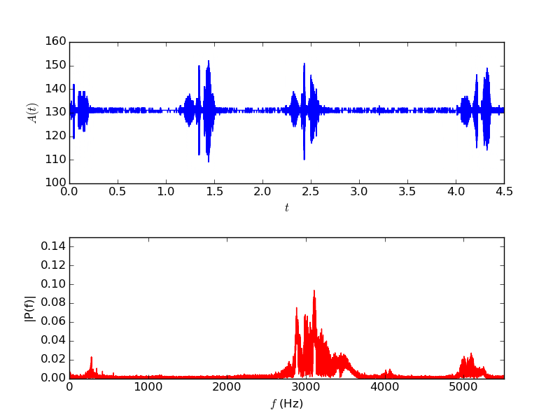
Original signal

Slide 368
Create highpass filter
Import signal processing package
Create IIR digital filter
…
import scipy.signal
…
fraction of Nyquist frequency
order of the filter
minimum attenuation
…
b, a = sp.signal.iirfilter(17, cutoff,
rs=min_attenuation,
btype='highpass',
analog=False,
ftype='cheby2')
…
filter type
IIR filter type
Notes:
The Nyquist frequency is half of the sampling rate of a discrete signal processing system.
Infinite impulse response (IIR) is a property applying to many linear time-invariant systems. Common examples of linear time-invariant systems are most electronic and digital filters. Systems with this property are known as IIR systems or IIR filters, and are distinguished by having an impulse response which does not become exactly zero past a certain point, but continues indefinitely. This is in contrast to a finite impulse response in which the impulse response h(t) does become exactly zero at times t > T for some finite T, thus being of finite duration.

Slide 369
Filter signal
Apply filter
Write signal to WAV file
…
base = np.uint8(np.mean(signal))
filtered_signal = sp.signal.filtfilt(b, a, signal)
wav_signal = base + np.array(filtered_signal,
dtype=np.uint8)
…
…
wavfile.write(filtered_wav_file_name, sample_rate,
wav_signal)
…

Slide 370
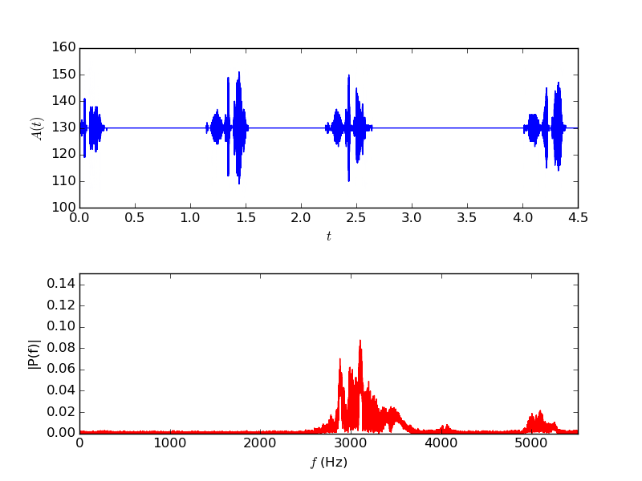
Filtered signal

Slide 371
Matplotlib
https://github.com/gjbex/training-material/tree/master/Python/Matplotlib

Slide 372
And some matplotlib…
Rich Python plotting library
  scatter plot
  line plot
  bar plot/histogram
  heatmap
  3D surface plot
Highly customizable plots
  LaTeX labels/annotation
Plot to screen, various file formats
Lots of features, this barely scratches the surface.
Convention: import matplotlib.pyplot as plt

Slide 373
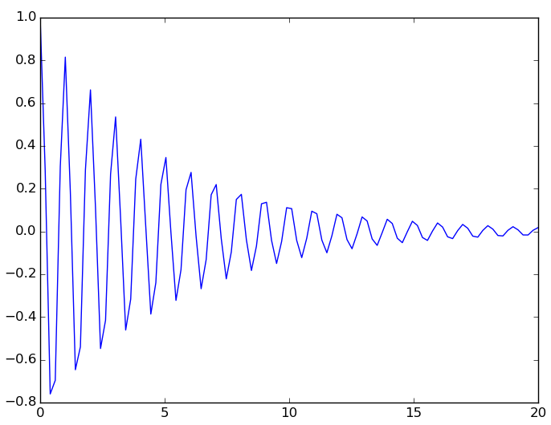
Simple line plot
Data: lists or numpy arrays
Add plot
Show plot
Save plot
x = np.linspace(0.0, 20.0, 500)
y = np.exp(-mu*x)*np.cos(2.0*np.pi*x)
plt.plot(x, y)
plt.show()
plt.savefig(file_name)

Slide 374
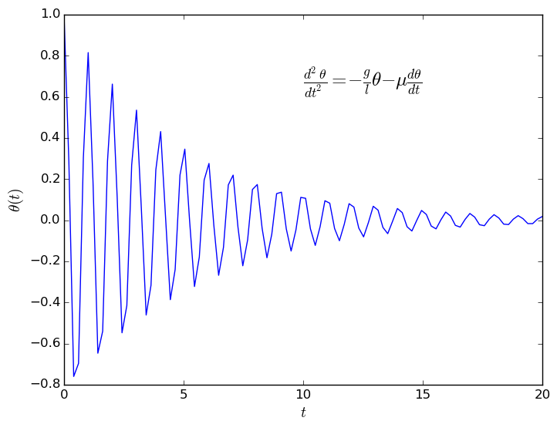
Axis labels, annotation
Add label for x and y axis
Add annotation
plt.xlabel(r'$t$', fontsize=14)
plt.ylabel(r'$\theta(t)$', fontsize=14)
construct plot
≡
gradually enrich plt
eq = (r'$\frac{d^2 \theta}{dt^2} = ' +
r'- \frac{g}{l} \theta ' +
r'- \mu \frac{d\theta}{dt}$')
plt.text(10.0, 0.65, eq, fontsize=18)
LaTeX notation, rendered

Slide 375
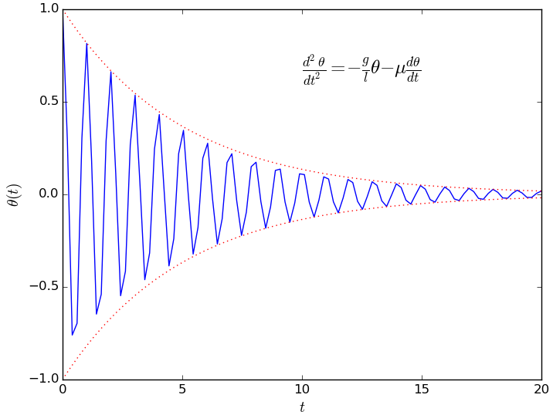
Multiple functions on line plot
Data
Add to plot, line style, color
y_plus = np.exp(-mu*x)
y_min = -np.exp(-mu*x)
plt.plot(x, y_plus,
':', alpha=0.8,
color='red',
linewidth=0.9)
plt.plot(x, y_min,
':', alpha=0.8,
color='red',
linewidth=0.9)
line type

Slide 376
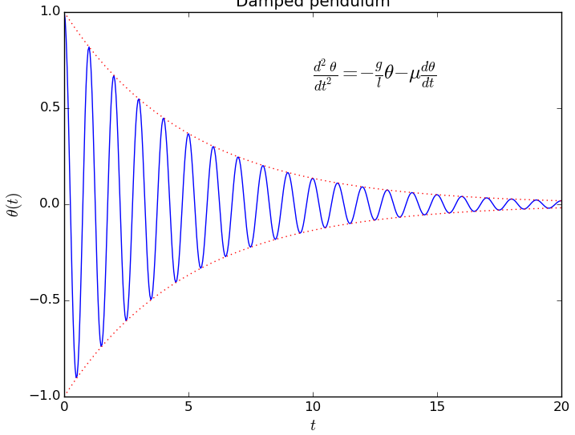
Complete line plot

Slide 377
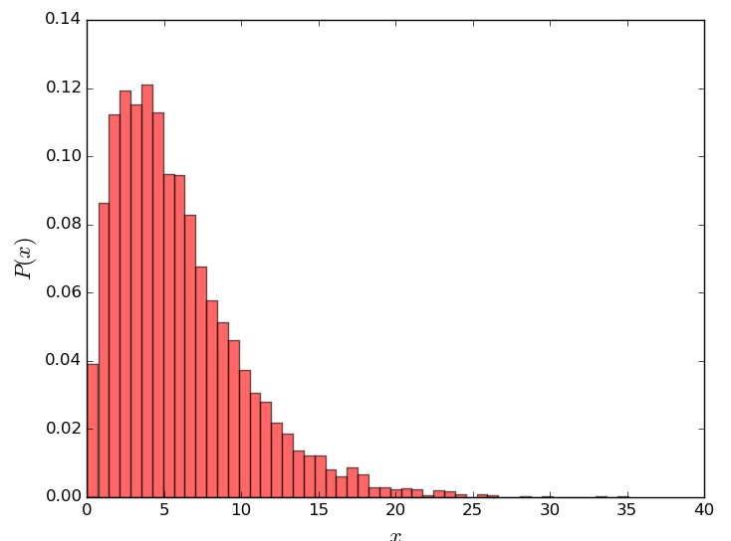
Histogram
13.3146868758
9.66243828428
6.44936354431
2.81183151337
9.55644862073
…
Data:
Plot histogram
values = np.loadtxt('data.txt')
bins = 50
data.txt
plt.hist(values, bins, normed=1,
color='red', alpha=0.6)
plt.xlabel('$x$', fontsize=16)
plt.ylabel('$P(x)$', fontsize=16)

Slide 378
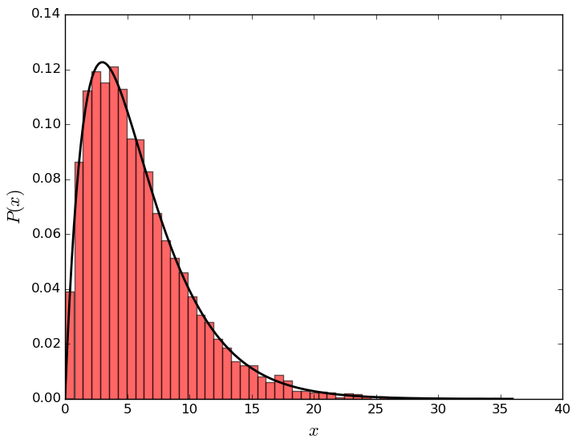
Line plot on histogram
Data:
Reminder
x = np.linspace(floor(np.min(values)), ceil(np.max(values)),
200)
y = sp.stats.gamma.pdf(x, 2, scale=3.0)
plt.plot(x, y, linewidth=2.0,
color='black')
import numpy as np
import scipy as sp
import scipy.stats
import matploblib.pyplot as plt

Slide 379
Heat map data
Function to plot
Data
def f(x, y, x0=0.0, freq=1.0, beta=0.5):
r = np.sqrt((x - x0)**2 + y**2)
return np.exp(-beta*r)*np.cos(2.0*np.pi*freq*r)
x = np.linspace(x_min, x_max, points)
y = np.linspace(y_min, y_max, points)
X, Y = np.meshgrid(x, y)
z = f(X, Y, x0=x0_1, freq=f_1) + f(X, Y, x0=x0_2, freq=f_2)

Slide 380
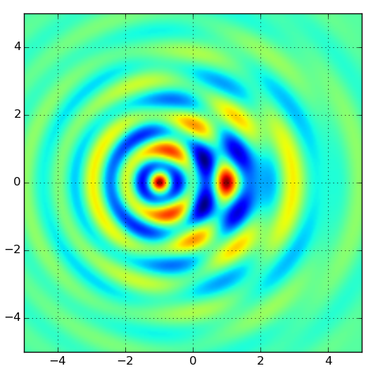
Heat map plot
Plot map
plt.imshow(z, extent=[x_min, x_max, y_min, y_max])
plt.grid(True)
Explore color maps,
helps interpret data!
Brewer schemes

Slide 381
3D surface plot I
Importing extra modules
Plot
from mpl_toolkits.mplot3d import Axes3D
from matplotlib import cm
figure = plt.figure()
axes = figure.gca(projection='3d')
axes.set_xlim(x_min, x_max)
axes.set_ylim(y_min, y_max)
axes.set_zlim(z_min, z_max)
surface = axes.plot_surface(X, Y, z,
rstride=4, cstride=4,
cmap=cm.coolwarm,
linewidth=0)
figure.colorbar(surface)

Slide 382
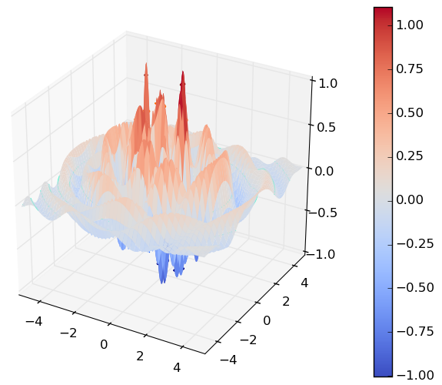
3D surface plot II

Slide 383
References
ColorBrewer 2.0: advice on choosing appropriate color maps
http://colorbrewer2.org/
Overview of data visualization types & libraries for Python
https://python-graph-gallery.com/

Slide 384
Sympy

Slide 385
Introduction
sympy: library for computer algebra
  symbolic computations
Features
  linear algebra
    vectors, matrices, tensors
    solving linear sets of equations
    eigenvalues/eigenvectors, SVD
    …
  calculus
    computing derivatives, series expansions
    limits
    integrals (indeterminate/determinate)
  …

Slide 386
Defining symbols
import sympy
Defining multiple symbols
Symbol with assumptions
  real
  rational
  integer
  positive/negative
Matrices
a, b, c, x = sympy.symbols('a b c x')
y = sympy.Symbol('y', positive=True)
A = sympy.Matrix([[x**2, x*y], [-x*y, y**2]])

Slide 387
Solving equations
Solve
Solve
sympy.solve(a*x**2 + b*x + c, x)
[ (-b + sqrt(-4*a*c + b**2))/(2*a),
-(b + sqrt(-4*a*c + b**2))/(2*a) ]
A = sympy.Matrix([[a, b], [c, d]])
X = sympy.Matrix([x, y])
B = sympy.Matrix([1, 0])
sympy.solve(A*X - B, X)
{ x: d/(a*d - b*c),
y: -c/(a*d - b*c) }

Slide 388
Eigenvalues, eigenvectors
multiplicity
eigen = A.eigenvects()
[(a/2 + d/2 - sqrt(a**2 - 2*a*d + 4*b*c + d**2)/2, 1, [Matrix([
[-b/(a/2 - d/2 + sqrt(a**2 - 2*a*d + 4*b*c + d**2)/2)],
[ 1]])]),
(a/2 + d/2 + sqrt(a**2 - 2*a*d + 4*b*c + d**2)/2, 1, [Matrix([
[-b/(a/2 - d/2 - sqrt(a**2 - 2*a*d + 4*b*c + d**2)/2)],
[ 1]])])]
v1, v2 = eigen[0][2][0], eigen[1][2][0]
sympy.simplify(v1.T*v2)
Matrix([[(-b + c)/c]])
if A is symmetric, eigenvectors are orthogonal

Slide 389
Derivatives
Define function
Derivative with respect to x
Derivative with respect to x and y
def f(x, y):
return a*x**2 + b*x*y + c*y**2 + d
sympy.diff(f(x, y), x)
2*a*x + b*y
sympy.diff(f(x, y), x, y)
b

Slide 390
Integration
Indefinite integral
Definite integral
Multiple integrals
sympy.integrate(f(x, y), x)
a*x**3/3 + b*x**2*y/2 + x*(c*y**2 + d)
from sympy import exp, sqrt, pi, oo
sympy.integrate(exp(-x**2/2)/sqrt(2*pi),
(x, -oo, oo))
1
sympy.integrate(f(x, y), (x, 0, 1), (y, 0, 2))
2*a/3 + b + 8*c/3 + 2*d

Slide 391
Limits and series expansion
Limit
Series expansion
sympy.limit(sin(x)/x, x, 0)
1
sympy.series(sin(x)/x, x, 0, n=6)
1 - x**2/6 + x**4/120 + O(x**6)
Use .removeO()
when not required
Use .taylor_term()
to get term of specific order

Slide 392
Expression representation
sympy expression = tree
from sympy import Add, Mul, Pow
Add(Mul(a, Pow(x, 2)), Mul(b, x), c)
Add
Mul
Mul
Symbol('c')
Symbol('a')
Pow
Symbol('b')
Symbol('x')
Symbol('x')
Integer(2)

Slide 393
Parts of expressions
Taking expression apart
Operator
Operands
Pow
expr = 1/(a*x + b)
Add
Integer(-1)
Mul
Symbol('b')
expr.func
sympy.core.power.Pow
Symbol('a')
Symbol('x')
expr.args
expr.args[0].args[0]
(a*x + b, -1)
b

Slide 394
Expression manipulation
Substitution
Factor, expand
Simplify
expr = x**2 + 2*a*x + y**2
expr.subs(y, a)
x**2 + 2*x*y + y**2
(x**2 + 2*x*y + y**2).factor()
((x + y)**2).expand()
(x + y)**2
x**2 + 2*x*y + y**2
x, y = symbols('x y', positive=True)
(log(x) + log(y)).simplify()
log(x*y)

Slide 395
Further reading
Sympy: symbolic computing in Python
A. Muerer, C.P. Smith, M. Paprocki et al.
PeerJ.CompSci

Slide 396
HDF5:
PyTables
https://github.com/gjbex/training-material/tree/master/Hdf5/PythonSamples

Slide 397
HDF5: what is it?
System, OS,
programming language
independent way of
storing data
Hierarchical Data Format
Abstract data model
  File
  Group
  Dataset
  Data type
  Attribute
Storage model
File system
Directory
File
Metadata
Documentation, comments
in data file itself, self contained

Slide 398
HDF5 data
Data stored in dataset as n-dimensional arrays
  Dataspace describes layout of data (rank,dimensions)
  Datatype describes single data element
    Atomic
      Integer, float
      String, time
      Opaque
    Composite
      Compound
      Enumeration
      Array
      Variable length
  Partial read/writes, hyperslab selection
Data layout & type description part of
HDF5 file:
  self-documenting
  discovery!

Slide 399
HDF5 storage
Filtering
  Compression
  Error detection
Datasets can be extended
Storage drivers
  Single file
  Multiple files
  Multiple files on parallel file system
  Memory

Slide 400
HDF5: how to use it?
C/C++
Fortran 90
Java
Python
  PyTables, h5py
HDF5 file can be read by program in any language
Not so easy in C/C++/Fortran, fairly trivial in Python

Slide 401
Importing modules
To work with HDF5 files
  import tables
  if necessary (usually not, unless when using compounds), import specific functions, classes
  if necessary (almost certainly), import numpy
…
import tables
from tables import Int32Col, Float64Col
import numpy as np
…

Slide 402
Open & close HDF5 file
Create new HDF5 file (w for write)
Open HDF5 file for modification (a for append)
Open HDF5 file for reading (r for read)
Close file
Preferred alternative
h5file = tables.open_file('data.h5', mode='w',
'simulation input and results')
file name
title
h5file = tables.open_file('data.h5', mode='a')
h5file = tables.open_file('data.h5', mode='r')
h5file.close()
with tables.open_file('data.h5', 'w', '…') as h5file:
…

Slide 403
Creating a group
group location in hierarchy
group name
Groups start in root
Creating a subgroup
input_group = h5file.create_group(h5file.root, 'input',
'input data')
≡
comment
input_group = h5file.create_group('/', 'input',
'input data')
field_group = h5file.create_group(input_group, 'fields',
'various fields')
≡
field_group = h5file.create_group('/input', 'fields',
'various fields')

Slide 404
Adding an array
Use numpy arrays
Add it to HDF5 file
magn_field = lambda x, y: x**2 + 2*x*y
X, Y = np.meshgrid(np.linspace(-1.0, 1.0, x_dim),
np.linspace(-1.0, 1.0, y_dim))
field = magn_field(X, Y)
array location in hierarchy
array name
h5file.create_array(field_group, 'magnetic', field,
'static magnetic field')
h5file.flush()
comment
array

Slide 405
Adding an 2D array
Create numpy array
Add array
positions = np.random.normal(scale=10.0, size=(20, 2))
h5file.create_array('/coords', 'positions', positions,
'particle positions', createparents=True)
h5file.flush()

Slide 406
Annotations
Adding a unit annotation to array
Adding annotation to a group
attrs, _v_attrs behave mostly like Python dictionaries, to set, get, remove an annotation
  list of attributes:
field_group.magnetic.attrs['units'] = 'mT'
field_group._v_attrs['warning'] = 'do not modify'
field_group._f_list('user')

Slide 407
Objects & tables
Define class
Create table
from tables import IsDescription, Int32Col, Float64Col
class Particle(IsDescription):
particle_id = Int32Col()
mass = Float64Col()
x_pos = Float64Col()
y_pos = Float64Col()
x_vel = Float64Col()
y_vel = Float64Col()
initial_state = h5file.create_table(
'/', 'particles', Particle, 'initial state of particles'
)

Slide 408
Populate table
Add new particles
particle = h5file.root.particles.row
for particle_id in range(100):
particle['particle_id'] = particle_id
particle['mass'] = random.gauss(0.0, 1.0)
particle['x_pos'] = random.gauss(0.0, 1.0)
particle['y_pos'] = random.gauss(0.0, 1.0)
particle['x_vel'] = random.gauss(0.0, 1.0)
particle['y_vel'] = random.gauss(0.0, 1.0)
particle.append()
h5file.flush()
append particles one by one, unlimited (except by disk space)

Slide 409
Reading an array
Read entire dataset, i.e., array
Read slice
Read non-consecutive data
magn_field = h5file.root.input.fields.magnetic
print(np.average(magn_field))
pos = h5file.root.coords.positions[3:7, :]
read x- and y-coordinates
of 4 particles
indices = [2, 4, 6]
pos = h5file.root.coords.positions[indices, :]
read x- and y-coordinates
of 3rd, 5th, and 7th particle
Hyperslabs!

Slide 410
Reading a table
Compute center of mass
x, y = 0.0, 0.0
mass = 0.0
for particle in h5file.root.particles:
mass = particle['mass']
x += particle['mass']*particle['x_pos']
y += particle['mass']*particle['y_pos']
x /= mass
y /= mass

Slide 411
HDF5 command line utilities
h5dump
  Print a textual representation of HDF5 file
h5ls
  Explore structure of HDF5 file
h5copy
  Copy data set from one HDF5 file to another
h5mkgrp
  Create a group in an HDF5 file

Slide 412
Pandas
https://github.com/gjbex/training-material/tree/master/Python/Pandas

Slide 413
What is it?
Library for data science
  defines datastructures
    Series (1D)
    DataFrame (2D)
  defines algorithms
    selection
    pivot tables
  defines utilities
    visualization, e.g., scatter_matrix
Backed by numpy
Nice to experiment with data, jupyter notebooks
convention
import pandas as pd
R dataframes
for Python

Slide 414
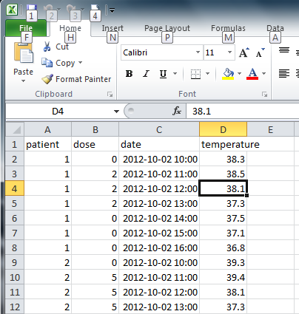
Example data
Microsoft Excel spreadsheet

Slide 415
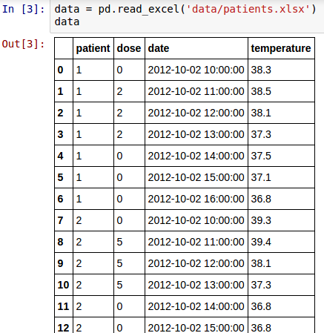
Read dataframe
Create DataFrame from Excel file
  Also tabular data,
  CSV, HDF5, SQL
  query, HTML page,…
Show in notebook

Slide 416
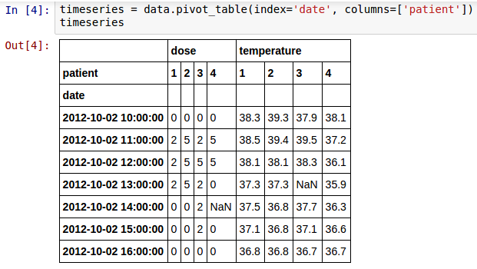
Transform dataframe
Patient data as columns, date as index:
pivot table
missing value

Slide 417
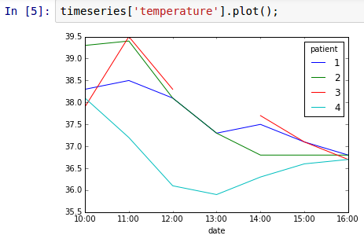
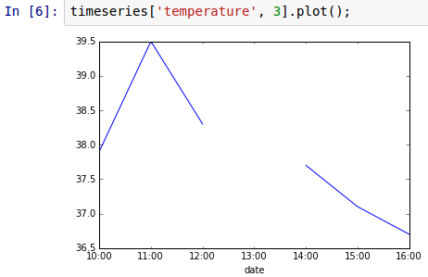
Plot data
missing value

Slide 418
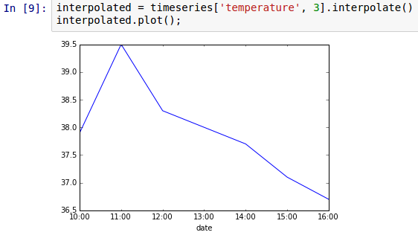
Missing data: NaNs
Can be filled with 0, other value, or interpolated
interpolated
value

Slide 419
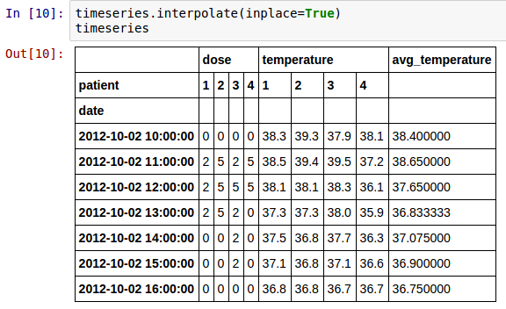
In-place changes
Changes produce new DataFrame
  good to experiment
  bad for performance/memory usage
Use in place

Slide 420
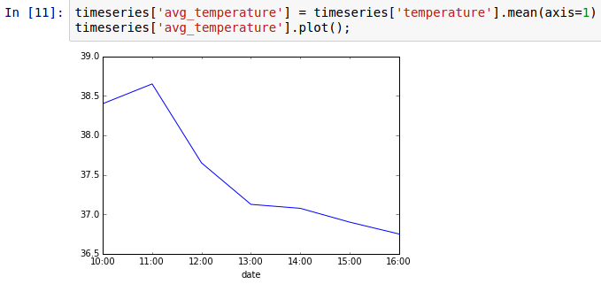
Statistics & adding columns
Compute average temperature and add as column
add column
compute
statistics

Slide 421
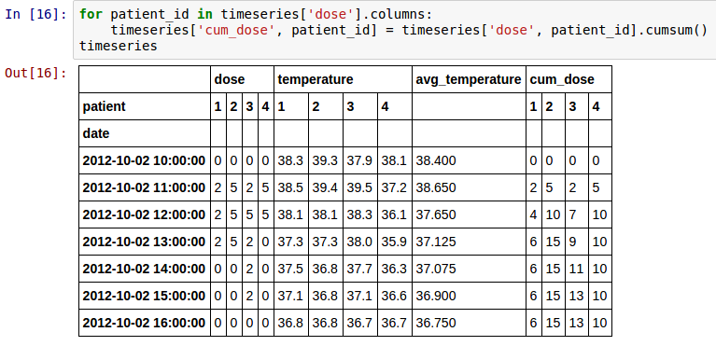
Cumulative sum
compute
sums
Dose is better expressed cumulatively
modify column

Slide 422
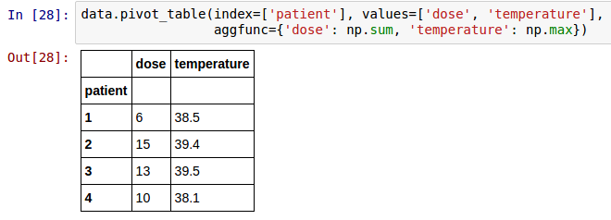
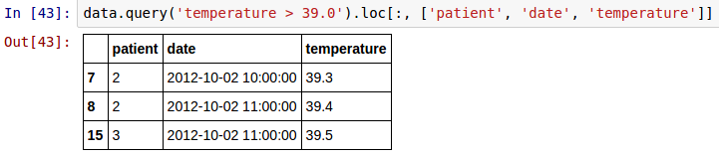
More pivot & query
pivot_table and query are powerful!
What is total dose versus maximum temperature
for each patient?
Which patients had temperature > 39,
and when?

Slide 423
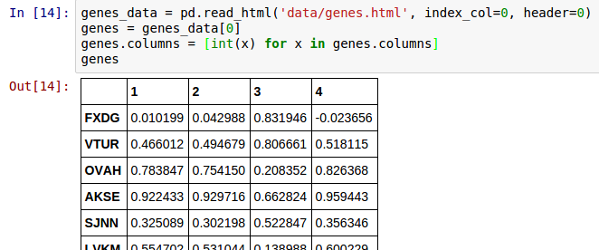
Reading HTML tables
column
names
index
column
read_html produces list of DataFrame,
one per HTML table on page
Column names are str by default,
converted to int for consistency
with running example

Slide 424
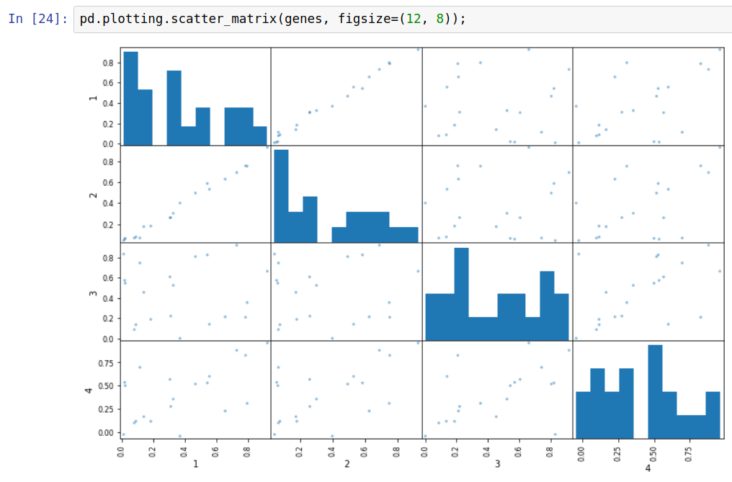
Scatter matrix

Slide 425
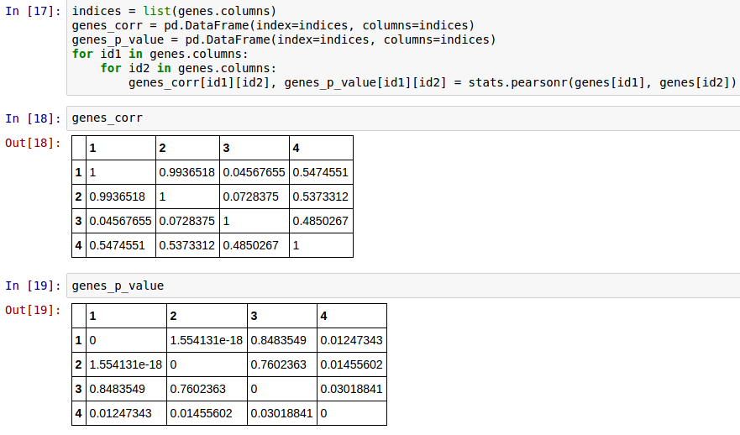
Computing correlations
Creating
DataFrames
by hand
Note:
import scipy.stats as stats

Slide 426
HoloViews
https://github.com/gjbex/training-material/tree/master/Python/HoloViews

Slide 427
What is it?
Library for exploratory data visualization
  Easy to create overlays
  Parameter exploration
    GridSpace
    HoloMap
  Interfaces with numpy, pandas
Nice to experiment with/explore data, jupyter notebooks
Very simple for complex things
convention
import holoviews as hv

Slide 428

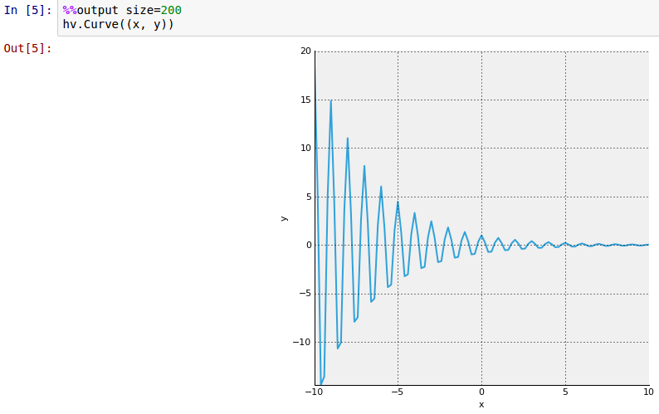
Trivial example
Plotting numpy arrays
plot tuple
of x and y
values

Slide 429
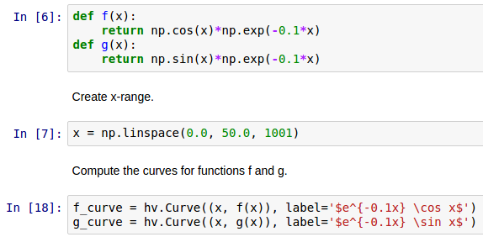
Combining plots
Create data & two plots
create two plots
not yet displayed
label plots
using LaTeX

Slide 430
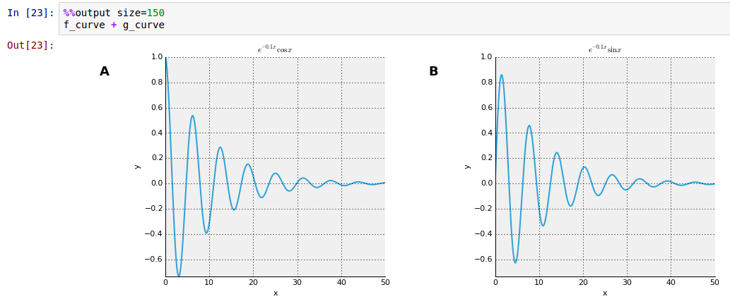
Side by side
combine
plots side
by side

Slide 431
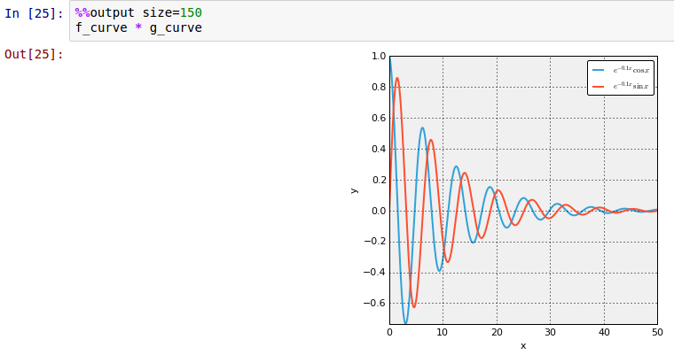
Overlay
combine
plots by
overlaying

Slide 432
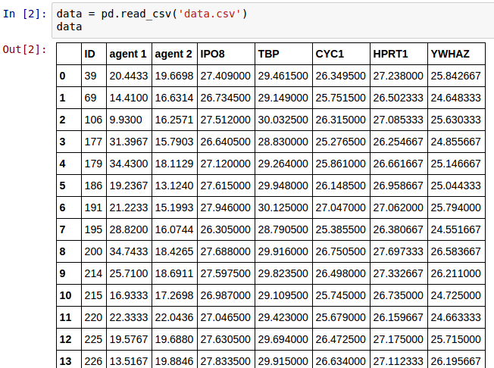
pandas & HoloViews
Read data

Slide 433
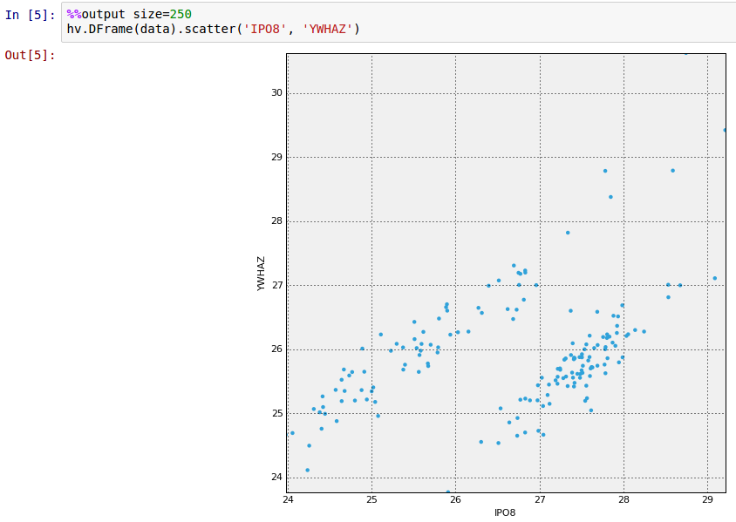
Plotting DataFrame
"bridge" between
pandas & HoloViews

Slide 434
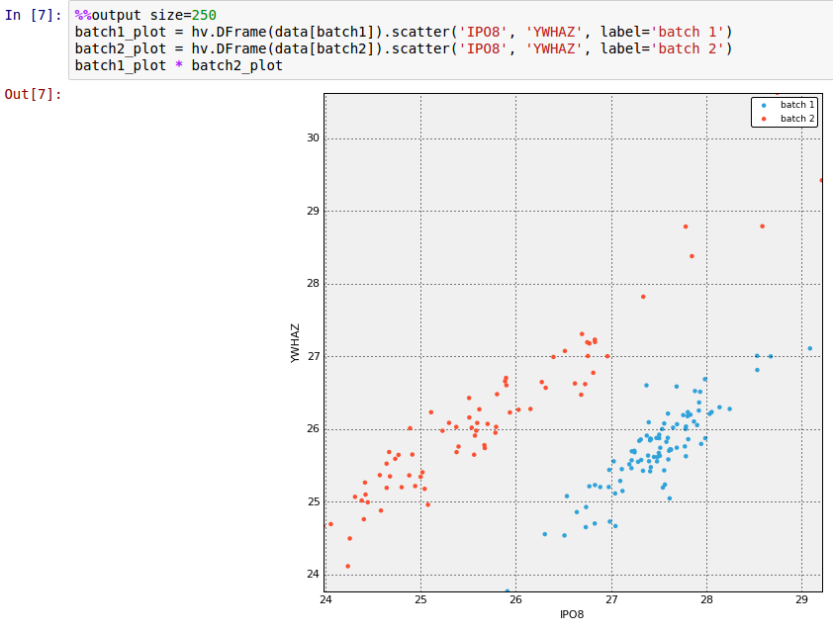
More overlays

Slide 435
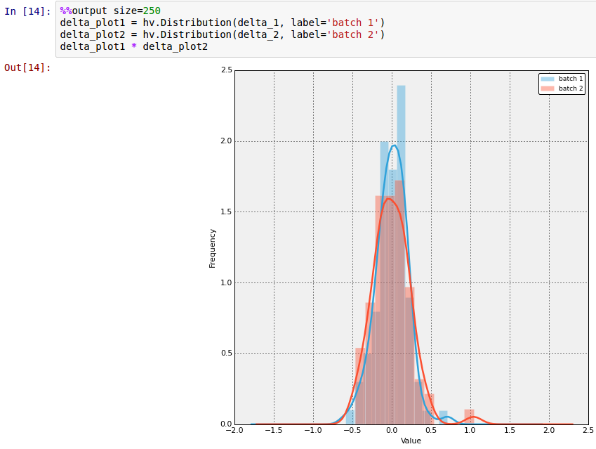
Plotting distributions

Slide 436

GridSpace
create key pairs,
gene, agent
create plots,
one per key pair

Slide 437

HoloMap
select parameters
to plot from menus

Slide 438
Bokeh
https://github.com/gjbex/training-material/tree/master/Python/Bokeh

Slide 439
What is it?
Plot library
  Easy to use
  Integrates with Pandas
  Interactive demos in jupyter notebooks
  Export to HTML pages, interactive plots using Javascript
Disadvantages
  No (convenient) LaTeX labels
More oriented towards information visualization

Slide 440
Simple plot
import required
functions
from bokeh.plotting import figure, output_file, show
…
x = np.linspace(0.0, 20.0, 500)
y = np.exp(-mu*x)*np.cos(2.0*np.pi*x)
y_plus = np.exp(-mu*x)
y_min = -np.exp(-mu*x)
…
output_file('plot.html', title='damped pendulum')
fig = figure(title='damped pendulum',
x_axis_label='t', y_axis_label='theta')
fig.line(x, y)
fig.line(x, y_min, line_color='red',
line_width=0.6,
line_dash=(2, 2))
fig.line(x, y_plus, line_color='red',
line_width=0.6,
line_dash=(2, 2))
show(fig)
set output file
create figure
plot data
create file

Slide 441

HTML file
pan tool
box zoom
wheel zoom
save image
reset
Interactive in web browser!

Slide 442

HTML file with widget
Required: callback function
• modifies data
• triggers update
• involves Javascript tinkering
interactive slider

Slide 443

Linked figures
linked figures for
• panning, zooming
• interactive settings

Slide 444

Linked brushing
consistent selection

Slide 445

Hover tool
hover for details
Any information can be added

Slide 446
Image & video processing
https://github.com/gjbex/training-material/tree/master/Python/ImageProcessing

Slide 447
Image & video processing
Use dedicated software, e.g., GIMP, OpenShot
  use Python for plugins
  use Python for scripting
Image processing
  pillow: basic image processing (successor to PIL)
  scikit-image: more sophisticated algorithms
  OpenCV: comparable to scikit-image
Video processing
  OpenCV: many useful algorithms

Slide 448

Image restoration
Define point spread function
Perform deconvolution
point_spread_f = np.ones((5, 5))/25.0
from skimage.restoration import unsupervised_wiener
…
denoised, _ = unsupervised_wiener(img, point_spread_f)
3D numpy array, RGB
For image I/O:
skimage.io

Slide 449


Segmentation
Define initial contour
Compute snake
theta = np.linspace(0, 2*np.pi, n)
x = x0 + radius*np.cos(theta)
y = y0 + radius*np.sin(theta)
initial_snake = np.array([x, y]).T
from skimage.segmentation import active_contour
snake = active_contour(smoothed_image, initial_snake,
alpha=alpha, beta=beta,
gamma=gamma)
from skimage.filters import Gaussian
smoothed_image = gaussian(image, 3)

Slide 450
Capturing video
Capture from camera, show in window
import cv2
capture = cv2.VideoCapture(0)
while True:
status, frame = capture.read()
if not status:
# oops
…
cv2.imshow('frame', frame)
if cv2.waitKey(1) & 0xFF == ord('q'):
break
cv2.destroyAllWindows()
capture.release()
device number
3D numpy array, BGR
quit on 'q'

Slide 451
Reading/writing video
Reading from my_video.avi
Writing to my_video.avi
capture = cv2.VideoCapture('my_video.avi')
video encoding
fourcc = cv2.VideoWriter_fourcc(*'XVID')
writer = cv2.VideoWriter('my_video.avi', fourcc,
frames_per_second,
(width, height))
for frame in frames:
writer.write(frame)
writer.release()

Slide 452
Follow the ball: setup
Hue histogram of ROI (region of interest)
status, frame = capture.read()
track_window = (x, y, width, height)
hsv_frame = cv2.cvtColor(frame, cv2.COLOR_BGR2HSV)
mask = cv2.inRange(hsv_frame,
np.array((min_hue, 50, 50)),
np.array((max_hue, 255, 255)))
roi_hist = cv2.calcHist([hsv_frame], [0],
mask, [max_hue], [0, max_hue])
cv2.normalize(roi_hist, roi_hist, 0, 255,
cv2.NORM_MINMAX)
only histogram
for hue on ROI
HSV = Hue, Saturation, Value
determines color

Slide 453

Follow the ball
Read frames and update track window
termin_cond = (cv2.TERM_CRITERIA_EPS |
cv2.TERM_CRITERIA_COUNT,
iterations, pixels)
while True:
status, frame = capture.read()
hsv = cv2.cvtColor(frame, cv2.COLOR_BGR2HSV)
back_proj = cv2.calcBackProject([hsv], [0], roi_hist,
[0, max_hue], 1)
status, track_window = cv2.meanShift(back_proj,
track_window,
termin_cond)

Slide 454
Further reading
Success depends on
understanding algorithms!
Many things to explore
Check out
  http://scikit-image.org/docs/0.12.x/user_guide.html
  http://docs.opencv.org/3.2.0/d6/d00/tutorial_py_root.html

Slide 455
Machine learning
https://github.com/gjbex/training-material/tree/master/Python/ScikitLearn

Slide 456
Introduction
Machine learning is making great strides
  Large, good data sets
  Progress in algorithms
Many libraries
  scikit-learn
  theano
  TensorFlow
  Keras
  …
classic machine learning
deep learning frameworks
Fast-evolving ecosystem!

Slide 457
scikit-learn
Nice end-to-end framework
  data exploration (+ pandas + holoviews)
  data preprocessing (+ pandas)
    cleaning/missing values
    normalization
  training
  testing
  application
Classic only?
Sure, but don't jump into deep end
unless you can swim!

Slide 458
Machine learning tasks
Supervised learning
  regression: predict numerical values
  classification: predict categorical values, i.e., labels
Unsupervised learning
  clustering: group data according to "distance"
  association: find frequent co-occurrences
  link prediction: discover relationships in data
  data reduction: project features to fewer features

Slide 459
Data set
training: 2015
test: 2016
World happiness index 2015 & 2016
(http://worldhappiness.report/)
Happiness score for country based on
  economic factors (GDP)
  family situation (social network)
  health care (life expectancy)
  freedom
  trust (government corruption)
  generosity
  dystopia residual
Geographical region, e.g., Western Europe, Southern Asia,…
don't touch!
quantitative data
categorical data

Slide 460

World happiness
https://en.wikipedia.org/wiki/World_Happiness_Report

Slide 461
Task 1
Given
  economy
  family
  health
  freedom
  trust
  generosity
  dystopia residual
  region
Predict happiness score
Regression

Slide 462

Let's peek…
Rescaling

Slide 463


Missing values?
No NaNs, otherwise, use Imputer

Slide 464
Extracting data
Part of machine learning pipeline
  fit + transform
Extracting columns from pandas data frame
from sklearn.base import BaseEstimator, TransformerMixin
class DataFrameSelector(BaseEstimator, TransformerMixin):
def __init__(self, attr_names):
self.attribute_names = attr_names
def fit(self, X, y=None):
return self
def transform(self, X):
return X[self.attribute_names].values
no-op: nothing to fit
numpy array of
selected columns

Slide 465
Numerical attributes pipeline
Extract, then scale
from sklearn.pipeline import Pipeline
from sklearn.preprocessing import MinMaxScaler
num_attrs = data_2015.columns[5:13]
num_attrs_pipeline = Pipeline([
('num_attrs_selector', DataFrameSelector(num_attrs)),
('scaling', MinMaxScaler()),
])
first operation
second operation
name of operation
operation constructor

Slide 466
Categorical attribute pipeline
Extract, then create one-hot attributes
Country | Region
Belgium | Western Europe
Canada | North America
Germany | Western Europe
… | …
Country | Western Europe | Northren America | …
Belgium | 1 | 0 | …
Canada | 0 | 1 | …
Germany | 1 | 0 | …
… | … | … | …
from sklearn.preprocessing import LabelBinarizer
region_attr_pipeline = Pipeline([
(‘region_selector', DataFrameSelector(['Region'])),
('one-hot', LabelBinarizer()),
])

Slide 467
Combining pipelines & execution
Both pipelines must be executed, results combined
Run data through pipeline
from sklearn.pipeline import FeatureUnion
preparation_pipeline = FeatureUnion(transformer_list=[
('region_attr', region_attr_pipeline),
('num_attrs', num_attrs_pipeline),
])
train_data = preparation_pipeline.fit_transform(data_2015)
numpy array
Ready to start training!

Slide 468
Training & prediction
Create learning algorithm
Train
Predict
from sklearn.linear_model import Ridge
ridge_regr = Ridge(alpha=0.5, fit_intercept=False)
hyperparameters
X = np.array(train_data)
Y = np.array(data_2015['Happiness Score'])
ridge_regr.fit(X, Y);
Y_ridge_regr = ridge_regr.predict(X)

Slide 469
Score & errors
Score
Better: cross validation
ridge_regr.score(X, Y)
0.9984
scores = cross_val_score(
ridge_regr, X, Y,
scoring='neg_mean_squared_error',
cv=10
)
10-fold
0.1954, 0.0215,
0.0579, 0.0478,
0.0551, 0.0649,
0.0591, 0.0451,
0.0729, 0.0803
np.sqrt(-scores)

Slide 470
Fine tuning
Define hyper parameter search space
Define grid searcher
Search
Best hyper parameters
grid_params = [
{'alpha': [0.0005, 0.001, 0.005, 0.01, 0.05, 0.1, 0.5],
'fit_intercept': [True, False]},
]
grid_search = GridSearchCV(ridge_regr, grid_params, cv=10,
scoring='neg_mean_squared_error')
grid_search.fit(X, Y)
grid_search.best_params_
{'alpha': 0.0005, 'fit_intercept': True}

Slide 471

Training result

Slide 472
Testing the model
Use pipeline
Predict
Score
test_data = preparation_pipeline.transform(data_2016)
Note: only transform, no fit_transform!
Y_test = ridge_regr.predict(X_test)
ridge_regr.score(X_test, Y_test)
0.9950

Slide 473

Test result

Slide 474
Task 2
Given
  economy
  family
  health
  freedom
  trust
  generosity
  dystopia residual
Predict whether country
in Western Europe
Classification

Slide 475
Data preparation
Numerical pipeline is same as in task 1
  select from pandas DataFrame
  scale
Add column for class
  True if in Western Europe, False otherwise
prepared_data = num_attrs_pipeline.fit_transform(data_2015)
data_2015['Western Europe'] = (data_2015['Region'] ==
'Western Europe')

Slide 476
Training & scoring
Create learning algorithm
Train
Scoring
from sklearn.naive_bayes import GaussianNB
nb = GaussianNB()
attributes: approx. Gaussian distr.
nb.fit(prepared_data, data_2015['Western Europe'])
nb.score(prepared_data, data_2015['Western Europe'])
0.9367
Seems reasonable

Slide 477
Testing the model
Use pipeline
Predict
Score
test_data = num_attrs_pipeline.transform(data_2016)
Note: only transform, no fit_transform!
Y_test = nb.predict(test_data)
nb.score(test_data, Y_test)
0.8662
Not so good

Slide 478
Actually…
Compute confusion matrix
confusion_matrix(data_2016['Western Europe'],
nb.predict(test_data))
false positives
array([[132, 4],
[ 17, 4]])
false negatives
Massive exit from Western Europe: 17 countries just left!

Slide 479

Data set properties
small class,
many detractors

Slide 480
Task 3
Given
  economy
  family
  health
  freedom
  trust
  generosity
  dystopia residual
Find countries that are
"close"
Clustering

Slide 481
Data preparation & Training
Data preprocessing same as task 2
Create learning algorithm
Train
Add cluster label to data set
from sklearn.cluster import KMeans
k_means = KMeans(n_clusters=3)
How many clusters?
k_means.fit(prepared_data)
data_2015['Cluster'] = 0
for i in range(3):
data_2015.loc[clusterer.labels_ == i, 'Cluster'] = i

Slide 482


Examine clusters
data_2015.boxplot(by='Cluster', column=num_attr_names)
data_2015.loc[:, ('Cluster', 'Country')].groupby('Cluster').count()

Slide 483
And the winners are…
Switzerland
Iceland
Denmark
Norway
Canada
Finland
Netherlands
Sweden
New Zealand
Australia
Austria
United States
Luxembourg
Ireland
Belgium
United Arab Emirates
United Kingdom
Oman
Singapore
Germany
Qatar
France
Uruguay
Saudi Arabia
Malta
Kuwait
Uzbekistan
Japan
Bahrain
Turkmenistan
Hong Kong

Slide 484



Caveat
InspiroBot (http://inspirobot.me/)
  "I am an artificial intelligence dedicated to generating unlimited amounts of unique inspirational quotes for endless enrichment of pointless human existence".

Slide 485
Conclusions
scikit-learn
  easy to use
  consistent, elegant API
  restricted to classic machine learning
Consider using pre-trained networks

Slide 486
Further reading
Success depends on
understanding algorithms!
Success also depends on
understanding data & domain!
Many things to explore
Hands-on machine learning with scikit-learn & TensorFlow
Aurélien Géron
O'Reilly, 2017
Excellent keras tutorial
https://github.com/leriomaggio/deep-learning-keras-tensorflow

Slide 487
Graphical Information Systems data processing
https://github.com/gjbex/training-material/tree/master/Python/Gis

Slide 488
Introduction
Graphical Information System (GIS), e.g.,
  ArcGIS
  QGIS
Many data formats, e.g.,
  shape files
  GeoJSON
  GeoTIFF
Python & GIS
  I/O library: Fiona, gdal
  visualization: Folium
  data processing/modeling: Shapely, GeoPandas
Can be scripted with Python

Slide 489
World Happiness Index
Data
  World Happiness information: CSV file
    relevant columns: Country, Happiness Score
    data on 157 countries
  country names, borders,… : GeoJSON
import pandas as pd
happiness_data = pd.read_csv(happiness_filename)

Slide 490
Folium visualization
import folium
Create world map
Add chloropleth
longitude
lattitude
world = folium.Map(
location=[0.0, 0.0],
tiles='Mapbox Bright',
zoom_start=2)
shows entire world
world.choropleth(
name='world happiness',
data=happiness_data,
columns=['Country', 'Happiness Score'],
geo_data=str(country_geo_filename),
key_on='properties.name',
fill_color='YlGn', fill_opacity=0.7,
line_opacity=0.2,
legend_name='Happiness Score')
pandas
GeoJSON

Slide 491

Folium in Jupyter Notebook
Missing data?

Slide 492

Data linkage issue
In World Happiness Index: United States
In GeoJSON file: United States of America
Fix: change names, e.g.,
happiness_data.at[12, 'Country'] = 'United States of America'

Slide 493




Shapely: geometric objects
Point: 2D or 3D
MultiPoint: collection of Point
LineString: sequence of Point
MultiLineString: multiple LineString
LinearRing: closed LineString
  should not cross
Polygon: LinearRing as outer boundary, optionally multiple LinearRing as "holes"
  should not touch in more than one point
MultiPolygon: multiple Polygon
  should not touch in more than one point

Slide 494
Shapely: object examples
LineString
LinearRing
Polygon
line = LineString([(0.0, 0.0), (1.0, 1.0), (2.0, 0.5)])
outer = LinearRing([(3.0, 2.0), (3.0, 5.0), (6.0, 5.0),
(6.0, 2.0)])
inner1 = LinearRing([(3.5, 2.5), (3.5, 4.5), (4.5, 4.5),
(4.5, 2.5)])
inner2 = LinearRing([(5.0, 2.5), (5.0, 4.5), (5.5, 4.5),
(5.5, 2.5)])
polygon = Polygon(outer, [inner1, inner2])

Slide 495
Shapely: predicates
a.within(b) ≡ b.contains(a)
a.intersects(b)
≡ not a.disjoint(b)
a.crosses(b)
a.almostequals(b, decimal=3)
a.is_valid
  Shapely lets you create invalid objects
line.is_ring

Slide 496
Shapely: spatial analysis
a.intersection(b)
a.union(b)
a.difference(b)
a.symmetric_difference(b)
a.boundary: one dimension less
a.centroid: "mean" position
Set theoretic
operations
a ≡ a.intersection(b).union(a.symmetric_difference(b))
a.symmetric_difference(b)
≡ a.difference(b).union(b.difference(a))
Note: use cascading_union for performance

Slide 497



Shapely: buffer
Point: 0D, LineString: 1D
  buffer operation → 2D
line1 = LineString([(0.0, 1.0), (1.0, 0.5), (2.0, 1.5)])
line2 = LineString([(1.0, 0.5), (0.0, 2.0), ((-1.5, 1.0))])
multi_line = MultiLineString([line1, line2]
buff1 = multi_line.buffer(0.1)
buff2 = multi_line.buffer(0.1, cap_style=CAP_STYLE.flat,
join_style=JOIN_STYLE.mitre)

Slide 498


Shapely: example
Create island
  create coast as LinearRing
  create lake contour as LinearRing
  check whether lake.within(coast)
  create island as Polygon, coast as boundary, lake as hole
Create cities
  create city position as Point
  extend proportional to size
  city = city.buffer(population)
  retain if city.within(island)
Create roads
  create road as LineString between cities
  retain if road.within(island)

Slide 499

Shapely: other constructions
shape.convex_hull:
shape → Polygon
shape.envelope: shape → Polygon
  rectangle, sides parallel to axes
shape.minimum_rotated_rectangle:
shape → Polygon
line.parallel_offset(…):
line → LineString
parallel = line.parallel_offset(0.5, 'left',
join_style=JOIN_STYLE.mitre)

Slide 500

Shapely: interpolation
Compute point at given distance from point along a line
point1 = Point((1.0, 1.0))
point2 = Point((3.0, 3.0))
line = LineString([point1, point2])
point3 = line.interpolate(1.0)
point1.distance(point3)
→ 1.0
d = 1.0

Slide 501
GeoPandas: shape files & GeoJSON
import geopandas as gpd
%matplotlib inline
Read GeoJSON
Coordinate reference system
gdf = gdp.read_file(geo_json_filename)
print(gdf.info())
<class 'geopandas.geodataframe.GeoDataFrame'>
RangeIndex: 180 entries, 0 to 179
Data columns (total 3 columns):
id 180 non-null object
name 180 non-null object
geometry 180 non-null object
dtypes: object(3)
memory usage: 4.3+ KB
gdf.crs

Slide 502

GeoPandas: selection
longitude range
Spatial selection
Visualization
latitude range
western_europe = gdf.cx[0:10, 50:55]
id
BEL Belgium
DEU Germany
DNK Denmark
FRA France
GBR United Kingdom
LUX Luxembourg
NLD Netherlands
Name: name, dtype: object
Based on intersection
print(western_europe['name'])
western_Europe.plot()

Slide 503

GeoPandas operations
Shapely operations, e.g., buffer(…), boundary, rotate(…)
  GeoSeries/GeoDataFrame → GeoSeries
unary_union:
GeoDataFrame/GeoSeries → Polygon/MultiPolygon
Overlay operations: overlay(…)
  union, intersection, difference, symmetric_difference
southern_europe = gdf.cx[-10:20, 40:45]
intersection = gpd.overlay(western_europe, southern_europe,
how='intersection')

Slide 504

GeoPandas merge
Merging dataframes
consistent column names
df = pd.read_csv(csv_filename)
df.rename(columns={'Country': 'name'})
df_merged = gdf.merge(df, on='name')
df_merged.plot(column='Happiness Score',
cmap='OrRd')
merge on country name
Cholopleth plot
by happiness score

Slide 505

GeoPandas dissolve
Aggregate GIS information based attributes
world = df_merged[['name', 'Region', 'geometry']]
regions = world.dissolve(by='Region')
western_Europe_shape = regions.at['Western Europe',
'geometry']

Slide 506
GeoTIFF
Raster data, e.g., satellite imagery
  TIFF image file
    1 or more raster bands
  meta-data in tags
    coordinate reference system
    geotransform
I/O: GDAL library with Python wrapper

Slide 507

Reading GeoTIFF
Open & read GeoTIFF
Number raster bands: data.RasterCount
Raster band as numpy array
Projection: data.GetProjection()
Geo-transform: data.GetGeoTransform()
import gdal
data = gdal.Open(file_name)
count from 1!
raster_band = data.GetRasterBand(1).ReadAsArray()

Slide 508
Writing GeoTIFF
Create file
Set projection/geo-transform
Write numpy array data
Flush cache
driver = gdal.GetDriverByName('GTIFF')
new_data = driver.Create(new_file_name,
data.RasterXSize, data.RasterYSize,
1, gdal.GDT_Byte)
nr. of bands
many types, e.g.,
GDT_Float32
GDT_Int16
new_data.SetProjection(data.GetProjection())
new_data.SetGeoTransform(data.GetGeoTransform())
new_data.GetRasterBand(1).WriteArray(new_raster_band)
new_data.Flush()

Slide 509
GeoTIFF geo-transformation
Geo-transformation: pixels → coordinates

Slide 510
Further reading
Folium manual
http://python-visualization.github.io/folium/docs-master/
Shapely manual
https://shapely.readthedocs.io/en/latest/
GeoPandas manual
http://geopandas.org/index.html
GIS & Python introduction
https://macwright.org/2012/10/31/gis-with-python-shapely-fiona.html
Fiona manual
http://toblerity.org/fiona/index.html
Editing/displaying GeoJSON
http://geojson.io/
GIS data sources
http://gisgeography.com/best-free-gis-data-sources-raster-vector/

Slide 511
Conclusions

Slide 512
Conclusions
Python pros
  Versatile & expressive
  Easy to read
  Good & extensive standard library
Python cons
  Fairly slow
  Some weird idiosyncrasies
  Python 2 to 3: disruptive changes

Slide 513
Migrating from 2.x to 3.x

Slide 514
New in Python 3
print and exec are functions
dict.keys(), dict.items() return views, not lists
map(), filter(), zip() return iterators, not lists
xrange() no longer exists, just use range
1/2 → 0.5, 1//2 == 0
nonlocal makes scoping somewhat more sane
a, *rest = [1, 2, 3, 4] → a == 1, rest == [2, 3, 4]
dictionary & set comprehensions
super(…) is more sane
strings: UTF-8, so can't be compared to or written as bytes directly (binary I/O)

Slide 515
Tools to help migration
Create (lots of) tests
  doctest, or, better,
  unittest, pytest
Prepare 2.x code: import from the future
  from __future__ import division, print_function
  from future_buildins import map, filter, zip
Use 2to3
  Shows a diff in patch format
  Can convert file in place (-n -w flags)
pylint, flake8 for syntax/semantic checks

Slide 516
Pitfalls
Division of integers return float:
  Python 2.x: 3/4
  Python 3.x: 3//4
Universal newlines mode for text file reading
  Python 2.x: line ending not translated
  Python 3.x: line endings translation to '\n'
Binary I/O
  Python 2.x: strings and bytes mix easily
  Python 3.x: strings are UTF-8, so can't be compared or concatenated to binary reads (bytes)

Slide 517
More pitfalls
List sort
  Python 2: cmp keyword
  Python 3: use key keyword

Slide 518
Writing for both 2.x and 3.x
Use the future
Use module six
from __future__ import (absolute_import, division,
print_function, unicode_literals)
from builtins import (bytes, dict, int, list, object, range,
str, ascii, chr, hex, input, next, oct,
open, pow, round, super, filter, map,
zip)

Slide 519
Further reading
Migrating to Python 3 with pleasure
https://github.com/arogozhnikov/python3_with_pleasure

Slide 520
References

Slide 521
Some useful learning references
Python tutorial:
https://docs.python.org/3.6/tutorial/
Library reference:
https://docs.python.org/3.6/library/
Language reference:
https://docs.python.org/3.6/reference/
Think Python:
http://www.greenteapress.com/thinkpython/thinkpython.pdf
Python style guides:
  Idioms and anti-idioms in Python:
  http://docs.python.org/2/howto/doanddont.html
  PEP 8: http://www.python.org/dev/peps/pep-0008/
  Google:
  http://google-styleguide.googlecode.com/svn/trunk/pyguide.html
Python Youtube channels:
https://realpython.com/python-youtube-channels/

Slide 522
Books
How to make mistakes in Python
Mike Pirnat, O'Reilly, 2015
Writing idiomatic Python 3.3
Jeff Knupp, 2013
Fluent Python: clear, concise and effective programming
Luciano Ramalho, O'Reilly, 2015
Python tricks: a buffet of awesome Python features
Dan Bader, 2017
https://realpython.com/best-python-books/
Many, many more

Slide 523
Python software
Official Python website:
http://www.python.org/
PyPI (Python Package Index):
https://pypi.python.org/pypi
Continuum Anaconda (fully loaded Python distribution, free for academic use) :
https://store.continuum.io/cshop/anaconda/
Miniconda:
http://conda.pydata.org/miniconda.html
PyLint (check syntax before running script):
http://www.pylint.org/
Flake8 (another syntax/semantics checker)
https://pypi.python.org/pypi/flake8
PyDev (Eclipse plugin for Python development):
http://pydev.org/

Slide 524
Useful non-standard Python libraries
Numerical computations, especially linear algebra: numpy, scipy
http://www.numpy.org/, http://www.scipy.org/
Image processing: scikit-image
http://scikit-image.org/
Parsing context free languages: pyparsing
http://pyparsing.wikispaces.com/
HDF5: PyTables
http://www.pytables.org/
Data analysis: pandas
http://pandas.pydata.org/
Plots: matplotlib, Bokeh, HoloViews
http://matplotlib.org/, http://bokeh.pydata.org/, http://ioam.github.io/holoviews/
Bioinformatics: BioPython
http://biopython.org/
Graphs: NetworkX
http://networkx.github.io/

Slide 525
Python Easter eggs
from __future__ import braces
import __hello__
import this
import antigravity

