Slide 1
The latest developments on analytical techniques in
High Resolution Scanning Electron Microscopy.
Ir. Arnold Kruize
JEOL (Europe) B.V.

Slide 2

About me
Arnold Kruize
From Harkstede, Netherlands
2005: Msc. Applied Physics from the Rijksuniversiteit Groningen (the Netherlands) under prof.dr. J.T.M. De Hosson
Worked on SEM and TEM in Materials Sciencses on:
  Automated Crystallography for TEM
  EDS and EBSD
  Characterization of vacuum plasma sprayed W-HfC using FIB and TEM
2011: joined JEOL BV as sales executive for Electron Optics
2018: Sales manager for Electron Optics @ JEOL BV

Slide 3
Outline
Some basics about SEM
Analytical techniques in SEM
Latest developments in SEM
Soft X-ray detection in SEM

Slide 4
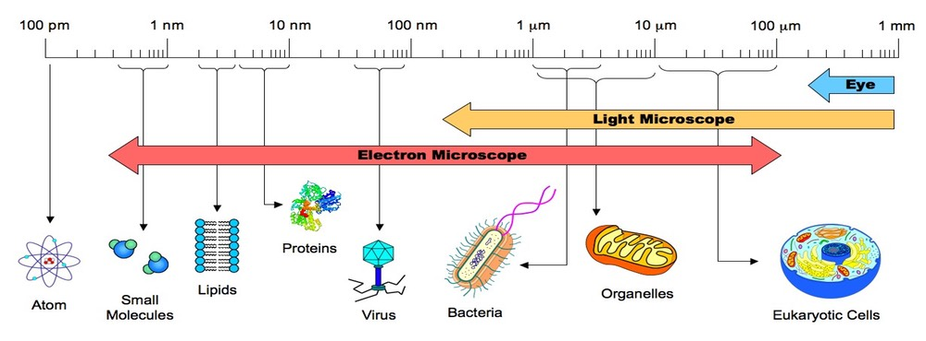
Some basics about SEM
Wavelength of visible light (380-700nm)

Slide 5
Some basics about SEM
Electrons
Subatomic particle
Mass = 9.10938291×10⁻³¹ kg
    Charge = −1.602176565(35)×10⁻¹⁹ C
    Energy at 1V: 1 eV = 1.602 x 10-19 J
    Velocity at 20kV = 83.817 km/s !! (relativistic correction 80.479 km/s)
    Wavelength at 20kV = 0.062nm

Slide 6
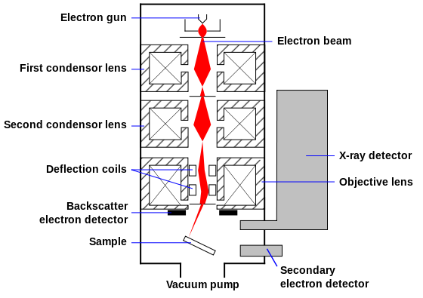
Some basics about SEM
SEM Column
Electron gun is either a FE gun or a filamant
Lenses are coils
Deflection coils for x-y direction
Objective lens for focussing
Samples are inside a vacuum

Slide 7
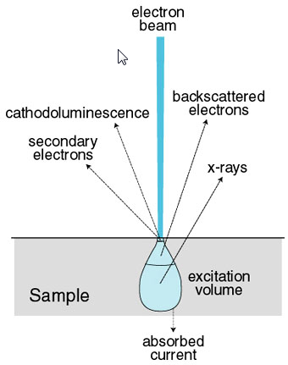
Some basics about SEM
Electron beam interaction
    Cathodoluminescence
    Secondary electrons
    Backscattered electrons
    X-rays (EDS/WDS/SXES)
    Interaction volume depends on
    Acceleration voltage
    Atomic weight (Z)

Slide 8
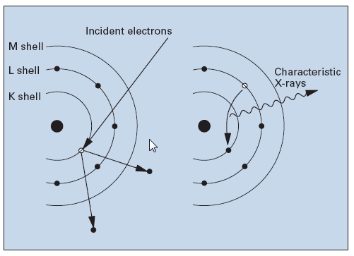
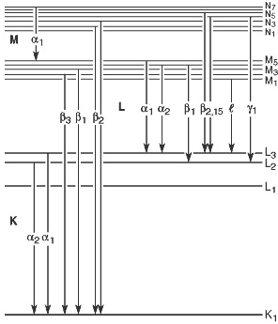
Some basics about SEM
  Electron beam interaction
  X-rays
  Incident electron beam knocks out electron and causes a transition from an electron from an outer shell to an inner shell
  This transition causes the emission of an photon
  Energy of each transition are fixed values (Characteristic x-rays)
  Spectroscopic techniques van be used to detect and quantify the chemical composition

Slide 9
Analytical techniques in SEM
    Cathodoluminescence
      Detection of visible light using a Photo Multiplier Tube
      Spectroscopy also possible
    EDS
      Energy Dispersive Spectroscopy
      Most common analytical technique
    WDS
      Wavelength Dispersive Spectroscopy
      Mostly used on EPMA’s
    EBSD
      Electron Backscattered Electron Detector
      Visualizing crystal structures in SEM
    SXES
      Soft X-ray Emission Spectroscopy
      Light element detection (Li)
      Chemical state analysis

Slide 10
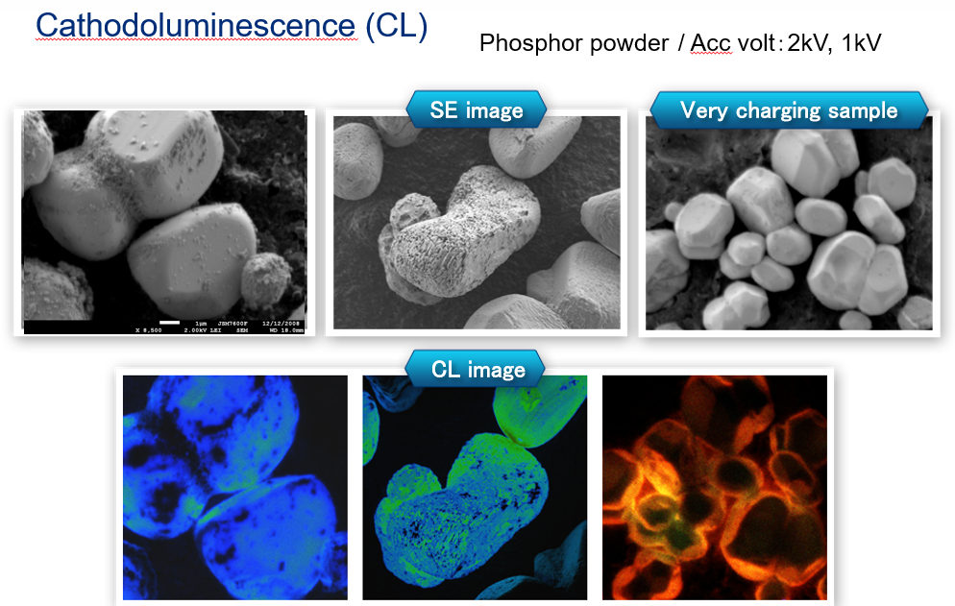
Analytical techniques in SEM

Slide 11
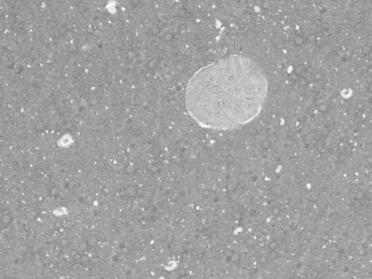
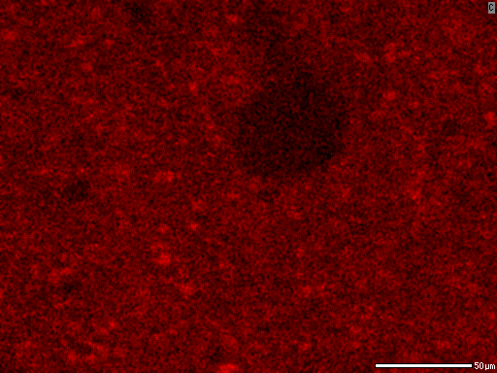
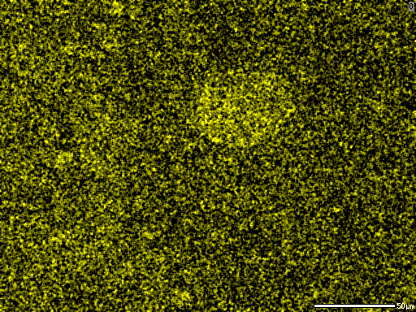
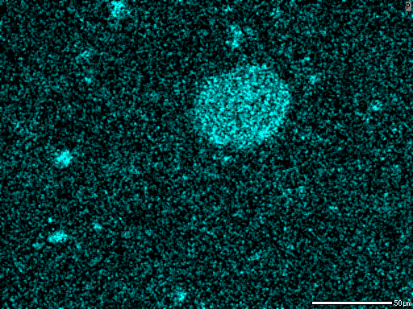
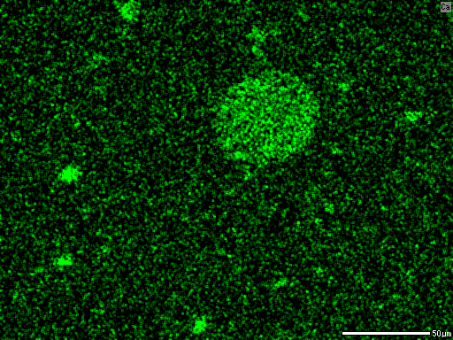
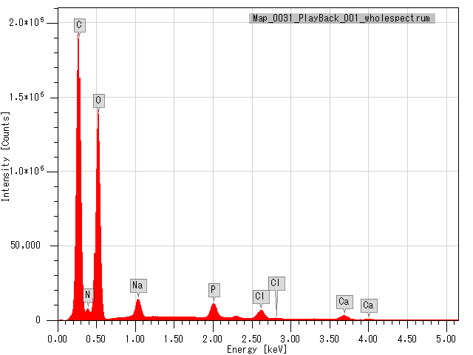
EDS: Mineral distribution in processed cheese
Specimen: Processed cheese
Backscattered electron composition image
C-K
O-K
50 µm
P-K
Ca-K
Elemental maps can reveal the distribution of minerals contained in cheese.
A cooling holder (option) can be used for observation and analysis of the food while preserving its structure.

Slide 12
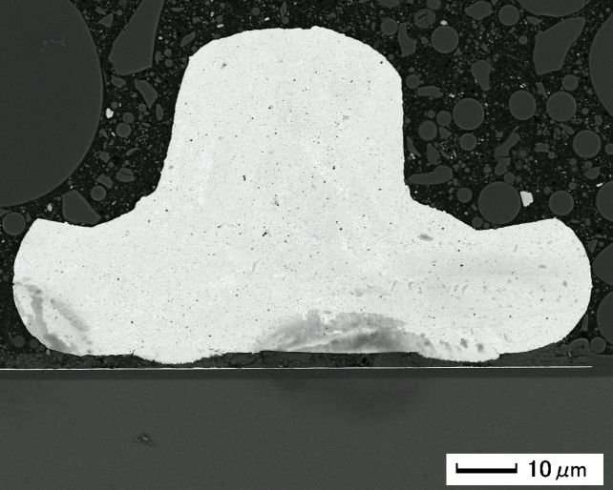
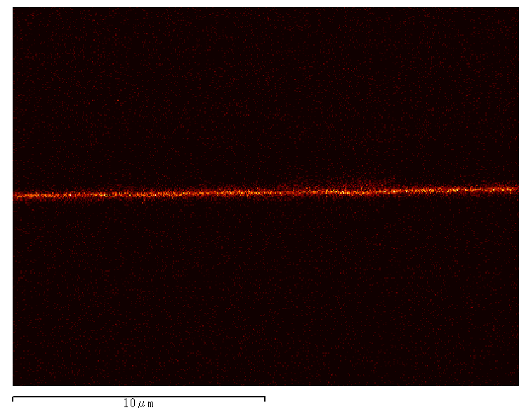
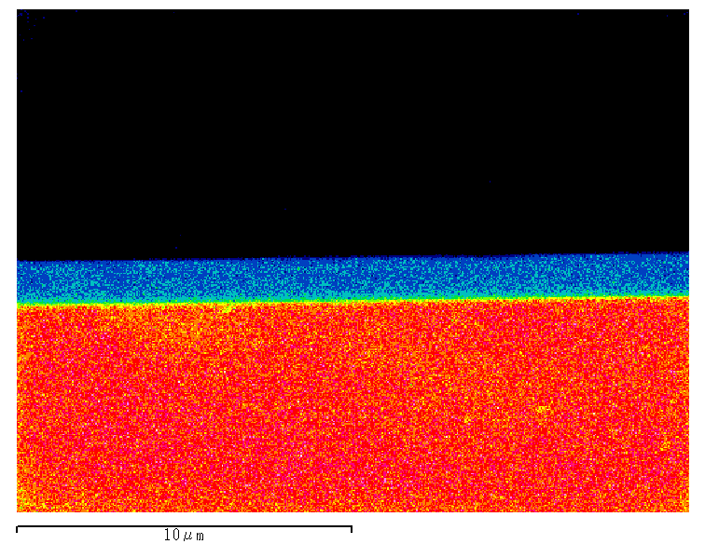
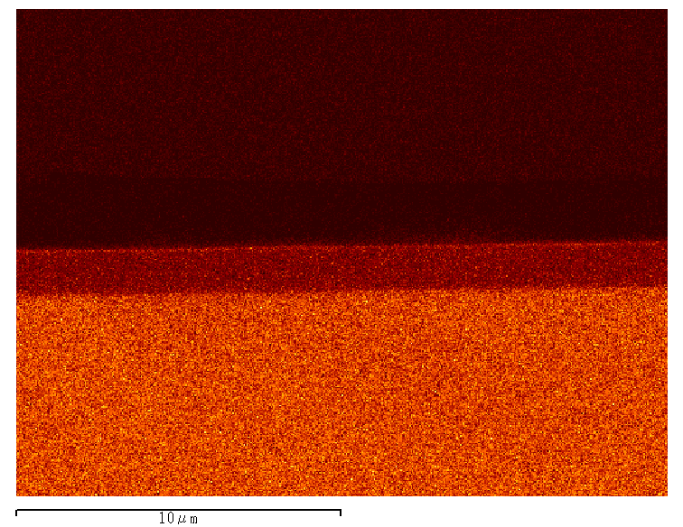
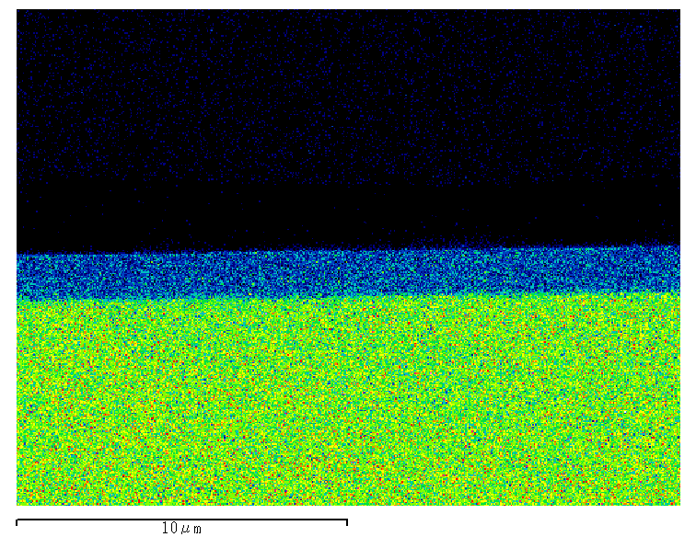
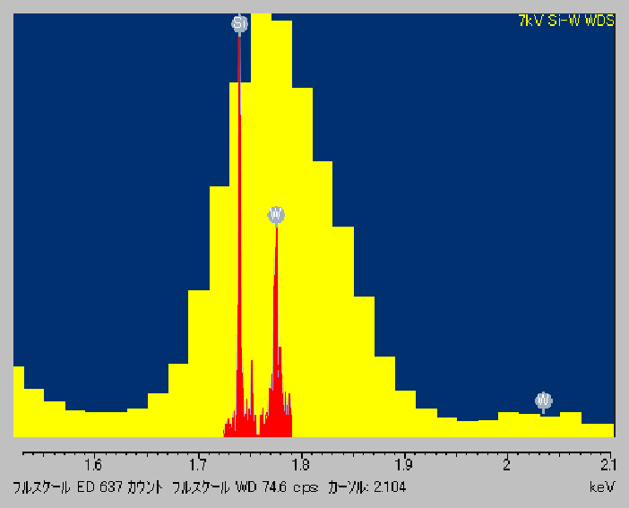
Analytical techniques in SEM: WDS
Specimen: Wire bonding
7kV
WDS W-Mα
WDS Si-Kα
Si
WDS
W
EDS
EDS W-Mα
EDS Si-Kα
2 spectra superimposed
(yellow: EDS, red: WDS)
Notes:
Tungsten M-alpha and Silicon K-alpha are very close in energy. EDS can not separate these elements. WDS can separate them clearly. In this example, tungsten thin film of sub micron thickness is clearly detected.

Slide 13
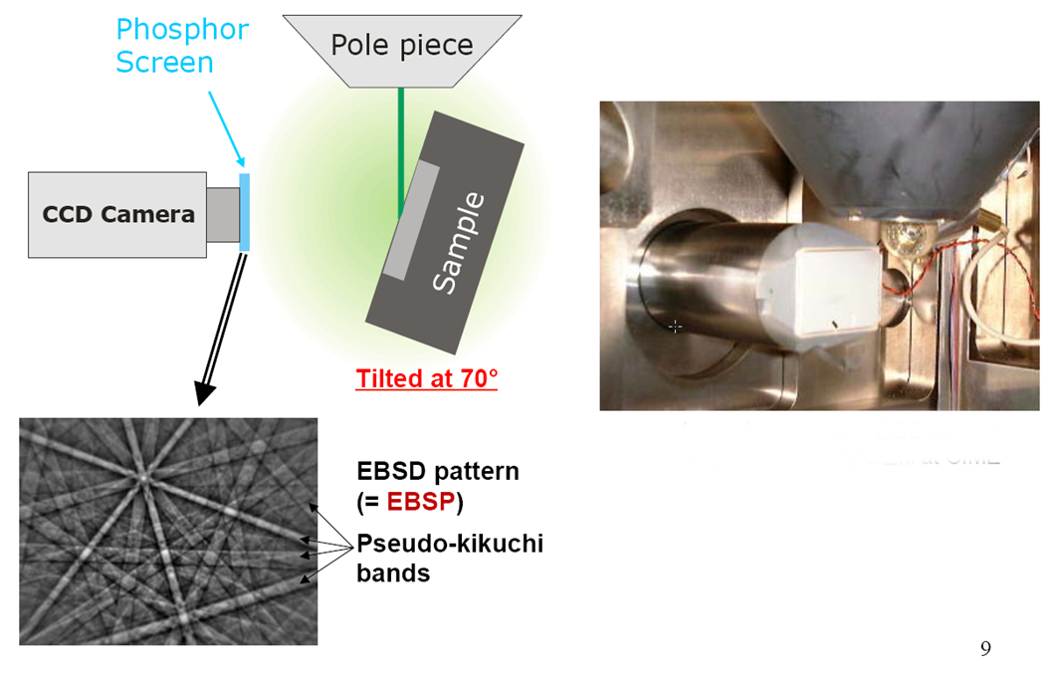
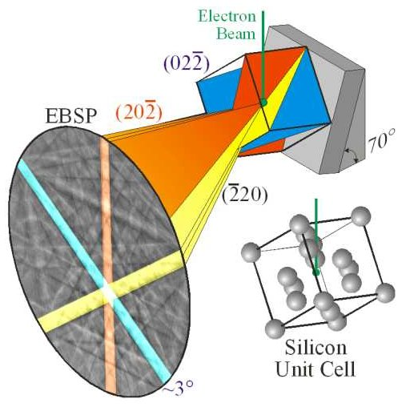
Analytical techniques in SEM
EBSD
Electron beam diffracted by crystal structure
Crystal structure type and paramets can be identified

Slide 14
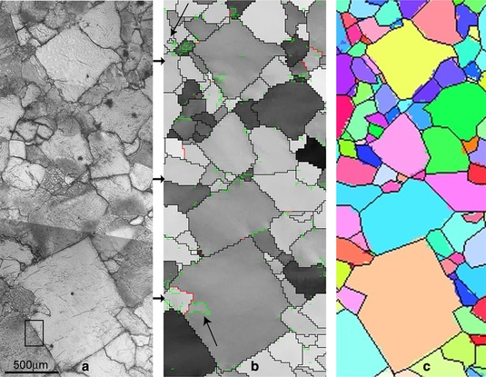
Analytical techniques in SEM
EBSD
EBSD map:

Slide 15
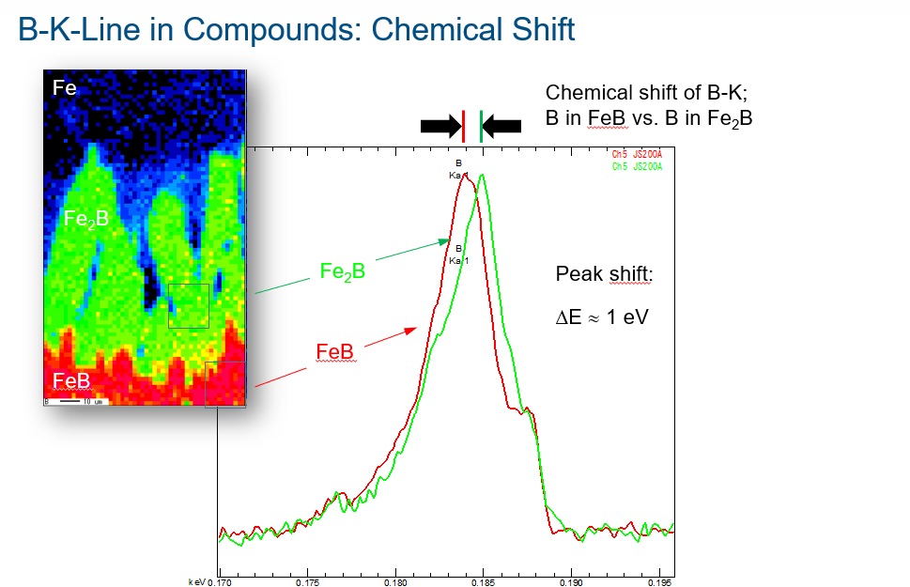
Analytical techniques in SEM
SXES

Slide 16
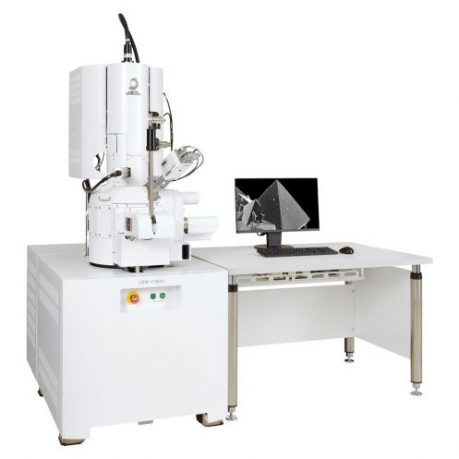
Latest developments in SEM
Market demands and development over the last decade has focused on the following aspects:
  Low voltage imaging for surface analysis
  The push for resolution, in imaging and EDX (at low voltage)
  Wide range of applications
  Reducing time to answer
  Making SEM accessible for less experienced users
  Our solution: JEOL JSM-IT800

Slide 17
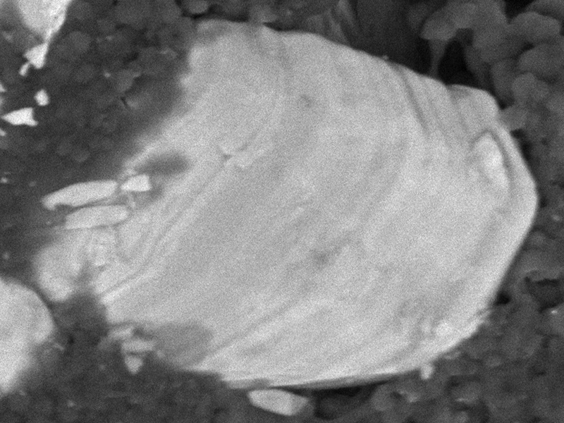
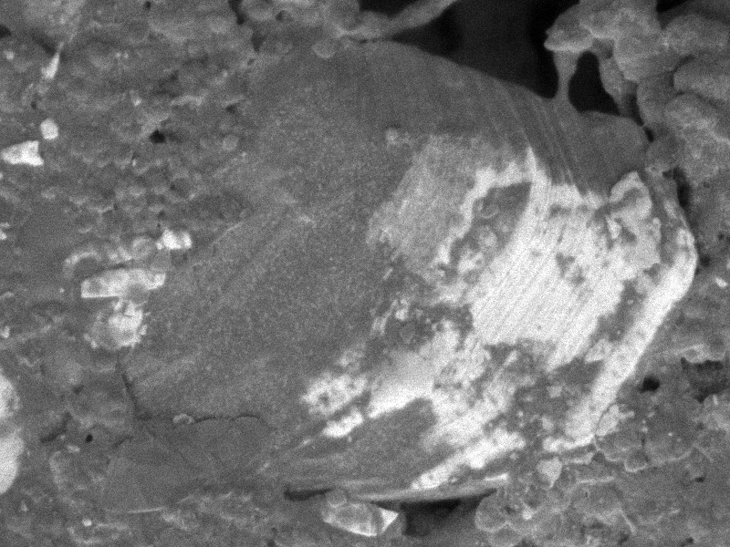
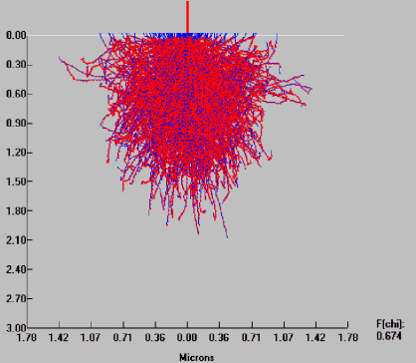
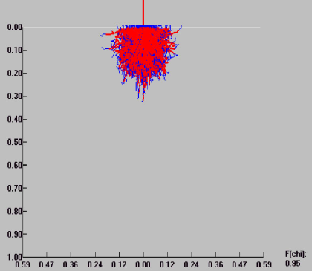
Latest developments in SEM: Low voltage imaging
More surface information! (and less charging)
500nm
Incident electron energy: 3.0kV
Incident electron energy: 0.5kV
Penetration depth
Penetration depth

Slide 18
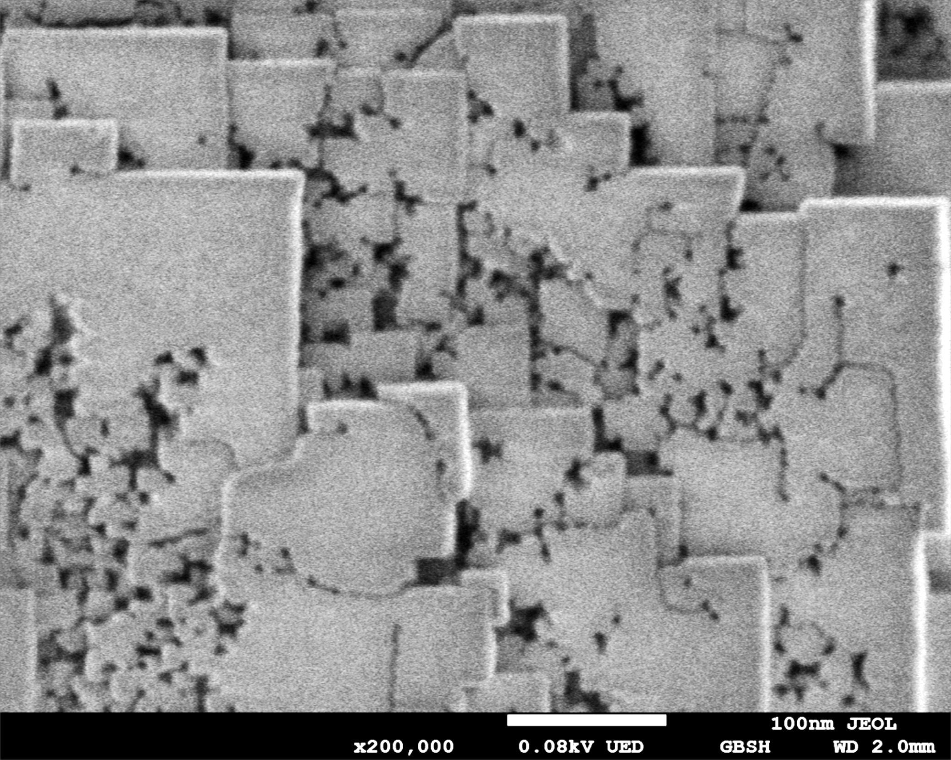
Latest developments in SEM: Low voltage imaging
1st step:
Image @ 80V
Experiment:
Zeolite at 200.000x
Can 1 kV change the structure?
Zeolite

Slide 19
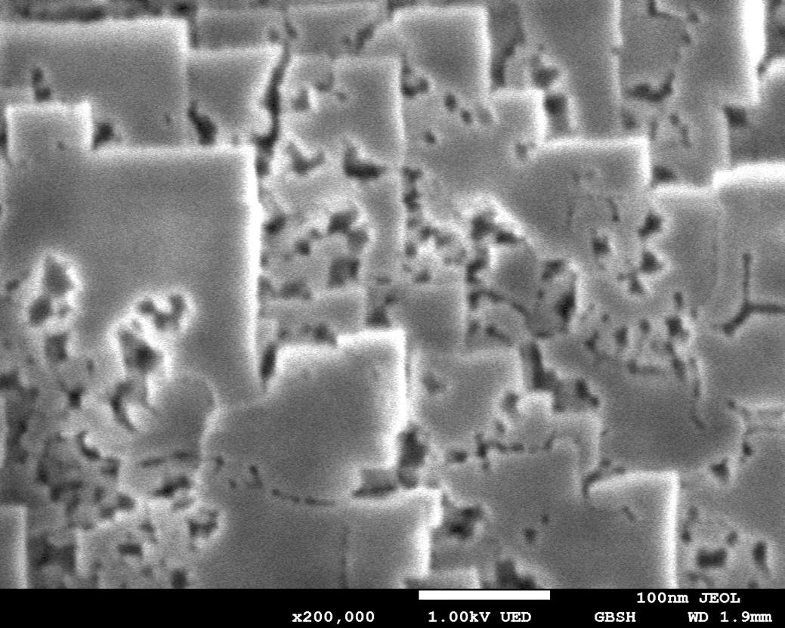
Latest developments in SEM: Low voltage imaging
1st step:
Image @ 80V
2nd step:
Image @ 1kV
Irradiation!

Slide 20
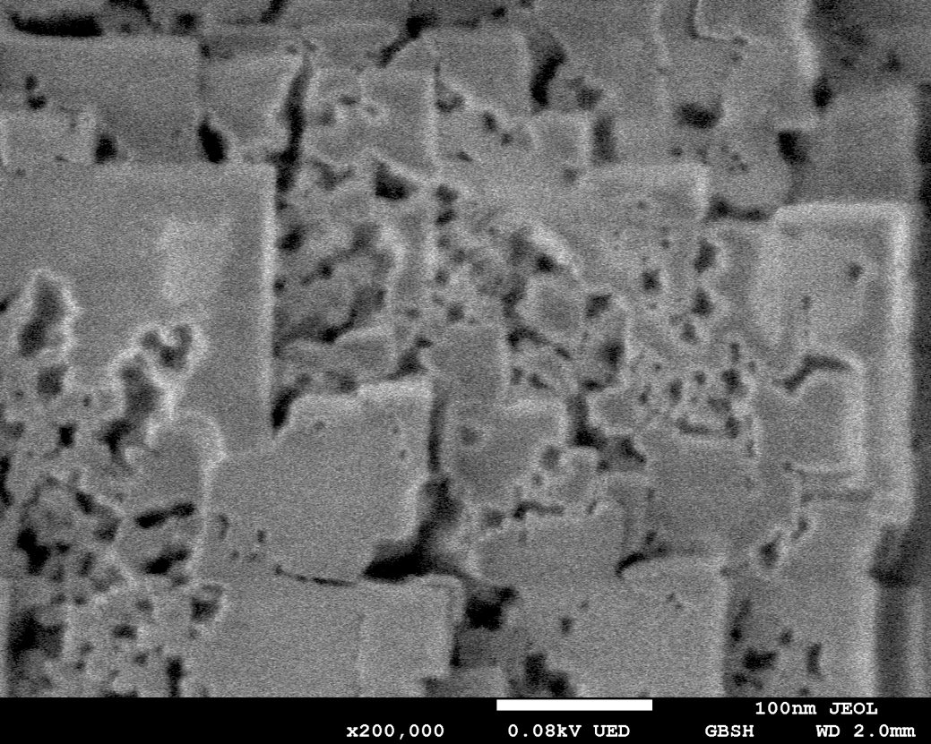
Latest developments in SEM: Low voltage imaging
1st step:
Image @ 80V
2nd step:
Image @ 1kV
Irradiation!
3rd step:
Image @ 80V
Visible
changes!
Even 1kV imaging can cause beam damage in materials!

Slide 21
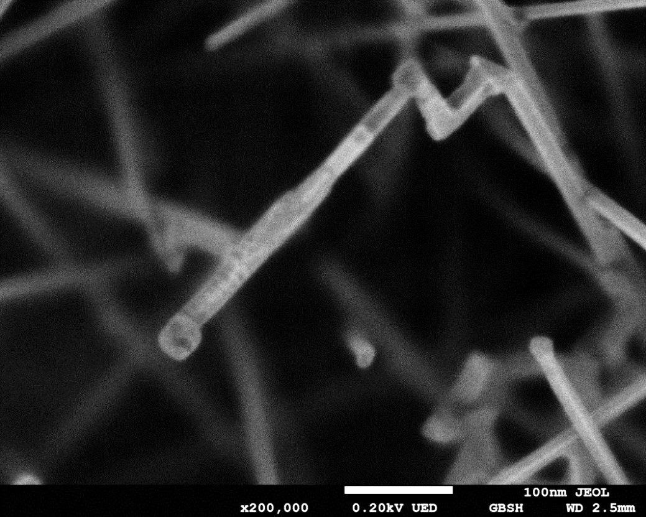
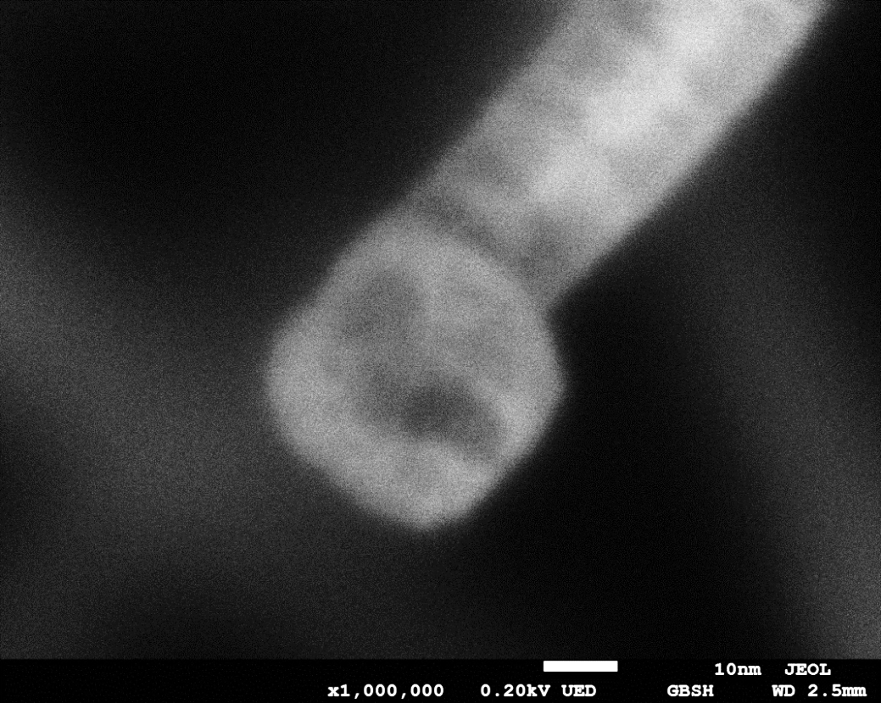
Latest developments in SEM: Low voltage imaging
Low-kV imaging (0.2kV)
SnO₂ nano-wire

Slide 22
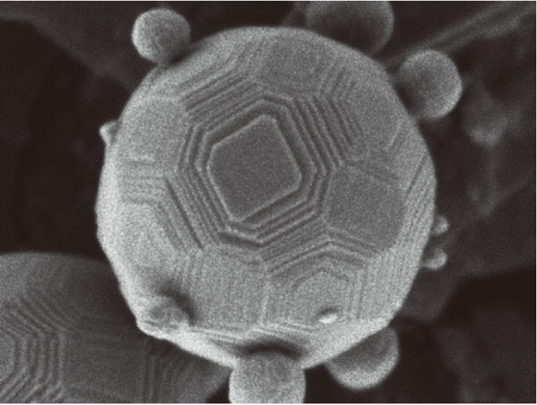
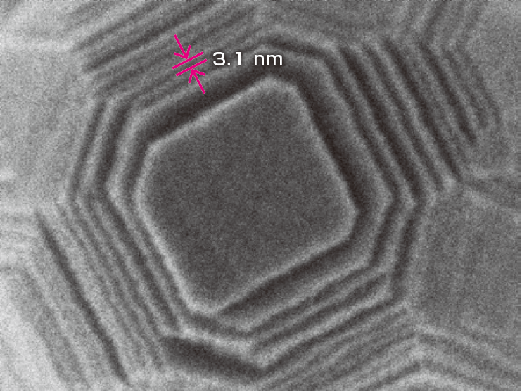
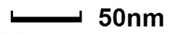
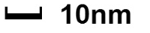
Latest developments in SEM: Low voltage imaging
Low-kV imaging (0.5kV)
Aluminum oxide nanoparticles

Slide 23
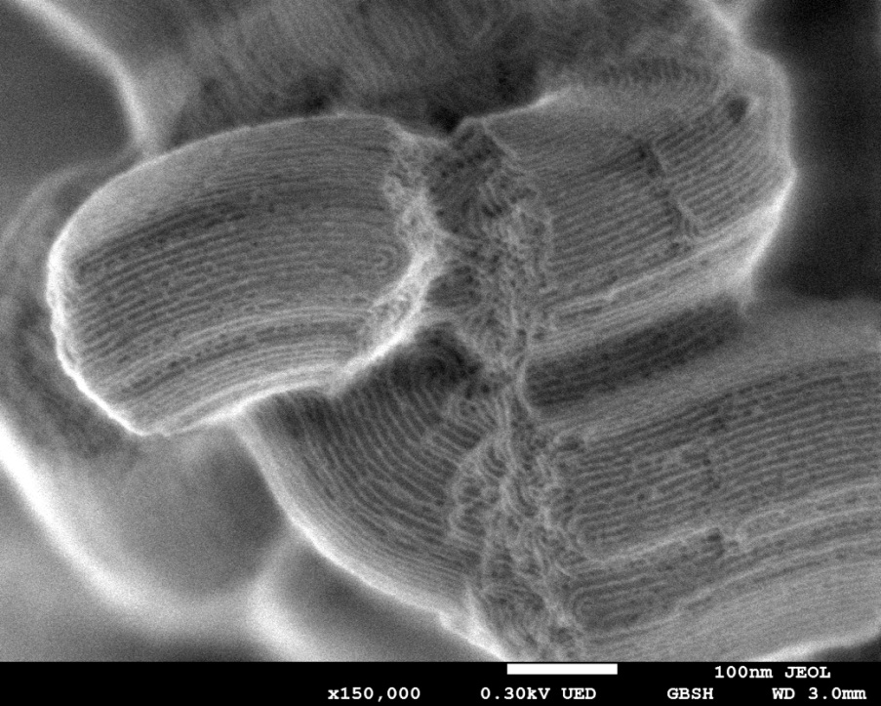
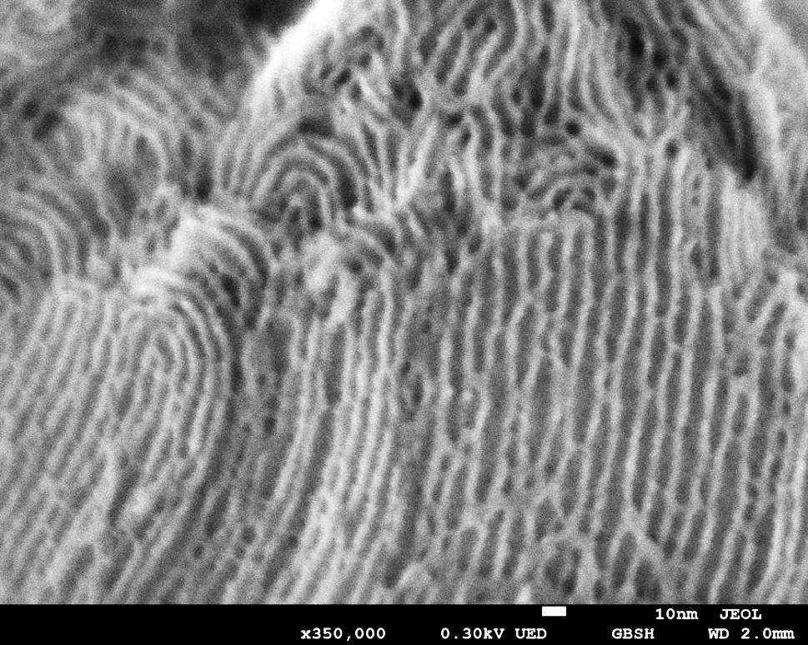
Latest developments in SEM: Low voltage imaging
Low-kV imaging (0.3kV)
Mesoporous Silica (non-conductive)

Slide 24
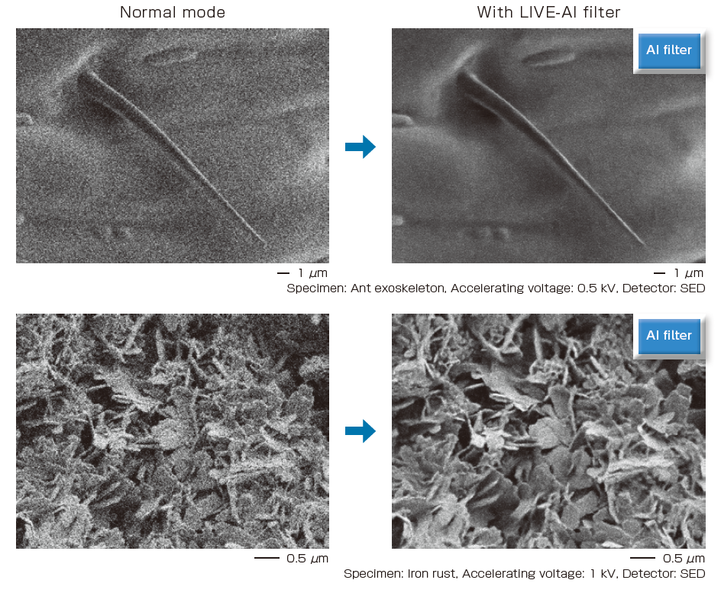
Latest developments in SEM: Low voltage imaging
Live-AI filter
Comparison between
Normal mode and
LIVE-AI filter live images

Slide 25
Latest developments in SEM: EDX at low voltage
As described before, the interaction volume depends on the acceleration voltage and on the material atomic weight.
The resolution in EDX mappings (typically around 1 micron) can be improved by lowering the voltage, but:
  It is harder to achieve a good resolution and beam current and lower voltages. Not only for SEMs with a thermionic source, but also for some FEG-SEMs
  Lowering voltage also means less peaks will
  be visible in the spectrum, simply because high
  energy excitations will not take place.
  For heavier elements we have to look at low
  energy transitions
C
Ni

Slide 26
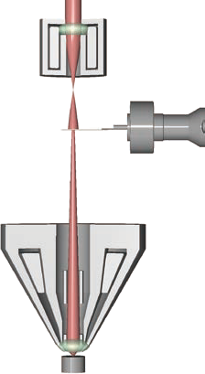
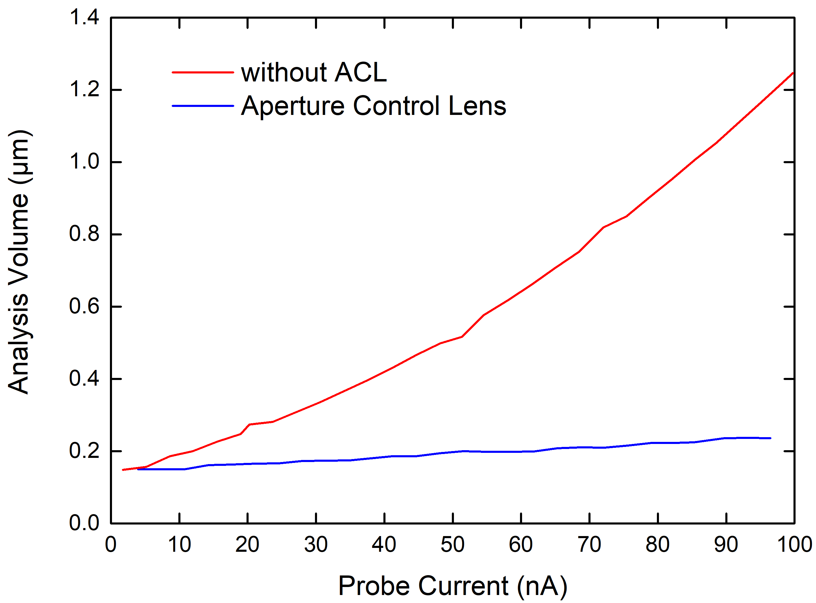
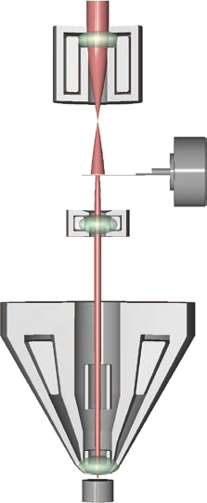
Latest developments in SEM: EDX at low voltage
High resolution @ high current?
Aperture
No ACL
Aperture
C
Aperture
Aperture
Ni
ACL
(Aperture Control Lens)
Minimized spherical aberration

Slide 27
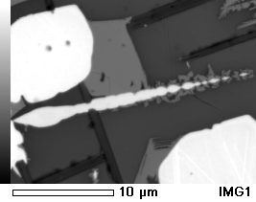
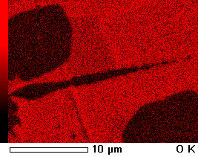
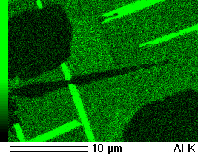
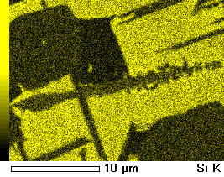
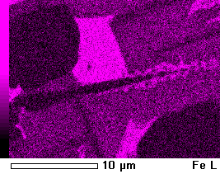
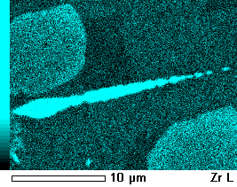
Latest developments in SEM: EDX at low voltage
Ceramics
5 kV, 110nA, 60sec mapping time

Slide 28
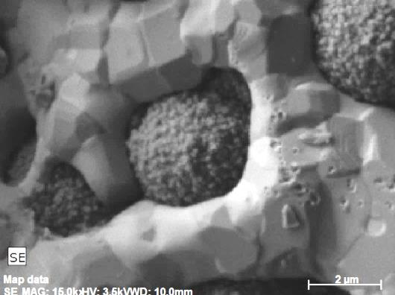
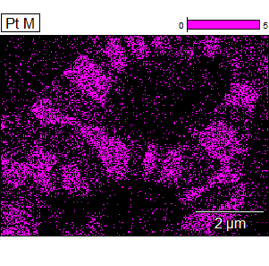


Latest developments in SEM: EDX at low voltage
High speed EDS – 3.5kV
Sample : AlN/Pt/Ni
1nA
2nA
50nA
12 Frames : 60 sec
By simply increasing probe current, the user can enhance significantly the S/N ratio in the EDS map, without sacrificing time or resolution.

Slide 29



High resolution EDS – using GB (Beam deceleration)
Latest developments in SEM: EDX at low voltage
BSE Image
No Gentle Beam
Gentle Beam
Gold particles about 10nm in size visible in EDS
Notes:
EDS condition: Specimen incident voltage 4kV, Probe current 440 pA, Map acquisition time 50 min.
EDS detector: Oxford X-max 150 mm²
Sample: Au@TiO2

Slide 30




Latest developments in SEM: EDX at low voltage
1.2 kV
□ 002
ZnS powder at 1.2 kV
Probe current : 5 nA
Magnification : x 5,000
□ 001
001
002
Surface Oxygen clusters are detected for the first time at very low voltages.
Due to High probe current and a fine probe diameter even at 1.2kV.
Notes:
30
This is an EDS analysis.
I analyzed the same area as the previous page by using 1.2kV.
I selected two areas of different gray levels on the composition image.
The darker area 001 has more oxygen than the lighter area 002.
The oxygen map shows that this darker area is rich in oxygen.
You can get a high probe current and a fine probe diameter even at 1.2kV by using the Gentle Beam with TTLSystem.
The EDS analysis by using the Gentle Beam mode can be a strong point of the TTL system.
次に、低加速電圧でのEDS分析結果を示します。
同一視野を加速電圧1.2kVでEDS分析を実施しました。
反射電子像でコントラストの異なる2点の定性スペクトルを示します。
001では酸素の強度が強く検出されています。酸素のマッピングを見てください。
反射電子像で灰色に見える部分に酸素が多いことがわかります。
TTLSでは加速電圧1.2kVであってもGBモードを使用することにより、大照射電流が得られ
かつ、細い電子プローブが実現できます。
GBモードでのEDS分析は良い特徴です。

Slide 31


Latest developments in SEM: Easy of use
Stage Navigation System
Color camera automatically aquires image for stage navigation (during pumping of airlock)
Direct navigation in SEM software („ZeroMag“): Scroll to zoom in!

Slide 32


Latest developments in SEM: Easy of use
Neo Engine: Fast image optimization even at high magnifications!
Auto
Focus
Astigmatism
Brightness
Specimen: Sn nanoparticles on carbon
15 kV, WD: 2 mm, Magnification: x200,000

Slide 33

Latest developments in SEM: Easy of use
Neo Engine: Fast image optimization even at high magnifications!

Slide 34

Latest developments in SEM: Easy of use

Slide 35

Comparison of x-ray detection techniques
Soft X-ray detection in SEM
 | EDS | WDS
Resolution | 123 eV Mn Kα | 8 eV Fe Kα LiF220
Chemical State Analysis | impossible | yes, but limited
Method | Parallel - fast | Serial - slower
Sensitivity @ B | 1000 ppm | 100 ppm
 | EDS | WDS | SXES
Resolution | 125 eV Mn Kα | 8 eV Fe Kα LiF220 | 0,3 eV Al L Fermi edge
Chemical State Analysis | impossible | yes, but limited | excellent
Method | Parallel - fast | Serial - slow | Parallel - fast
Sensitivity @ B | 1000 ppm | 100 ppm | 20 ppm

Slide 36


Soft X-ray detection in SEM
Direct-X-ray-area-CCD
Grating
Spectrum
Mirror
Sample

Slide 37

Soft X-ray detection in SEM
High current needed for sufficient signal.
Only available on IT800 series
And EPMA
Notes:
Source: Wikipedia.
Fluorescence and Auger electron yields as a function of atomic number for K shell vacancies. Auger transitions (red curve) are more probable for lighter elements, while X-ray yield (dotted blue curve) becomes dominant at higher atomic numbers. Similar plots can be obtained for L and M shell transitions. Coster – Kronig (i.e. intra-shell) transitions are ignored in this analysis.

Slide 38
Soft X-ray detection in SEM
EDS-like parallel acquisition of an X-ray-spectrum of a 100% charged Li-graphite anode
Li-K
C-K(2)
Li-satellite
C-K(4)
C-K(5)
Presence of the Li-satellite peak indicates a chemical reaction between graphite and Li
P-L
Li-K
C-K(3)
O-K(4)
O-K(6)
O-K(7)
O-K(5)
C-K(4)

Slide 39

Soft X-ray detection in SEM
Li-Battery
0% charged
30% charged
100% charged
Li-K (VB)
Li-K
C-K

Slide 40

B-K-Line in Compounds: Chemical Shift
Soft X-ray detection in SEM

Slide 41
Soft X-ray detection in SEM
SXES

Slide 42

C-K-Line in Compounds: Chemical Shift
Soft X-ray detection in SEM

Slide 43

C-K-Line in Polymers: Chemical Shift
Soft X-ray detection in SEM

Slide 44
Thank you for your attention!

