Slide 2
Ghent & its university

Slide 3
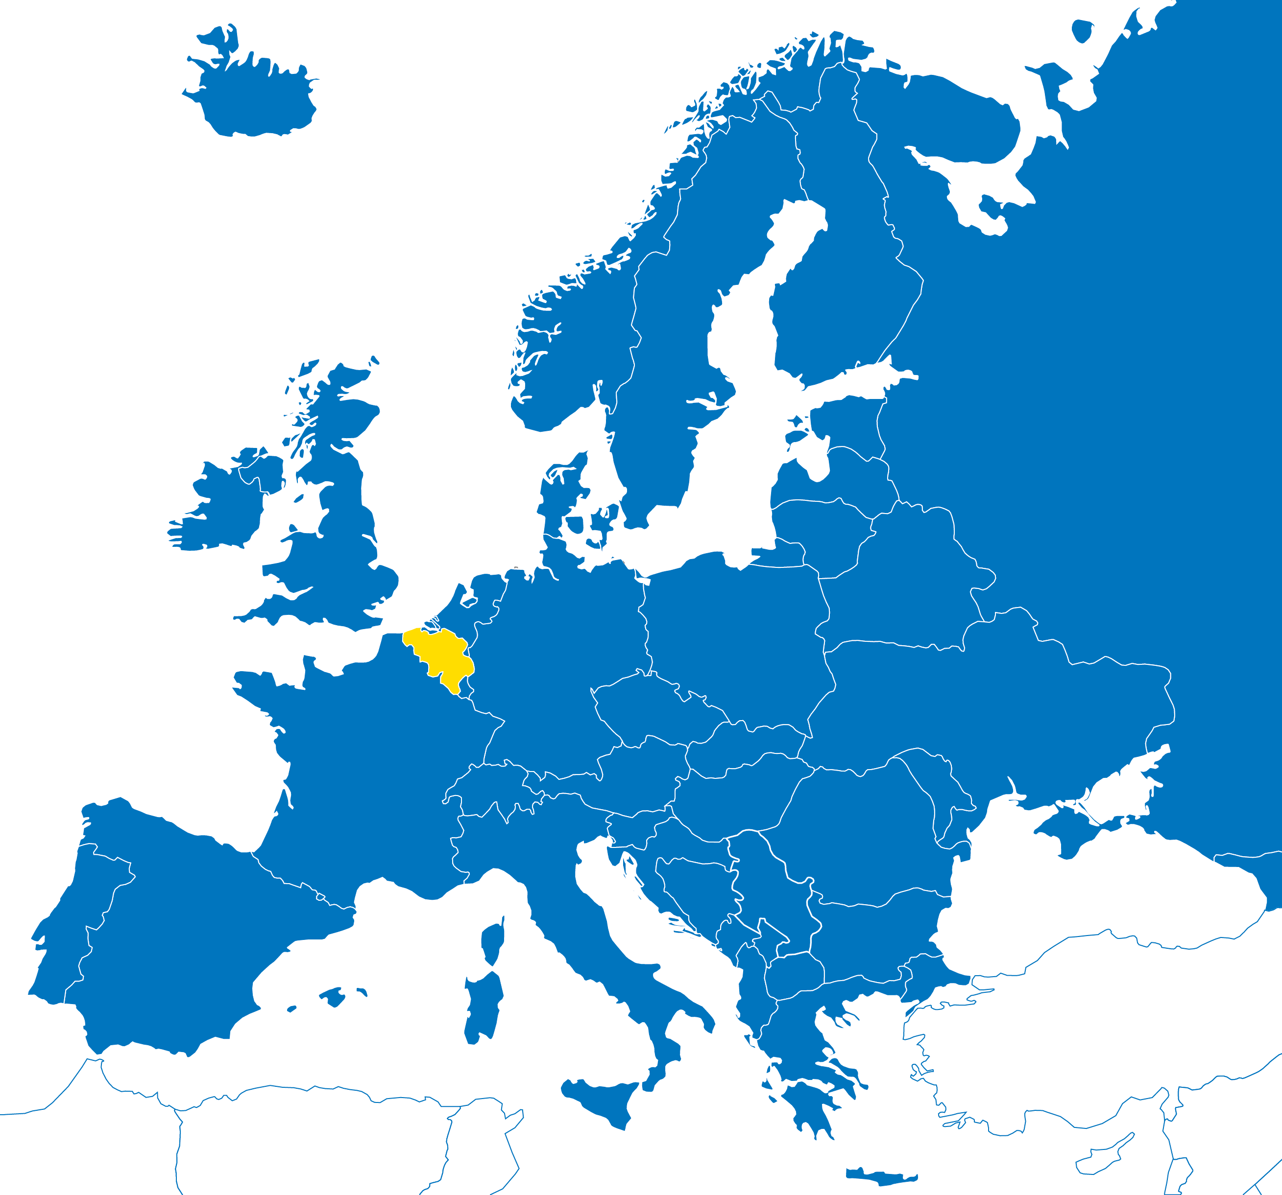
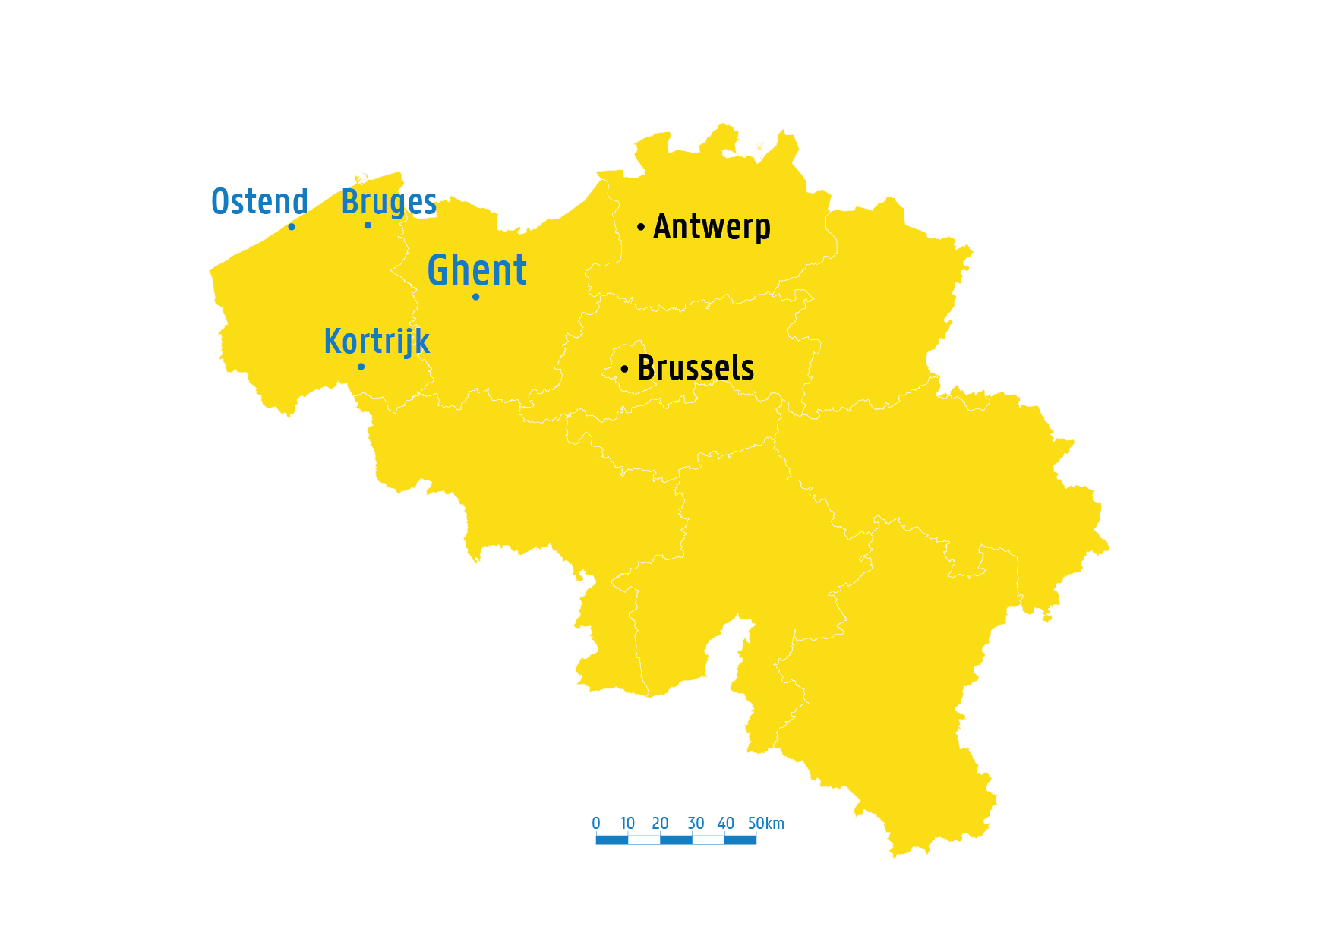
in belgium
In the heart of Europe
Amsterdam
200 km
London
350 km
Berlin
800 km
Paris
300 km
Notes:
Ghent is located in Flanders, Belgium. The city is close to a few major European cities like Brussels, Paris and Amsterdam.

Slide 4
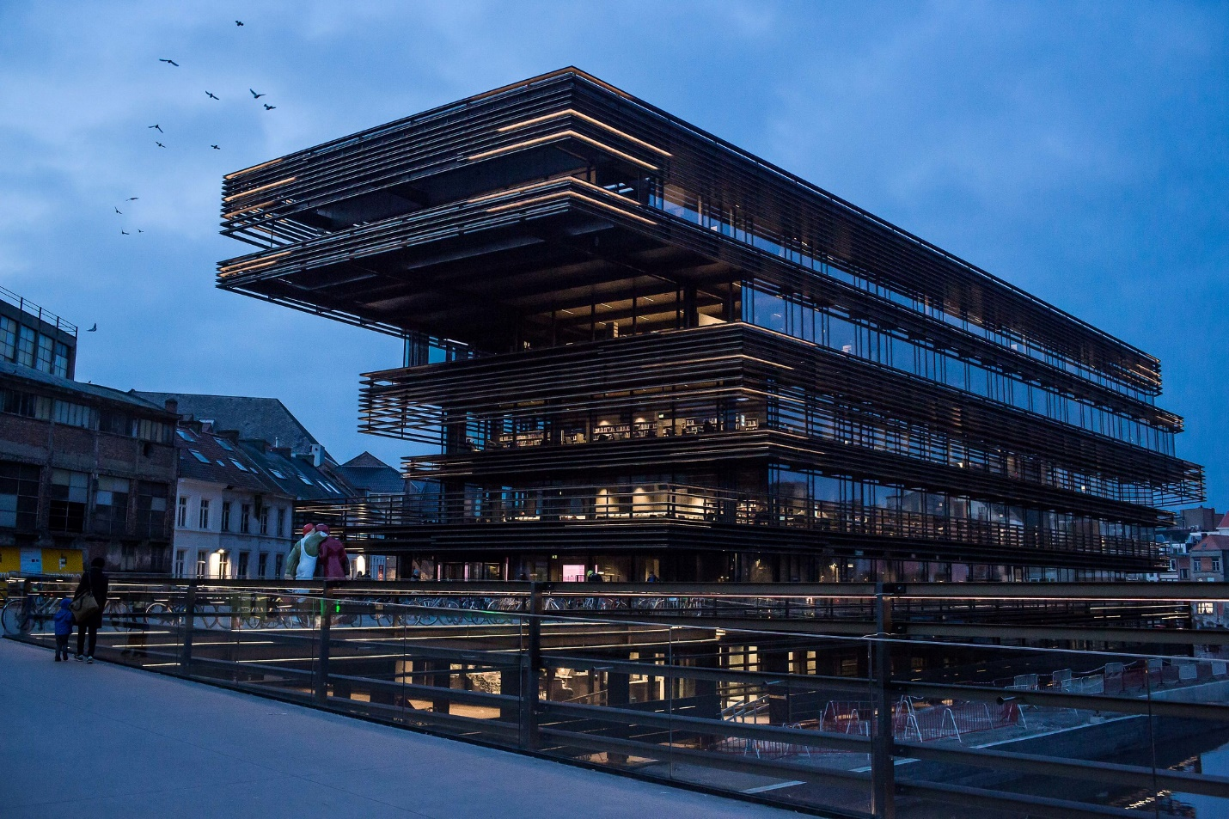
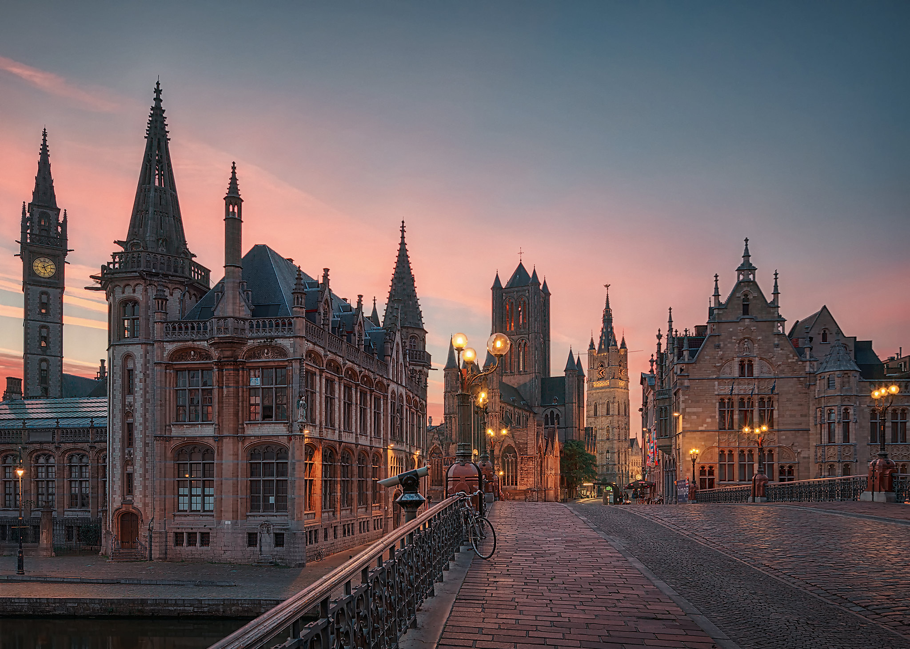
© Stad Gent - Dienst Toerisme, Bas Bogaerts
Ghent: Medieval city
263.600 inhabitants
76.500 students
167 nationalities
1.400 restaurants & cafés
3.600 startups per year
Bron: gent.buurtmonitor.be/dashboard
© Flickr, Robert Schüller
© Stad Gent - Dienst Toerisme, Bas Bogaerts

Slide 5
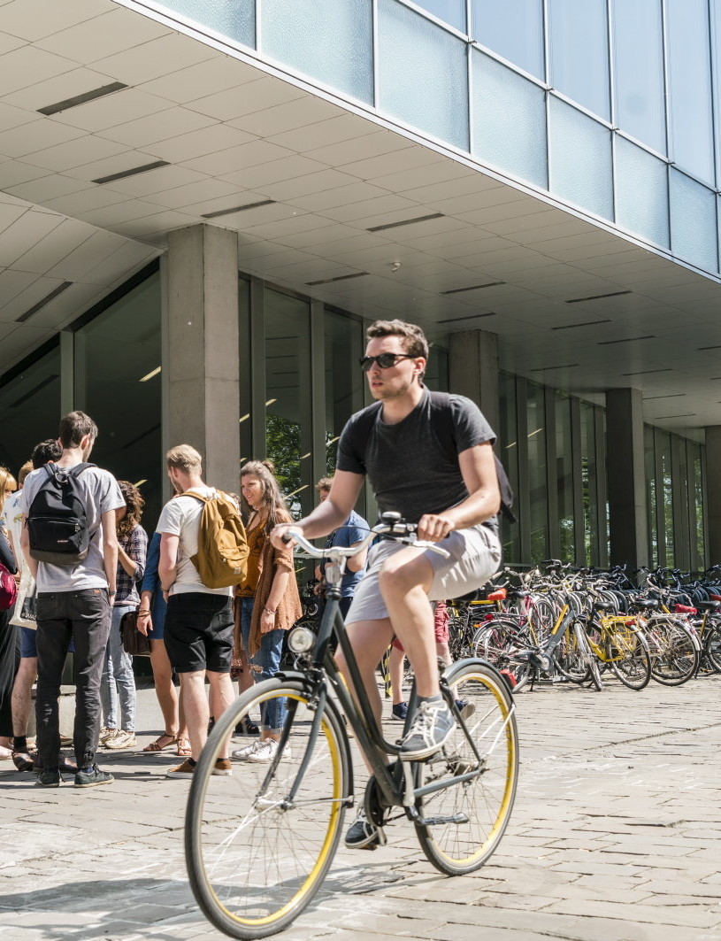
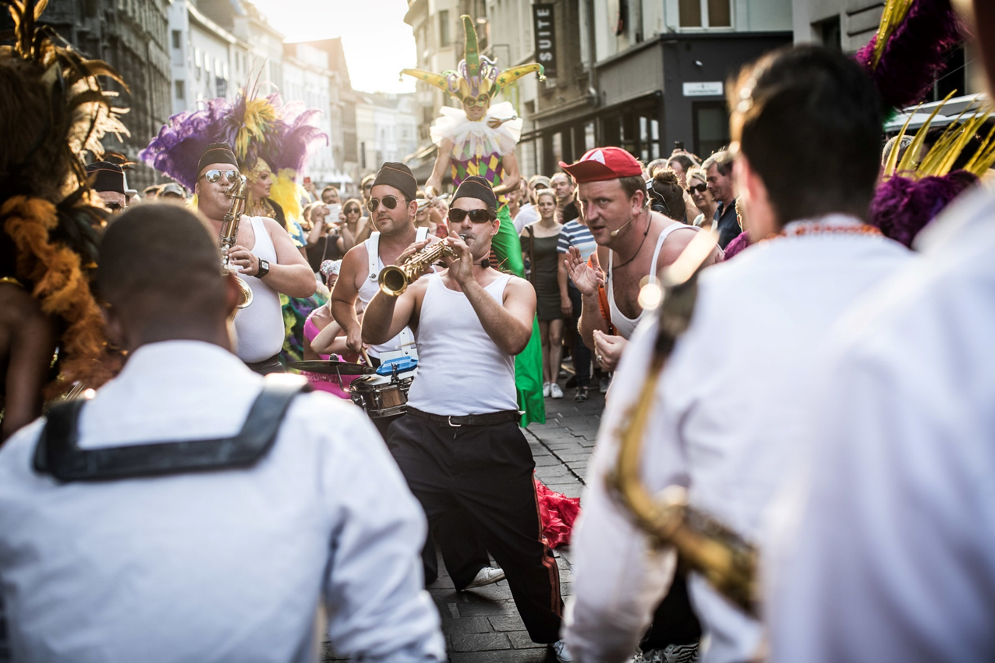
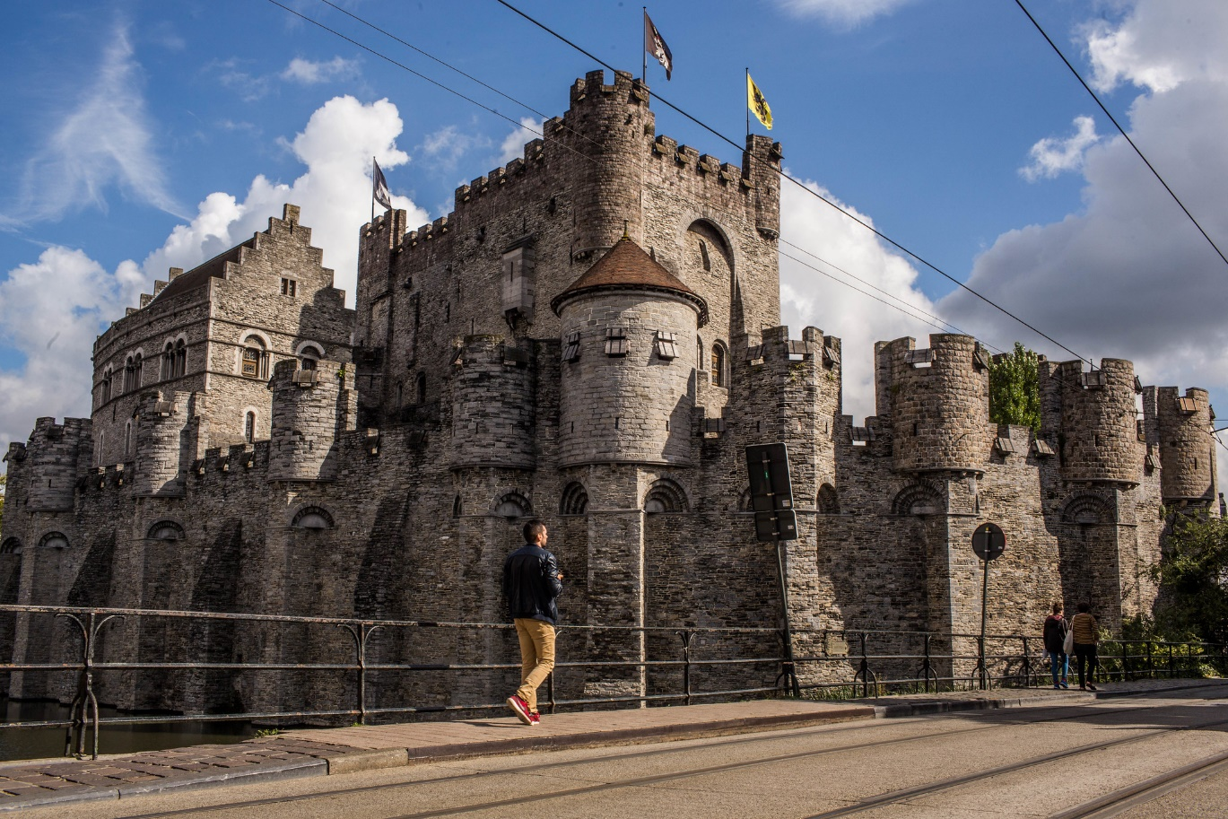
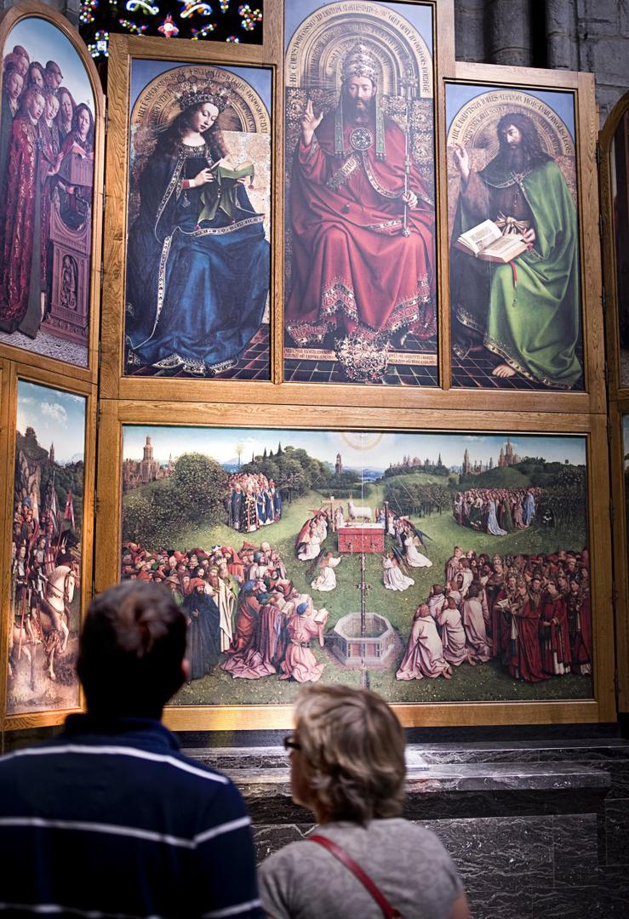
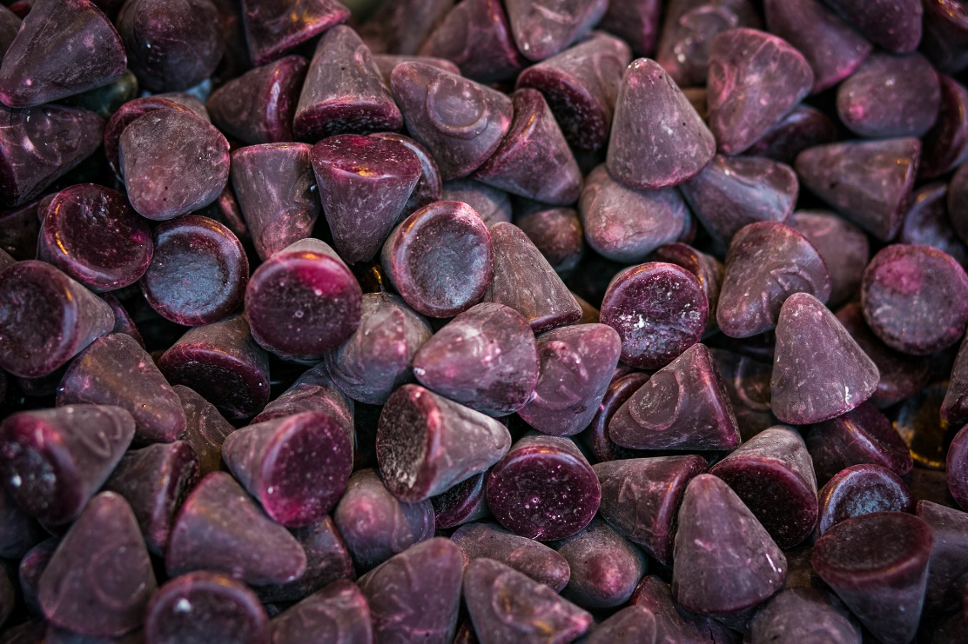
Bike-friendly city
Castle of the Counts
Festival of Ghent & other festivals
© UGent – Christophe Vander Eecken
© Stad Gent - Dienst Toerisme, Bas Bogaerts
© Stad Gent - Dienst Toerisme, Bas Bogaerts
Cuberdons ‘Neuzekes’
GHENT IS …
Veggie capital
of Europa
Mystic Lamb
Van Eyck
© Stad Gent - Dienst Toerisme, Bas Bogaerts
© Stad Gent - Dienst Toerisme, Bas Bogaerts
© www.lukasweb.be - Art in Flanders vzw, Hugo Maerten
Notes:
Gent is a true festival city: Ghent Festival, Light Festival, Ghent Jazz Festival, ...

Slide 6
Notes:
Ghent University is a top 100 university, founded in 1817, and one of the major universities in Belgium with more than 48,000 students and 15,000 employees. Our 11 faculties offer more than 200 courses and conduct in-depth research within a wide range of scientific domains. Our credo is ‘Dare to Think’, challenging everyone to question conventional views and to dare to take a nuanced stand. We are a pluralistic university open to all, regardless of their ideological, political, cultural or social background. Ghent University Global Campus is also the first European university in Songdo, South Korea.
www.ugent.be
#ugent

Slide 7
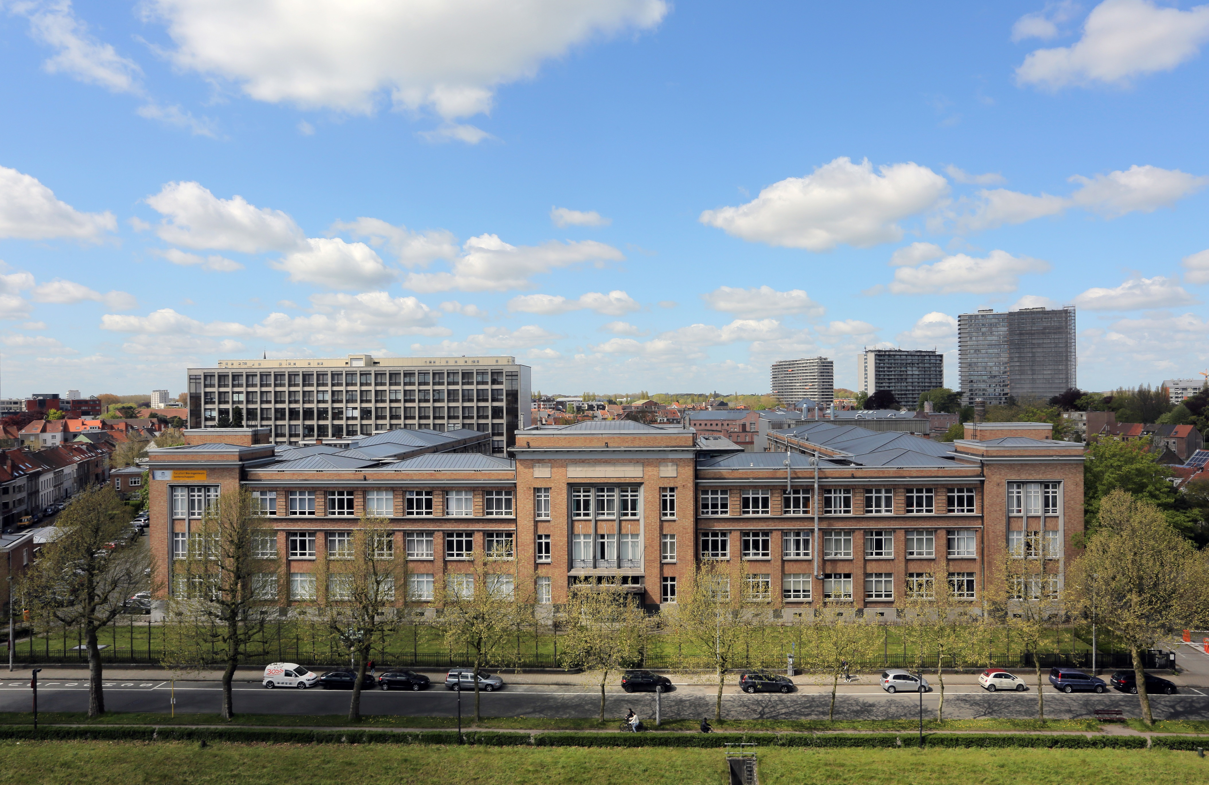

Slide 8
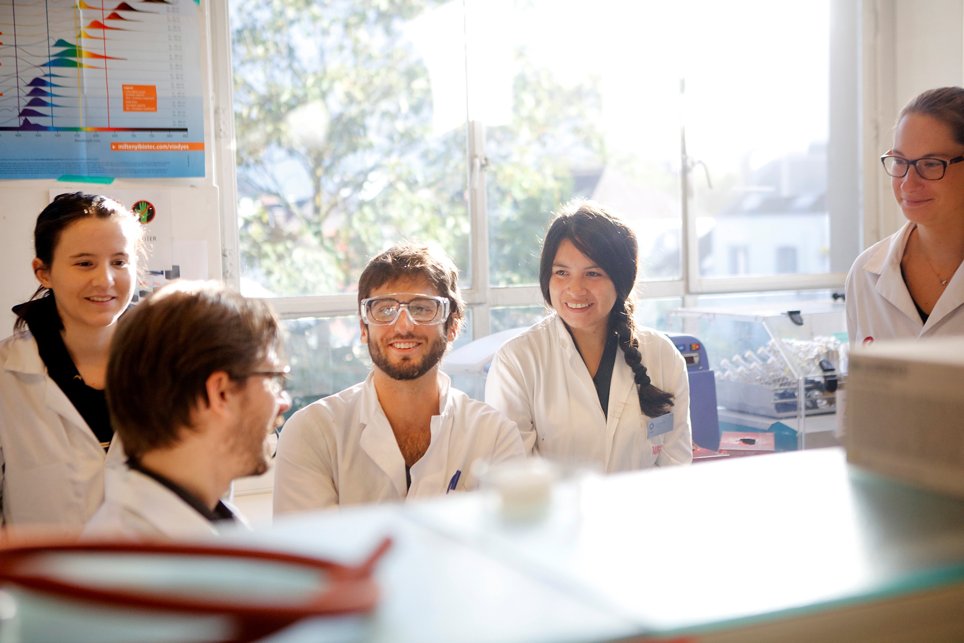
FACULTY OF BIOSCIENCE ENGINEERING
Ambition
to empower learners as globally engaged citizens with state-of-the-art knowledge, skills, and innovation potential to address major societal transitions and to promote equitable quality of life and sustainability.
QS World University Ranking
Agriculture & forestry
TOP
50
Biological Sciences, Environmental Sciences
& Chemical Engineering
TOP
100

Slide 9
education

Slide 10
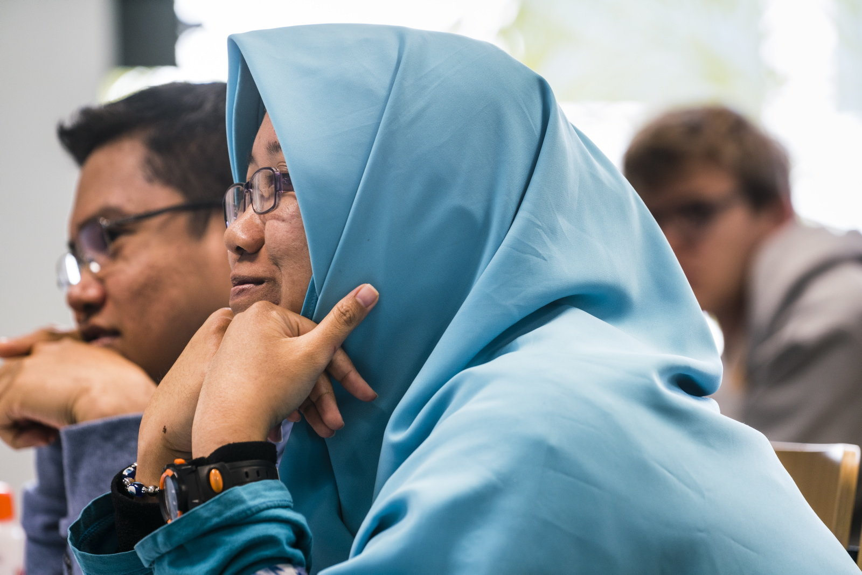
All programmes
Bachelors
Dutch taught: 8
English taught (in South Korea): 3
Masters
Dutch taught: 10
English taught: 12
2 Belgian Master of Science Programmes
5 International Course Programmes
5 Erasmus Mundus Master Programmes
Summer courses - tailor made trainings - consultancy

Slide 11
Bachelor programmes
3 years
BIOSCIENCE ENGINEERING
Campus Coupure, Ghent
Agricultural Sciences
Cell and Gene Biotechnology
Chemistry and Food Technology
Environmental Technology
Forest and Nature Management
Land, Water and Climate Management
BIOSCIENCE ENGINEERING TECHNOLOGY
Campus Schoonmeersen, Ghent
BIOINDUSTRIAL SCIENCES
Campus Kortrijk

Slide 12
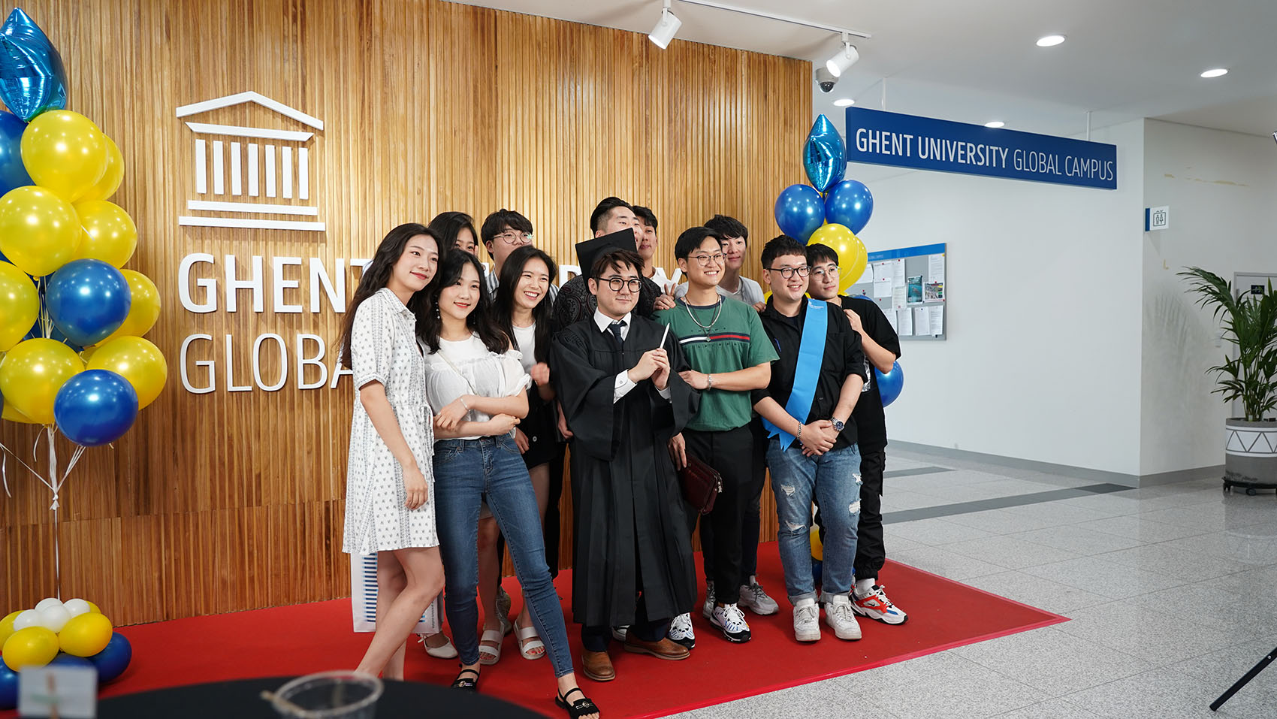
Bachelor programmes
4 years
BACHELOR OF SCIENCE
Global Campus, Incheon, Korea
Food Technology
Environmental Technology
Molecular Biotechnology
Notes:
English-taught courses
The same degree as the main campus - Graduates of Ghent University Global Campus will receive the same “Bachelor of Science” degree as the main campus
Academic staff - The academic staff of Ghent University Global Campus consists out of professors who are permanently located at the Global Campus to teach and conduct research. Next to these permanent professors a number of specialized courses will be taught by highly-acclaimed professors assigned from the home campus (the flying faculty). Postdoctoral assistants and teaching assistants are present to help students with acquiring the course.
Interconnected operation three departments - Fundamental courses applicable to all students from the three departments will be taught as common courses. Particularly, the curricular for 1st and 2nd year students will consist entirely of common courses to help them prepare for advanced studies in their major.
STEM Education - All three educational programs are focused on the fields of study in the categories of science, technology, engineering, and mathematics. From day one, students focus on these fields of study which will give them a competitive advantage in their future careers in industry or as master student and researcher.
Theoretical background with hands-on practical experience - Unlike many institutions focusing only on lectures, Ghent University Global Campus offers both theoretical grounding in the material and practical techniques applicable to the real world. Theoretical lectures are taught to all students at the same time and practical exercises are organized in relatively small groups.
One semester at the main campus - Students in their third year will mandatory spend one semester at the main campus.
Intensive internship opportunities - Students will have internship opportunities at companies located in Songdo Bio-Cluster and other multinational companies and research centers in Korea and Europe.

Slide 13
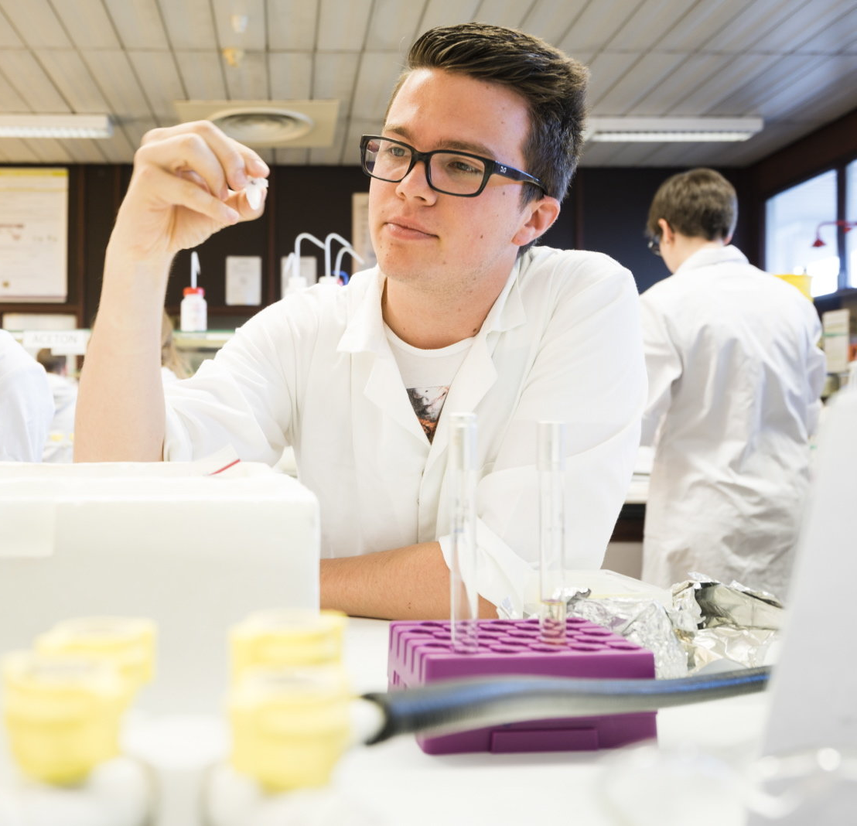
Master programmes
2 years
BIOSCIENCE ENGINEERING
Campus Coupure, Ghent
Master of Science in Bioscience Engineering:
Agricultural Sciences
Cell and Gene Biotechnology
Chemistry and Bioprocess Technology
Environmental Technology
Forest and Nature Management
Food Science and Nutrition
Land, Water and Climate Management
Master of Science in Bioinformatics:
Bioscience Engineering
Notes:
De masteropleidingen Bio-ingenieur duren 2 jaar

Slide 14
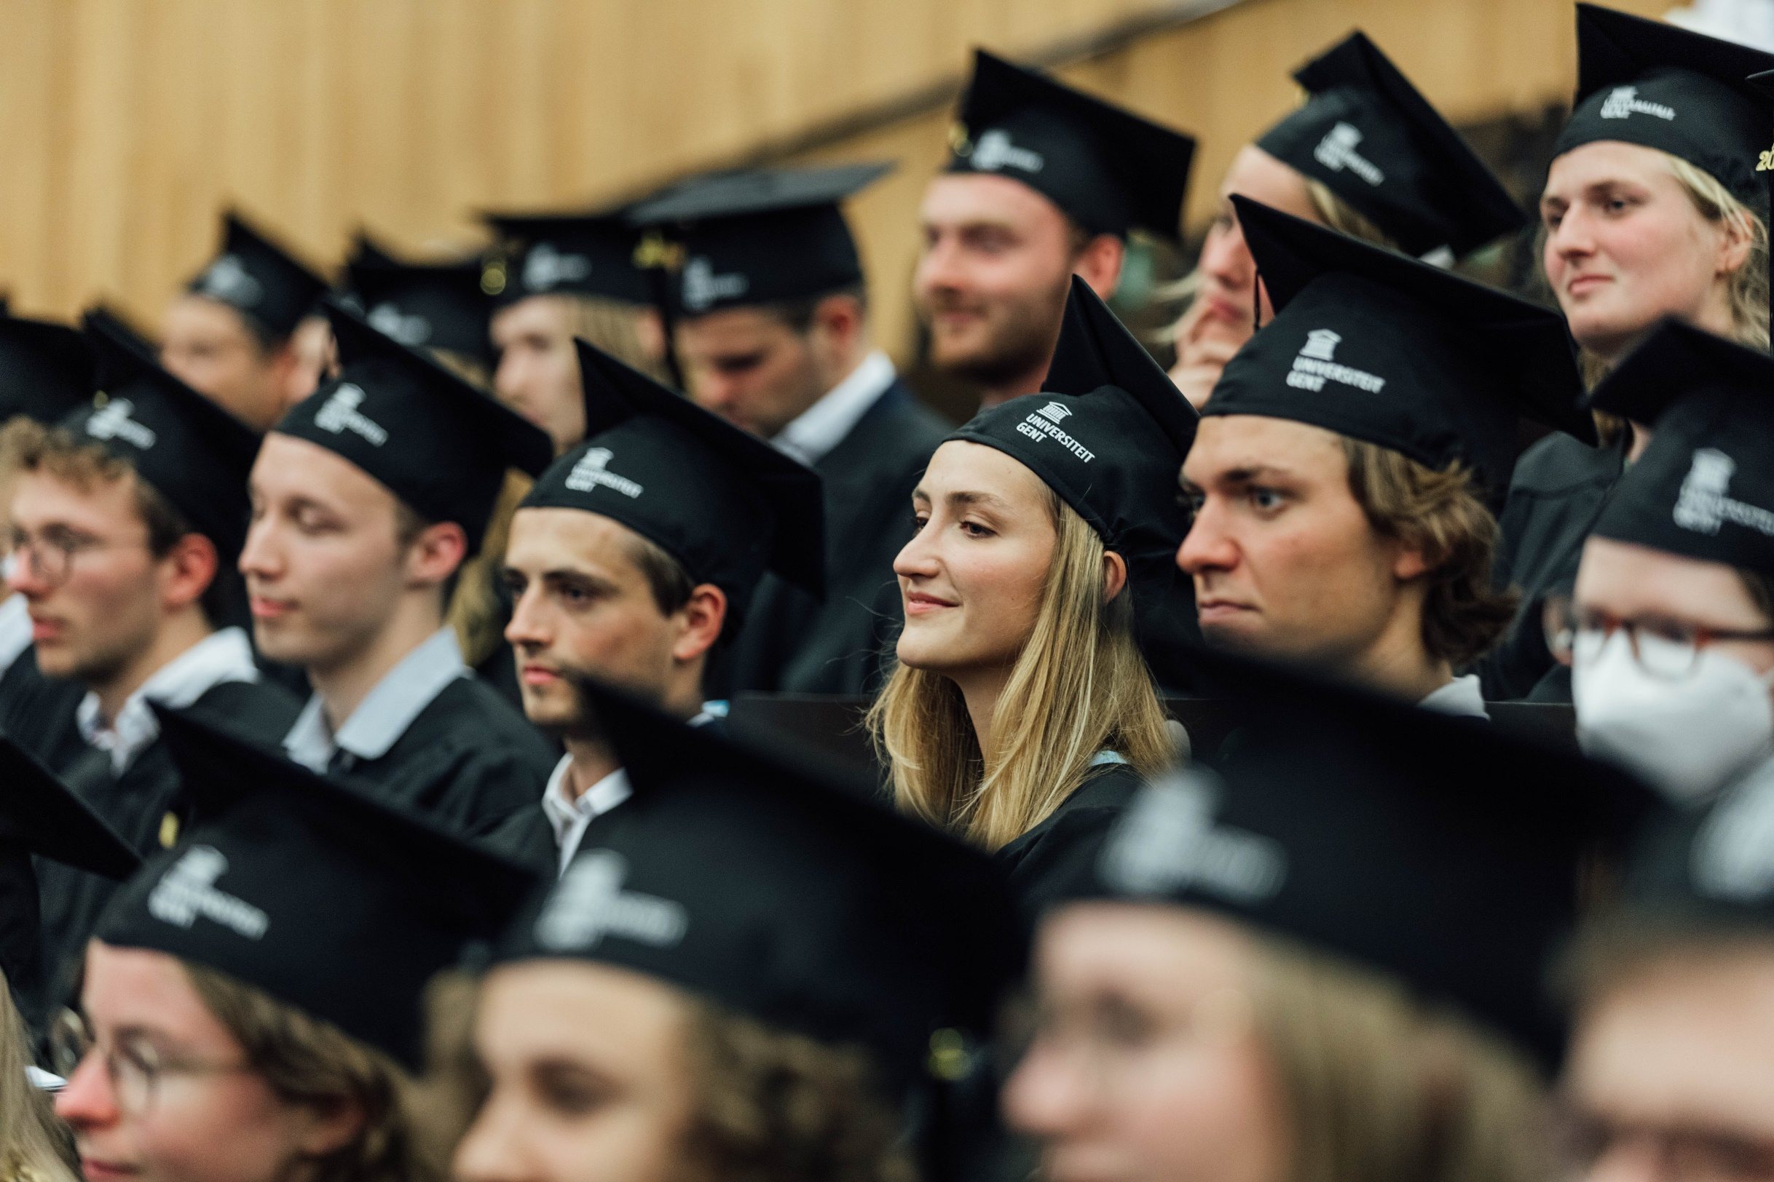
Master programmes
1 year
BIOSCIENCE ENGINEERING TECHNOLOGY
Campus Schoonmeersen, Ghent
Agriculture and Horticulture
Food Industry
Biochemical Engineering Technology
BIOINDUSTRIAL SCIENCES
Campus Kortrijk
Circular bioprocess technology
Notes:
De masteropleidingen Industrieel ingenieur duren 1 jaar

Slide 15
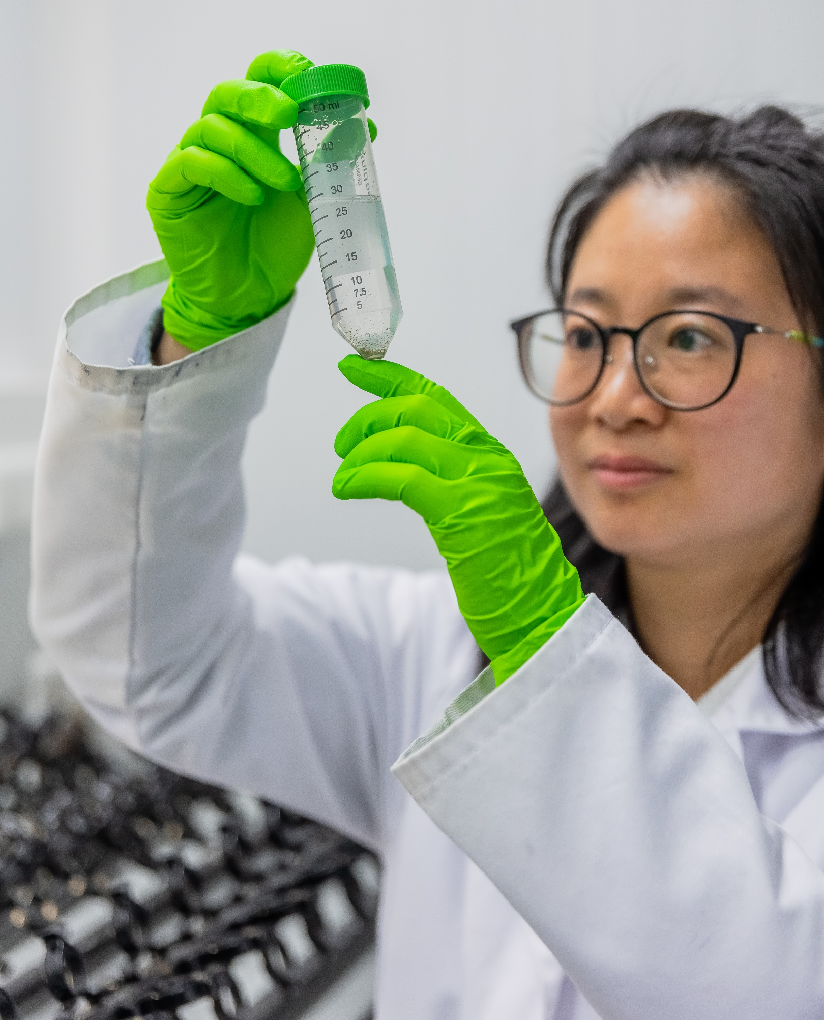
Master programmes
2 years
MASTER OF SCIENCE
Campus Coupure, Gent
Aquaculture
Environmental Science & Technology
Food Technology
Nutrition and Rural Development
Sustainable Land Management
Notes:
Every year, more than 250 students from more than 80 countries come to study at our faculty, spread over different international master programmes.
These programmes (except of the Master of Science in Cell & Gene Biotechnology and Bio-informatics) are supported by the International Training Centre of the faculty. The programmes are based on development cooperation (VLIR-UOS) or Erasmus Mundus cooperation programmes. Unlike in the Dutch master programmes, students don’t obtain the title of engineer when studying these programmes.
Partners for internationalisation:
VLIR UOS
Erasmus Mundus
Erasmus+
Industrial partners (e.g. Nestlé, Taminco, Agrimex/Nutrex)

Slide 16
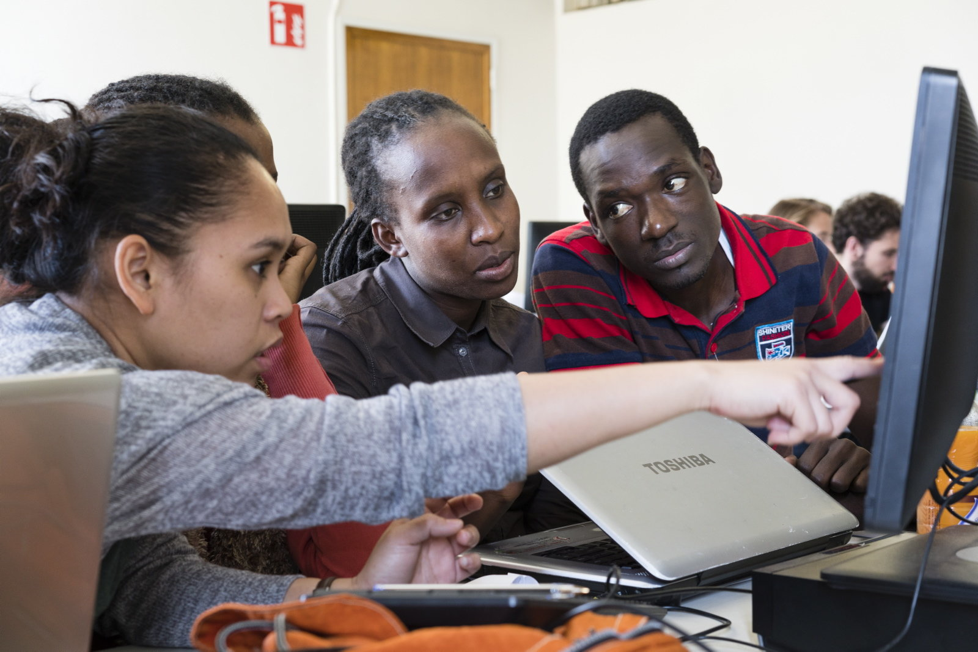
Master programmes
2 years
INTERNATIONAL MASTER OF SCIENCE
Campus Coupure, Gent
Environmental Technology and Engineering
Health Management in Aquaculture
Rural Development
Soils and Global Change
Sustainable and Innovative Natural Resource Management

Slide 17
Other programmes
SHORT TRAINING
Summer schools
Introduction courses
Welcome programme
Training programmes (14 days up to 3 months)
Refresher courses
DOCTORAL TRAINING
(Bioscience) Engineering
Life Sciences and Medicine

Slide 18
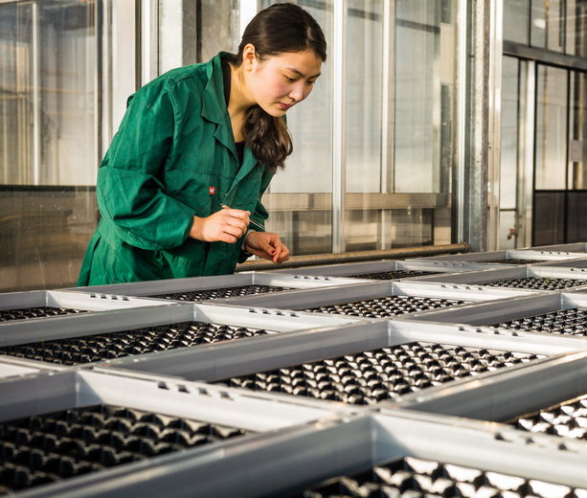
students
3,100 students
400 international students in graduate programmes
500 international students in doctoral training programmes
200 international students in exchange programmes
More than 100 nationalities
Notes:
Nationality
Our faculty has the highest number of international students of all Ghent University faculties.
The highest diversity is found in the group of English master students and PhD students.

Slide 19
PhD
Belgian
Number of PhD’s per nationality
not Belgian
Where our PhD students come from:
Notes:
Every year about 90 PhD students obtain their doctoral degree at our faculty.

Slide 20
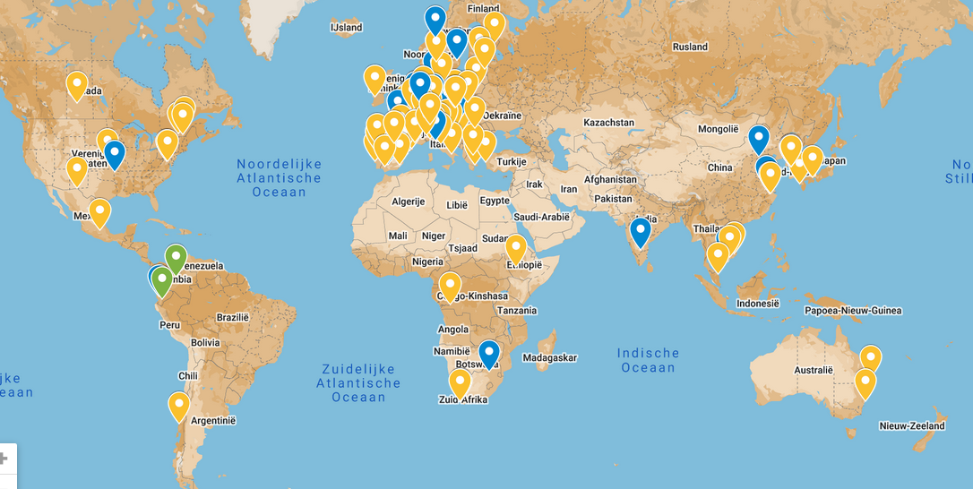
INTERNATIONAL NETWORK
More than 160 cooperation partners
Staff mobility
Course units
PhD programmes
Internships
Master dissertation
Notes:
Overview of our partner universities: http://www.ugent.be/bw/en/faculty/cooperation/projects-south

Slide 21
Research

Slide 22
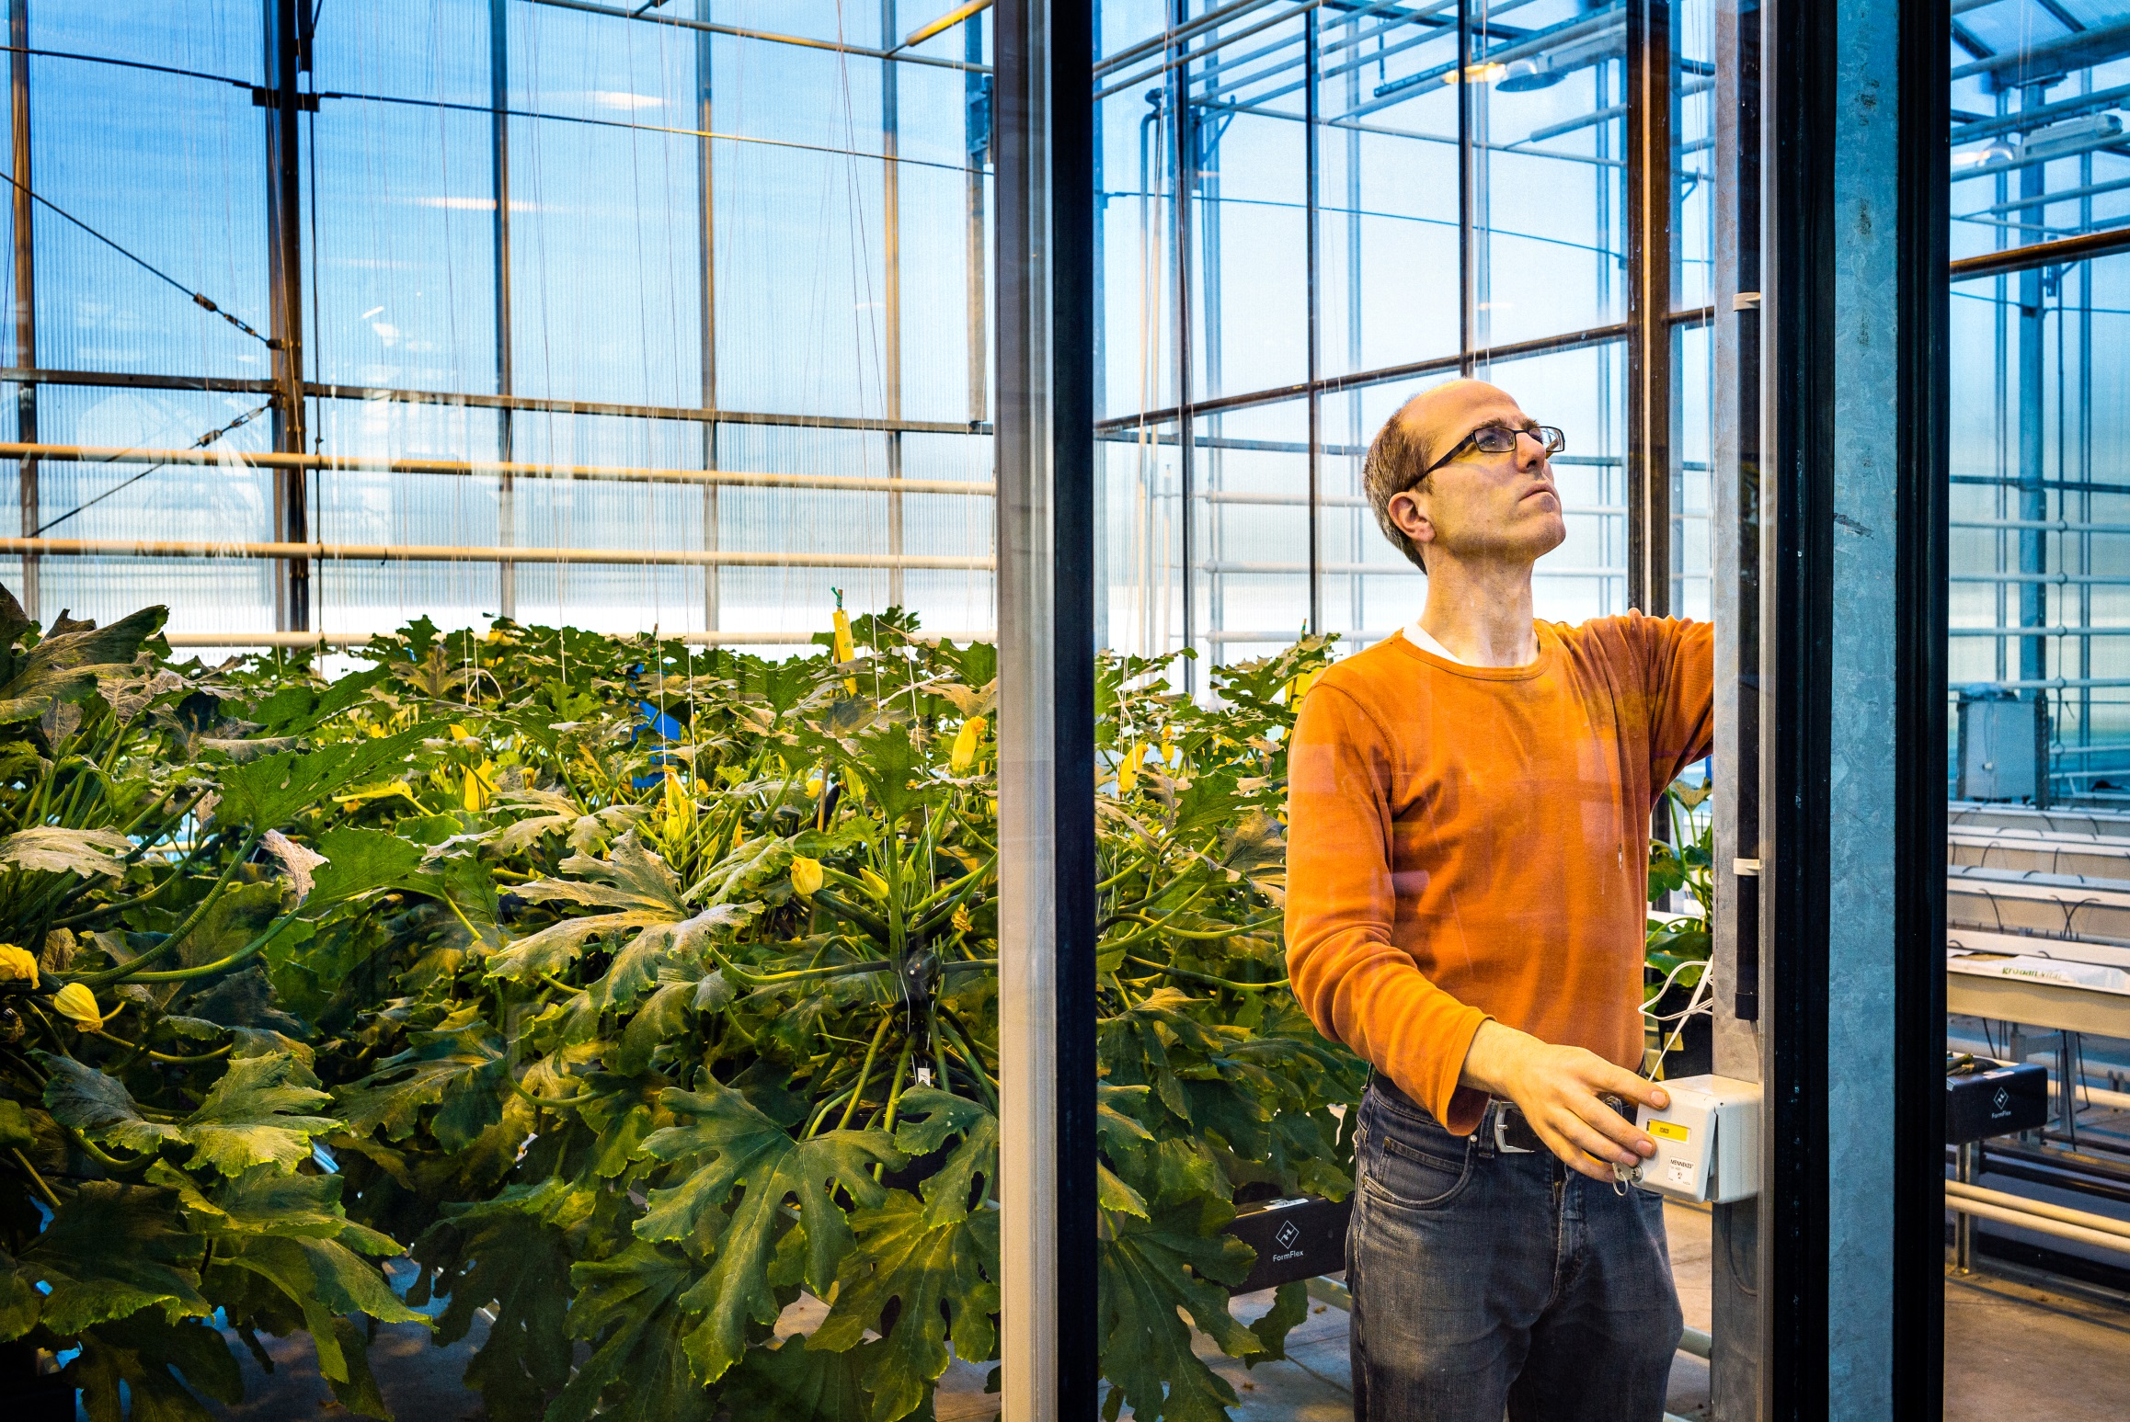
Research
Innovative and sustainable solutions for global challenges
European Top 5
Research
expenditures
Per year: 29 million euros
Cooperation with
More than 300
organisations
1.000 researchers
110 professors
900 A1 publications per year
90 PhD’s
Per year
Notes:
Our academics and researchers harness basic research to tackle global challenges and develop innovative and sustainable responses in areas such as natural resource management, food production, health, waste transformation and climate change. The Faculty of Bioscience Engineering is a global academic force for sustainability.
Our faculty belongs to the European top 5 of Life Science Research institutions.
With approximately 700 A1 publications per year, our researchers publish more than the average of Ghent University.
We focus on a strong cooperation with both national and international industrial partners, NGOs and governments. In international research cooperation, we focus on partners in both North and South of the world.

Slide 23
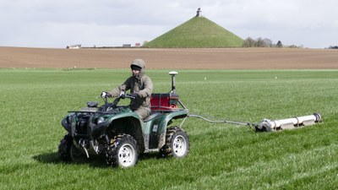
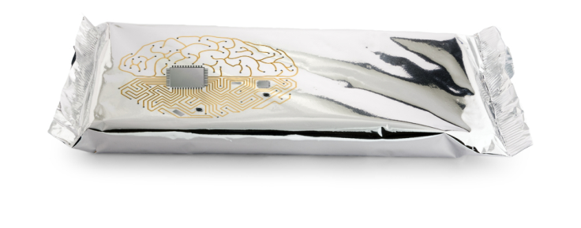
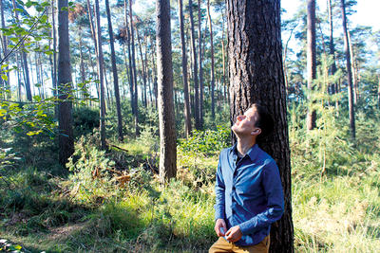
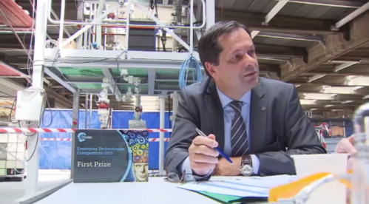
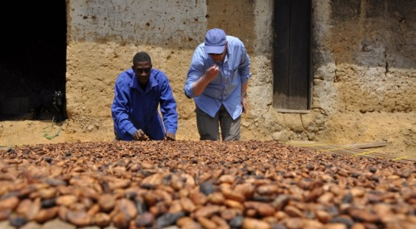
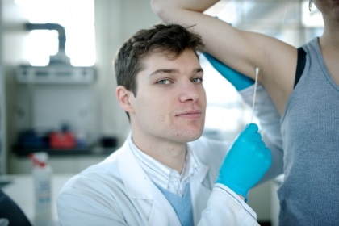
Impact
Soil scan: precision agriculture technique that can also be used in other domains
Beer made of recovered waste water
Intelligent packaging with sensors
Innoveren van cacaoproductie Ghana
Trees eliminate particulate matter
Chemical heat pump
Innovating the Ghanaian cocoa production
Dr. Armpit: transplantation of armpit bacteria
Notes:
Soil scan: precision agriculture technique that can also be used in other domains (Stonehenge) -> primary production
Beer made of recovered waste water -> clean environmental technology; we also have our own brewery (campus Schoonmeersen: Bijloke beer)
Intellingent packaging of food -> engineering & food waste (food & health)
Trees eliminate particulate matter -> Natural Capital; health
Chemical heat pump -> green chemistry, clean environmental technology
Cacoa agro-forestry and chocolate production-> primary production, food processing
Dr Armpit -> health

Slide 24
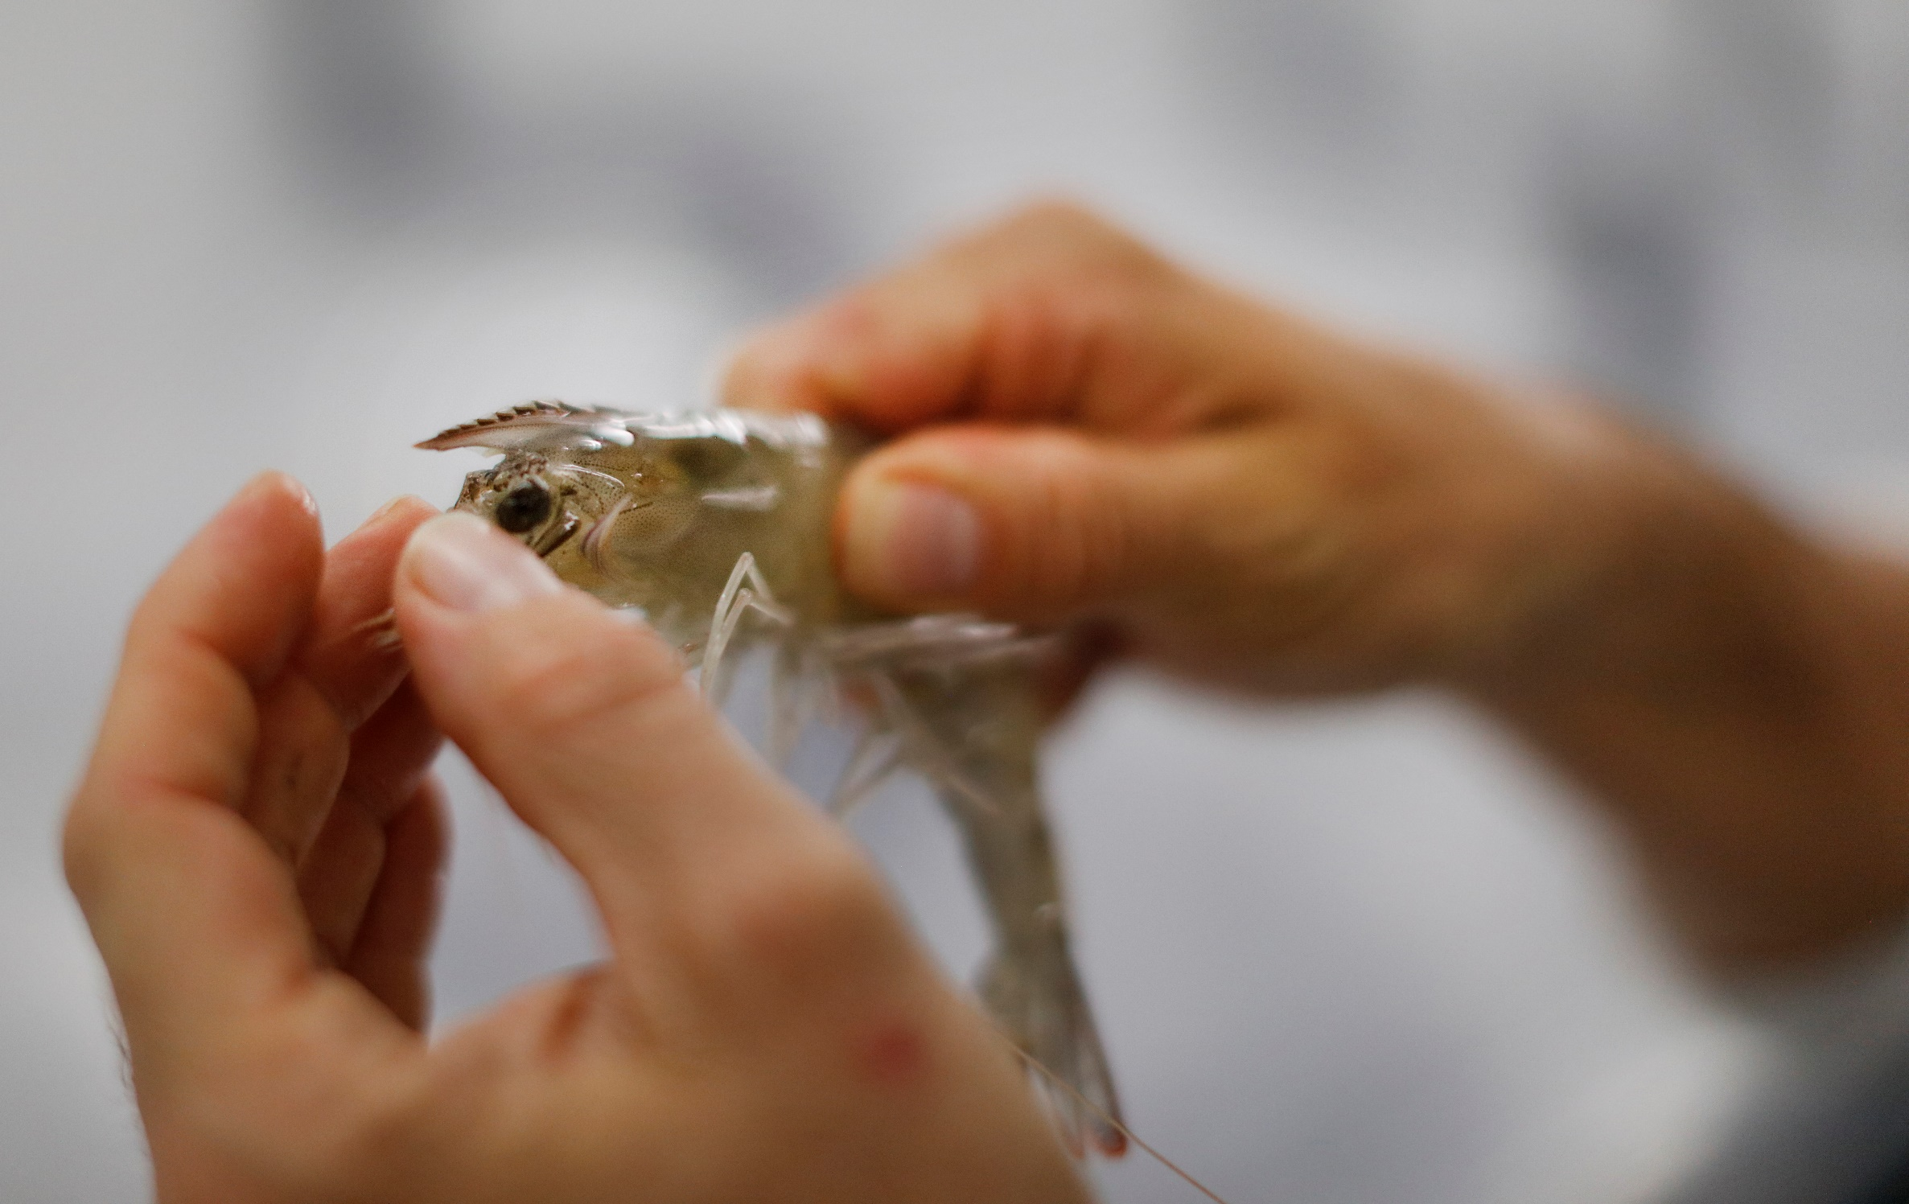
Knowledge transfer
Knowledge transfer centres
Improve business performance through innovation and new collaborations by driving the flow of people, knowledge and experience between business and the science-base
Drive knowledge transfer between the supply and demand sides of technology-enabled markets through a high quality, easy to use service
Provide business with the opportunity to meet and network with individuals and organizations, nationally and internationally
Notes:
Various Knowledge Transfer Centres connect our research with society.

Slide 25
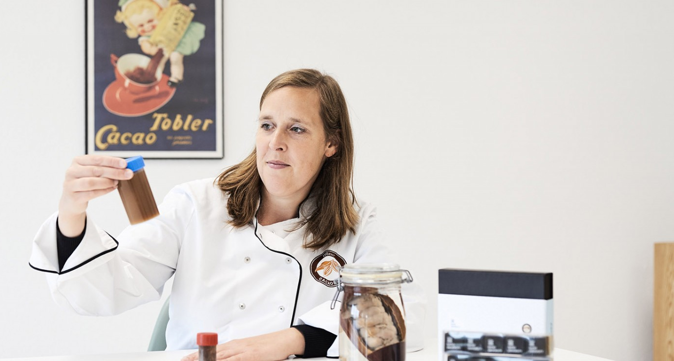
Spin-offs
AM-TEAM
Advanced modeling for process optimization, design, and accelerated upscaling. Works on water treatment, bioprocess technology, and pharmaceutical manufacturing.
Amphistar
Develops and scales biosurfactant technology to industrial level.
Avecom
Operation and optimization of microbial processes
Biotim (acquired by Waterleau)
Wastewater treatment technology
Cacaolab
Creates innovative chocolate products and processes and stimulates
the export potential of chocolate producers.
e-Coast (acquired by Eurofins)
Marine and maritime research
EPAS (acquired by Seureca Veolia)
Eco process assistance
Hydrohm
Electrification of water treatment as an opportunity to shift towards more local
and sustainable water systems, with an increased focus on quality and health
Imaqua
contract research for the shrimp/aquaculture industry
Inbiose
Produces specialty carbohydrates
Innolab
Offers services related to biogas production, purification of waste water, and biomass analysis
Kytos
Microbiome screening in all kinds of industrial processes
Notes:
Spin-offs zorgen ervoor dat het onderzoek ontwikkeld aan de faculteit Bio-ingenieurswetenschappen omgezet wordt in voor de industrie bruikbare toepassingen.

Slide 26
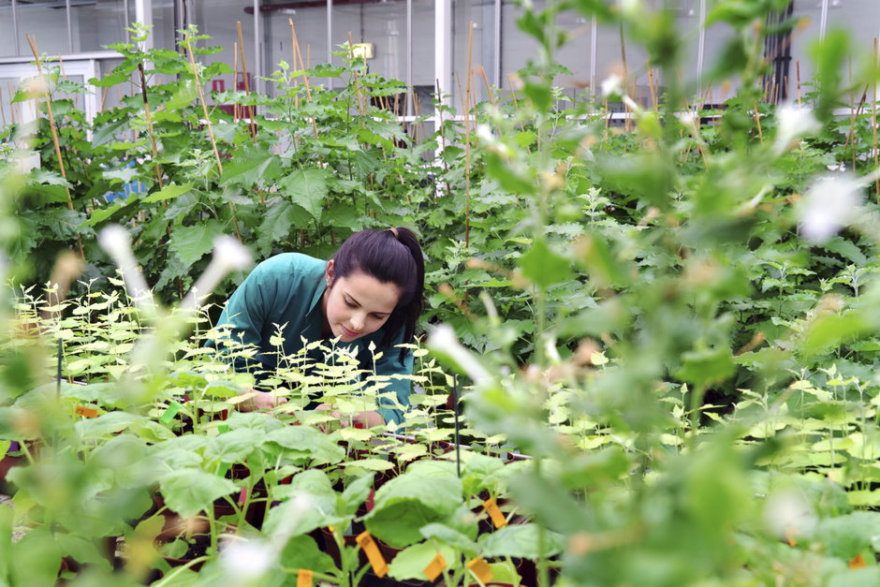
Spin-offs
MRM Health
Development of microbiome-based drugs
Olfascan
Odor problem solution - measures, analyses, modeling, and advice
Organic Waste Systems
Testing and services for biodegradability, compostability, anaerobic digestion, auditing, control & sorting of various waste streams and consulting on sustainable development
Phyto-IT
Software for plant science, agriculture and horticulture
Primoris
Supports companies and organizations in the food industry with high quality residue analysis of pesticides and mycotoxins in food and feed
Prodigest
Provides professional services in the field of gastrointestinal transit, bioavailability and metabolism of food compounds and pharmaceuticals, in relation to their final functionality in the body
Progeno
Empowers professional plant and animal breeders by giving them direct access to the state-of-the-art in breeding and selection methods by means of a user-friendly and industry-proven software system
Qpinch
Transforms wasted heat into useful energy
Statter
Provides services related to study design, (statistical) data analysis and reporting
Terracottem
Soil condition technology
Notes:
Spin-offs zorgen ervoor dat het onderzoek ontwikkeld aan de faculteit Bio-ingenieurswetenschappen omgezet wordt in voor de industrie bruikbare toepassingen.

Slide 27
Departments

Slide 28
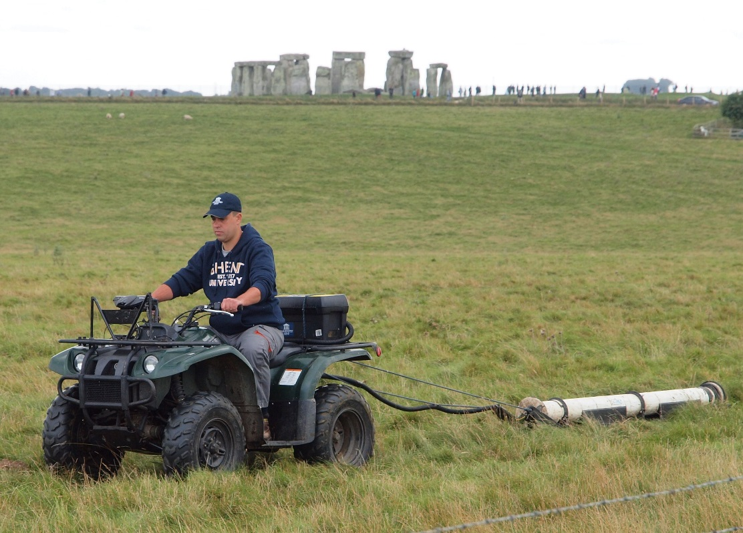
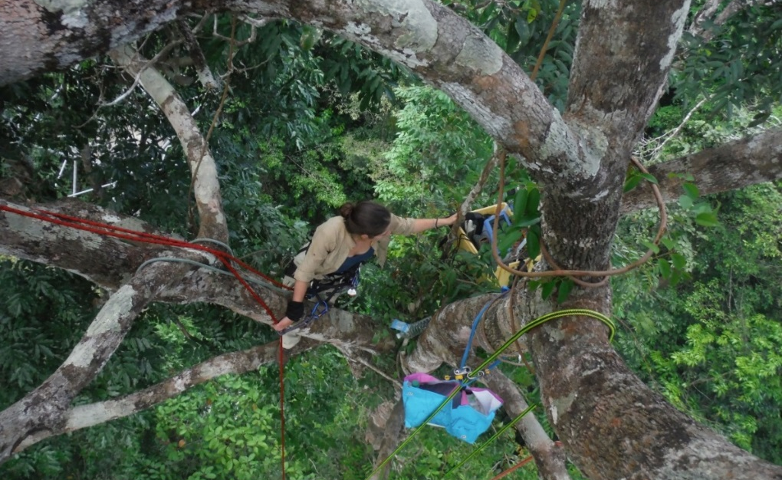
department of environment
Pioneering research to better understand, map, value, and manage the world’s natural resources, combined with high-quality education programmes in natural resource management.
Topics:
Impacts of global change on ecosystems
Bio economy, ecosystem services and nature-based solutions
Ecosystem resilience
Multidisciplinary and interdisciplinary research
Impact:
Independent, critical voice through the Natural Capital Research Platform
Generating awareness on the preservation and management of natural resources

Slide 29
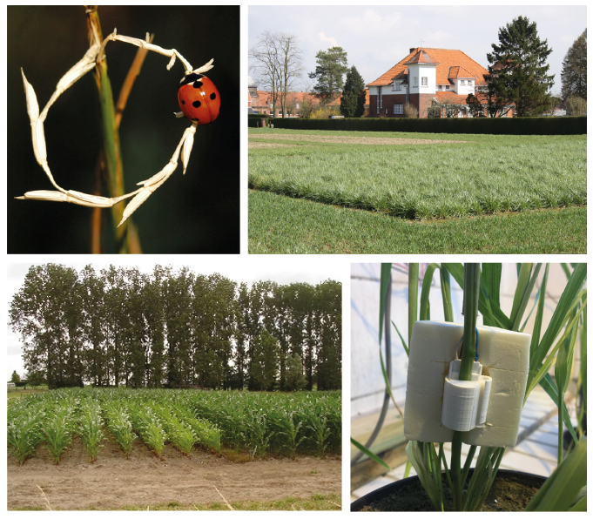
Department of plants and crops
We acquire, create, interpret and transfer biological, ecological and technological knowledge and expertise related to the sustainable (re)production of healthy, high-quality plants and crops.
Topics:
Production systems
Breeding
Ecophysiology
Diseases, pests, weeds and their integrated management
Applied entomology and acarology
Biotechnology
Monitoring and modelling
Impact:
Sustainable production of plants and crops for a wide array of end uses
Training science-based plant and crop specialists with open, critical minds and engineers’ attitudes.

Slide 30
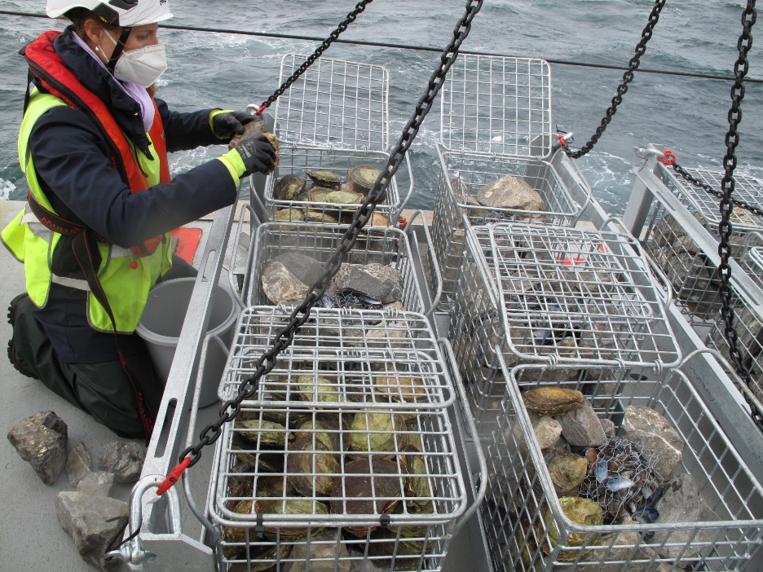
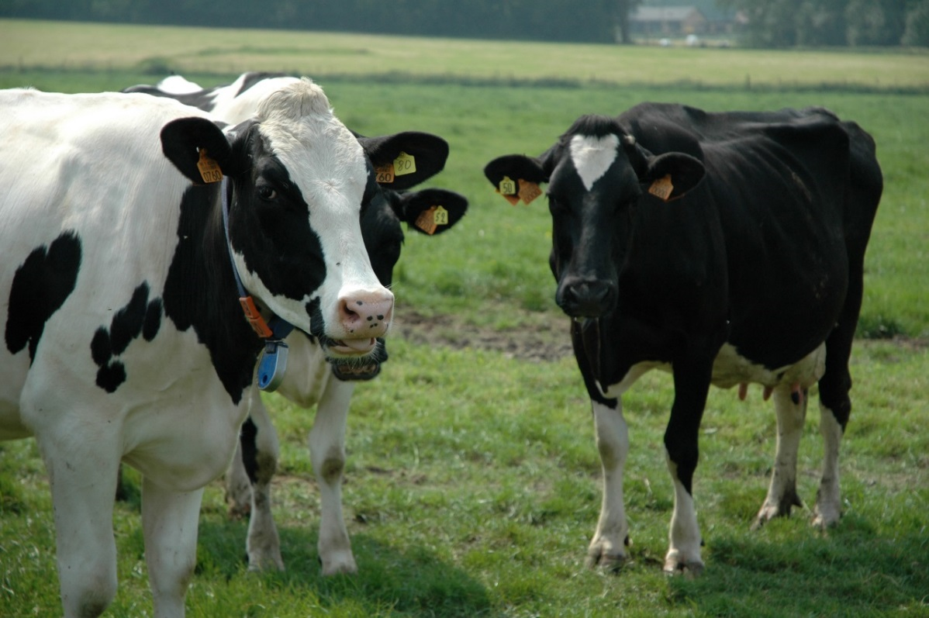
DEPARTMENT OF ANIMAL SCIENCES AND AQUATIC ECOLOGY
Research, education, and services to society in relation to the various contributions of animals to human wellbeing (including the sustainable production of healthy food) and the evaluation of anthropogenic influence on the environment (in relation to its optimal and sustainable use).
Topics:
Feed and animal product quality
Data-driven animal management
Immunology and biotechnology for man and animal
Larviculture of aquatic animals
Integrated aquaculture
Aquatic ecology
Marine biotechnology and bioeconomy
Impact:
Qualitative, safe and sustainable use of animals with a minimal impact on climate and environment
Ecological assessment of man’s impact on the environment, for sustainability policy purposes

Slide 31
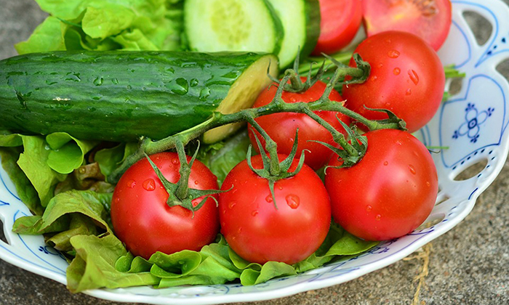
DEPARTMENT OF FOOD TECHNOLOGY, SAFETY AND HEALTH
Top-notch innovative research with an international reputation in food technology, food chemistry, food microbiology and human nutrition.
The department stands for applied and fundamental, multifaceted research of high social relevance and (inter)national cooperation with food industry, competent authorities, consumer organisations and all food-chain stakeholders.
Topics:
Food technology
Food chemistry
Food microbiology
Food packaging
Nutrition and health
Impact:
To provide the consumer with tasty, safe and nutritious food.
Interaction with different stakeholders: agri-food business and scientific community, government and NGOs.

Slide 32
Department of green chemistry and technology
Internationally recognized research related to both fundamental and applied aspects of chemistry in the domain of bioscience engineering. Comprising advanced analysis, (bio)chemical as well as physicochemical conversion and treatment techniques, and sustainable process design.
Topics:
Advanced analytical chemistry and ultra-trace (high-resolution) mass spectrometry
Applied ecochemistry with focus on trace elements, isotopes, and organic micropollutants
Organic synthesis, use of renewable resources, bio-organic chemistry, microreactor technology
Particle and interfacial technology
Thermochemical biomass conversion
Ecotechnology for air and water treatment and resource recovery
Biosystems control
Life cycle assessment and sustainable process design
Catalysis
Impact:
Sustainable (re)use of biological raw material and natural resources
Technological solutions, fit-for-use in different (industrial) and international contexts (e.g. developing countries)
Expertise and services for SMEs and non-profit organizations for their water treatment and re-use

Slide 33
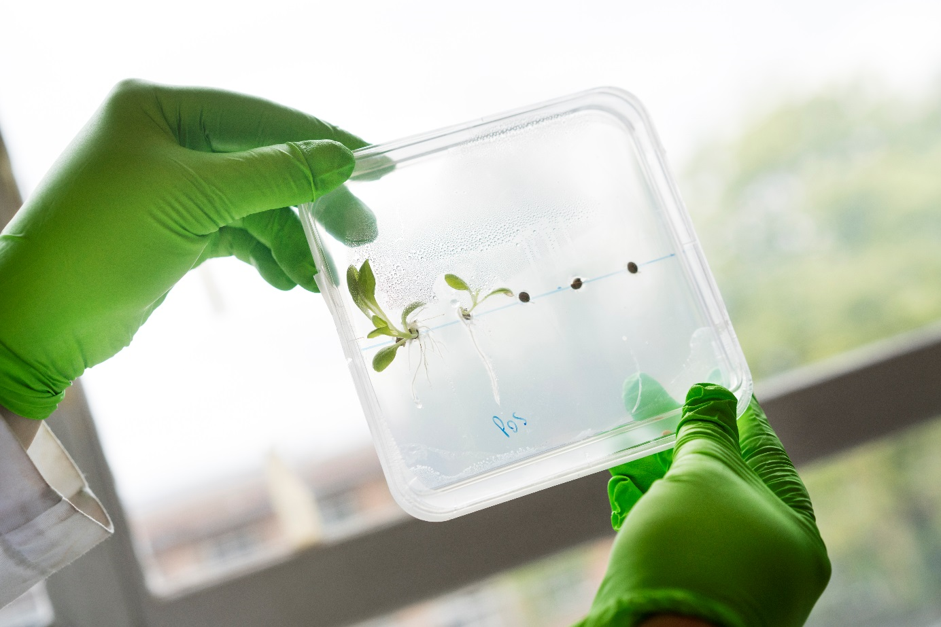
department of biotechnology
Innovation through molecular characterization and optimization of biological systems enabling agricultural, culinary, environmental and medical applications.
Topics:
Nanobiotechnology
Microscopy
Plant biotechnology
Epigenetics
Plant-pathogen interactions
Protein engineering
Metabolic engineering
Synthetic biology
Industrial biotechnology
Microbial production and recovery of resources
Brewing and fermentation technology
Biological water treatment
Microbe-host interactions
Microbial ecology
Impact:
Optimizing biological systems for sustainable production and human health

Slide 34
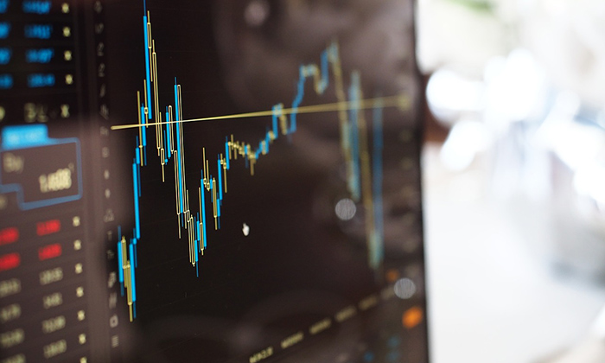
department of data anAlysis and mathematical modelling
Multidisciplinary engineering approach to the entire data-to-decision cycle of biosystems modelling for science, industry and society.
Topics:
Data analysis for life sciences: biostatistics and bioinformatics
Knowledge-based, predictive and spatially explicit modelling of biological and natural processes
Model-based design and optimization of processes in resource recovery and pharmaceutical manufacturing
Impact:
Promoting and implementing high-quality data analysis and modelling solutions for scientific, industrial and societal problems.

Slide 35
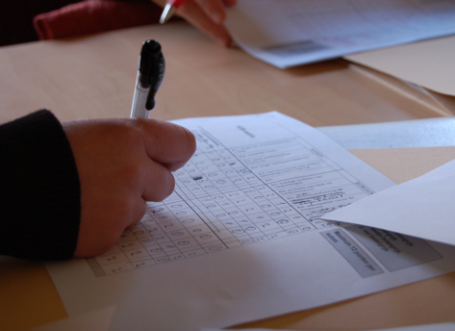
department of agricultural economics
Economic and socio-political analyses of agriculture and food ‘from farm to fork’, including urban, peri-urban and rural areas all over the globe.
Topics:
Agricultural and rural economics
Agri-food marketing
Consumer behaviour
Business management
Chain and agribusiness management
Natural resources management
Agricultural and environmental policy analysis
Institutional, sociological and political analysis
Impact:
Policy advice at local, national and international level
Capacity building of partner institutes in the global South

Slide 36
What can we do for you?
Collaboration projects
Trainings on demand
PhD mobility grants
Summer schools
Intensive study programmes
Educational consultancy
Scientific consultancy

Slide 37
Faculteit Bio-ingenieurswetenschappen UGent @fbwUGent Ghent University
www.ugent.be/bw

